Slide 1




KRUNCHH - PRASTHUTI
IIT MADRAS
TERRIFIC TRIO :
Abishek S
M K Vishal Rishi
S Vishal
THE ANALYTICS EVENT
Powered by

Slide 2

The Case

Slide 3




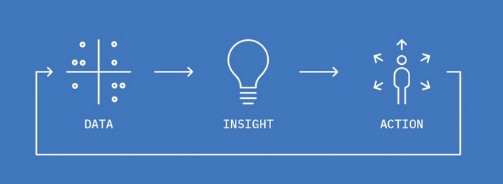
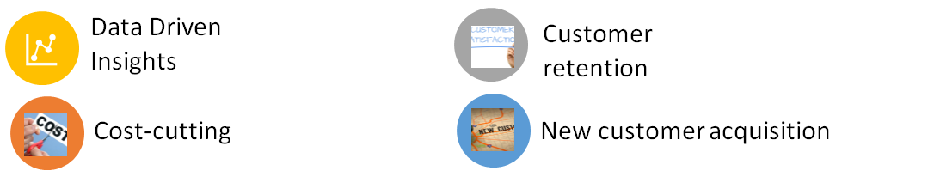
Objective: To improve the
market share and
sales of the company
Our Approach:

Slide 4
Customer Acquisition

Slide 5
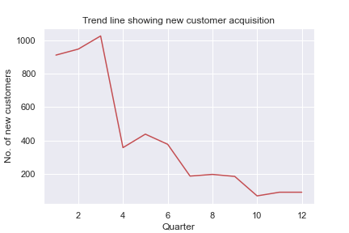

Referral Marketing strategy - Customer acquisition
This is the trend line that shows new customer acquisition at each quarter. A quarter is a period of three months (4 quarters in a year) and hence, we have 12 quarters in the period (2011 - end of 2014)

Slide 6
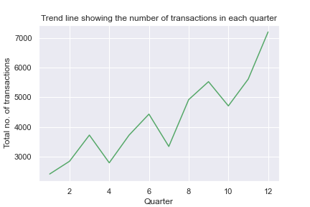

The total number of transactions the customers make steadily increases
The company does not seem to attract new customers
Most of the acquired customers are very loyal and hence an increase in the number of transactions
A strong suggestion would be to use a ‘Referral marketing strategy’

Slide 7
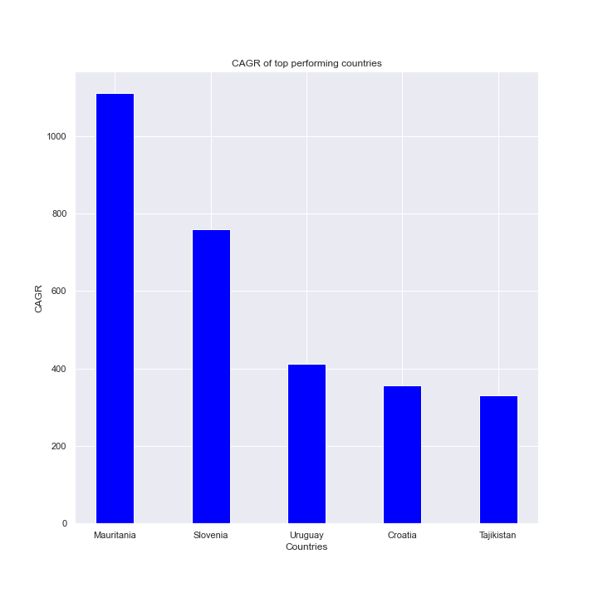
Investments in top performing countries
Country | Average sales per transaction (95% confidence interval)
Mauritania | Mean: 402.0 Confidence interval: (14.55, 789.44)
Slovenia | Mean: 489.67 Confidence interval: (-995.61, 1974.94)
Uruguay | Mean: 404.79 Confidence interval: (57.94, 751.63)
Croatia | Mean: 139.47 Confidence interval: (62.31, 216.62)
Tajikistan | Mean: 80.67 Confidence interval: (-251.35, 412.69)

Slide 8
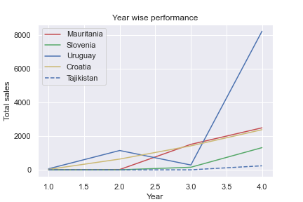
CAGR is a good indicator of a country’s performance. But risks involved in the investment are not considered
Mauritania, Slovenia and Tajikistan - Higher CAGR, relatively new to these countries
Hence, indicated by the very large confidence interval (high risk involved)
Uruguay and Croatia - Relatively narrow confidence interval. Hence, the risk involved is less
The company should look to invest more in Uruguay and Croatia and increase its customer base

Slide 9
Customer Retention

Slide 10
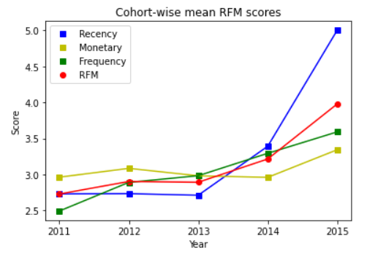
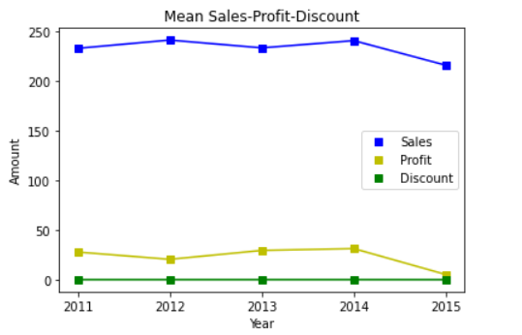
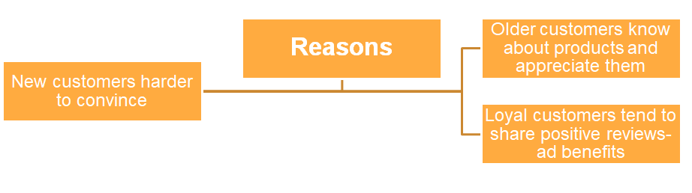
Special Campaign- how to? and why to?
2012 cohort is the best choice for running the special campaign

Slide 11
Insights From RFM
Hibernating & can’t lose
20%
Reduce Customer churn: Reconnect with these customers. Run Surveys to better know about their needs.
Champions and Loyal
Product Launches: With a huge chunk of them being very loyal, we suggest new innovations in the products and services of the company can be tested with their help.
31%
Need Attention and about to sleep
Run personalized offers: With special offers, these customers who have once experienced the company’s products could be back into the main fold!
25%
Marketing costs are minimized as a result of strengthening of customer base and targeted advertisements
2012 Customers form a part of the bottom two categories as well as potential loyalists. So they deserve the special campaign as mentioned earlier

Slide 12
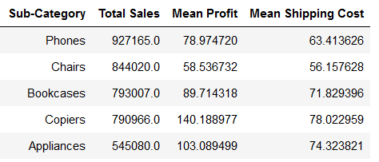
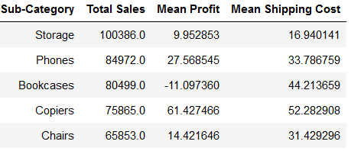
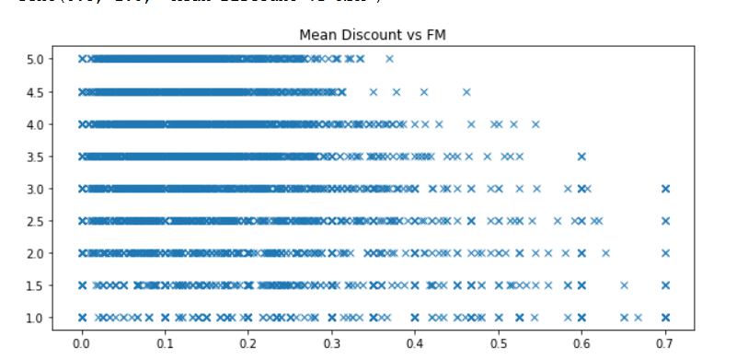
Buying Practices
Top 5 items ranked by total sales: Storage negatively affects sales
Top 25%
Bottom 25%
Customers receiving high average discounts don’t necessarily have high RFM.
Law of Diminishing Returns

Slide 13
Sales and Profitability

Slide 14
SALES FORECAST - ROADMAP
There are 3 types of products :
Furniture
Office Supplies
Technology
Analyse and forecast sales of each type individually
Combine the sales forecast of the three to get total sales forecast
Resample the sales by taking sum over a month to get a clear and smooth picture of the scenario
Time series analysis using SARIMA model to forecast the sales of each product type for next two years
Try different parameters and select the ones with the lowest AIC score for the SARIMA model

Slide 15
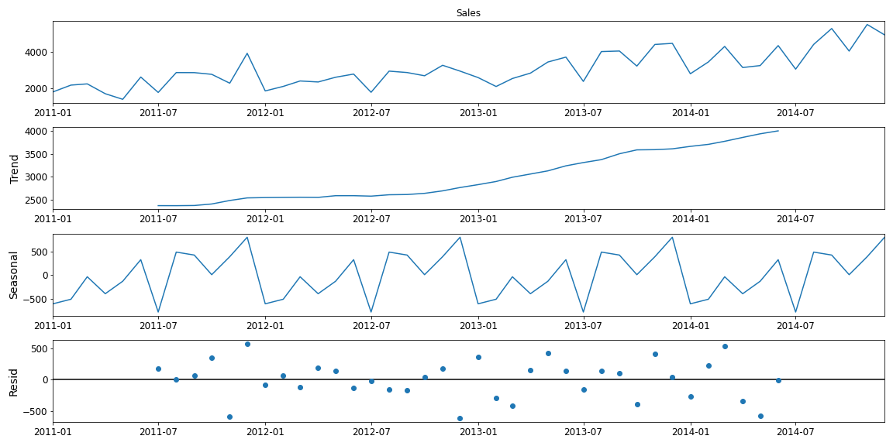
CHOOSING SARIMA MODEL
Seasonal Decomposition of Office Supplies sales
The seasonal decomposition of sales of all three product types had an upward trend (not stationary), and a strong seasonality factor
Hence SARIMA model was chosen

Slide 16
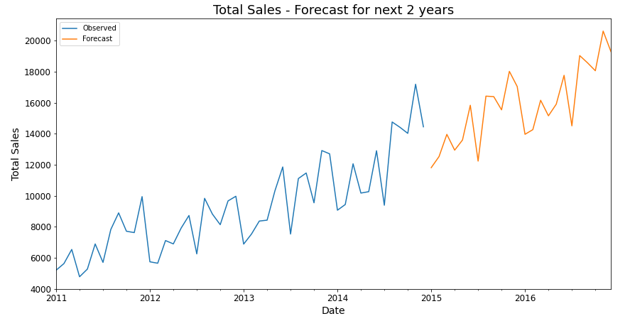
Total Sales forecast for 2015,
2016
Substantially increasing sales over the years representing greater demand and supply and indicating improving quality and innovation of products, and trust among customers
Clear seasonality in sales within a year evident - sales are low during months in the middle and high during other times, probably because of weather, festival or holiday factor.

Slide 17
Quantifying Profitability
NET PROFIT
Sum of profits of all sales within a day
Profitable if Net Profit greater than zero
Quite deceiving, does not show the vulnerability to minor cost shifts
NET PROFIT MARGIN
Net Profit per unit sales made in a day
Profitable if Profit Margin exceeds some threshold we decide (12% here)
Accurately represents long-term profitability and vulnerability to sudden increase in fixed costs

Slide 18
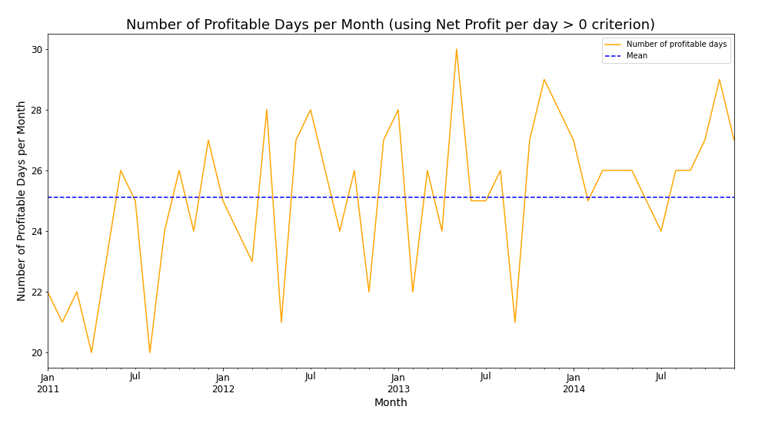
Number of Profitable Days in a Month
Using Net Profit > 0 criterion
Lower in earlier years
Higher in the recent years, with lesser months below the mean line
Hence profit made more often recently

Slide 19
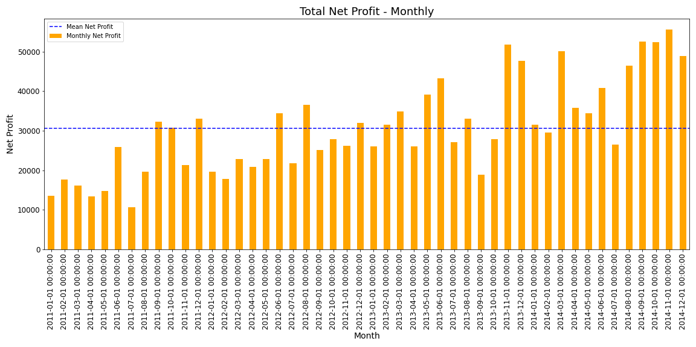
Monthly Net Profit
Peaks of monthly net profit has increased over the years, though not as substantially as sales
Indicates increased operating and administrative costs

Slide 20
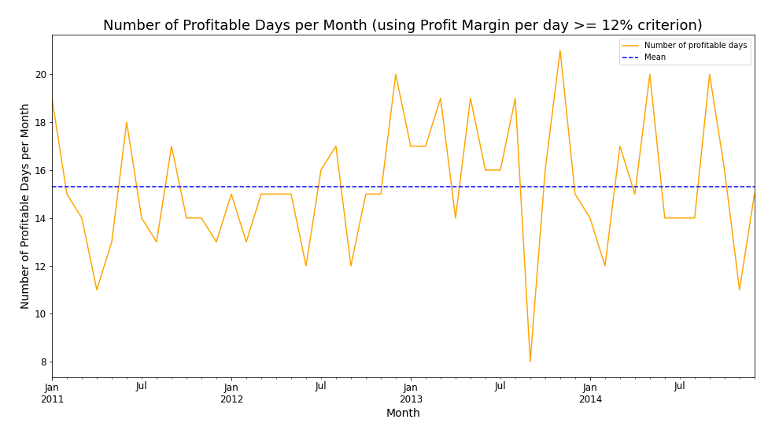
Number of Profitable Days in a Month
Using Net Profit Margin >= 12% criterion
Stable and high during earlier years
Extreme variations in recent years
Daily profit margin more susceptible to seasonality of sales within a year in recent years because of higher cost of goods sold and other overhead costs

Slide 21
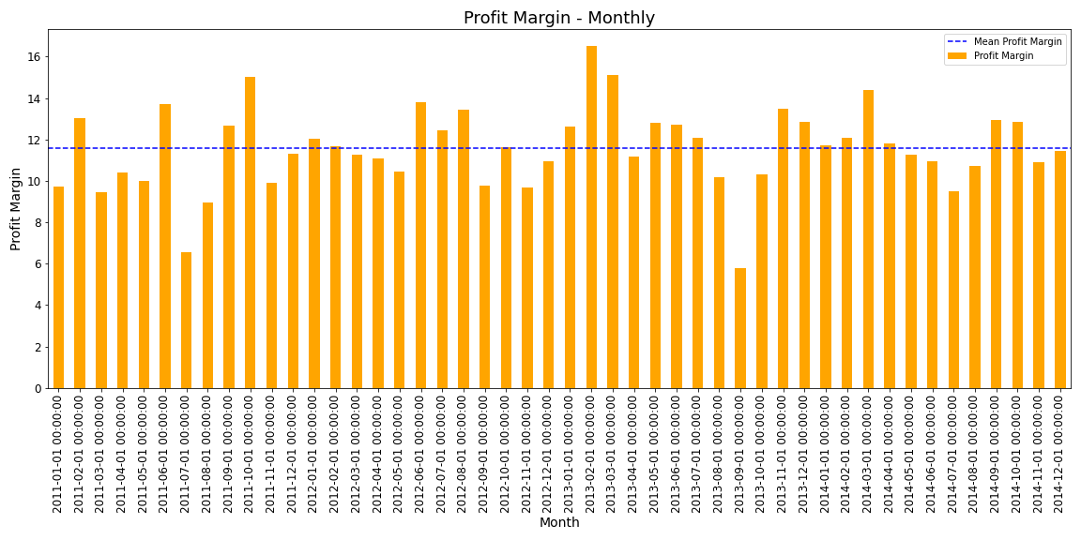
Monthly Net Profit Margin
Monthly net profit margin has remained almost stagnant at a good percentage over the years which is a healthy sign
Sudden valleys during middle months re-emphasize the seasonality of sales and indicate higher risk and slower growth during those months

Slide 22
Profit is the main measure of a company’s performance and a good profit margin creates a positive impact on the shareholders and other people who are potential customers
The healthy profit margin enables company to handle extreme situations well and grow faster
Good profit margin enables company to spend more on advertising and marketing, which can increase the visibility of their products and improve customer base
Profits are also the source for future innovations, endeavours, expansions and investments all of which improve the quality and appeal of the products and contribute constructively to the company’s sales and market share
RELATION BETWEEN PROFIT AND SALES
The effect of seasonality of sales on profit and profit margin can be reduced by changing production capacities according to the past and predicted future sales forecast, that reduce the inventory and other operating costs during the off-season months
The off-season sales, though cannot be completely evaded, can be improved by conducting give-aways and campaigns for existing customers, introducing off-season deals, or targeting a new geographic market
IMPROVING SALES AND PROFIT

Slide 23
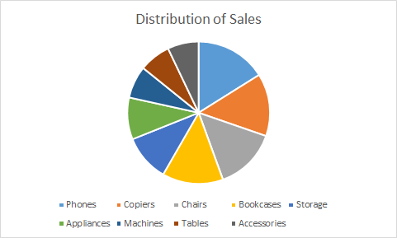
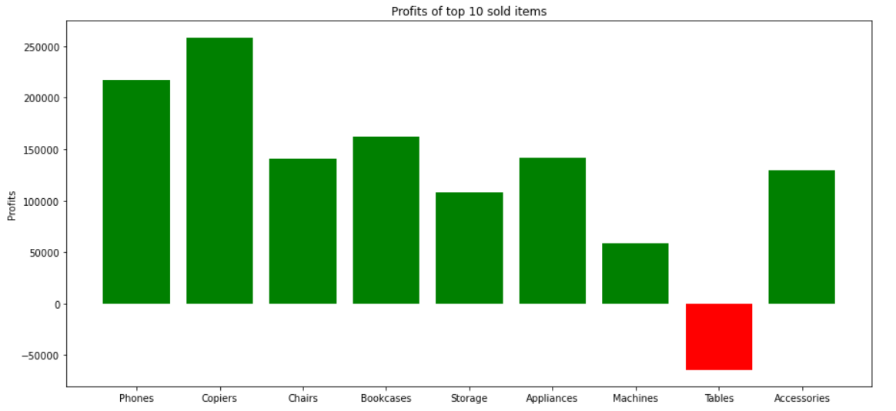
Additional Insights
Tables occupy a significant portion of Sales.
However, the specific category is running at a loss.
Mitigation Measures:
Warehousing- cuts shipping costs
Reduce
discounts
Optimize the process

Slide 24
Conclusion

Slide 25
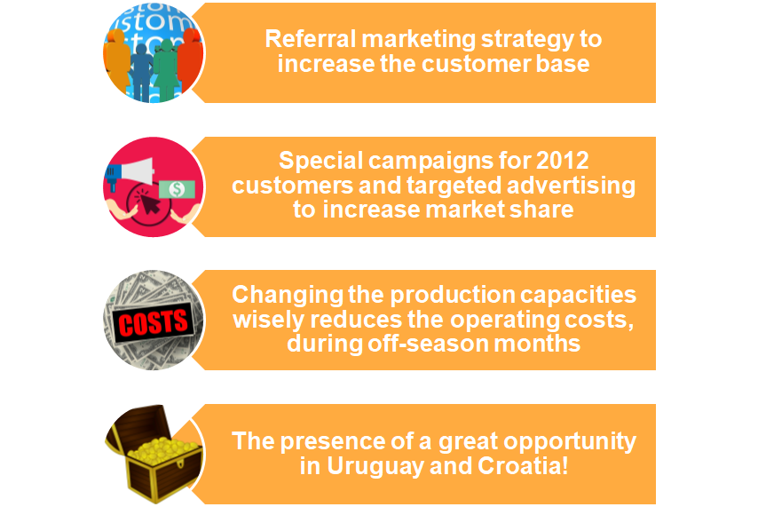
Salient points of our suggestions

Slide 26
THANK YOU!

