Slide 1
TopoDP to Graph
Lin Chen
2012 Fall Report
12/07/2012

Slide 2
Frame
Modify previous weight setting part of TopoDP
Update graph
Future research plan

Slide 3
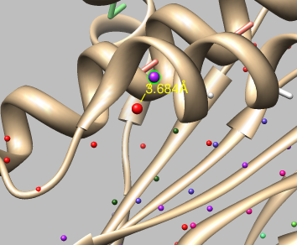
Modify TopoDP
Default parameter of TopoDP in weight setting part can not guarrantee the good rand of true topology for some proteins
1733
distTHR, distance of end point of
stick to the point around it
Previous take 3.0
True topology can not be found
Within top 600 topologies
Rank 13
distTHR is changed to 4.0*apixX

Slide 4
Modify TopoDP
Dist = loopLength – traceLength - gapt
Get best fitting trace
Trace includes two end points of two sticks
Dist >= 0
Distance between two trace less than gap
Dist < 0
Two trace, each includes one end point of two sticks
+penalty
Best
Fitting
Distance between two trace greater than gap
Edge Weight

Slide 5
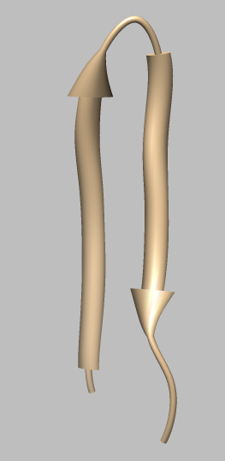

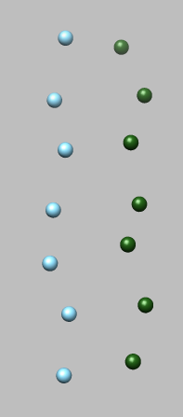
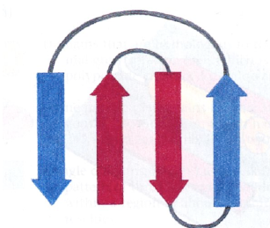
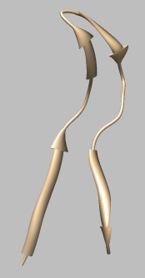

Update graph
Sheet Gap Penalty
Apply two beta strands which in same sheet
gapSeq = 1
= 2
gapSeq = 3
High weight
gapStick = dist/4.5
gapSeq >= gapStick?return 0:return penalty

Slide 6

Update graph
Strand Direction Penalty
Apply the strands in same sheet
distES < distEE
+Penalty
gapSeq
even
distES
E
S
distEE
distES > distEE
+Penalty
gapSeq
odd
S
E

Slide 7
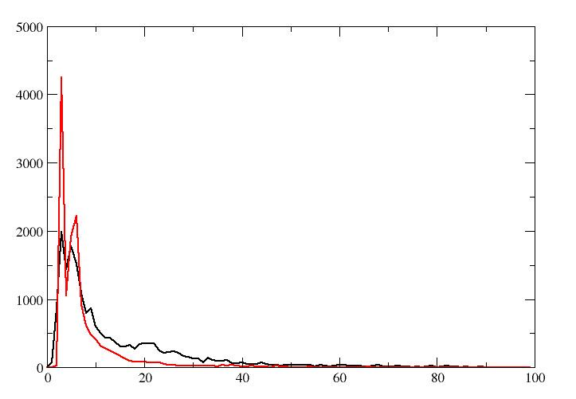
Update graph
Neighbor Strand in Sheet
Apply to strands in same sheet
gapSeq = gapStick = 1
add reward
gapLoop <= 4
Red line: times that consecutive
strands in same sheet with different
sequence gap
Black line: times that consecutive
strands in different sheet with different
sequence gap

Slide 8
Update graph
Helix Match
sequenceLength: helix length in sequence *1.5
stickLength: helix stick length
if length difference is within 15% AND sequenceLength > 13
add reward
Helix stick is easier to be recognized, fix the long helix can help
rank the true toplogy

Slide 9
Update graph
Node Direction Penalty
distES
E
S
Apply to two nodes in graph
distEE
Works for both helix and strand
gapLoop less than 5
S
E

Slide 10
Results
ID | #Helices | #Sticks | #Strand | #Sticks | Rank
 |  |  |  |  | Op | NoOp
1FLP | 7 | 7 | 0 | 0 | 2 | 2
1NG6 | 9 | 7 | 0 | 0 | 2 | 4
2XB5 | 13 | 9 | 0 | 0 | 13 | 58
3LTJ | 16 | 12 | 0 | 0 | 1 | 13
3ACW | 17 | 14 | 0 | 0 | 28 | - / 100
3ODS | 21 | 16 | 0 | 0 | 53 | - / 100
1HZ4 | 21 | 19 | 0 | 0 | 15 | - / 100
3HJL | 20 | 20 | 0 | 0 | 1 | 4
3FIN_R | 4 | 4 | 0 | 0 | 5 | 26
5030 | 4 | 3 | 4 | 3 | 1 | 1
1733 | 5 | 5 | 12 | 12 | 13 | - / 100
1OZ9 | 5 | 5 | 5 | 4 | 7 | 25
2KUM | 2 | 2 | 3 | 3 | 1 | 5
2KZX | 3 | 3 | 3 | 3 | 10 | 10
2L6M | 2 | 2 | 3 | 3 | 6 | 6
1BJ7 | 5 | 1 | 9 | 9 | 4 | - / 100
1ICX | 6 | 3 | 7 | 7 | 1 | 2
1JL1 | 4 | 4 | 5 | 5 | 16 | 22

Slide 11
Future Plan
Optimize memory consuming
Make program works for pure beta sheet
Add amino acid to SSE
Consider the error in SSE and stick
Generate protein with topology

Slide 12
Thanks !

