Slide 1




Interactive Proofs for Distribution Testing with Conditional Oracles
Ari Biswas Mark Bun Clément Canonne Satchit Sivakumar
University of Warwick Boston University University of Sydney Boston University

Slide 2


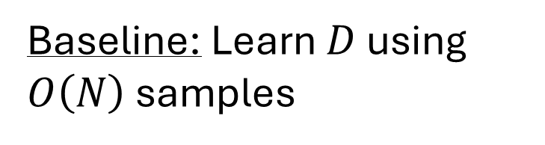


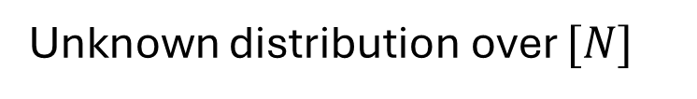
Distribution Testing
Is $D$ (approximately) uniform?
What is the support size of $D$?
What is the Shannon entropy of $D$?
Is the PMF of $D$ monotone?
Unknown distribution over $[N]$
$$D$$
i.i.d. samples
Testing algorithm $A$
Baseline: Learn $D$ using $O\left(N\right)$ samples

Slide 3

Distribution Testing
A property is a set $Π$ of distributions
Completeness: If $D∈Π$,
$Pr⁡[A^{D}$ accepts$]≥2/3$
Soundness: If $D$ is $ε$-far from every distribution in $Π,$
$Pr⁡[A^{D}$ accepts$]≤1/3$
Cost: Number of samples $A$ draws from $D$
Unknown distribution over $[N]$
$$D$$
i.i.d. samples
Testing algorithm $A$

Slide 4
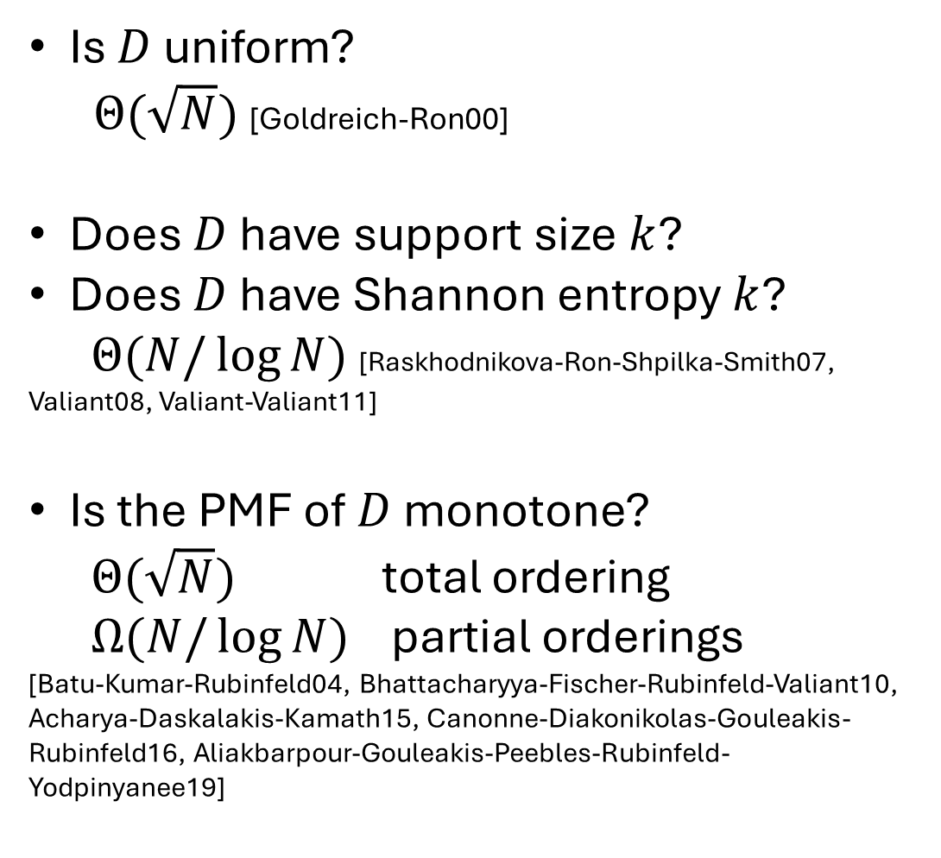
Distribution Testing
[Batu-Fortnow-Rubinfeld-Smith-White00]
A property is a set $Π$ of distributions
Completeness: If $D∈Π$,
$Pr⁡[A^{D}$ accepts$]≥2/3$
Soundness: If $D$ is $ε$-far from every distribution in $Π,$
$Pr⁡[A^{D}$ accepts$]≤1/3$
Cost: Number of samples $A$ draws from $D$
Is $D$ uniform?
$Θ(\sqrt{N})$ [Goldreich-Ron00]
Does $D$ have support size $k$?
Does $D$ have Shannon entropy $k$?
$Θ(N/\log{N})$ [Raskhodnikova-Ron-Shpilka-Smith07, Valiant08, Valiant-Valiant11]
Is the PMF of $D$ monotone?
$Θ(\sqrt{N})$ total ordering
$Ω(N/\log{N)}$ partial orderings
[Batu-Kumar-Rubinfeld04, Bhattacharyya-Fischer-Rubinfeld-Valiant10, Acharya-Daskalakis-Kamath15, Canonne-Diakonikolas-Gouleakis-Rubinfeld16, Aliakbarpour-Gouleakis-Peebles-Rubinfeld-Yodpinyanee19]

Slide 5

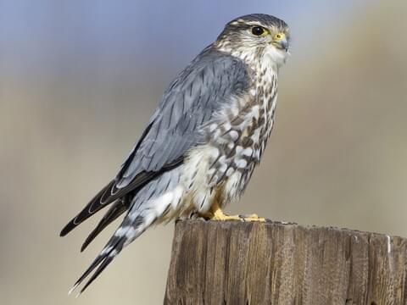




Verifying Distribution Properties
[Chiesa-Gur18]
Distribution over $[N]$
$$D$$
Full knowledge
i.i.d. samples
Prover $P$
Verifier $V$
accept or reject
Inspired by interactive proofs from complexity/cryptography [Goldwasser-Micali-Rackoff85, Babai85]

Slide 6


Verifying Distribution Properties
[Chiesa-Gur18]
Distribution over $[N]$
$$D$$
Full knowledge
i.i.d. samples
Prover $P$
Verifier $V$
accept or reject

Slide 7


Verifying Distribution Properties
[Chiesa-Gur18]
Distribution over $[N]$
$$D$$
Full knowledge
i.i.d. samples
Prover $P$
Verifier $V$
accept or reject

Slide 8
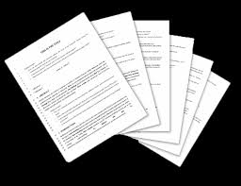
Verifiable Data Science
Interactive proofs where verification is cheaper than learning
Distribution testing [Chiesa-Gur18, Herman-Rothblum22, Herman-Rothblum23, Herman-Rothblum24, Herman25] Focus of this work
Agnostic PAC learning (classification) [Goldwasser-Rothblum-Shafer-Yehudayoff21, Mutreja-Shafer23, Gur-Jahanara-Khodabandeh-Rajgopal-Salamatian-Shinkar24, Caro-Hinsch-Ioannou-Nietner-Sweke24]
Proofs of proximity [Ergün-Kumar-Rubinfeld04, Rothblum-Vadhan-Wigderson13, Fischer-Goldhirsh-Lachish14, Gur-Rothblum15, Goldreich-Gur-Rothblum15, Reingold-Rothblum-Rothblum16, Gur-Rothblum17, Berman-Rothblum-Vaikuntanathan18, Gur-Liu-Rothblum18, Rothblum-Rothblum20, Goldreich-Gur21, Dall’Agnol-Gur-Moulik-Thaler22, Aaronson-Gur-Rajgopal-Rothblum24, Amir-Goldreich-Rothblum25]
Replicability as algorithmic stability [Impagliazzo-Lei-Pitassi-Sorrell21, Ghazi-Kumar-Manurangsi21, B.-Gaboardi-Hopkins-Impagliazzo-Lei-Pitassi-Sivakumar-Sorrell23, Kalavasis-Karbasi-Moran-Velegkas23, Ghazi-Kamath-Kumar-Manurangsi-Meka-Zhang23, Moran-Schefler-Shafer23, Esfandiari-Kalavasis-Karbasi-Krause-Mirrokni-Velegkas23, Esfandiari-Karbasi-Mirrokni-Velegkas-Zhou23, Eaton-Hussin-Kearns-Sorrell23, Karbasi-Velegkas-Yang-Zhou23,…]

Slide 9





Verifying Distribution Properties
Completeness: If $D∈Π$,
$Pr⁡[P↔V^{D}$ accepts$]≥2/3$
Soundness: If $D$ is $ε$-far from every distribution in $Π,$ for every $P^{∗}$
$Pr⁡[P^{∗}↔V^{D}$ accepts$]≤1/3$
Cost:
Number of samples $V$ draws from $D$
Communication: Bits exchanged between $P$ and $V$
Distribution over $[N]$
$$D$$
Full knowledge
i.i.d. samples
Prover $P$
Verifier $V$
accept or reject

Slide 10


Verifying Distribution Properties
Completeness: If $D∈Π$,
$Pr⁡[P↔V^{D}$ accepts$]≥2/3$
Soundness: If $D$ is $ε$-far from every distribution in $Π,$ for every $P^{∗}$
$Pr⁡[P^{∗}↔V^{D}$ accepts$]≤1/3$
Cost: Samples, Communication
Distribution over $[N]$
$$D$$
Full knowledge
i.i.d. samples
Other desirable properties:
Tolerance: Accept whenever $D$ is close to $Π$
Few rounds of interaction
Computational efficiency
Double-efficiency: Prover doesn’t need to know $D$, but can run in $o(N)$ time
Public coins
Prover $P$
Verifier $V$
accept or reject

Slide 11
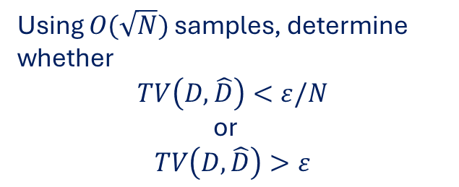
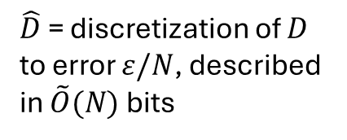

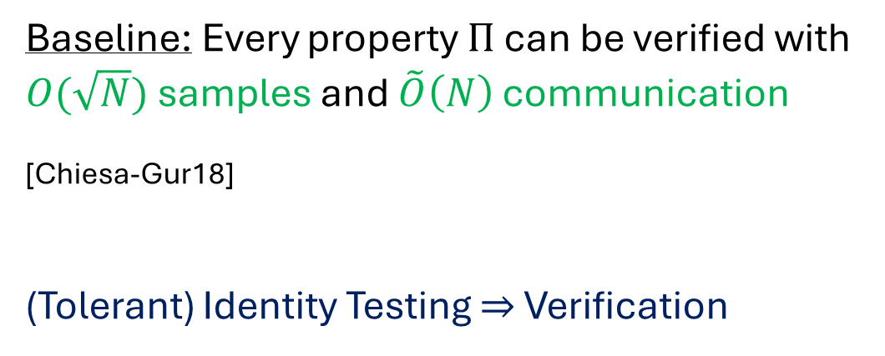
Verifying Distribution Properties
Completeness: If $D∈Π$,
$Pr⁡[P↔V^{D}$ accepts$]≥2/3$
Soundness: If $D$ is $ε$-far from every distribution in $Π,$ for every $P^{∗}$
$Pr⁡[P^{∗}↔V^{D}$ accepts$]≤1/3$
Cost: Samples, Communication
Distribution over $[N]$
$$D$$
Full knowledge
i.i.d. samples
Verifier $V$
Baseline: Every property $Π$ can be verified with $O(\sqrt{N})$ samples and $\tilde{O}\left(N\right)$ communication
[Chiesa-Gur18]
(Tolerant) Identity Testing $⇒$ Verification
Prover $P$
$$\hat{D}$$
Using $O(\sqrt{N})$ samples, determine whether
$$TV\left(D,\hat{D}\right)<ε/N$$
or
$$TV\left(D,\hat{D}\right)>ε$$
$\hat{D}$ = discretization of $D$ to error $ε/N$, described in $\tilde{O}(N)$ bits

Slide 12
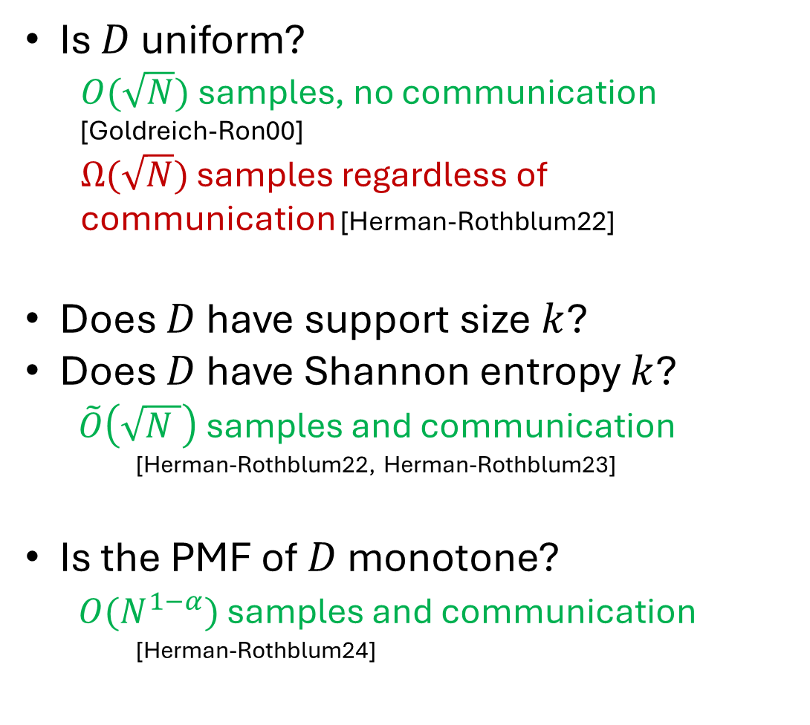
Verifying Distribution Properties
Completeness: If $D∈Π$,
$Pr⁡[P↔V^{D}$ accepts$]≥2/3$
Soundness: If $D$ is $ε$-far from every distribution in $Π,$ for every $P^{∗}$
$Pr⁡[P^{∗}↔V^{D}$ accepts$]≤1/3$
Cost:
Number of samples $V$ draws from $D$
Communication: Bits exchanged between $P$ and $V$
Is $D$ uniform?
$O(\sqrt{N})$ samples, no communication
[Goldreich-Ron00]
$Ω(\sqrt{N})$ samples regardless of communication [Herman-Rothblum22]
Does $D$ have support size $k$?
Does $D$ have Shannon entropy $k$?
$\tilde{O}\left(\sqrt{N }\right)$ samples and communication
[Herman-Rothblum22, Herman-Rothblum23]
Is the PMF of $D$ monotone?
$O(N^{1−α})$ samples and communication
[Herman-Rothblum24]

Slide 13
Verifying Distribution Properties
Is $D$ uniform?
$O(\sqrt{N})$ samples, no communication
[Goldreich-Ron00]
$Ω(\sqrt{N})$ samples regardless of communication [Herman-Rothblum22]
Does $D$ have support size $k$?
Does $D$ have Shannon entropy $k$?
$\tilde{O}\left(\sqrt{N }\right)$ samples and communication
[Herman-Rothblum22, Herman-Rothblum23]
Is the PMF of $D$ monotone?
$O(N^{1−α})$ samples and communication
[Herman-Rothblum24]
Label-invariant a.k.a. symmetric properties
Holds for all label-invariant properties
Holds for all properties

Slide 14





Lower Bound for Verifying Uniformity
Claim: Verifying the property $Π=\left\{Unif_{N}\right\}$ requires $Ω(\sqrt{N})$ samples regardless of communication [Herman-Rothblum22]
Proof idea: Use proof system to construct a (prover-free) tester, which needs $Ω(\sqrt{N})$ samples
Distribution over $[N]$
$$D$$
Full knowledge
i.i.d. samples
Prover $P$
Verifier $V$
accept or reject

Slide 15


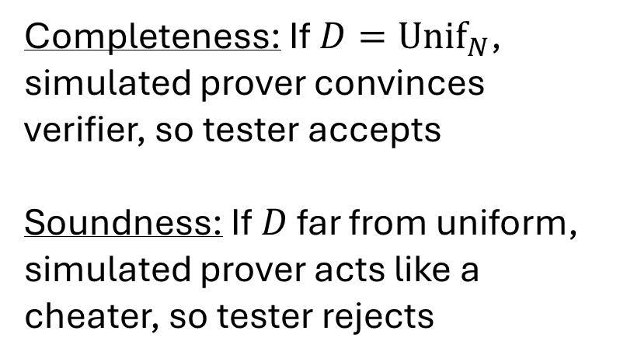


Lower Bound for Verifying Uniformity
Claim: Verifying the property $Π=\left\{Unif_{N}\right\}$ requires $Ω(\sqrt{N})$ samples regardless of communication [Herman-Rothblum22]
Proof idea: Use proof system to construct a (prover-free) tester, which needs $Ω(\sqrt{N})$ samples
i.i.d. samples
$$D$$
Completeness: If $D=Unif_{N}$, simulated prover convinces verifier, so tester accepts
Soundness: If $D$ far from uniform, simulated prover acts like a cheater, so tester rejects
$$Unif_{N}$$
Prover $P$
Verifier $V$
Tester
accept or reject

Slide 16
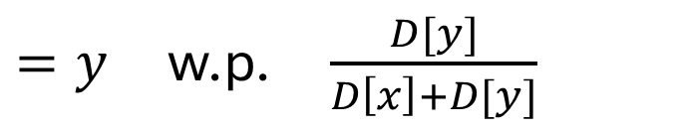
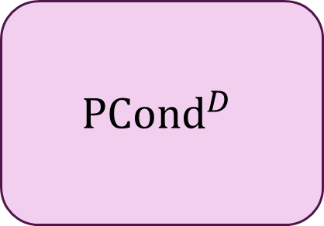
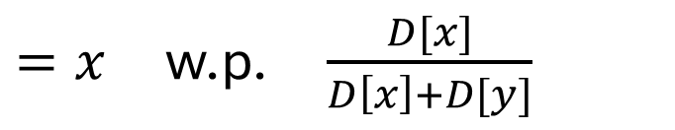



Toward Practical Verification?
Question: How might we (slightly) augment the verifier’s power so that it can get away with $≪\sqrt{N}$ samples?
This work: Give the verifier pairwise conditional queries
$$x∈[N]$$
$=x$ w.p. $\frac{D[x]}{D\left[x\right]+D[y]}$
$$PCond^{D}$$
$$z$$
$$y∈[N]$$
$=y$ w.p. $\frac{D[y]}{D\left[x\right]+D[y]}$

Slide 17
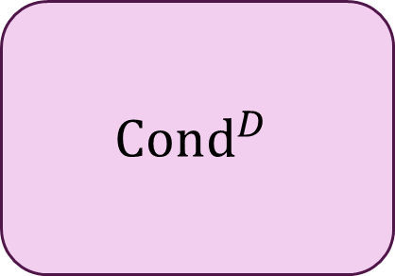



Pairwise Conditional Queries
[Chakraborty-Fischer-Goldhirsh-Matsliah13, Canonne-Ron-Servedio14]
Special (more realistic?) case of conditional queries where $\left|S\right|=2$
$$Cond^{D}$$
w.p. $\frac{D[z]}{D[S]}$
$$S⊆[N]$$
$$z∈S$$

Slide 18

Pairwise Conditional Queries
[Chakraborty-Fischer-Goldhirsh-Matsliah13, Canonne-Ron-Servedio14]
Special (more realistic?) case of conditional queries where $\left|S\right|=2$
To draw random samples:
Survey everyone and ask for their occupation
To draw pairwise conditional samples:
Target survey to, e.g., “nurses or firefighters”

Slide 19


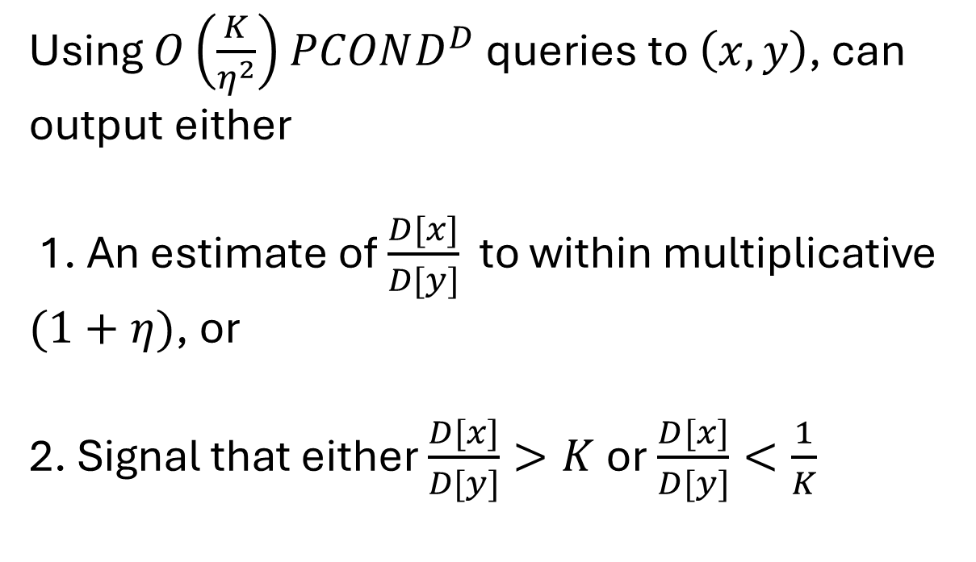

$PCOND$ Can Be Powerful!
[Canonne-Ron-Servedio14]
Warmup: Can compare the probability mass on two arbitrary points
Using $O\left(\frac{K}{η^{2}}\right)$ $PCOND^{D}$ queries to $\left(x, y\right)$, can output either
1. An estimate of $\frac{D[x]}{D[y]}$ to within multiplicative $(1+η)$, or
2. Signal that either $\frac{D[x]}{D[y]}>K$ or $\frac{D[x]}{D[y]}<\frac{1}{K}$
$$x$$
$$y$$

Slide 20


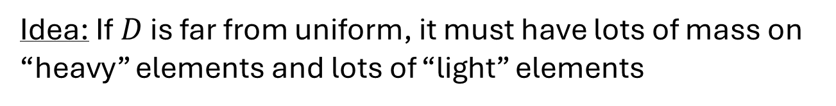
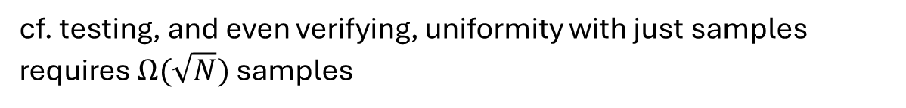
$PCOND$ Can Be Powerful!
[Canonne-Ron-Servedio14]
Theorem: Can $ε$-test uniformity using $O(1/ε^{4})$ $PCOND$ queries + samples
cf. testing, and even verifying, uniformity with just samples requires $Ω(\sqrt{N})$ samples
Idea: If $D$ is far from uniform, it must have lots of mass on “heavy” elements and lots of “light” elements
$$1/N$$
$$[N]$$

Slide 21
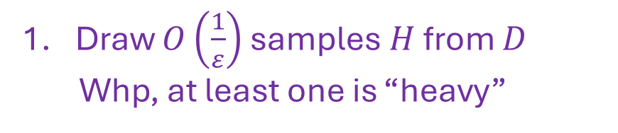
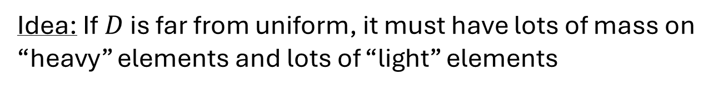
$PCOND$ Can Be Powerful!
[Canonne-Ron-Servedio14]
Theorem: Can $ε$-test uniformity using $O(1/ε^{4})$ $PCOND$ queries + samples
cf. testing, and even verifying, uniformity with just samples requires $Ω(\sqrt{N})$ samples
Idea: If $D$ is far from uniform, it must have lots of mass on “heavy” elements and lots of “light” elements
Draw $O\left(\frac{1}{ε}\right)$ samples $H$ from $D$
Whp, at least one is “heavy”
$$1/N$$
$$[N]$$

Slide 22
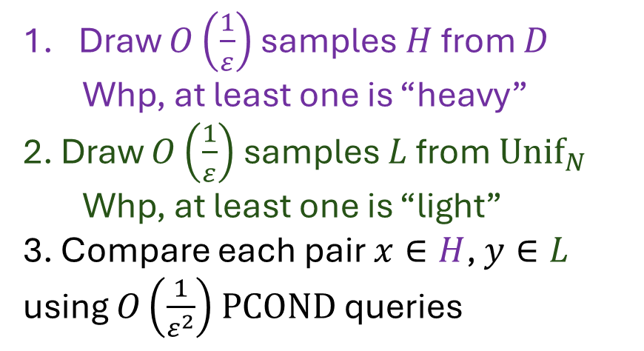
$PCOND$ Can Be Powerful!
[Canonne-Ron-Servedio14]
Theorem: Can $ε$-test uniformity using $O(1/ε^{4})$ $PCOND$ queries + samples
cf. testing, and even verifying, uniformity with just samples requires $Ω(\sqrt{N})$ samples
Idea: If $D$ is far from uniform, it must have lots of mass on “heavy” elements and lots of “light” elements
Draw $O\left(\frac{1}{ε}\right)$ samples $H$ from $D$
Whp, at least one is “heavy”
2. Draw $O\left(\frac{1}{ε}\right)$ samples $L$ from $Unif_{N}$
Whp, at least one is “light”
3. Compare each pair $x∈H$, $y∈L$ using $O\left(\frac{1}{ε^{2}}\right)$ $PCOND$ queries
$$1/N$$
$$[N]$$

Slide 23

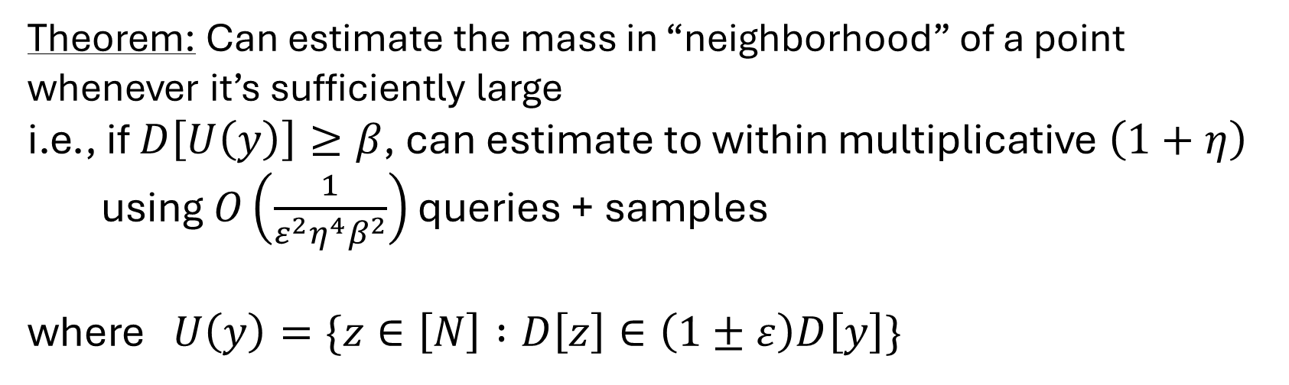
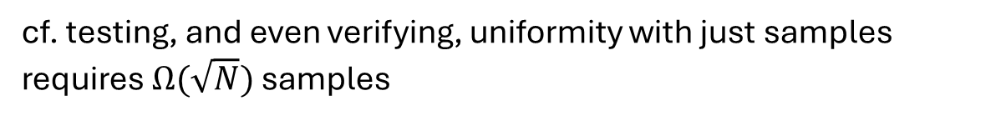
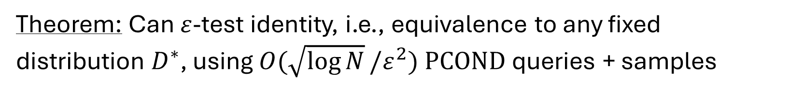
$PCOND$ Can Be Powerful!
[Canonne-Ron-Servedio14]
Theorem: Can $ε$-test uniformity using $O(1/ε^{2})$ $PCOND$ queries + samples
Theorem: Can $ε$-test identity, i.e., equivalence to any fixed distribution $D^{∗}$, using $O(\sqrt{\log{N}}/ε^{2})$ $PCOND$ queries + samples
[Canonne-Ron-Servedio14, Narayanan21]
cf. testing, and even verifying, uniformity with just samples requires $Ω(\sqrt{N})$ samples
Theorem: Can estimate the mass in “neighborhood” of a point whenever it’s sufficiently large
i.e., if $D\left[U\left(y\right)\right]≥β$, can estimate to within multiplicative $\left(1+η\right)$
using $O\left(\frac{1}{ε^{2}η^{4}β^{2}}\right)$ queries + samples
where $U\left(y\right)=\{z∈\left[N\right] :D\left[z\right]∈\left(1±ε\right)D\left[y\right]\}$
[Canonne-Ron-Servedio14]
This work: Can also sample from $U(y)$

Slide 24

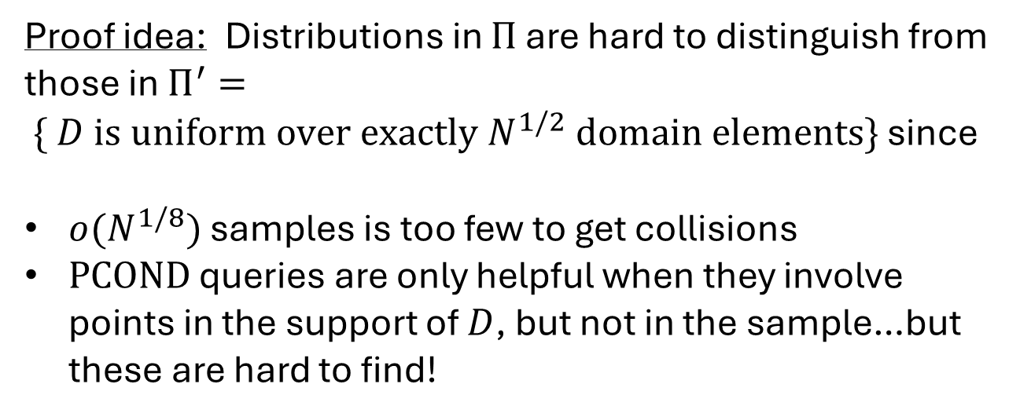

But Not Too Powerful
This work: There is a label-invariant property $Π$ which requires at least $Ω(N^{1/8})$ $PCOND$ queries + samples to test
$$Π= \{ D is uniform over exactly N^{1/4} domain elements\}$$
Proof idea: Distributions in $Π$ are hard to distinguish from those in $Π^{′}= \{ D is uniform over exactly N^{1/2} domain elements\}$ since
$o(N^{1/8})$ samples is too few to get collisions
$PCOND$ queries are only helpful when they involve points in the support of $D$, but not in the sample…but these are hard to find!
$$[N]$$
$$[N]$$
cf. In the full $COND$ query model, every label-invariant property can be tested with $poly\log{N}$ queries [Chakraborty-Fischer-Goldhirsh-Matsliah13]

Slide 25
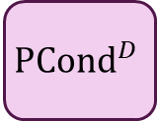





Verification with $PCOND$ (this work)
Completeness: If $D∈Π$,
$Pr⁡[P↔V^{D}$ accepts$]≥2/3$
Soundness: If $D$ is $ε$-far from every distribution in $Π,$ for every $P^{∗}$
$Pr⁡[P^{∗}↔V^{D}$ accepts$]≤1/3$
Cost:
Number of samples $V$ draws from $D$
Communication: Bits exchanged between $P$ and $V$
Number of $PCOND$ queries $V$ makes
$$D$$
$$PCond^{D}$$
i.i.d. samples
queries
Prover $P$
accept or reject
Verifier $V$

Slide 26
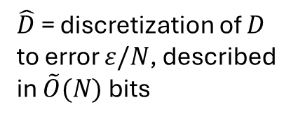
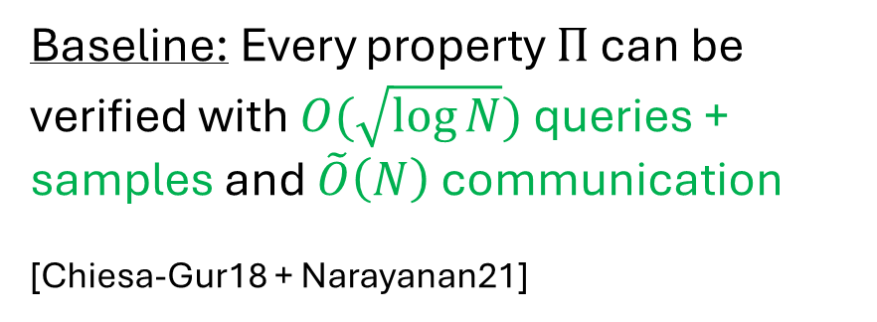

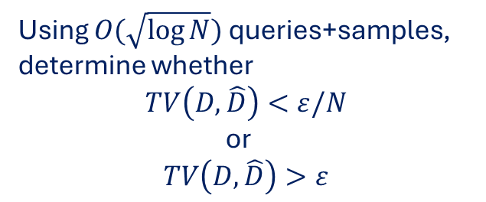

Verification with $PCOND$ (this work)
Completeness: If $D∈Π$,
$Pr⁡[P↔V^{D}$ accepts$]≥2/3$
Soundness: If $D$ is $ε$-far from every distribution in $Π,$ for every $P^{∗}$
$Pr⁡[P^{∗}↔V^{D}$ accepts$]≤1/3$
Cost: Samples, Communication, Queries
$$D$$
$$PCond^{D}$$
i.i.d. samples
queries
$$\hat{D}$$
Baseline: Every property $Π$ can be verified with $O(\sqrt{\log{N}})$ queries + samples and $\tilde{O}\left(N\right)$ communication
[Chiesa-Gur18 + Narayanan21]
Prover $P$
Verifier $V$
Using $O(\sqrt{\log{N}})$ queries+samples, determine whether
$$TV\left(D,\hat{D}\right)<ε/N$$
or
$$TV\left(D,\hat{D}\right)>ε$$
$\hat{D}$ = discretization of $D$ to error $ε/N$, described in $\tilde{O}(N)$ bits

Slide 27
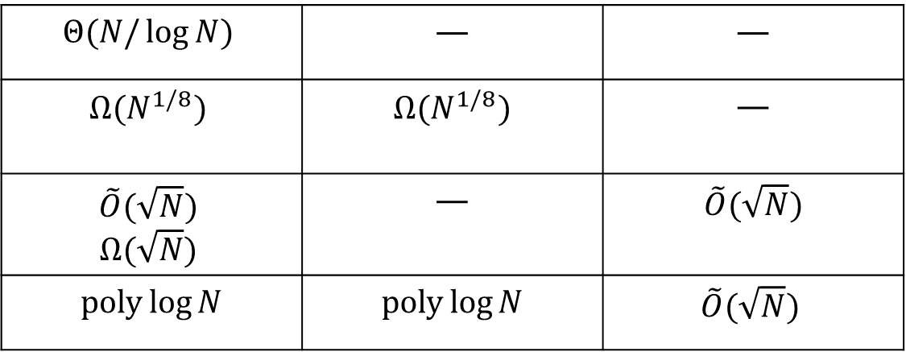
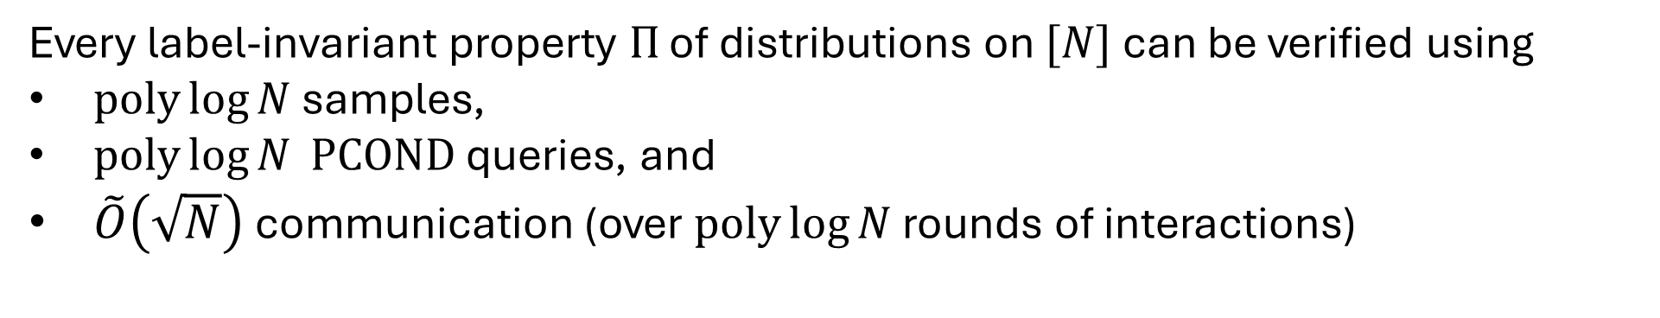
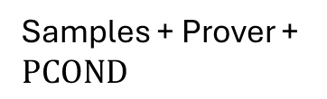

Main Results
Every label-invariant property $Π$ of distributions on $[N]$ can be verified using
$poly\log{N}$ samples,
$poly\log{N} PCOND$ queries, and
$\tilde{O}\left(\sqrt{N}\right)$ communication (over $poly\log{N}$ rounds of interactions)
Samples
Queries
Communication
Samples only
$$Θ(N/\log{N)}$$ | — | —
$$Ω(N^{1/8})$$ | $$Ω(N^{1/8})$$ | —
$$\tilde{O}(\sqrt{N})$$ $$Ω(\sqrt{N})$$ | — | $$\tilde{O}(\sqrt{N})$$
$poly\log{N}$ | $poly\log{N}$ | $$\tilde{O}(\sqrt{N})$$
[Valiant-Valiant11]
Samples + $PCOND$
This work
Samples + Prover
[Herman-Rothblum22, Herman-Rothblum23]
Samples + Prover + $PCOND$
This work

Slide 28
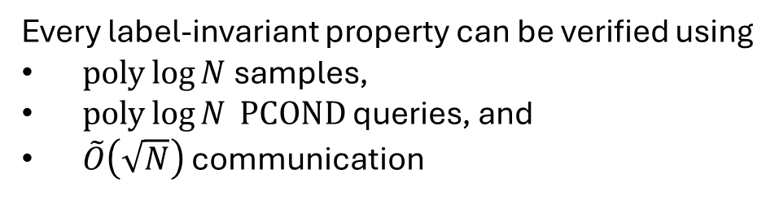
Proof Overview
Every label-invariant property can be verified using
$poly\log{N}$ samples,
$poly\log{N} PCOND$ queries, and
$\tilde{O}\left(\sqrt{N}\right)$ communication
1. Verifying a label-invariant property
2. Verifying a bucket histogram
3. Verifying the probability mass of one point
4. Verifying the support size of a nearly-flat distribution

Slide 29

Bucket Histograms
A label-invariant property depends only on a distribution’s weights, not on the underlying elements
probability weights
$$≡$$
$$1 2 3 4 5 6 7 8 9 10$$
$$1 2 3 4 5 6 7 8 9 10$$
total mass on elements with given weight
probability weights

Slide 30





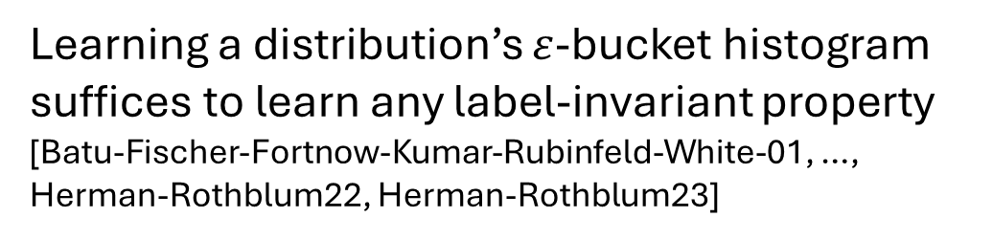

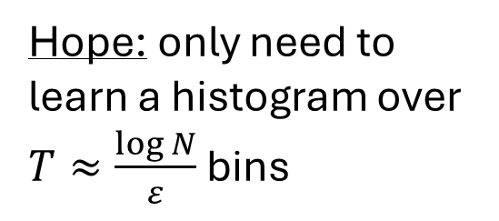


Bucket Histograms
Even when probabilities are not so nice…
Learning a distribution’s $ε$-bucket histogram suffices to learn any label-invariant property
[Batu-Fischer-Fortnow-Kumar-Rubinfeld-White-01, …, Herman-Rothblum22, Herman-Rothblum23]
Hope: only need to learn a histogram over $T≈\frac{\log{N}}{ε}$ bins
total weight in bucket
$$\frac{1}{N}$$
$$\frac{1+ε}{N}$$
…
$$\frac{{\left(1+ε\right)}^{j−1}}{N}$$
$$\frac{{\left(1+ε\right)}^{j}}{N}$$
…
$$\frac{{\left(1+ε\right)}^{T−2}}{N}$$
$$\frac{{\left(1+ε\right)}^{T−1}}{N}$$
$$\frac{{\left(1+ε\right)}^{T}}{N}$$
$$0$$
probability weight buckets

Slide 31
Proof Overview
Every label-invariant property can be verified using
$poly\log{N}$ samples,
$poly\log{N} PCOND$ queries, and
$\tilde{O}\left(\sqrt{N}\right)$ communication
1. Verifying a label-invariant property
2. Verifying a bucket histogram
3. Verifying the probability mass of one point
4. Verifying the support size of a nearly-flat distribution

Slide 32
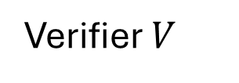







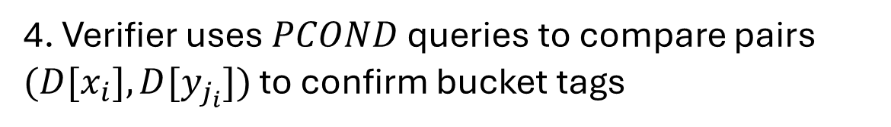
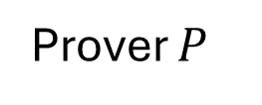


Verifying a Bucket Histogram
Prover $P$
Verifier $V$
Bucket $0$
Bucket $1$
…
Bucket $j$
…
Bucket $T−1$
Bucket $T$
Verifier samples $x_{1},…, x_{m}∼D$ for some $m=\tilde{O}\left(T\right)$
Prover sends back “tags” $j_{1},…, j_{m}$
claiming sample $x_{i}$ is from bucket $j_{i}$
3. Prover sends “anchor points”
$y_{0},…, y_{T}$ claiming that each
a) $y_{j}$ is in bucket $j$
b) $y_{j}$ has a “heavy neighborhood”
$$x_{1},…, x_{m}$$
$$j_{1},…, j_{m}$$
$$y_{0},…, y_{T}$$
4. Verifier uses $PCOND$ queries to compare pairs $(D[x_{i}], D[y_{j_{i}}])$ to confirm bucket tags

Slide 33
Proof Overview
Every label-invariant property can be verified using
$poly\log{N}$ samples,
$poly\log{N} PCOND$ queries, and
$\tilde{O}\left(\sqrt{N}\right)$ communication
1. Verifying a label-invariant property
2. Verifying a bucket histogram
3. Verifying the probability mass of one point
4. Verifying the support size of a nearly-flat distribution

Slide 34
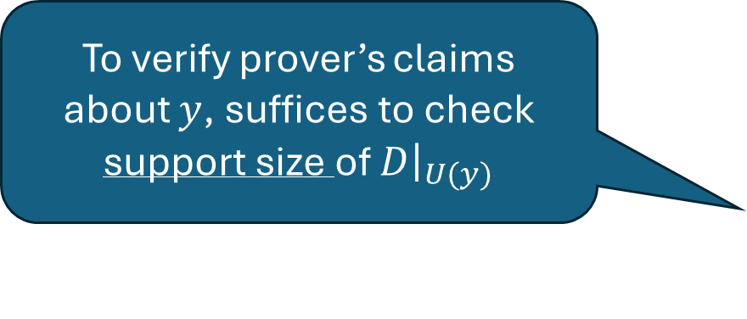
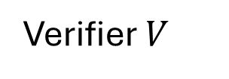


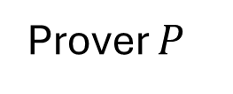
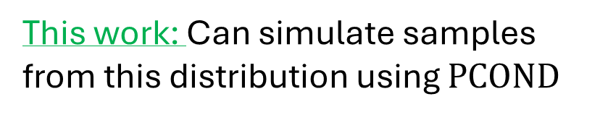
Verifying Probability Mass of One Point
Prover’s claims:
a) $y$ is in bucket $j$, i.e., $\frac{{\left(1+ε\right)}^{j−1}}{N}≤D\left[y\right]≤\frac{{\left(1+ε\right)}^{j}}{N}$
b) $D\left[U\left(y\right)\right]≥\frac{1}{poly\log{N}}$
where $U\left(y\right)=\{z∈\left[N\right] :D\left[z\right]∈\left(1±ε\right)D\left[y\right]\}$
Verifier uses $PCOND$ queries to estimate $D\left[U\left(y\right)\right]$ [Canonne-Ron-Servedio15]
$D\left[U\left(y\right)\right]≈$ $D\left[y\right]⋅$ $\left|U\left(y\right)\right|$
$p≈D\left[y\right] ⟺ \left|U\left(y\right)\right|≈\frac{D\left[U\left(y\right)\right]}{p}$
Prover $P$
Verifier $V$
$$y, j$$
To verify prover’s claims about $y$, suffices to check support size of $D{\left.​\right|}_{U(y)}$
This work: Can simulate samples from this distribution using $PCOND$

Slide 35
Proof Overview
Every label-invariant property can be verified using
$poly\log{N}$ samples,
$poly\log{N} PCOND$ queries, and
$\tilde{O}\left(\sqrt{N}\right)$ communication
1. Verifying a label-invariant property
2. Verifying a bucket histogram
3. Verifying the probability mass of one point
4. Verifying the support size of a nearly-flat distribution

Slide 36

Verifying Support Size
Input: Distribution $D$ promised to be “almost flat”: $\frac{1}{2}≤$ $\frac{D[x]}{D[y]}≤2$ for all $x,y$ in support
Prover’s claim: $D$ is supported on $A$ elements
Goal: Verify prover’s claim with $\tilde{O}(\sqrt{N})$ communication and $poly\log{(N)}$queries/samples

Slide 37

Verifying Support Size
Input: Distribution $D$ promised to be “almost flat”: $\frac{1}{2}≤$ $\frac{D[x]}{D[y]}≤2$ for all $x,y$ in support
Prover’s claim: $D$ is supported on $A$ elements
Goal: Verify prover’s claim with $\tilde{O}(\sqrt{N})$ communication and $poly\log{(N)}$queries/samples
Case 1: $A≤\sqrt{N}$
Prover $→$ Verifier: Send claimed support $\tilde{S}$ of $D$, where $\left|\tilde{S}\right|=A$

Slide 38

Verifying Support Size
Input: Distribution $D$ promised to be “almost flat”: $\frac{1}{2}≤$ $\frac{D[x]}{D[y]}≤2$ for all $x,y$ in support
Prover’s claim: $D$ is supported on $A$ elements
Goal: Verify prover’s claim with $\tilde{O}(\sqrt{N})$ communication and $poly\log{(N)}$queries/samples
Case 1: $A≤\sqrt{N}$
Prover $→$ Verifier: Send claimed support $\tilde{S}$ of $D$, where $\left|\tilde{S}\right|=A$
Two ways prover might try to lie:
Case 1a:$\tilde{S}$ is too small
Verifier: Sample from $D$ and check it is in $\tilde{S}$

Slide 39

Verifying Support Size
Input: Distribution $D$ promised to be “almost flat”: $\frac{1}{2}≤$ $\frac{D[x]}{D[y]}≤2$ for all $x,y$ in support
Prover’s claim: $D$ is supported on $A$ elements
Goal: Verify prover’s claim with $\tilde{O}(\sqrt{N})$ communication and $poly\log{(N)}$queries/samples
Case 1: $A≤\sqrt{N}$
Prover $→$ Verifier: Send claimed support $\tilde{S}$ of $D$, where $\left|\tilde{S}\right|=A$
Two ways prover might try to lie:
Case 1a:$\tilde{S}$ is too small
Verifier: Sample from $D$ and check it is in $\tilde{S}$
Case 1b:$\tilde{S}$ is too big
Verifier: Draw one point $x∼D$
Sample uniformly from $\tilde{S}$ and compare mass to $D[x]$

Slide 40













Verifying Support Size
Assumption:
$D$ is “almost flat”: $\frac{1}{2}≤$ $\frac{D[x]}{D[y]}≤2$ for all $x,y$ in support
Prover’s claim: $D$ is supported on $A$ elements
Let $S$ = true support of $D$
Verifier:
Sample from $D$ and check it is in $\tilde{S}$
Possible lie:
$$\left|S\right|≫|\tilde{S}|$$
Prover’s claim:
$$A<\sqrt{N}$$
Prover $→$ Verifier:
Send claimed support $\tilde{S}$
Possible lie:
|$S|≪|\tilde{S}|$
Verifier:
Draw one point $x∼D$
Sample uniformly from $\tilde{S}$ and compare mass to $D[x]$
Verifier $→$Prover:
Draw one point $x∼D$, hide it amongst $N/A$ samples from $[N]$
Prover $→$ Verifier: Location of $x$
Possible lie:
$$\left|S\right|≫A$$
Prover’s claim:
$$A≥\sqrt{N}$$
Verifier $→$Prover:
Draw $N/A$ samples from $[N]$
Prover $→$ Verifier: Identify some $x$in $S$
Verifier: Draw one point from $D$ and compare to $x$
Possible lie:
$$\left|S\right|≪A$$

Slide 41
Proof Overview
Every label-invariant property can be verified using
$poly\log{N}$ samples,
$poly\log{N} PCOND$ queries, and
$\tilde{O}\left(\sqrt{N}\right)$ communication
1. Verifying a label-invariant property
2. Verifying a bucket histogram
3. Verifying the probability mass of one point
4. Verifying the support size of a nearly-flat distribution

Slide 42


Conclusions
This work: Can verify any label-invariant property $Π$ of distributions on $[N]$ using
$poly\log{N}$ samples,
$poly\log{N} PCOND$ queries, and
$\tilde{O}\left(\sqrt{N}\right)$ communication (over $poly\log{N}$ rounds of interactions)
Open Questions:
Reduce rounds? Reduce communication?
What can we do with $\sqrt{\log{N }}$ or even constant $PCOND$ queries?
Doubly-efficient protocols? [Herman-Rothblum23]
Public-coin protocols? [Herman24]
What are reasonable distribution access models for verification?
Other verification problems/models for machine learning?
Thank you!

