Slide 1
NEURAL NETWORKS & DEEP LEARNING (NNDL)
AI-Based Driver Drowsiness & Safety Monitoring System
for Zero-Harm Industrial Transportation
MobileNetV2 + LSTM Based Temporal Drowsiness Detection with Closed-Loop Intervention
Team: Final Project Demonstration Group | Department of CSE
Notes:
WHAT TO SAY (20-40s):
Good morning committee. We present our research prototype for an AI-Based Driver Drowsiness and Safety Monitoring System using a spatio-temporal MobileNetV2-LSTM architecture with closed-loop intervention.
KEY POINT:
End-to-end real-time driver drowsiness monitoring prototype.
POTENTIAL EXAMINER QUESTION:
What problem does your system solve that existing commercial systems do not?

Slide 2
DRIVER SAFETY MONITORING
Problem Statement: Moving Beyond Open-Loop Classification
TRADITIONAL OPEN-LOOP MONITORS
• Focus solely on classification (Detect -> Alert)
• Emit simple acoustic chimes drivers easily ignore
• No assessment of fatigue severity or persistence
• Zero verification of whether driver regained alertness
• Open-loop gap: leaves post-alert actions undefined
OUR CLOSED-LOOP SAFETY WORKFLOW
• Integrated pipeline: Detect -> Intervene -> Verify
• Evaluates temporal persistence over 16-frame buffer
• Active visual warning guidance instructing pull-over
• Mandatory Recovery Verification ('look at camera & eyes open')
• Escalates to 3-minute simulated rest protocol if verification fails
Research Prototype — Not a Vehicle Control System | Final Presentation
Notes:
WHAT TO SAY (20-40s):
Commercial drivers habituate to simple acoustic alarms. Detection alone is insufficient for safety-critical scenarios; our system adds intervention and recovery verification.
KEY POINT:
Closed-loop workflow ensures driver wakefulness before resuming monitoring.
POTENTIAL EXAMINER QUESTION:
Why is open-loop detection insufficient?

Slide 3
DRIVER SAFETY MONITORING
System Objectives & Research Scope
1. Real-Time Video Monitoring: Capture live webcam/video frames at edge-compatible inference speeds.
2. Temporal Behavior Modeling: Model facial dynamics across 16-frame temporal sequences (530 ms) rather than static isolated frames.
3. Edge Deep Architecture: Combine frozen MobileNetV2 CNN spatial feature extraction with a 64-unit LSTM temporal memory network.
4. Closed-Loop Intervention: Implement a severity-aware state machine issuing active visual and acoustic pull-over guidance.
5. Recovery Verification: Verify driver eye openness and facial stability before resuming normal monitoring.
6. Event & Metric Logging: Log all safety events to demo_events.csv and real-time latency to realtime_metrics.csv.
7. Cross-Domain Evaluation: Rigorously evaluate cross-dataset generalization across multi-source datasets (NITYMED & UTA-RLDD).
Research Prototype — Not a Vehicle Control System | Final Presentation
Notes:
WHAT TO SAY (20-40s):
Our objectives span temporal modeling, real-time edge performance, active safety intervention, recovery verification, and transparent reporting of cross-domain limitations.
KEY POINT:
Comprehensive approach linking machine learning to real-world safety workflow.
POTENTIAL EXAMINER QUESTION:
How do you define temporal behavior?

Slide 4
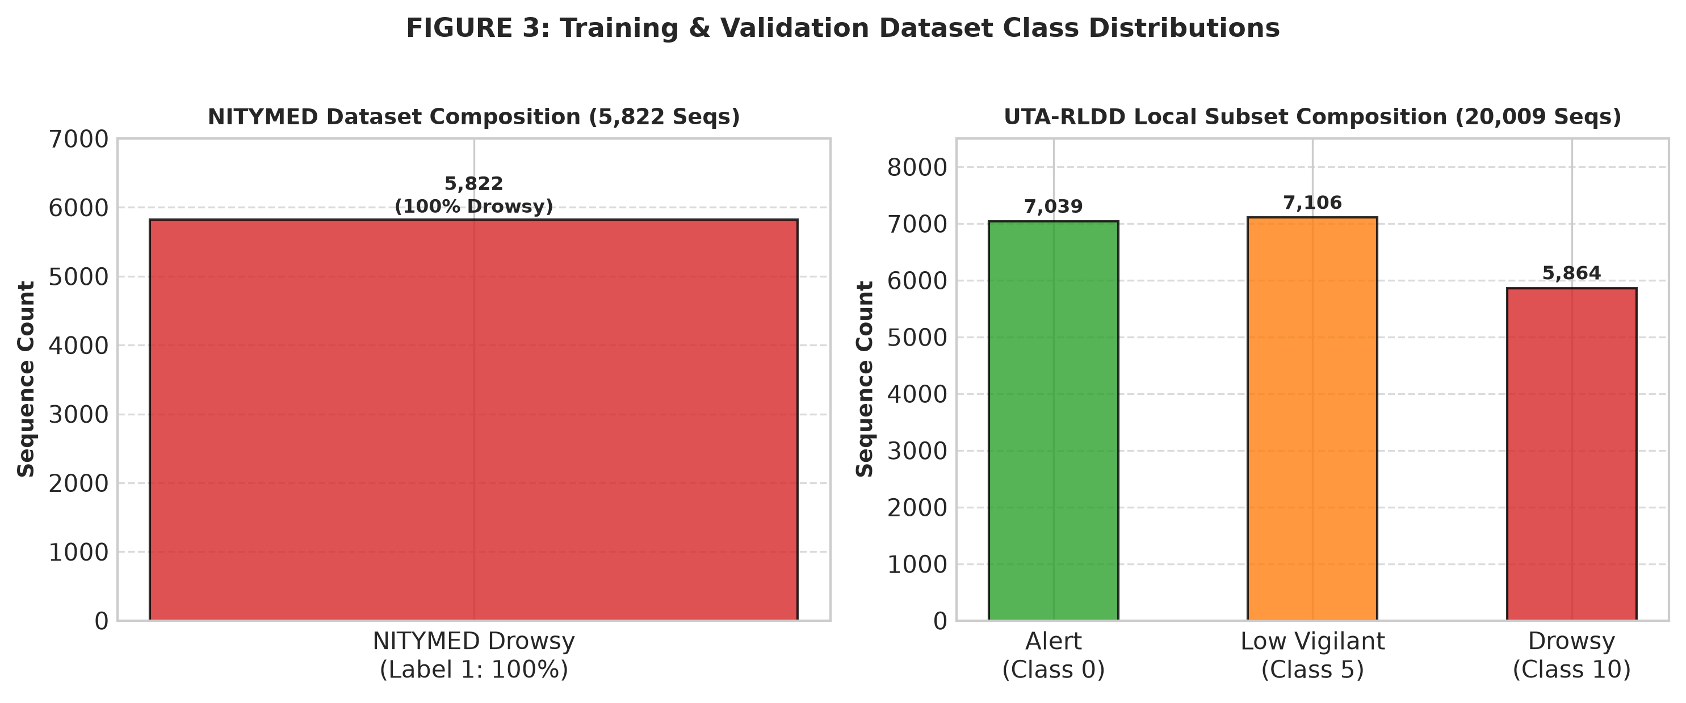
DRIVER SAFETY MONITORING
Datasets & Sequence Composition
NITYMED DATASET (Recall Benchmark)
• Official Metadata: 130 videos across 21 drivers (11M/10F)
• Official Behaviors: 107 Yawning, 21 Microsleep
• Local Usable Set: 126 videos -> 5,822 sequences
• Splits: Train (4,118), Val (860), Test (844)
• Label Property: 100% positive drowsiness (Label 1)
UTA-RLDD LOCAL SUBSET (Fold-1)
• Local Subset: 36 videos across 12 participants
• Classes: Alert (0), Low Vigilant (5), Drowsy (10)
• Binary Mapping: Alert=0, Low Vigilant+Drowsy=1
• Total Sequences: 20,009 (Train 13,755, Val 2,727, Test 3,527)
• Diagnostic Held-Out Participants: P04 and P07
Methodological Disclaimer: UTA-RLDD evaluation uses a custom participant-level split of the downloaded Fold-1 subset and is not the official five-fold benchmark protocol.
Research Prototype — Not a Vehicle Control System | Final Presentation
Notes:
WHAT TO SAY (20-40s):
We used NITYMED as a drowsiness recall benchmark and UTA-RLDD for multi-participant evaluation under a custom participant-level Fold-1 split.
KEY POINT:
Clear methodological distinction between NITYMED recall data and UTA-RLDD evaluation.
POTENTIAL EXAMINER QUESTION:
Is your UTA-RLDD evaluation the official five-fold benchmark?

Slide 5
DRIVER SAFETY MONITORING
Data Preprocessing & Sequence Generation
1. Video Stream
Raw MP4/webcam feed
2. Stride Sampling
Frame stride = 3
3. Face Detection
Localize face region
4. Face Crop
128×128 RGB resolution
5. Temporal Buffer
16 frames per sequence
6. Normalization
x / 127.5 - 1.0 (A1)
Research Prototype — Not a Vehicle Control System | Final Presentation
Notes:
WHAT TO SAY (20-40s):
Video is sampled at stride 3, localized to face crops, resized to 128x128, and normalized to [-1, 1] across 16 temporal frames.
KEY POINT:
Lightweight preprocessing pipeline optimized for edge inference.
POTENTIAL EXAMINER QUESTION:
Why 16 frames at stride 3?

Slide 6
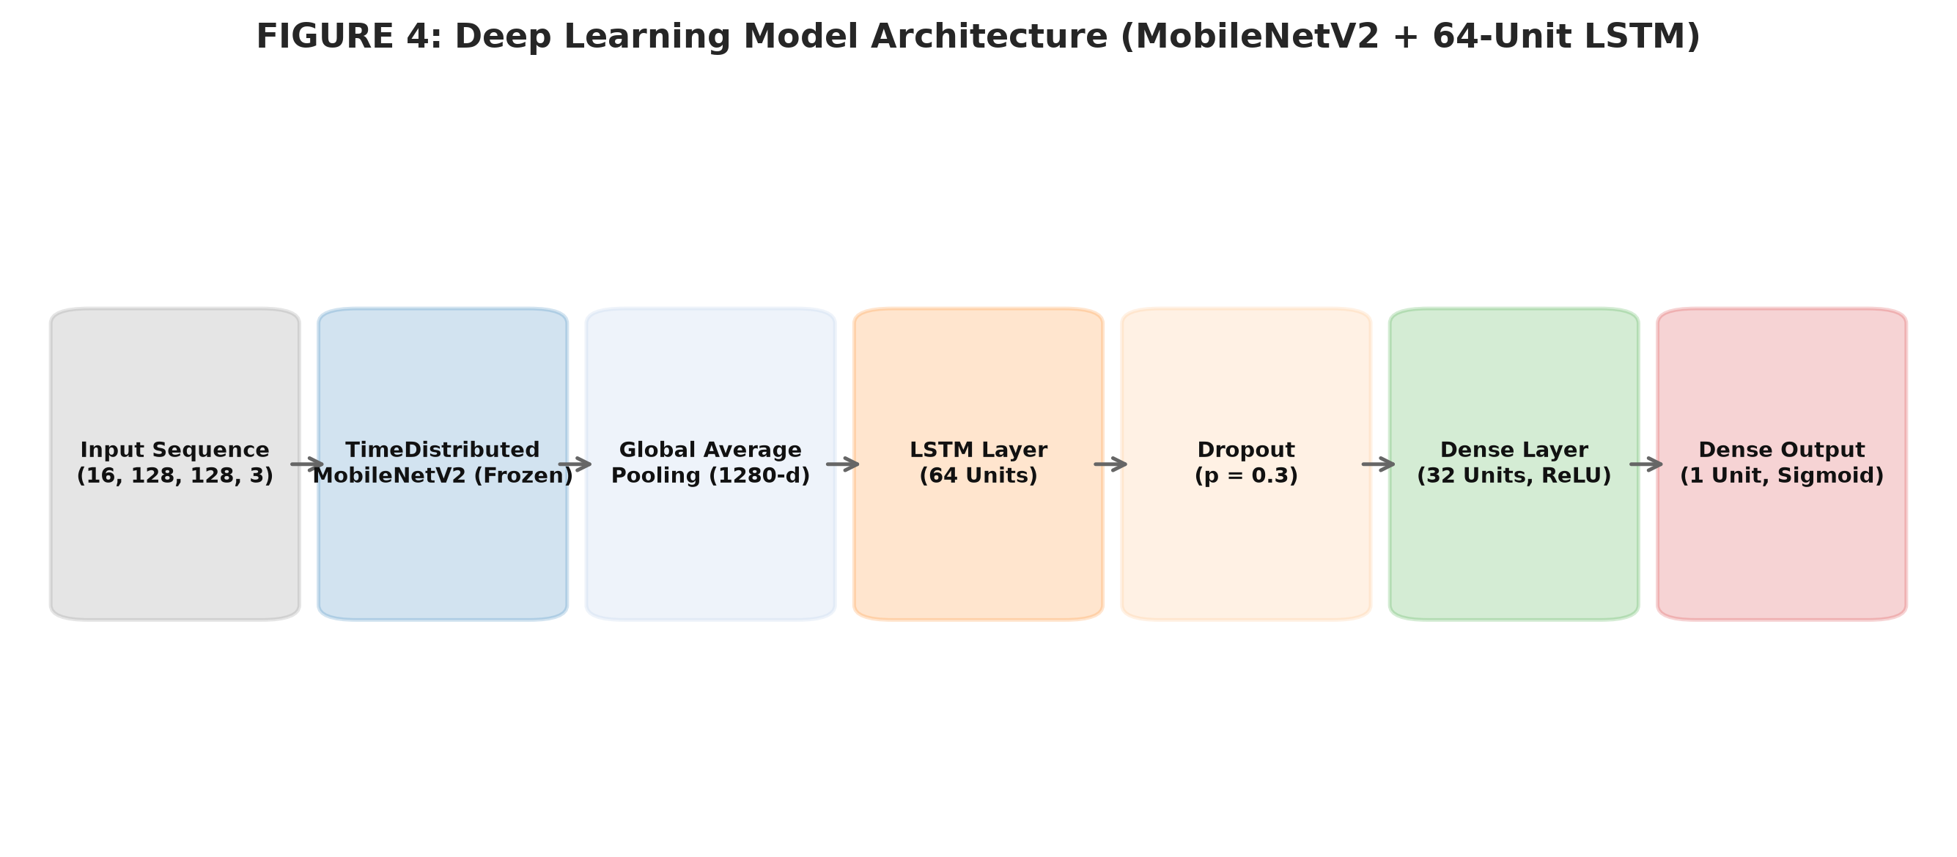
DRIVER SAFETY MONITORING
Deep Neural Network Architecture (MobileNetV2 + LSTM)
• TimeDistributed MobileNetV2: Pretrained ImageNet CNN, strictly frozen, outputs 1280-d spatial activations per frame.
• Global Average Pooling: Reduces 2D feature maps into compact 1D frame embeddings.
• 64-Unit LSTM Layer: Models sequential temporal dependencies and facial motion dynamics across 16 frames.
• Dropout Regularization: Dropout(0.3) after LSTM and Dropout(0.2) after Dense layer to prevent overfitting.
• Dense Output Layer: Dense(32, ReLU) followed by Dense(1, Sigmoid) outputting drowsiness probability p in [0, 1].
Research Prototype — Not a Vehicle Control System | Final Presentation
Notes:
WHAT TO SAY (20-40s):
Spatial features are extracted frame-by-frame by a frozen MobileNetV2 backbone and modeled sequentially by a 64-unit LSTM network.
KEY POINT:
Hybrid spatio-temporal deep neural network.
POTENTIAL EXAMINER QUESTION:
Why frozen MobileNetV2 instead of fine-tuning?

Slide 7
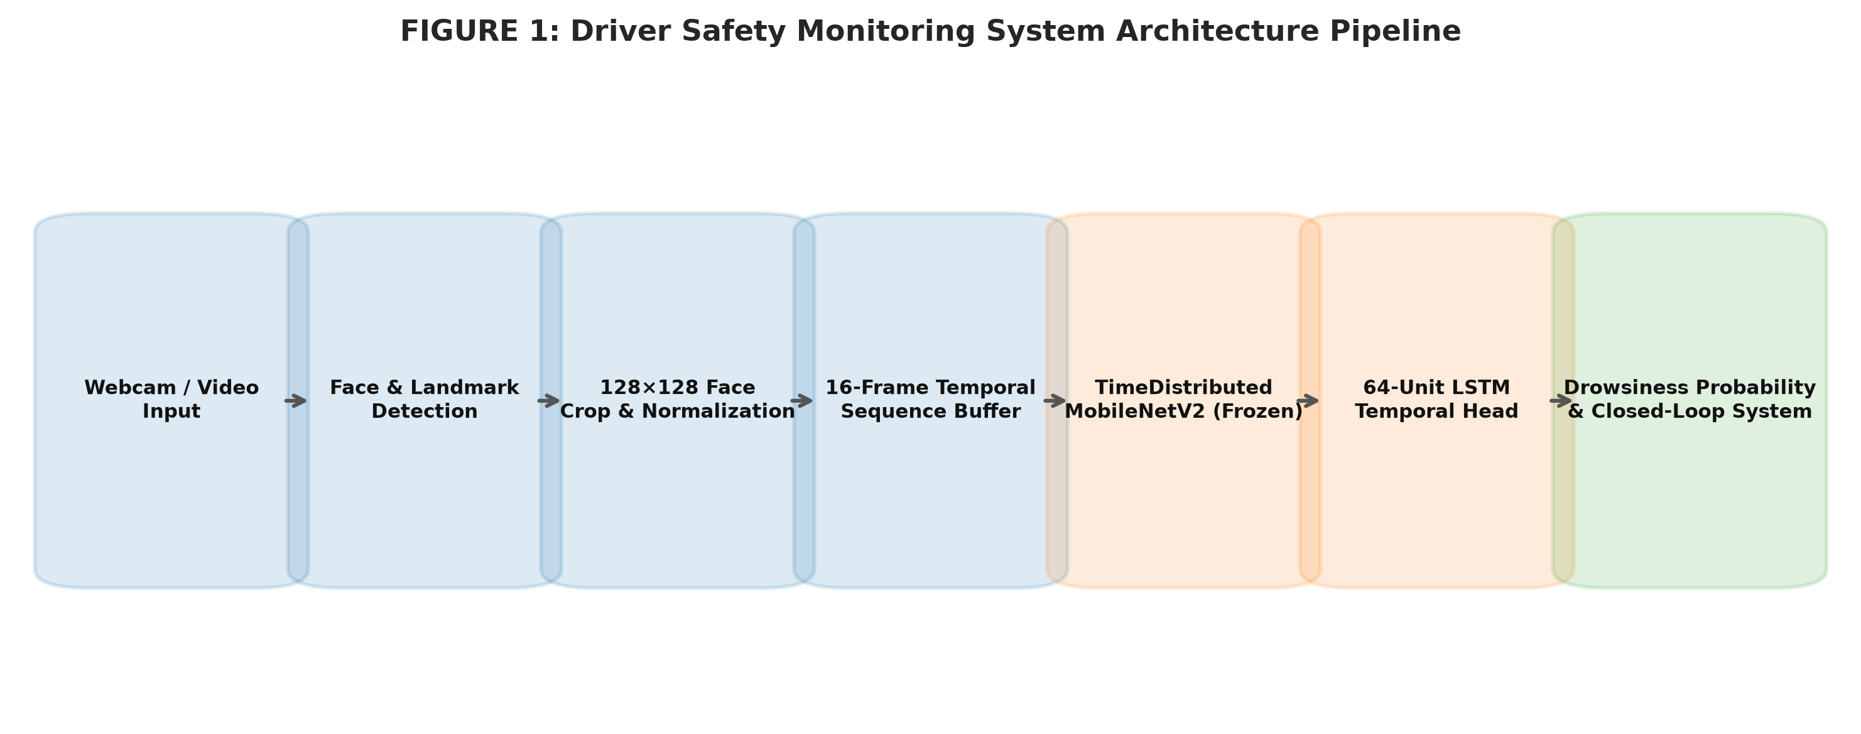
DRIVER SAFETY MONITORING
End-to-End System Architecture
Pipeline Flow Summary:
Camera Input -> Face Detection -> 16-Frame Sequence Buffer -> CNN-LSTM Model -> Raw Probability -> 5-Window Temporal Smoothing -> Closed-Loop State Machine -> Intervention & Recovery Verification
Research Prototype — Not a Vehicle Control System | Final Presentation
Notes:
WHAT TO SAY (20-40s):
The end-to-end system receives camera input, maintains a 16-frame rolling buffer, computes smoothed probabilities, and manages state transitions.
KEY POINT:
Real-time modular architecture.
POTENTIAL EXAMINER QUESTION:
Why apply temporal probability smoothing?

Slide 8
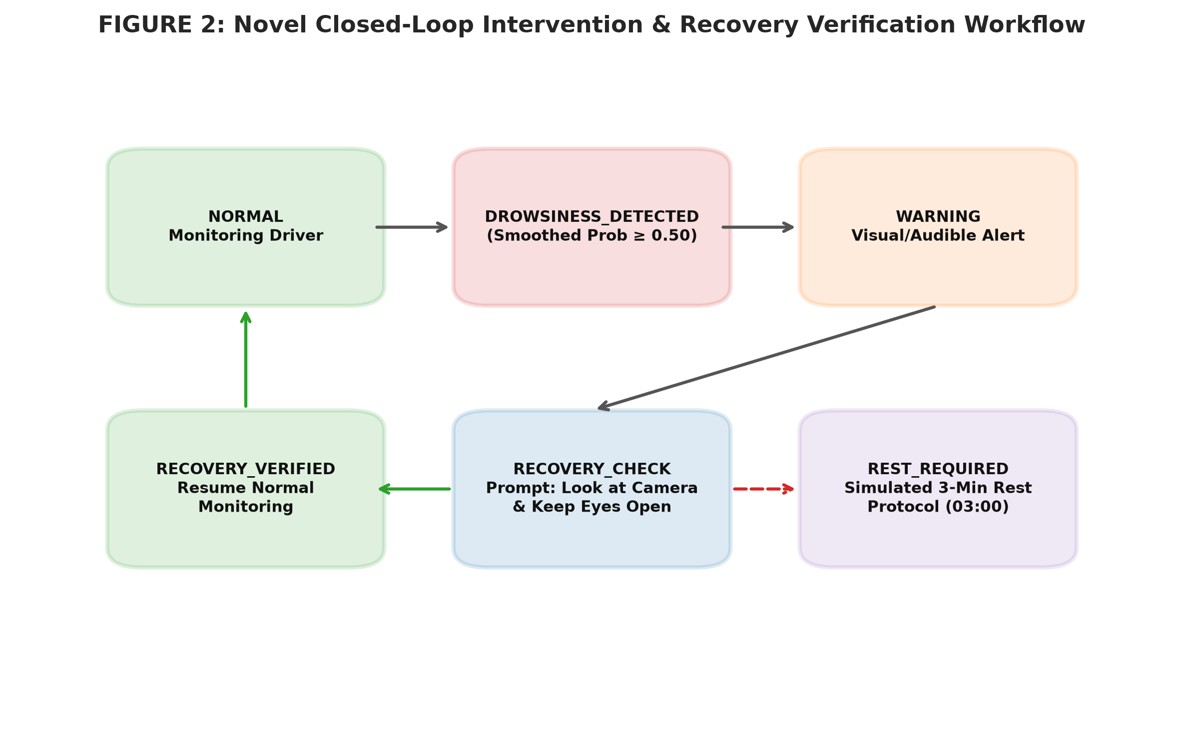
DRIVER SAFETY MONITORING
Core Novelty: Closed-Loop Intervention & Recovery Verification
WORKFLOW STAGES
• WARNING State: Visual/audible pull-over alert issued after 3 consecutive high-probability predictions.
• RECOVERY CHECK: Prompts: 'Look at camera & keep eyes open'. Evaluates face presence and eye stability over 3s.
• RECOVERY VERIFIED: Returns system to NORMAL monitoring upon verified wakefulness.
• SAFETY REST PROTOCOL: Simulated 3-minute rest countdown (03:00) if verification fails.
• Manual Emergency Alert: Operator override button / 'E' key press logged to demo_events.csv.
Research Prototype — Not a Vehicle Control System | Final Presentation
Notes:
WHAT TO SAY (20-40s):
Our novelty transitions the system from passive classification to active intervention and verification, requiring driver wakefulness confirmation before resuming.
KEY POINT:
Closed-loop workflow is the core project contribution.
POTENTIAL EXAMINER QUESTION:
What happens if recovery verification fails?

Slide 9
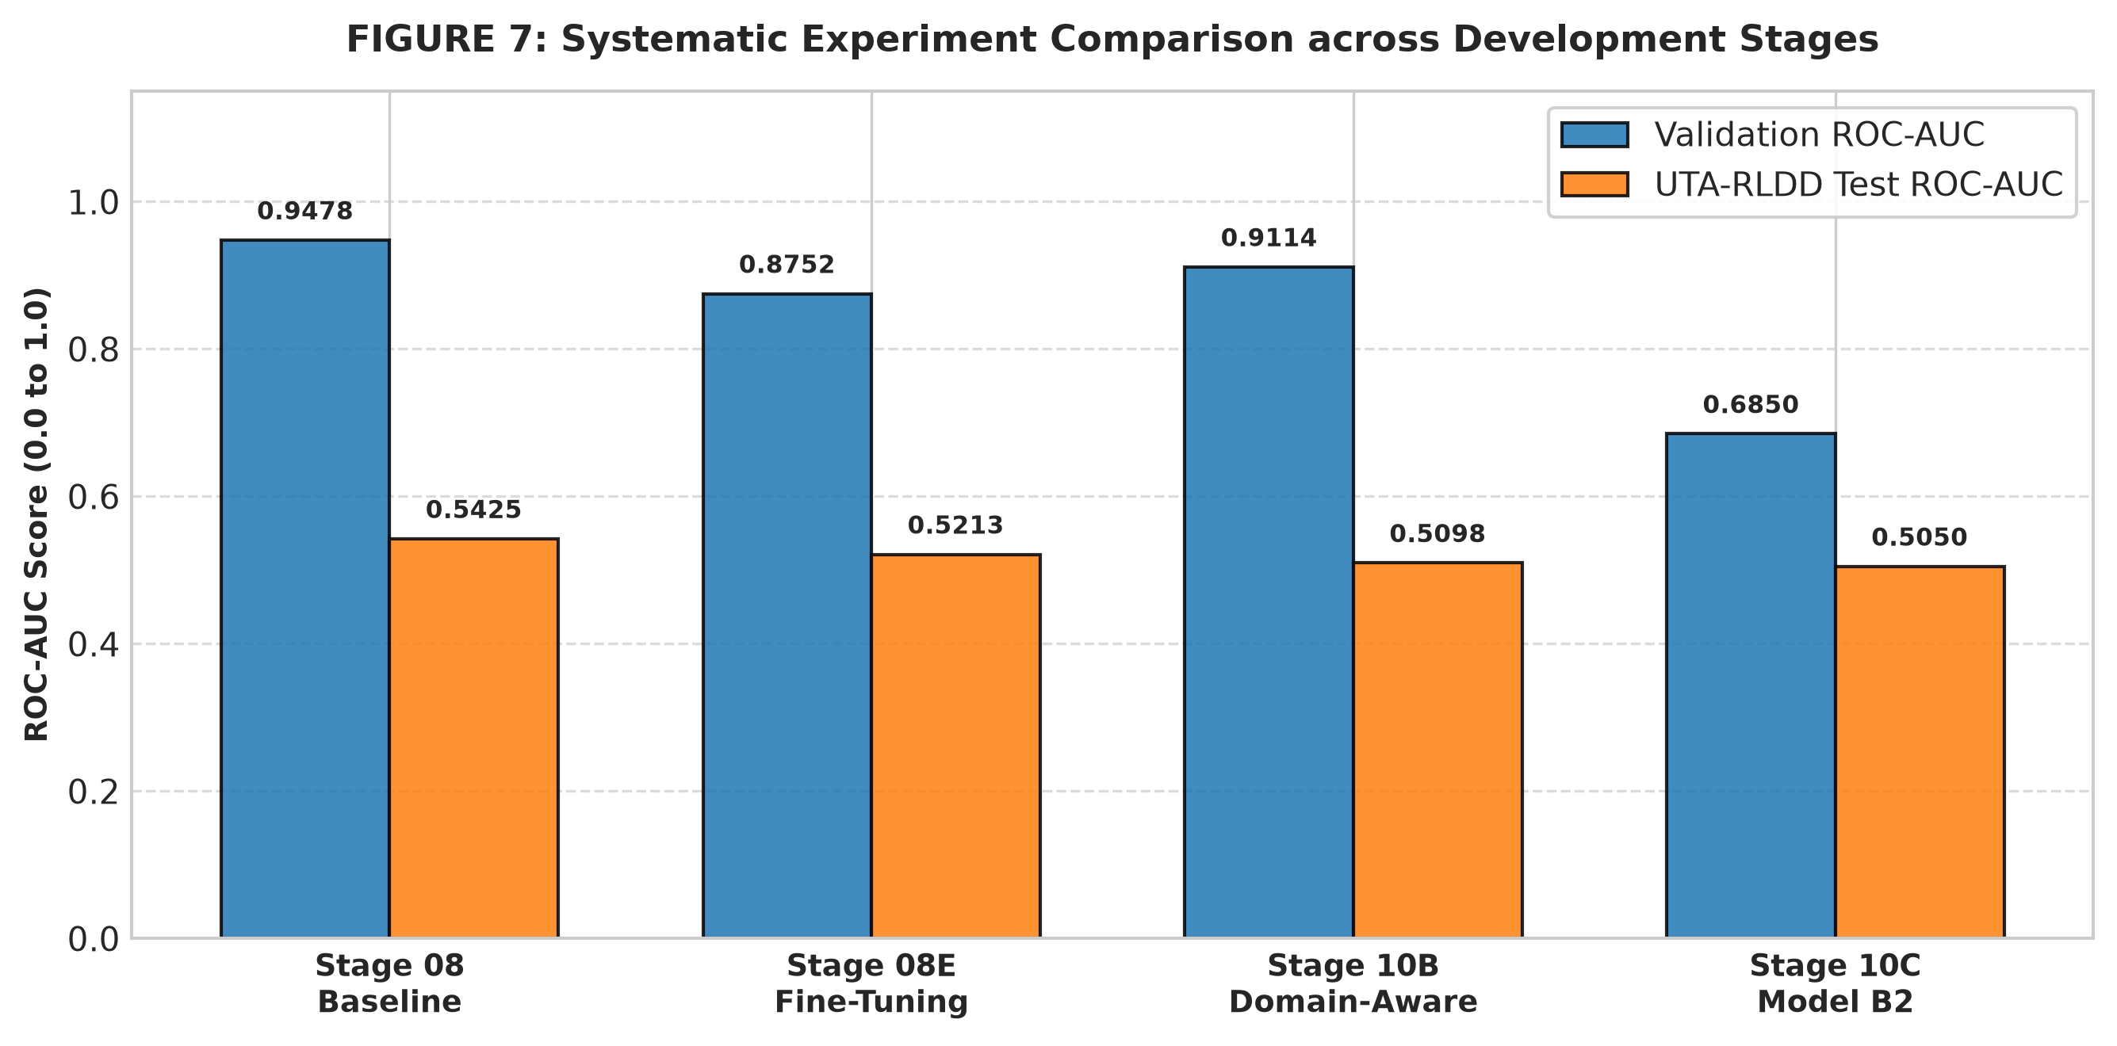
DRIVER SAFETY MONITORING
Experimental Progression Across Development Stages
EXPERIMENTAL HIGHLIGHTS
• Stage 08 Baseline: MobileNetV2 + LSTM frozen model (Val AUC: 0.9479).
• Stage 08E Fine-Tuning: Unfroze top 25 layers; observed severe P07 participant inversion (AUC 0.0339).
• Stage 10A Domain Audit: Identified 46.7-point luminance gap between NITYMED & UTA-RLDD.
• Stage 10B Domain Training: Color jitter reduced UTA FPR to 60.30% but did not resolve CNN feature shift.
• Stage 10C Domain Adaptation: Sequence norm (A3) reduced FPR to 25.40% but degraded Val AUC to 0.6850.
• Stage 11 Model Selection: Decision: KEEP BASELINE to preserve uncorrupted reproducibility.
Research Prototype — Not a Vehicle Control System | Final Presentation
Notes:
WHAT TO SAY (20-40s):
We conducted systematic experiments unfreezing layers and applying color jitter, retaining the baseline to preserve uncorrupted reproducibility.
KEY POINT:
Evidence-driven model evaluation.
POTENTIAL EXAMINER QUESTION:
Why did you keep the baseline instead of a fine-tuned model?

Slide 10
DRIVER SAFETY MONITORING
Empirical Baseline Results & Metrics
0.947850
Validation ROC-AUC
0.542460
UTA Test ROC-AUC
0.765152
UTA Test F1-Score
69.02%
UTA Test FPR (t=0.5)
0.638542
Combined Test ROC-AUC
100.00%
NITYMED Test Recall
Research Prototype — Not a Vehicle Control System | Final Presentation
Notes:
WHAT TO SAY (20-40s):
Our model achieved 0.9479 validation ROC-AUC and 100% NITYMED recall. External UTA testing yielded 0.5425 ROC-AUC, reflecting domain distribution differences.
KEY POINT:
Transparent distinction between validation and external test metrics.
POTENTIAL EXAMINER QUESTION:
Why is external UTA ROC-AUC lower than validation?

Slide 11
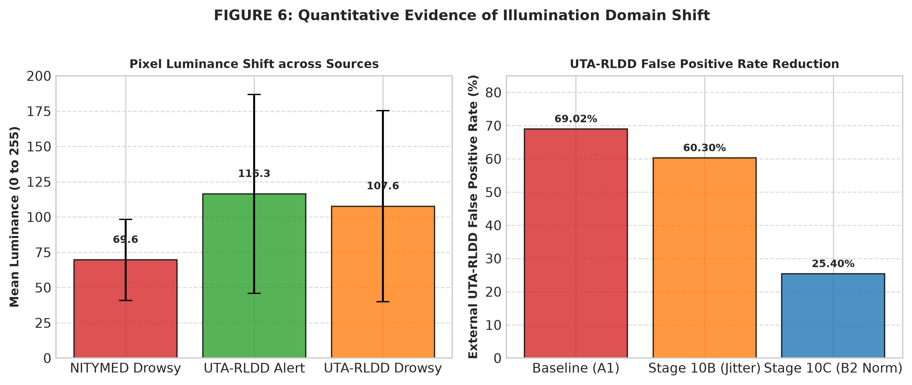
DRIVER SAFETY MONITORING
Domain Shift Investigation & Findings
KEY DOMAIN SHIFT FINDINGS
• Illumination Gap: NITYMED mean luminance is 69.60, whereas UTA-RLDD Alert mean luminance is 116.34 (46.7 point shift).
• CNN Brightness Sensitivity: Frozen ImageNet CNN features extract overall background brightness, causing elevated probabilities on bright sequences.
• Participant Sensitivity: Participants P04 and P07 exhibited contrasting behavior, with P07 suffering complete feature inversion in fine-tuned models.
• Scientific Conclusion: The experiments indicate substantial cross-domain generalization challenges that require multi-modal feature fusion.
Research Prototype — Not a Vehicle Control System | Final Presentation
Notes:
WHAT TO SAY (20-40s):
Domain audit revealed a 46.7-point luminance shift between datasets, causing frozen CNN features to elevate under bright lighting.
KEY POINT:
Illumination and camera setup drive cross-domain variation.
POTENTIAL EXAMINER QUESTION:
Did you solve domain shift?

Slide 12
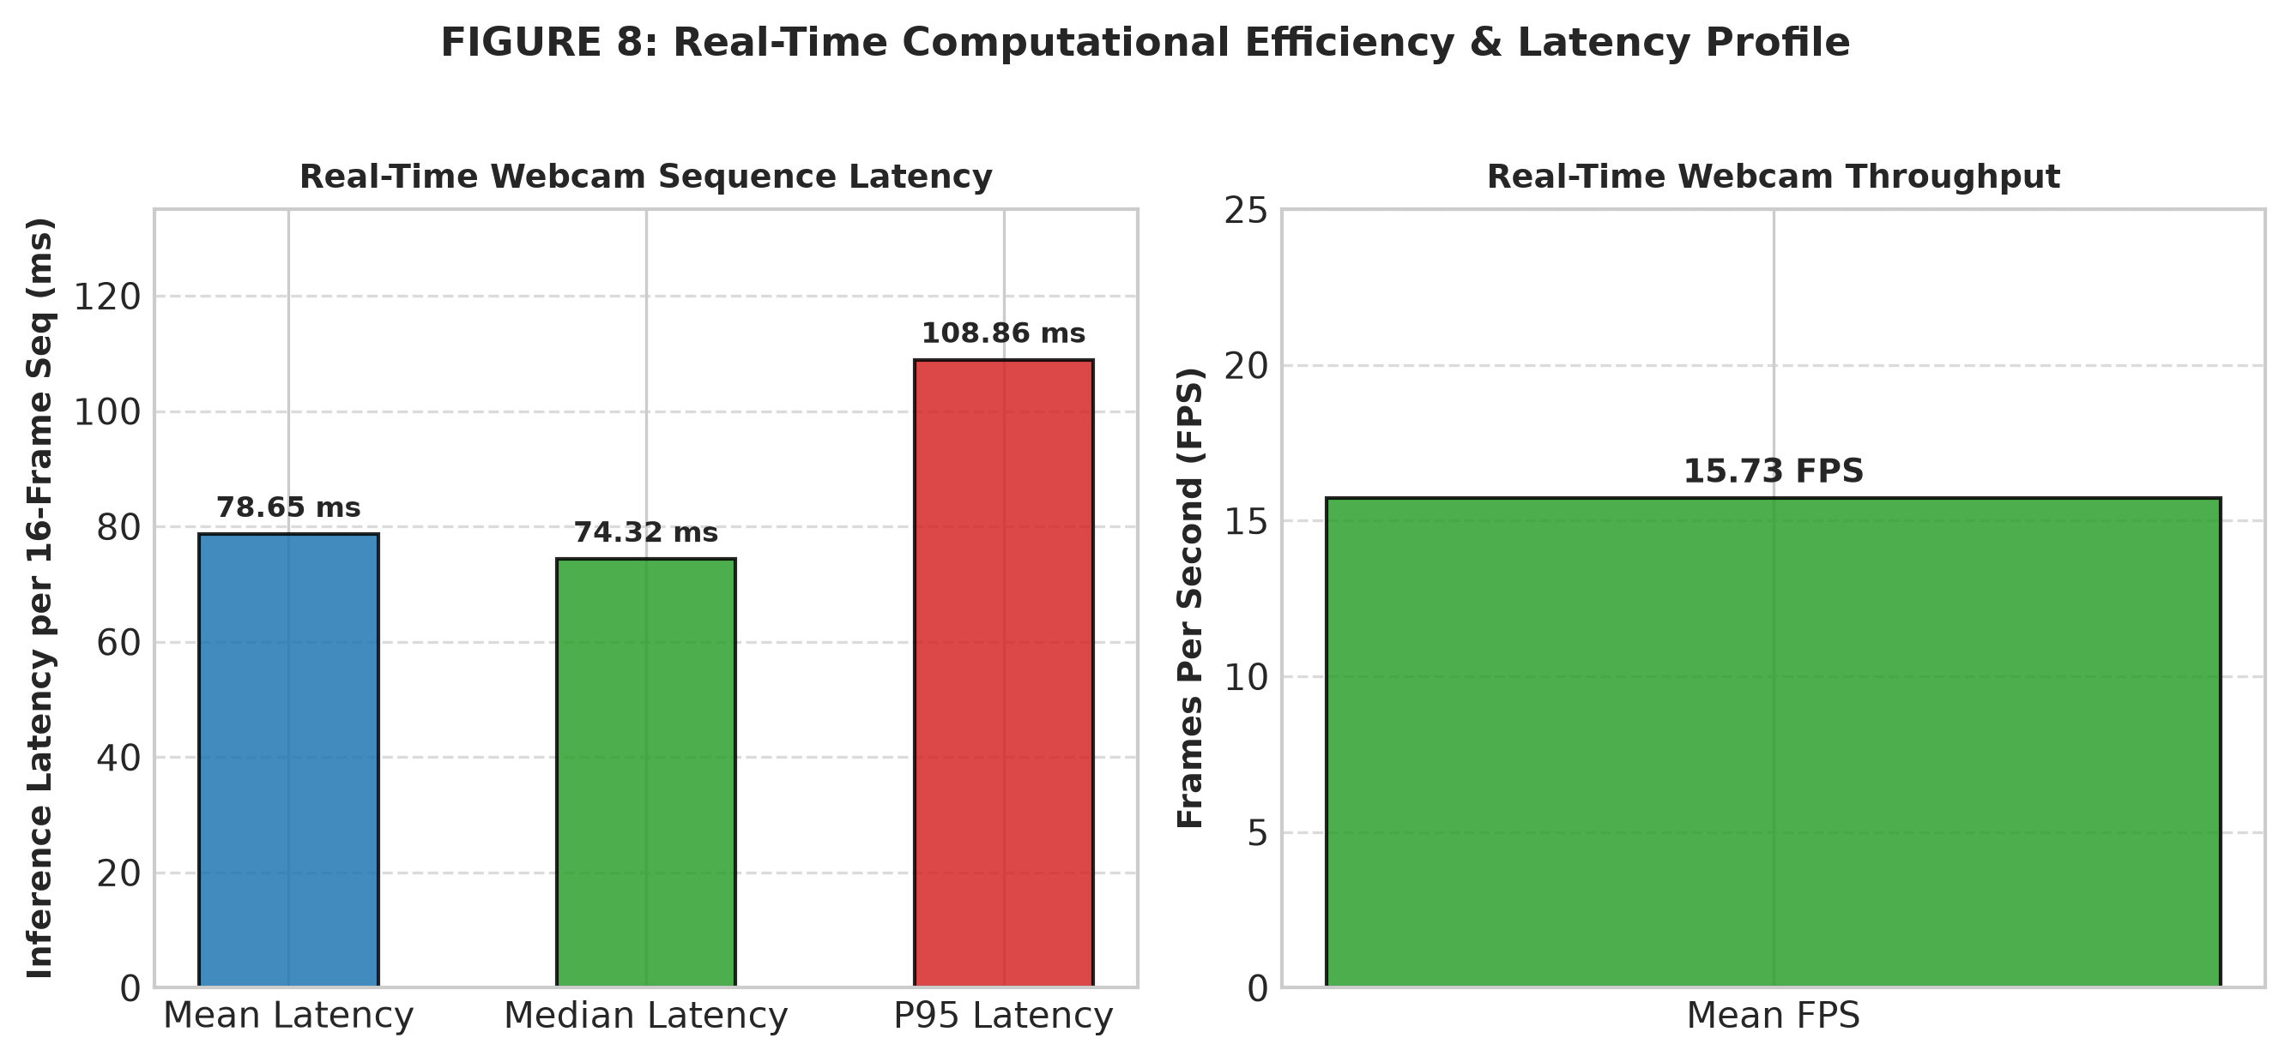
DRIVER SAFETY MONITORING
Real-Time Inference Performance & Final Checks
78.65 ms
Mean Sequence Latency (P95: 108.86 ms | Throughput: 15.73 FPS)
AUTOMATED SYSTEM CHECKS (17/17 PASSED)
✓ Webcam Stream: PASS
✓ Face Detection: PASS
✓ Temporal Inference: PASS
✓ State Machine: PASS
✓ Event Logging: PASS
✓ Performance Metrics: PASS
Research Prototype — Not a Vehicle Control System | Final Presentation
Notes:
WHAT TO SAY (20-40s):
Real-time benchmarking on native CPU achieved 78.65 ms sequence latency and 15.73 FPS, passing all 17 automated system checks.
KEY POINT:
Edge-compatible CPU execution speed.
POTENTIAL EXAMINER QUESTION:
Can 78.65 ms sequence latency support real-time execution?

Slide 13
DRIVER SAFETY MONITORING
Final Real-Time Demonstration & UI Dashboard
DEMONSTRATION FEATURES & DASHBOARD PANELS
• Dual-Panel Interface: Left Panel: Live video feed with face bounding box. Right Panel: Real-time status dashboard.
• Dashboard Fields: Displays System State, Smoothed Probability %, Face Detection Status, Temporal Buffer (XX/16), Latency, FPS.
• State Progression Flow: NORMAL -> DROWSINESS DETECTED -> WARNING -> RECOVERY CHECK -> RECOVERED / REST REQUIRED
• Presentation Demo Mode: Press 'M' key to toggle Demo Simulation Mode for clean presentation testing without fake random model probability hacks.
• Safety Disclaimer Banner: Always displays 'Research Prototype — Not a Vehicle Control System' on lower panel.
Research Prototype — Not a Vehicle Control System | Final Presentation
Notes:
WHAT TO SAY (20-40s):
Our live demonstration presents a dual-panel dashboard featuring real-time probabilities, state banners, interactive recovery checks, and manual alert logging.
KEY POINT:
Functional software prototype demonstration.
POTENTIAL EXAMINER QUESTION:
Is this connected to vehicle control hardware?

Slide 14
DRIVER SAFETY MONITORING
Research Limitations & Future Directions
DOCUMENTED LIMITATIONS
• Cross-domain shift degrades UTA-RLDD ROC-AUC (0.5425)
• High UTA-RLDD false positive rate (69.02% at t=0.5)
• Raw webcam probability saturation near 1.0
• Participant-specific feature inversion on P07
• Software prototype (no vehicle control/CAN bus connection)
• No clinical wakefulness or medical diagnosis claimed
FUTURE RESEARCH DIRECTIONS
• Multi-source training on larger diverse driving datasets
• Subject-independent Leave-One-Group-Out benchmarking
• Domain-Adversarial Neural Networks (DANN) feature alignment
• Dynamic local adaptive illumination normalization (CLAHE)
• Deep probability fusion with Eye Aspect Ratio (EAR) landmarks
• Edge hardware deployment (NVIDIA Jetson Nano) with IR camera
Research Prototype — Not a Vehicle Control System | Final Presentation
Notes:
WHAT TO SAY (20-40s):
We explicitly document 10 operational limitations and outline future work including domain-adversarial networks and multi-modal landmark fusion.
KEY POINT:
Honest research disclosure and future roadmap.
POTENTIAL EXAMINER QUESTION:
How would you reduce false positive rates in future work?

Slide 15
DETECTION IS ONLY THE FIRST STEP
MobileNetV2 + LSTM Architecture + Real-Time Monitoring
+ Closed-Loop Intervention + Recovery Verification
The research prototype demonstrates an end-to-end safety-oriented workflow while explicitly identifying cross-domain generalization as a key limitation and future research direction.
THANK YOU!
QUESTIONS & ANSWERS
Notes:
WHAT TO SAY (20-40s):
To conclude, detection alone is insufficient; our prototype closes the loop by intervening and verifying recovery before resuming monitoring. Thank you.
KEY POINT:
End-to-end closed-loop driver safety monitoring system.
POTENTIAL EXAMINER QUESTION:
What is the single most important takeaway from your project?

