Slide 1
Green Campus Carbon Footprint & Energy Audit Tracker
DBMS (BACSE202), Review 3
0
4
7
7
4
5
5
kg CO₂e logged across our six sample buildings, 1 to 3 September 2026
From an ER diagram to a working app on MySQL
Abitha Laxmi P 25BCE0535
Vishnunarayan Praveen 25BCE0761
Daksh Bharath Singoor 25BDS0319
Department of Computer Science and Engineering
github.com/abitha7-glitch/green_campus_tracker
Notes:
Presenter: Abitha
Good morning. We are presenting Review 3 of our DBMS project, the Green Campus Carbon Footprint and Energy Audit Tracker.
The number on the right is the total carbon our database has calculated from the 15 sample readings: 47,745.5 kg of CO2 equivalent. Every one of those kilograms was worked out by a trigger, not typed in by us. Today we'll show the application that sits on top of that database and then demo it live.

Slide 2
Three reviews, one database
0
2
1
2
3
Review 1
5 Oct 2026
Review 2
12 Oct 2026
Review 3
26 Oct 2026
Problem, objectives, 7 entities, 6 relationships, ER diagram
Tables, keys, constraints, CO₂e trigger, sample data, queries and two views
A web app on the same database: CRUD, search, reports, validation, 30 tests
The seven tables from Review 2 did not change. Review 3 adds one trigger, one stored procedure and the application.
Notes:
Presenter: Abitha
Quick recap of where we are. In Review 1 we analysed the problem and drew the ER diagram. In Review 2 we turned it into seven MySQL tables with constraints, a trigger that calculates CO2e, sample data, queries and views.
Review 3 is the working prototype. The important point is that the schema stayed the same, so the ER diagram, the relational schema and the actual database are still consistent, which the guidelines ask for.

Slide 3
What Review 3 asks for, and where we show it
0
3
Simple user interface
slide 5
Input validation
slide 12
✓
✓
Database connectivity
slide 6
Test cases
slide 13
✓
✓
CRUD operations
slide 7, 8
Final database
slide 14
✓
✓
Search and retrieval
slide 9
Final project report
report
✓
✓
SQL queries through the app
slide 10, 11
Complete flow, live
slide 15
✓
✓
Notes:
Presenter: Abitha
This is the Review 3 checklist from the project instructions, and the slide where each item is covered, so you can check them off as we go. The final report has the same table on its first page.

Slide 4
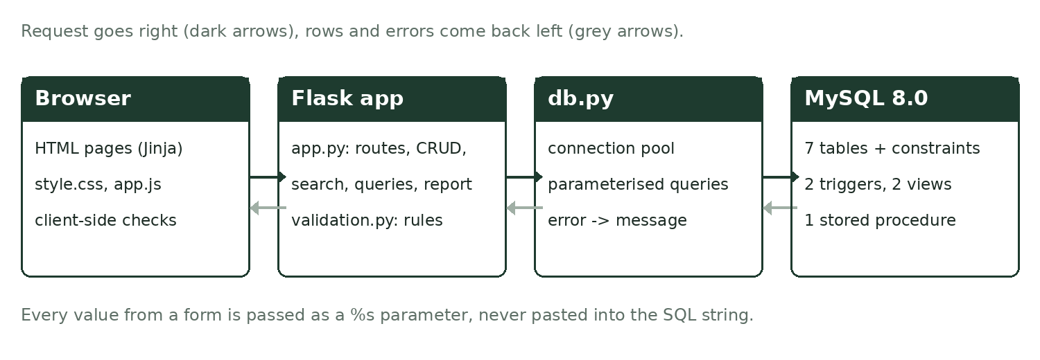
How the app is put together
0
4
Plain SQL
No ORM. Every query in app.py can be read and explained line by line.
Small
About 750 lines of Python across app.py, db.py and validation.py.
Same files as the report
The SQL queries page reads sql/03_queries.sql directly.
Notes:
Presenter: Abitha
The app has three layers. The browser shows HTML pages with a bit of JavaScript for checks. Flask, a small Python web framework, receives each request, validates the input and runs the SQL. MySQL stores everything and enforces the constraints.
We chose Flask because the whole thing is small enough to explain in a viva, and the SQL stays visible. There is no ORM hiding the queries.

Slide 5
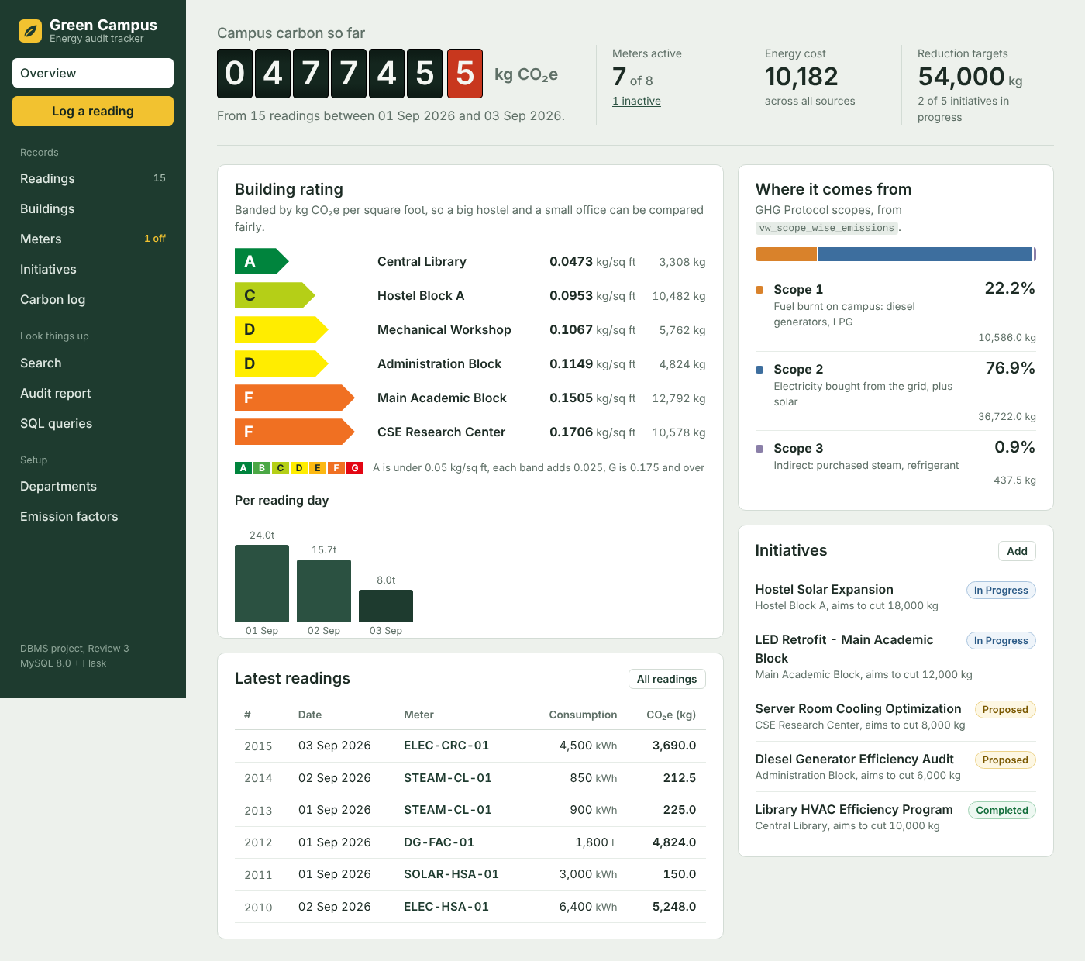
The interface
0
5
4
5
Meter counter
The campus total is shown like the digits on an electricity meter, tenths in red.
Building rating, A to G
Banded by kg CO₂e per sq ft, like an appliance energy label. Reads vw_building_carbon_summary.
One colour per scope
Scope 1, 2 and 3 keep the same colour on every page.
Notes:
Presenter: Abitha
This is the overview page. Three things on it come from the subject itself.
The total at the top is drawn like a real electricity meter. The building rating uses the A to G colours from appliance energy labels; the band is based on kg CO2e per square foot so a big hostel and a small office can be compared fairly. The CSE Research Center gets an F even though Main Academic Block emits more in total, because it is smaller.
And Scope 1, 2 and 3 always have the same colours, so you can read the source of emissions at a glance. The layout also works on a phone.
[Hand over to Vishnunarayan]

Slide 6
Connecting to MySQL
0
6
Login details live in config.py
Or in environment variables, so nobody's password is in the code.
Every form value is a %s parameter
MySQL gets the value apart from the SQL, so typing ' OR 1=1 -- into a field can't change the query.
# db.py: five connections, reused
pool = MySQLConnectionPool(
pool_size=5, host=..., user=...,
database="green_campus_db")
# app.py: values go separately
INSERT INTO energy_readings
(reading_id, meter_id, reading_date,
consumption_value, cost_incurred)
VALUES (%s, %s, %s, %s, %s)
MySQL error | What the user reads
1062 duplicate entry | 'ELEC-MAB-01' is already in use
1451 parent still used | other records still point to it
1452 parent missing | the record you linked to doesn't exist
3819 CHECK failed | breaks a CHECK rule
1265 bad ENUM | not one of the allowed options
Connection pool and parameterised insert, shortened from db.py and app.py
Notes:
Presenter: Vishnunarayan
The app connects with mysql-connector-python. Opening a connection for every page is slow, so we keep a pool of five and reuse them.
The important part is the second block. We never paste user input into the SQL string. The values are sent as parameters, separately from the statement, which is what stops SQL injection.
When MySQL rejects something, we don't show the raw error. The table on the right shows how each error code is turned into a sentence the user can act on.

Slide 7
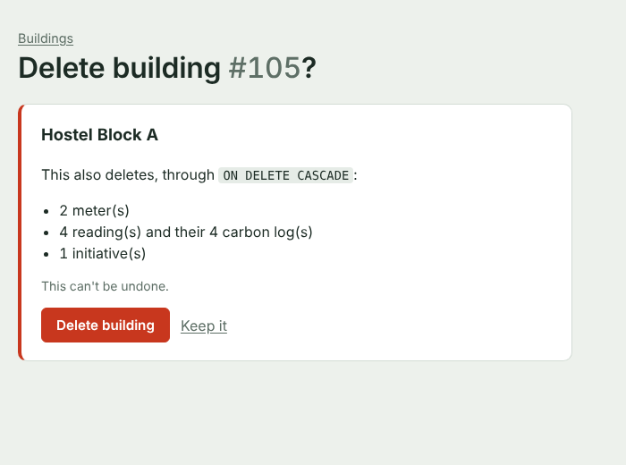
Create, read, update, delete on six tables
0
7
Table | Create | Read | Update | Delete
departments | ✓ | ✓ | ✓ | SET NULL
buildings | ✓ | ✓ | ✓ | CASCADE
emission_factors | ✓ | ✓ | ✓ | RESTRICT
meters | ✓ | ✓ | ✓ | CASCADE
energy_readings | trigger | ✓ | trigger | CASCADE
audit_initiatives | ✓ | ✓ | ✓ | ✓
carbon_logs | trigger only | ✓ | trigger only | via cascade
Before any delete, the app counts what ON DELETE CASCADE will remove
carbon_logs is never edited by hand. Only the two triggers write to it.
Notes:
Presenter: Vishnunarayan
Six tables have full create, read, update and delete from the browser. carbon_logs is the exception on purpose: only the triggers write to it.
The Delete column shows the foreign key rule from Review 2. Deleting never happens in one click. First a confirmation page counts what else will go, for example deleting Hostel Block A also removes 2 meters, 3 readings, 3 carbon logs and 1 initiative. Deleting an emission factor that meters still use is refused by MySQL because that key is RESTRICT. We'll show both in the demo.

Slide 8
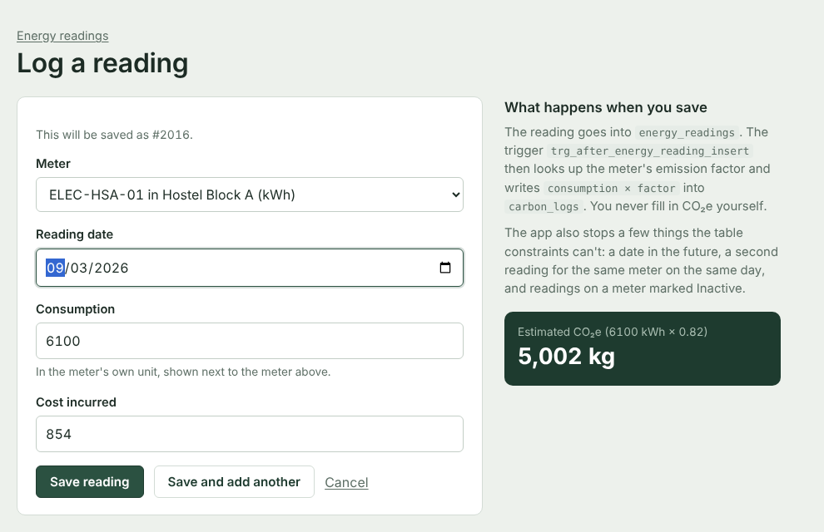
Saving a reading fires the trigger
0
8
5,000 kWh × 0.82
= 4,100 kg CO₂e
AFTER INSERT looks up the meter's emission factor and writes consumption × factor into carbon_logs.
New: AFTER UPDATE recalculates the log when a reading's value or meter is corrected. Changing a factor leaves old logs alone, they are the audit record.
The box on the right of the form estimates the value; the trigger writes the real one
Notes:
Presenter: Vishnunarayan
When a reading is saved, the insert trigger from Review 2 looks up the factor for that meter and writes the CO2e into carbon_logs. For example 5,000 kWh of grid electricity times 0.82 gives 4,100 kg. After saving, the app reads that row back and shows it in the confirmation message, so you can see the trigger worked.
Review 3 needed one new trigger. Once readings could be edited, the old log value would have been wrong, so trg_after_energy_reading_update recalculates it, but only when the consumption or the meter changes. If an emission factor is revised later, old logs stay as they were, which is the audit-record decision from Review 2.

Slide 9
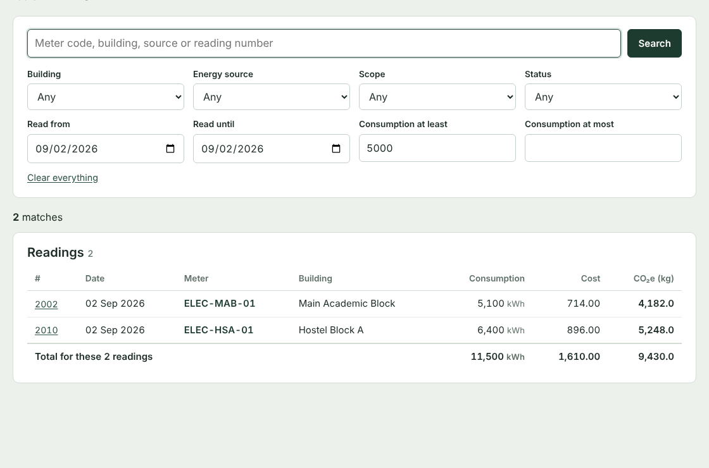
Search and retrieval
0
9
Filters, all optional
Text
Building
Energy source
Scope
Status
Date range
Consumption range
Each filled filter adds one more condition to the WHERE clause, as a parameter.
Example on the left: readings on 2 Sep with consumption of at least 5,000 gives readings 2002 and 2010, with totals underneath.
Notes:
Presenter: Vishnunarayan
The search page looks across buildings, meters, readings and initiatives at the same time. The text box uses LIKE on meter codes, building names, sources and titles. Each filter that is filled in adds one more condition to the WHERE clause, again as a parameter.
Under the readings it adds up consumption, cost and CO2e. Consumption is only added when all the units are the same, otherwise it says mixed units, the same point we made in Review 2 about adding kWh and litres.

Slide 10
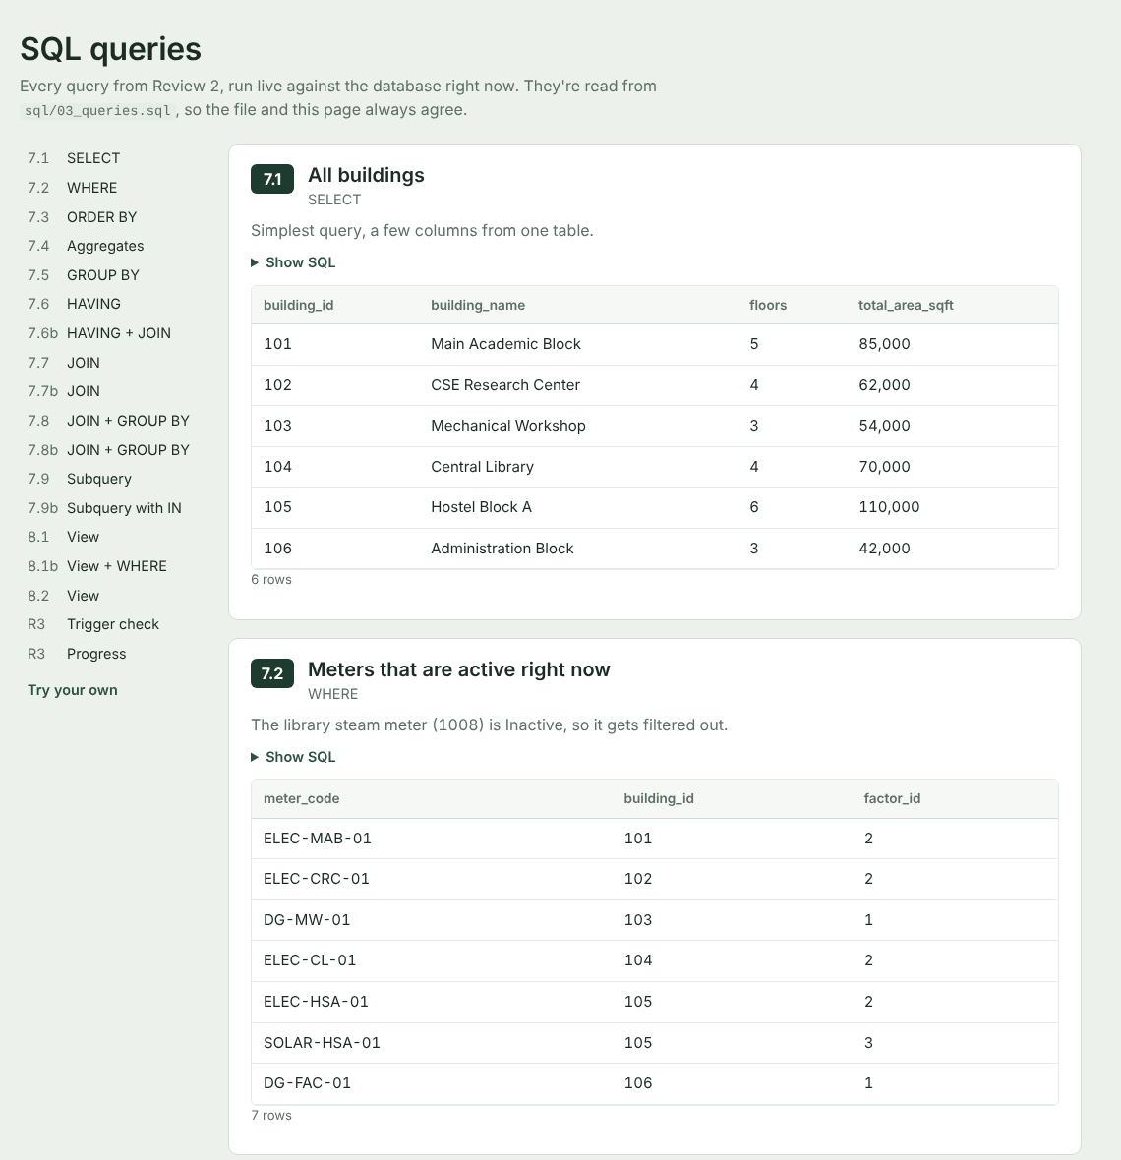
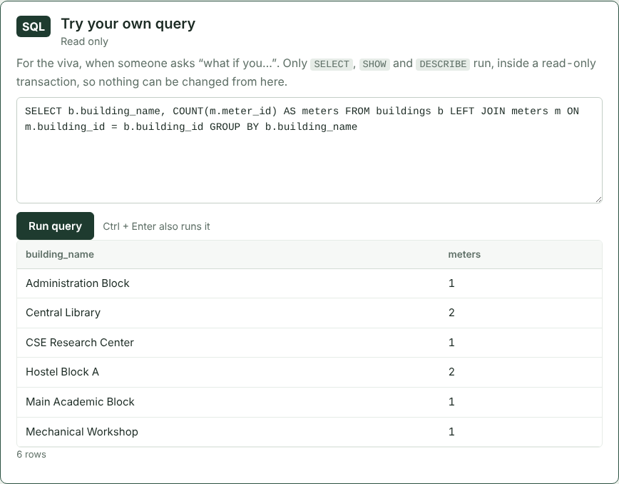
Every Review 2 query, run live
1
0
Useful when someone asks “what if you…”
Read from sql/03_queries.sql
So the page always matches the file we submit. Sections 7.1 to 8.2 plus two new checks.
A box for our own SELECT
Runs inside START TRANSACTION READ ONLY, so nothing can be changed from it.
Notes:
Presenter: Vishnunarayan
All the queries from Review 2, SELECT, WHERE, ORDER BY, aggregates, GROUP BY, HAVING, joins, subqueries and the two views, run live on one page with their results. The page reads them straight from our SQL file, so what we submit and what we show are the same.
At the bottom there's a box where we can type our own SELECT. It refuses anything that could change data, and it also runs inside a read-only transaction, so even if something slipped through, MySQL itself would refuse to write. If you'd like to ask a question of the data during the demo, we can answer it there.

Slide 11
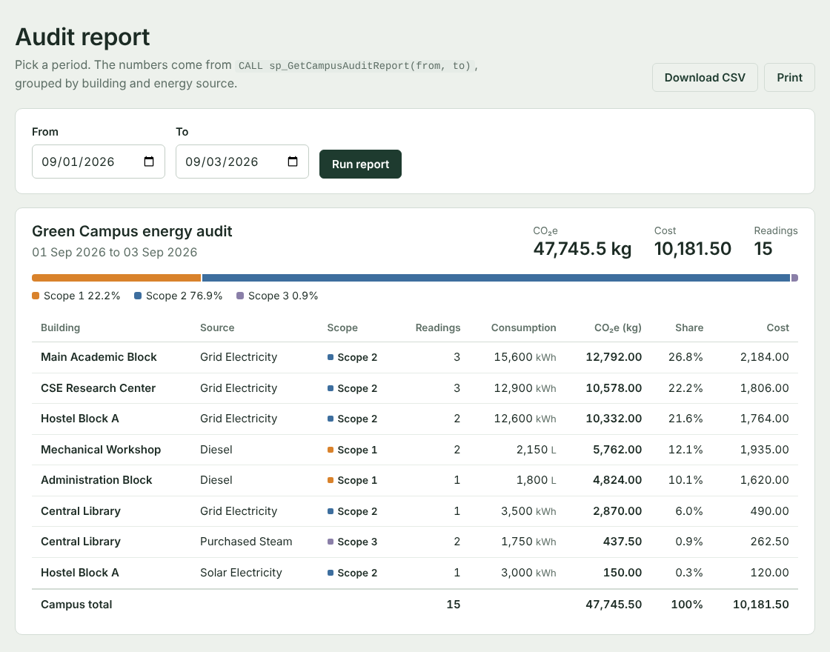
Audit report from a stored procedure
1
1
CALL sp_GetCampusAuditReport(
'2026-09-01', '2026-09-03');
47,745.5 kg
Same total as Review 2
Scope 2 76.9%
Scope 1 22.2%
Scope 3 0.9%
Groups readings in a date range by building and source. The page adds shares, prints cleanly and downloads as CSV.
Notes:
Presenter: Vishnunarayan
In our Review 1 slides we showed a stored procedure for an audit report. For Review 3 we actually wrote it. sp_GetCampusAuditReport takes a start and end date and groups the readings by building and energy source, joining five tables.
The report page calls it, adds each row's share and the split by scope, and can be printed or downloaded as a CSV. For the full sample period it gives 47,745.5 kg, with grid electricity, Scope 2, at about 77 percent, which matches Review 2.
[Hand over to Daksh]

Slide 12
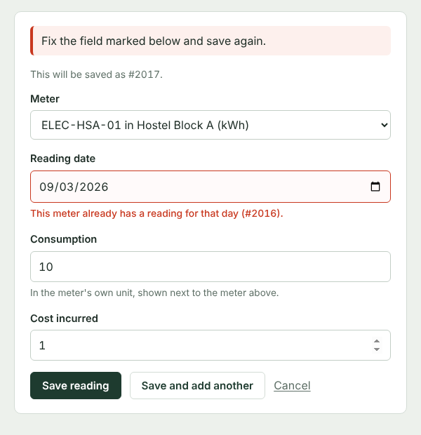
Input is checked three times
1
2
Browser app.js
Empty fields, negative numbers, wrong email, future dates, end date before start
Server validation.py
All of that again, plus duplicates, missing parents, one reading per meter per day, inactive meters
MySQL 01_schema.sql
PRIMARY KEY, FOREIGN KEY, UNIQUE, CHECK, ENUM, NOT NULL
Caught by the server: meter 1005 already has a reading on 3 Sep
Notes:
Presenter: Daksh
Every input is checked three times. The browser catches obvious mistakes before anything is sent. The server checks again, because browser checks can be switched off, and adds checks that need the database, like duplicates.
Three rules exist only in the app because a CHECK constraint can't look at other rows or today's date: no readings in the future, one reading per meter per day, and no new readings on an inactive meter.
The bottom layer is MySQL itself with the constraints from Review 2. The database always has the final say.

Slide 13
30 test cases, all passing
1
3
30/30
python -m pytest -v
Before every test the test database is rebuilt from the same two SQL files, so each one starts from the Review 2 data and nothing touches the real database.
Full table with inputs and expected results: report section 9
Notes:
Presenter: Daksh
We wrote the test cases as automated tests with pytest. There are 30, and all of them pass. Before each test the test database is rebuilt from our SQL files, so tests can't affect each other or the real data.
The biggest groups are input validation and the six raw SQL tests, which repeat the negative tests from Review 2 section 4.1 directly against MySQL, without the app, to show the constraints still hold on their own. The full list with inputs and expected results is in section 9 of the report.

Slide 14
The final database
1
4
7
tables
6
foreign keys
2
triggers
2
views
1
stored procedure
58
sample rows
New since Review 2
trg_after_energy_reading_update
sp_GetCampusAuditReport
Still consistent
Same seven entities, keys, names and ON DELETE rules as the ER diagram and the Review 2 schema.
Two files rebuild it from scratch: sql/01_schema.sql then sql/02_seed.sql. Safe to run again after the demo.
departments
buildings
emission_factors
meters
energy_readings
carbon_logs
audit_initiatives
carbon_logs (dark) is filled only by the triggers
Notes:
Presenter: Daksh
The final database has the same seven tables and six foreign keys, two triggers, two views and one stored procedure, with 58 sample rows. The two objects in red are new for Review 3. No table changed, so the ER diagram, the schema and the actual database still match.
The whole database can be rebuilt from two SQL files, which is also how we reset it after the demo.

Slide 15
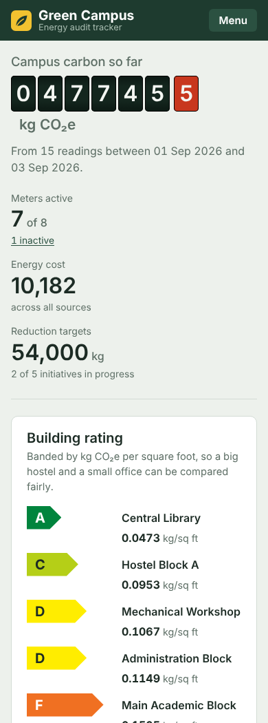
Live demo
1
5
1
Overview
meter counter, rating, scopes
6
Search
2 Sep, consumption 5,000 or more
2
Log a reading
6,100 kWh on ELEC-HSA-01
7
Queries
one typed live in the console
3
Break the rules
-50, tomorrow, same day twice
8
Audit report
1 to 2 Sep, download CSV
4
Edit the reading
watch the carbon log change
9
Tests
python -m pytest -v
5
Delete
Hostel Block A, then Grid Electricity
Works on a phone too
Notes:
Presenter: Daksh (driving the laptop), all three explain their own parts
1. Abitha: overview page.
2-4. Vishnunarayan: log a reading, show the confirmation with the CO2e from the trigger. Try -50, tomorrow's date, and a second reading for the same meter on the same day. Then edit the reading and open the carbon log.
5. Vishnunarayan: delete page for Hostel Block A (show the cascade list, click Keep it), then try deleting Grid Electricity to show RESTRICT.
6-8. Daksh: search, SQL queries page and console, audit report and CSV.
9. Daksh: run the tests in the terminal.
After the demo: python init_db.py to reset the data.

Slide 16
Thank you. Questions?
1
6
What we'd add with more time
Code, SQL and tests
Logins, so only facilities staff can delete records
Readings pulled from smart meters through an API
A department_emails table for several contacts
Monthly trends once there's more than three days of data
github.com/abitha7-glitch/
green_campus_tracker
Report: Review3_Final_Report.docx
Abitha Laxmi P Vishnunarayan Praveen Daksh Bharath Singoor
Notes:
Presenter: Daksh
To sum up: the database from Review 2 now has a working application on top of it, with every Review 3 item covered and 30 tests passing. These are the things we'd add next, and the code is on GitHub at the link shown.
Thank you. We're happy to take questions, and we can run any query you'd like in the console.

