Slide 1

Automated Disease Prediction System
Using Machine Learning
Abit Mon Rajan
PG Scholar
Amal Jyothi College of Engineering,
Kanjirappally, Kerala
Dr. Bijimol T K
Assistant Professor
Amal Jyothi College of Engineering,
Kanjirappally, Kerala

Slide 2
Contents
Introduction
Literature Survey
Existing System
Proposed System
Methodology
Result and Discussion
Conclusion
References

Slide 3
INTRODUCTION
In this digital world, data is an asset, and enormous data was generated in all the fields. Data in the healthcare industry consists of all the information related to patients.
We were able to extract the necessary data for disease prediction due to the ongoing expansion of medical data. To determine whether a disease is present, these disease prediction models are essential.

Slide 4
INTRODUCTION
The accurate analysis of medical data, which has benefited from early patient care, has increased as a result of the expansion in data in the medical and healthcare fields.
Using machine learning, created a method to forecast diseases. These systems will output the potential disease that an individual may have based on their symptoms.
For the detection of the diseases we require machine learning techniques like Decision Tree, Random Forest, Naive Bayes and
K Nearest Neighbor(KNN).

Slide 5
Literature Survey
Title of Paper | Concept
Sayali Ambekar . Recommended Disease Risk Prediction and used a convolution neural network to perform the task. 2018 | He employed machine learning algorithms in his paper. He applied methods such as the CNN-UDRP algorithm, CNN-MDRP algorithm, Naive Bayes, K-Nearest Neighbor, and Decision Tree to the prediction of disease. The accuracy of the suggested system was 94.8%.
Pahulpreet Singh Kohli Suggested disease prediction by using applications and methods of machine learning 2018 | This paper focuses on the prognosis of diabetes, breast cancer, and heart disease. Logistic regression yields the highest accuracy rates, which are 95.71% for breast cancer, 84.42% for diabetes, and 87.12% for heart disease.

Slide 6
Title of Paper | Concept
Rati Shukla Suggested breast cancer detection and prediction 2018 | This paper focuses on prediction and detection of Breast cancer using Decision Tree, Support Vector Machine, Random Forest, Naive Bayes, Neural Network, and KNN machine learning. Support Vector Machine gives more accurate results than all other algorithms.
Senthilkumar Mohan Effective Heart Disease Prediction 2019 | This paper focuses on hybrid techniques in machine learning that can be used for effectively predicting heart disease using algorithms like Decision Tree, Support Vector Machine, Random Forest, Naïve Bayes, Neural Network and KNN The accuracy of this system is 88.47%.

Slide 7
Title of Paper | Concept
Dhiraj Dahiwade designed a model for prediction of the disease. 2019 | Designed a model for prediction of the disease using approaches of machine learning and used techniques like KNN and CNN. The accuracy of KNN is 95% and the accuracy of CNN is 98%

Slide 8
Existing System
In the existing system the data set is typically small, for patients and diseases with specific conditions. These systems are mostly designed for the more colossal diseases such as Heart Disease, Cancer etc.
The pre-selected characteristics may sometimes not satisfy the changes in the disease and its influencing factors which could lead to inaccuracy in results.

Slide 9
Proposed System
Proposing such a system which will provides a simple and elegant User Interface.
The accurate analysis of medical data, which has benefited from early patient care, has increased as a result of the expansion in data in the medical and healthcare fields.
Using machine learning, created a method to forecast diseases. These systems will output the potential disease that an individual may have based on their symptoms.

Slide 10
METHODOLOGY
Using the vivid features of the Machine Learning Algorithms using the script written in python language.
Requirements:
Python 3
tkinter
Numpy
pandas
sklearn

Slide 11
tkinter:
Standard GUI library.
Fast and easy way to create GUI
pandas :
Most popular python library used for data analysis.
Highly optimized performance with back-end source code purely written in C or python.

Slide 12
Numpy:
Core library of scientific computing.
Powerful tools to deal with various multi-dimensional arrays.
General purpose array processing package.
sklearn:
Open source python library with implements a huge range of machine learning, pre-processing, cross-validation and visualization algorithms.
Various simple and efficient tools for data mining and data processing

Slide 13
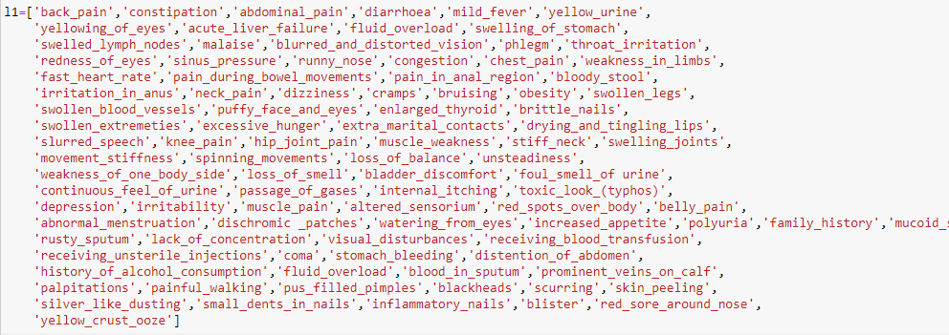
List of the symptoms used

Slide 14
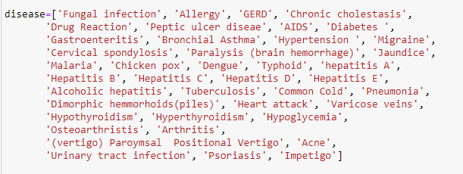
List of Diseases used

Slide 15
Four main types of models are used, involving
Decision tree
Random forest tree
Naive Bayes
KNN

Slide 16
Decision tree
Very effective and versatile classification technique.
Employed for classification in extremely complex problems.
Three parts root node, internal node and leaf node.
Get the user’s symptoms and put it in an array with the value assigned as 1 across these values.
Passed as an input to the model for predicting the disease.
This array matches the disease data collection and ends at a common leaf node with the highest degree of trust.

Slide 17
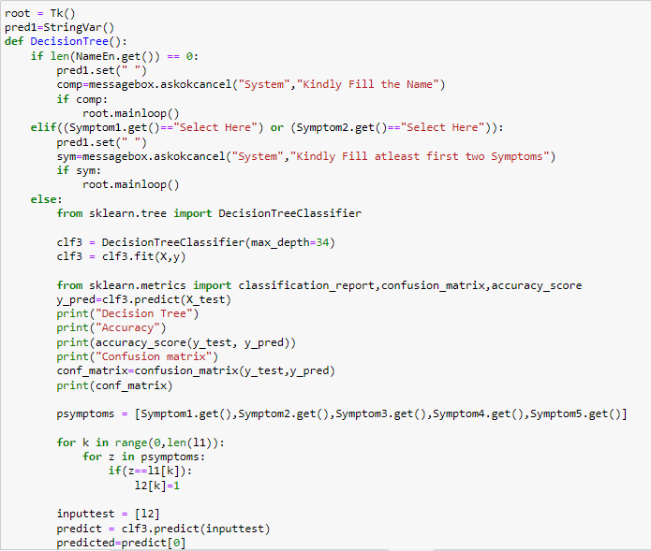

Slide 18
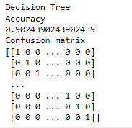
Accuracy 90%

Slide 19
Random Forest Algorithm
Supervised learning algorithm used for both classification and
regression. This algorithm works on 4 basic steps –
Chooses random data samples from dataset.
Constructs decision trees for every sample dataset chosen.
At this step every predicted result will be compiled and voted on.
At last most voted prediction will be selected and be presented as result of classification.

Slide 20
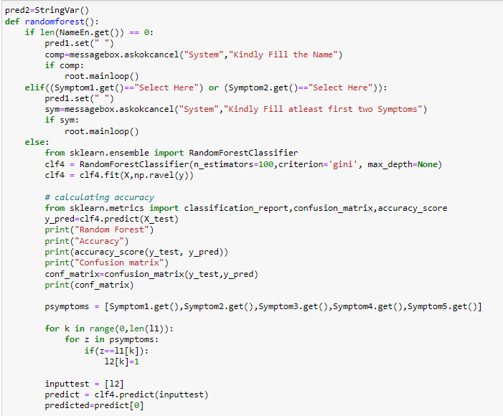

Slide 21
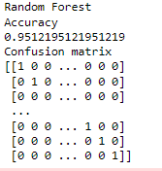
Accuracy 95%

Slide 22
K Nearest Neighbour
Supervised learning algorithm.
Finds extensive use in pattern finding and data mining.
Works by finding a pattern in data which links data to results and it improves upon the pattern recognition with every iteration.
K means number of nearest neighbours.
Output will be characteristic response variable using majority voting.

Slide 23
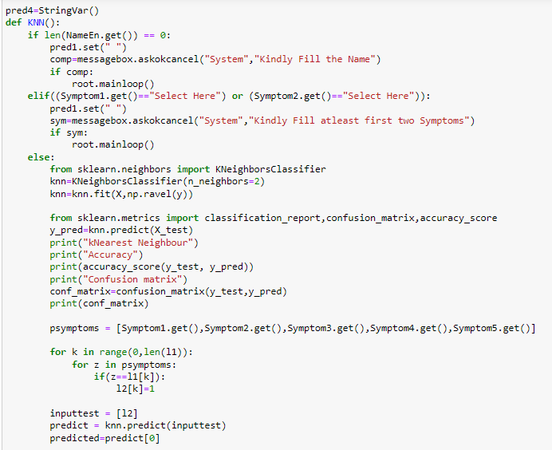

Slide 24
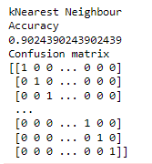
Accuracy 90%

Slide 25
Naive Bayes algorithm
Conditional probability based algorithm.
Most widely used and fastest algorithm since it uses less training data and strong independence assumptions.
Uses a built in function called MultinomialNaïveBayes which is mainly used for discrete features such as text classification.
Requires a feature count parameter which helps in determining each class while fitting the sample with appropriate weights.
In text classification, the main aim is to find the best class for the given document.
Final Score will be obtained by cumulative score for given Data.

Slide 26
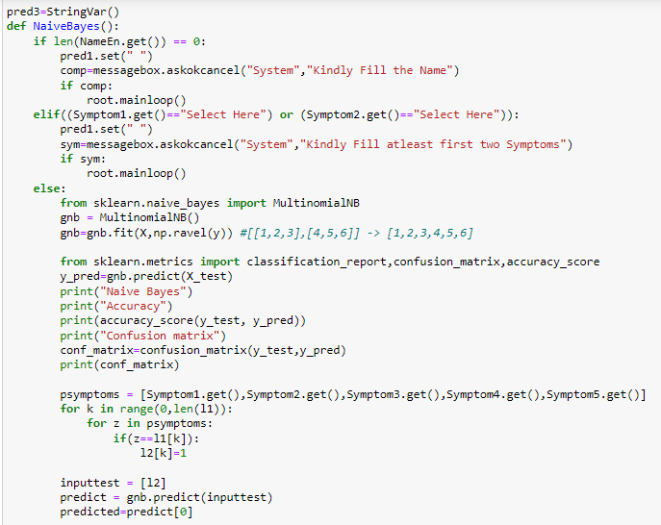

Slide 27
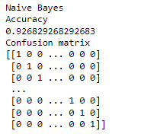
Accuracy 92%

Slide 28
RESULTS AND DISCUSSION
This proposed system produces results that can predict the disease more quickly and accurately.
By using Machine Learning classification techniques namely decision Tree, Random forest, Naive Bayes and KNN are implemented using Python programming in Jupyter Notebook
This system also has an elegant interface which takes all the necessary inputs for the evaluation and to facilitate with the system which is very easy to use.
The final result of our proposed system can be viewed from this GUI.

Slide 29
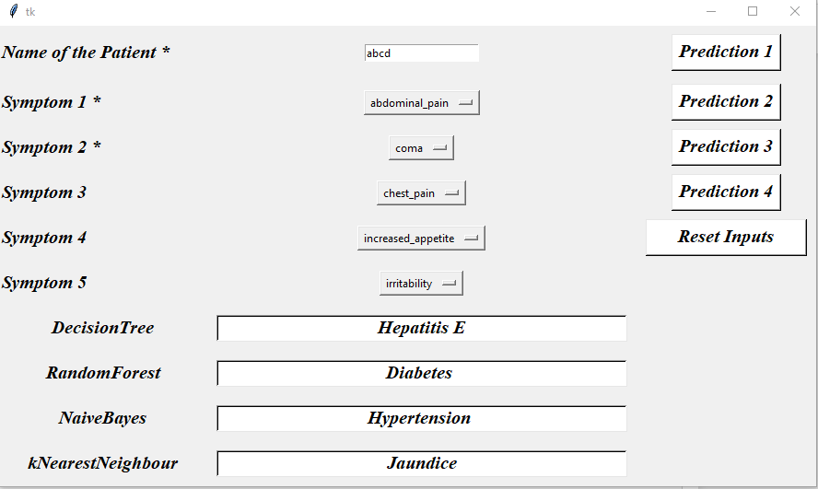

Slide 30
CONCLUSION
The primary goal of this research is to use an appropriate machine learning algorithm to forecast the disease based on symptoms provided by patients.
In this study, we used four machine learning algorithms for prediction, and we were able to achieve a 95% accuracy for Random Forest, which demonstrates remarkable correction and high accuracy as well as increases the system's reliability for this task.
This study demonstrates how a machine learning algorithm may be used to predict disease with various models and parameters.

Slide 31
REFERENCES
[1] Sayali Ambekar, Rashmi Phalnikar, “Disease Risk Prediction by Using Convolutional Neural Network” IEEE, 978-1-5386-5257-2/18, 2018.
https://ieeexplore.ieee.org/document/8697423
[2] Pahulpreet Singh Kohli and Shriya Arora, “Application of Machine Learning in Disease Prediction” IEEE, 978-1-5386-6947-1/18, pp. 1-4, 2018.
https://ur.booksc.eu/book/76324823/8429c7

Slide 32
REFERENCES
[3] Rati Shukla, Vikash Yadav, Parashu Ram Pal and Pankaj Pathak, "Machine Learning Techniques for Detecting and Predicting Breast Cancer" IJITEE, ISSN: 2278-3075, Volume-8, pp. 2658-2662, 2019. https://www.researchgate.net/publication/333506815_Machine_Learning_Techniques_for_Detecting_and_Predicting_Breast_Cancer
[4] Senthilkumar Mohan, Chandrasegar Thirumalai and Gautam Srivastava, “Effective Heart Disease Prediction Using Hybrid Machine Learning Techniques” IEEE Access, DOI 10.1109/ACCESS.2019.2923707, pp. 81542-81554, 2019.
https://ieeexplore.ieee.org/stamp/stamp.jsp?tp=&arnumber=8740989

Slide 33
REFERENCES
[5] Dhiraj Dahiwade, Gajanan Patle and Ektaa Meshram, “Designing Disease Prediction Model Using Machine Learning Approach” IEEE Xplore Part Number: CFP19K25-ART; ISBN: 978-1-5386-7808-4, pp. 1211-1215, 2019.
https://www.researchgate.net/publication/344499148_DISEASE_PREDICTION_SYSTEM_USING_SUPPORT_VECTOR_MACHINE_AND_MULTILINEAR_REGRESSION

Slide 34
Thank You

