Slide 1

Cafeteria Management System: Optimizing Operations
A Cafeteria Management system is a comprehensive solution that optimizes and automates cafeteria operations in various settings such as corporate offices, colleges/universities, and hospitals. This system simplifies processes like meal order processing, billing and payment, resulting in a seamless cafeteria experience. By utilizing digital signage for menu displays, chef's kiosks, and a smart mobile app, long queues are eliminated, enhancing the ordering experience and offering a wide range of easy food choices.
aa
by abiy andargie

Slide 2
Challenges Faced by Cafeteria Management Systems
1
Long Queues and Cash Payments
2
Paper-based Manual Processes
One of the main challenges faced by cafeteria management systems is the issue of long queues for ordering food and the need for cash payments. This can lead to a waste of time for students and staff, as they have to wait in line to place their orders and make payments.
Many cafeteria management systems still rely on manual processes, such as paper-based order forms and manual data entry. This can be time-consuming and prone to errors, leading to inefficiencies in the system.
3
Inefficient Data Analysis
4
High Manpower Requirements
Without proper data analysis tools and systems in place, cafeteria management may struggle to analyze and utilize the data collected from orders, inventory, and customer preferences. This can hinder decision-making and optimization of operations.
Cafeteria management systems often require a significant amount of manpower to handle orders, payments, and food preparation. This can lead to potential inefficiencies in managing the workload.

Slide 3
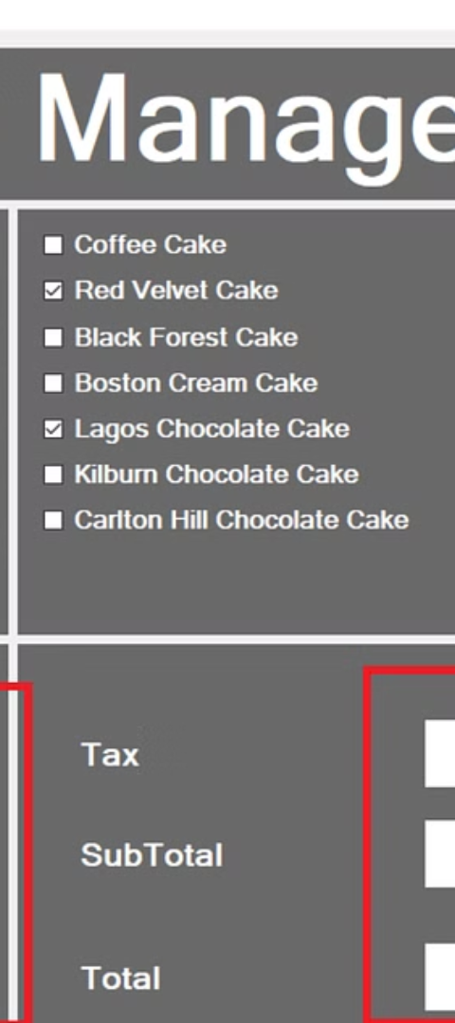
Objectives of Implementing a Computerized Cafeteria Management System
1
General Objective
The general objective of implementing a computerized cafeteria management system is to transform the manual and paper-based system into a computerized and well-organized form. This will streamline operations, improve efficiency, and enhance the overall management of the cafeteria.
2
Specific Objectives
1. Reducing the complexity of the food ordering system.
2. Minimizing the time for ordering food.
3. Improving employee productivity.
4. Easy access to the menu for customers.
5. Efficient and easy analysis of data.
6. Implementing an efficient payment method for customers.

Slide 4
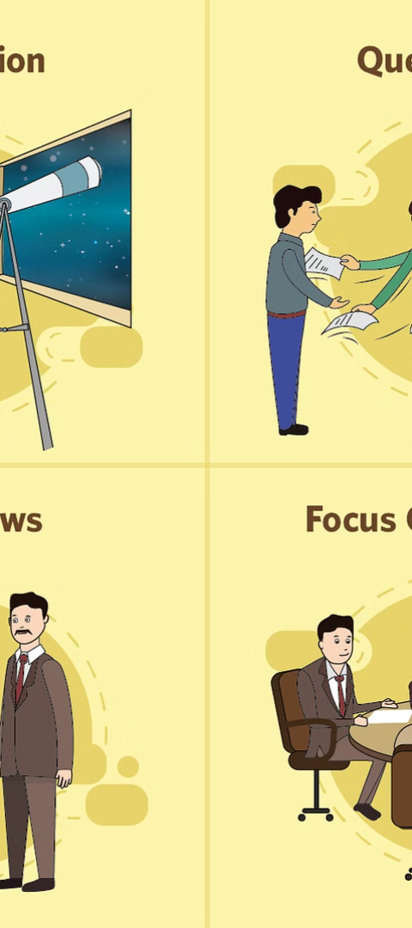
Data Collection Methodology
1
Data Collection Tools and Techniques
2
Practical Observation
It helps us to get more real information about how the organization performs its function, and this helps us to strengthen the data gathered through interviews.
Interview: We have gathered information by interviewing the cafeteria management system staff about the existing system. We have asked some prepared questions for the cafeteria management system manager to get the necessary information about the existing system.

Slide 5
Scope and Limitation of the Project
Scope of the Project
Limitation of the Project
- Online ordering food for students
- The project focuses only on food orders, menu list managements and bill generate but it doesn’t include many other cafeteria management system features.
- Food menu list management
- General report generates
- Customer order management
- Easy bill generates for customers who ordered food

Slide 6
Functional Requirements of the Project
1
Menu Management
2
Order Management
The system should allow menus to be created and added to the cafeteria, including sections and items. It should support easy configuration and customization of the menu. Ability to add, edit, and remove menu items. Ability to set prices, and availability of menu items.
The system should allow orders to be created and added to tables. Ability to specify quantities ordered.
3
User Management
4
Reporting and Analytics
Role-based access control for different user types, such as administrators, managers, and cashiers. Secure login and authentication mechanisms. Ability to manage user accounts, permissions, and privileges.
The system should provide reporting and analytics capabilities to track sales, inventory, and other relevant data. Generate reports on sales, revenue, popular items, and customer preferences.

Slide 7
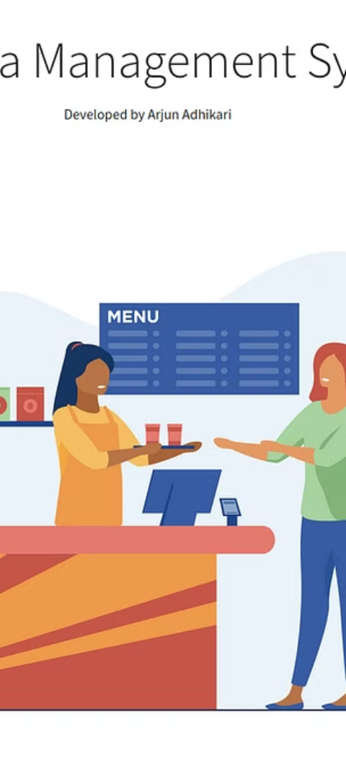
Benefits of a Computerized Cafeteria Management System
1
Improved Efficiency
2
Enhanced Dining Experience
A computerized/automated cafeteria management system offers numerous benefits for improving the efficiency and productivity of a cafeteria.
By streamlining the ordering process, automating management, and providing centralized data and reporting, the system enables employees to work more effectively and focus on delivering excellent service to customers.
3
Increased Customer Satisfaction
Contactless ordering can enhance the overall dining experience and increase customer satisfaction.

Slide 8
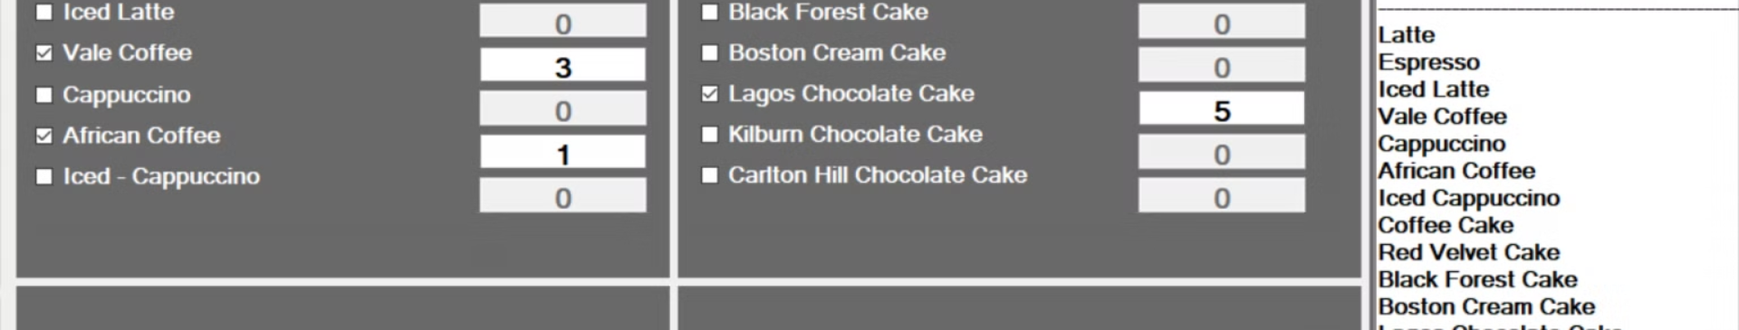
Challenges in Implementing a Cafeteria Management System
User Adoption
System Compatibility Concerns
It is important to consider the limitations and challenges that may arise during the implementation and use of such a system, such as user adoption.
It is important to consider the limitations and challenges that may arise during the implementation and use of such a system, such as system compatibility concerns.

Slide 9


Efficient Payment Methods and Customer Convenience
Cashless Payment
Mobile Banking
Providing customers with convenient and efficient payment options, reducing the need for cash transactions.
Implementing an efficient payment method for customers, such as mobile banking.

Slide 10
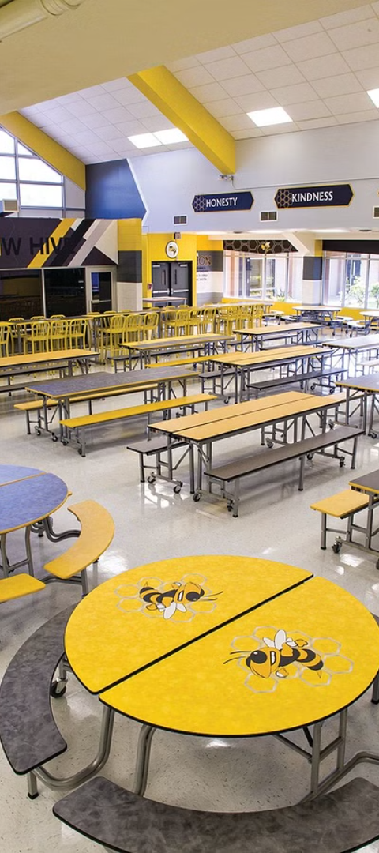



Conclusion: Enhancing Cafeteria Operations
Streamlining Ordering Process
A computerized/automated cafeteria management system offers numerous benefits for improving the efficiency and productivity of a cafeteria.
Automating Management
By streamlining the ordering process, automating management, and providing centralized data and reporting, the system enables employees to work more effectively and focus on delivering excellent service to customers.
Enhanced Dining Experience
Contactless ordering can enhance the overall dining experience and increase customer satisfaction.

Slide 11
THANK YOU!!
QUESTION??

