Slide 1
Teaching a network where to look
LOUISIANA TECH UNIVERSITY · MEDICAL IMAGE ANALYSIS
A region-weighted training objective for brain-tumour MRI restoration, benchmarked against thirteen published alternatives — and an honest account of what it does and does not buy you.
Notes:
One idea: change what the network is graded on, not the network. Every image in this deck is from a real BraTS run on my own machine.

Slide 2
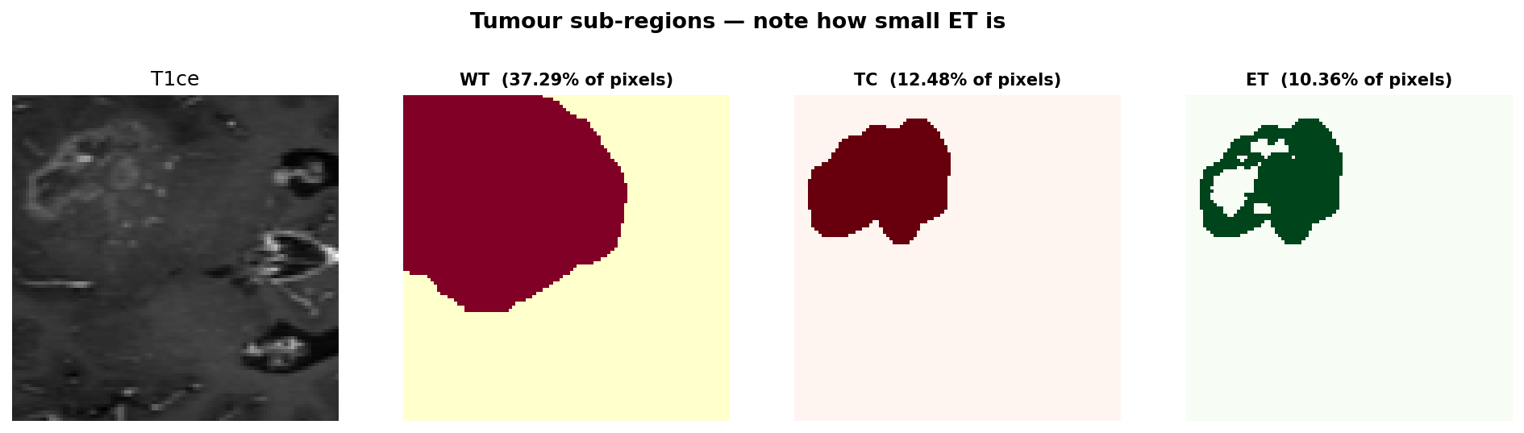
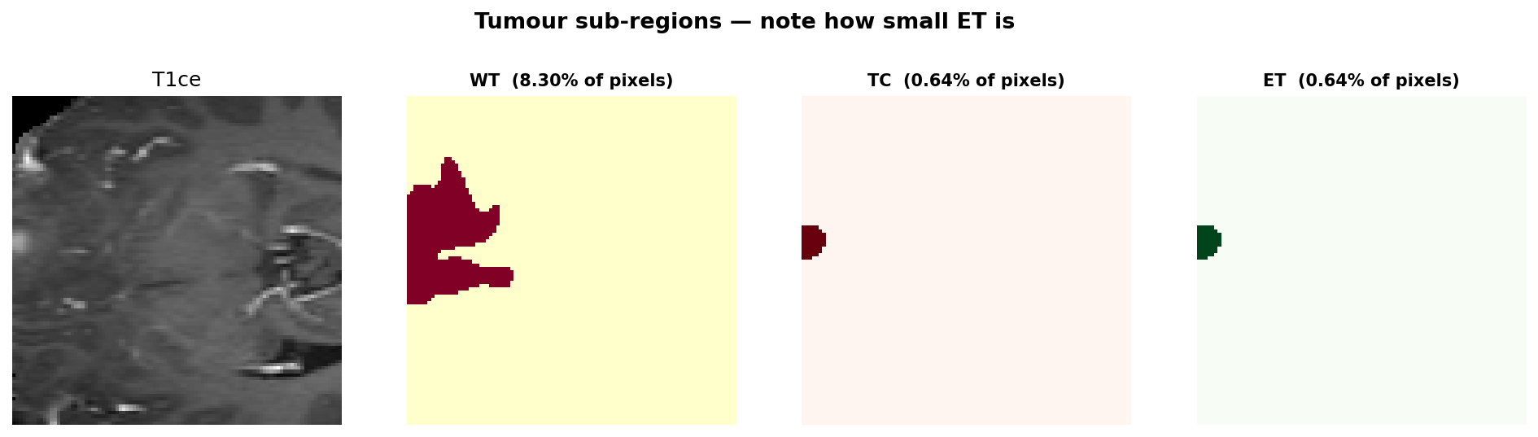
The same disease, sixteen times smaller
Two patients from the dataset. Left, the enhancing tumour fills 10.4% of the slice. Right, it fills 0.64%. A pixel-averaged loss treats both identically.
Patient A — WT 37.3%, TC 12.5%, ET 10.4% of the slice
Patient B — WT 8.3%, TC 0.64%, ET 0.64% of the slice
The enhancing tumour drives staging, surgical planning and response assessment. It is also, routinely, under one percent of the image — so a network trained to minimise average pixel error has almost no incentive to preserve it.
Notes:
The hook. Pause on the two percentages before explaining anything. Both figures are real slices from the validation set.

Slide 3
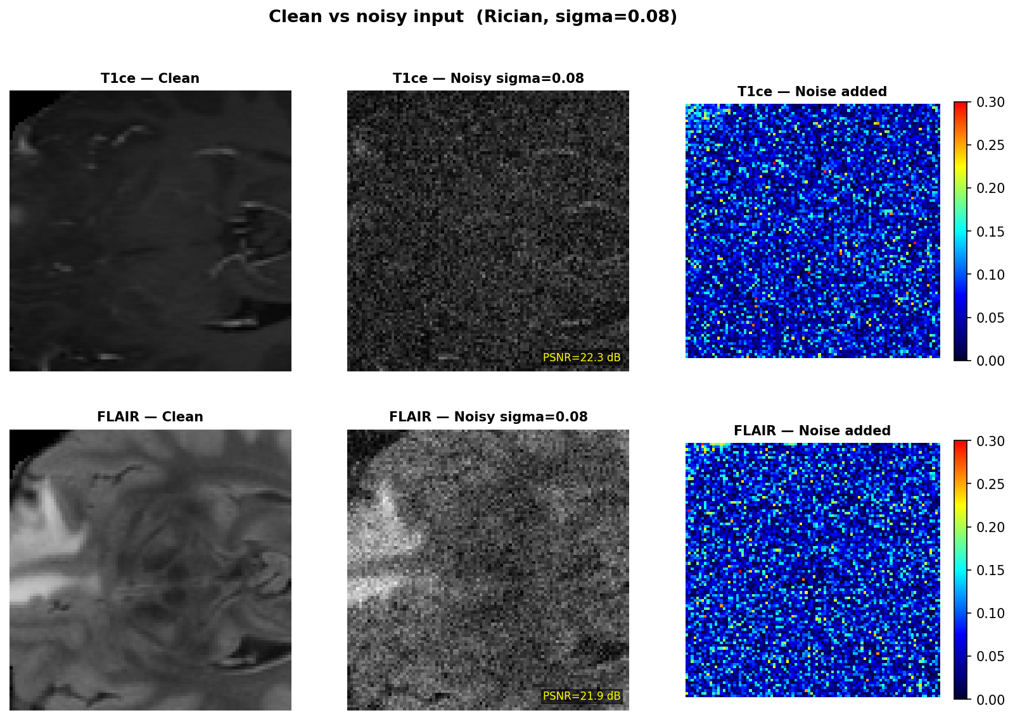
A faster scan is a noisier scan
MRI trades time for quality. Children, patients in pain and anyone who cannot lie still do not get a ten-minute acquisition. We simulate that trade with Rician noise at sigma 0.08.
What is lost first
Fine structure at the tumour margin — exactly the boundary a radiologist traces to decide whether disease is progressing.
The denoiser sits between the scanner and the diagnosis. Whatever it destroys, no later step recovers.
Clean, corrupted, and the noise field itself. T1ce falls to 22.3 dB, FLAIR to 21.9 dB.
Notes:
Real figure from the run. Point at the noise panel on the right — that is what the network has to undo.

Slide 4
The network is graded on the wrong thing
Training minimises the average error over every pixel. That average belongs to the healthy brain.
WHAT THE LOSS REWARDS
WHAT THE CLINIC NEEDS
99.4%
0.6%
of pixels drive the gradient
of pixels carry the decision
A smooth reconstruction of healthy tissue. Score it on PSNR and it looks excellent.
A faithful enhancing-tumour margin. The network can smear it and barely move the average.
The metric we optimise is not the thing we care about.
Notes:
The thesis. Say the closing line slowly; everything after this follows from it.

Slide 5
Change the grading rubric, not the student
The architecture stays byte-for-byte identical to its control. Only the loss function changes — so any difference in the result belongs to the objective and nothing else.
Notes:
The scope decision. It is what makes this a loss study rather than an architecture study, and it is why the comparison is interpretable.

Slide 6
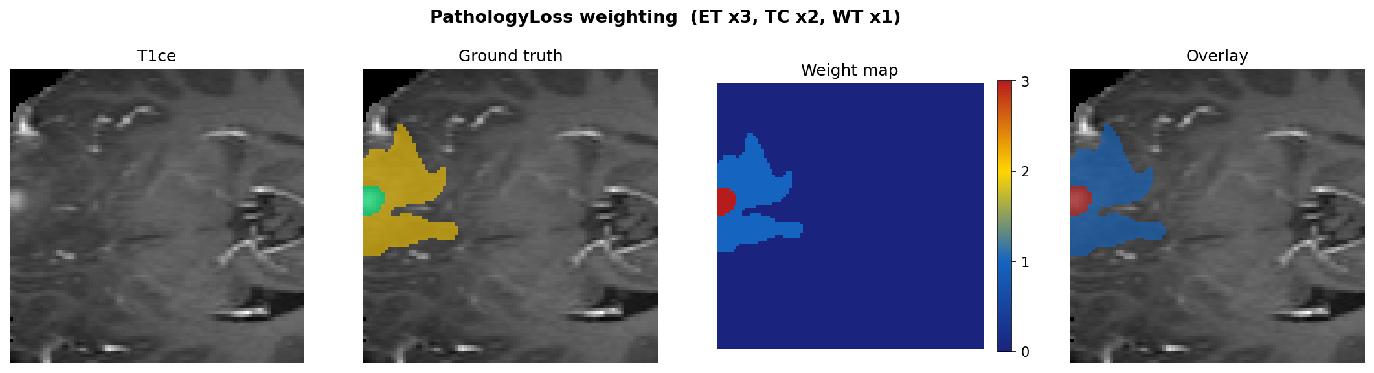
PathologyLoss
L = L₁ + Σ wᵣ · ‖ Mᵣ ⊙ (X̂ − X) ‖₁ / |Mᵣ|
global term + one size-normalised penalty per tumour region
Errors inside the enhancing tumour count ×3, the core ×2, the rest ×1.
Each region is divided by its own size, so a small region is not diluted by being small.
The weight map on a real slice: red ×3, blue ×1. The entire intervention.
The mask is used only in training. At inference the network sees the noisy image alone.
Notes:
The equation, the three properties, and the real weight map. Note how little of the field is red — that is the imbalance the loss corrects.

Slide 7
How it was tested
1
Split by patient
100 subjects, 80 train / 20 held out. No patient appears in both — a leak here inflates every number downstream, and an earlier version of this study had one.
2
Corrupt
Rician noise, sigma 0.08, applied in the image domain to all four modalities.
3
Freeze the judge
A U-Net learns to outline tumours from clean images, then is locked. Every objective is scored by the identical network, so the ruler cannot drift.
4
Train and compare
Same backbone, same data, same optimiser, same epochs. Only the loss differs.
Notes:
The frozen judge is the methodological spine. Without it a Dice difference could be the segmentor changing rather than the images.

Slide 8
Benchmarked against published objectives
An earlier version of this study compared PathologyLoss only against plain L₁ — our loss against nothing. That is a control, not a benchmark.
REGION-AWARE RIVALS
CONVENTIONAL STRENGTH
FREQUENCY & TASK-AWARE
FlatROI — binary tumour weighting
BraSyn masked L₁ (2023)
ROIRecNet-inspired (2019)
L₂, SSIM, MS-SSIM
Mix (Zhao 2017)
Total variation, VGG perceptual
BraSyn frequency split
DAGAN-style (Yang 2017)
LIDnet-inspired task feedback
Plus two reference arms that cost no training at all and change how every other number reads: segment the noisy image, and segment the clean one.
Notes:
Be candid that the first version had no real baselines. That criticism is what produced this slide and most of the work behind it.

Slide 9
First question: does denoising help the diagnosis at all?
Nobody had measured this. Without it, every Dice score in the study floats free.
0.244
0.514
0.617
No restoration
After denoising
Clean image
segment the noisy image directly
plain L₁ objective
the ceiling — best achievable
Restoration recovers 72% of the achievable gap.
That leaves 0.103 of headroom. A loss function that wins +0.05 is claiming half of what remains — a far more meaningful statement than a Dice number quoted alone.
Notes:
Dice_ET, 20 held-out patients. Floor and ceiling are what make everything after this interpretable.

Slide 10
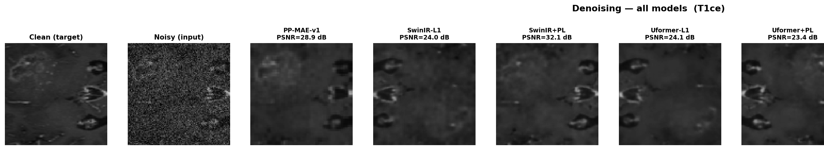
What each objective produces
The same slice, restored by each objective, with its PSNR. By eye they are nearly indistinguishable — which is the problem with judging restoration by eye.
Every one of these looks acceptable. The differences that matter are not in the picture — they are in what a segmentor can still find afterwards.
Notes:
Real figure. Let the audience look for a difference and fail to find one. That failure is the argument for the next slide.

Slide 11
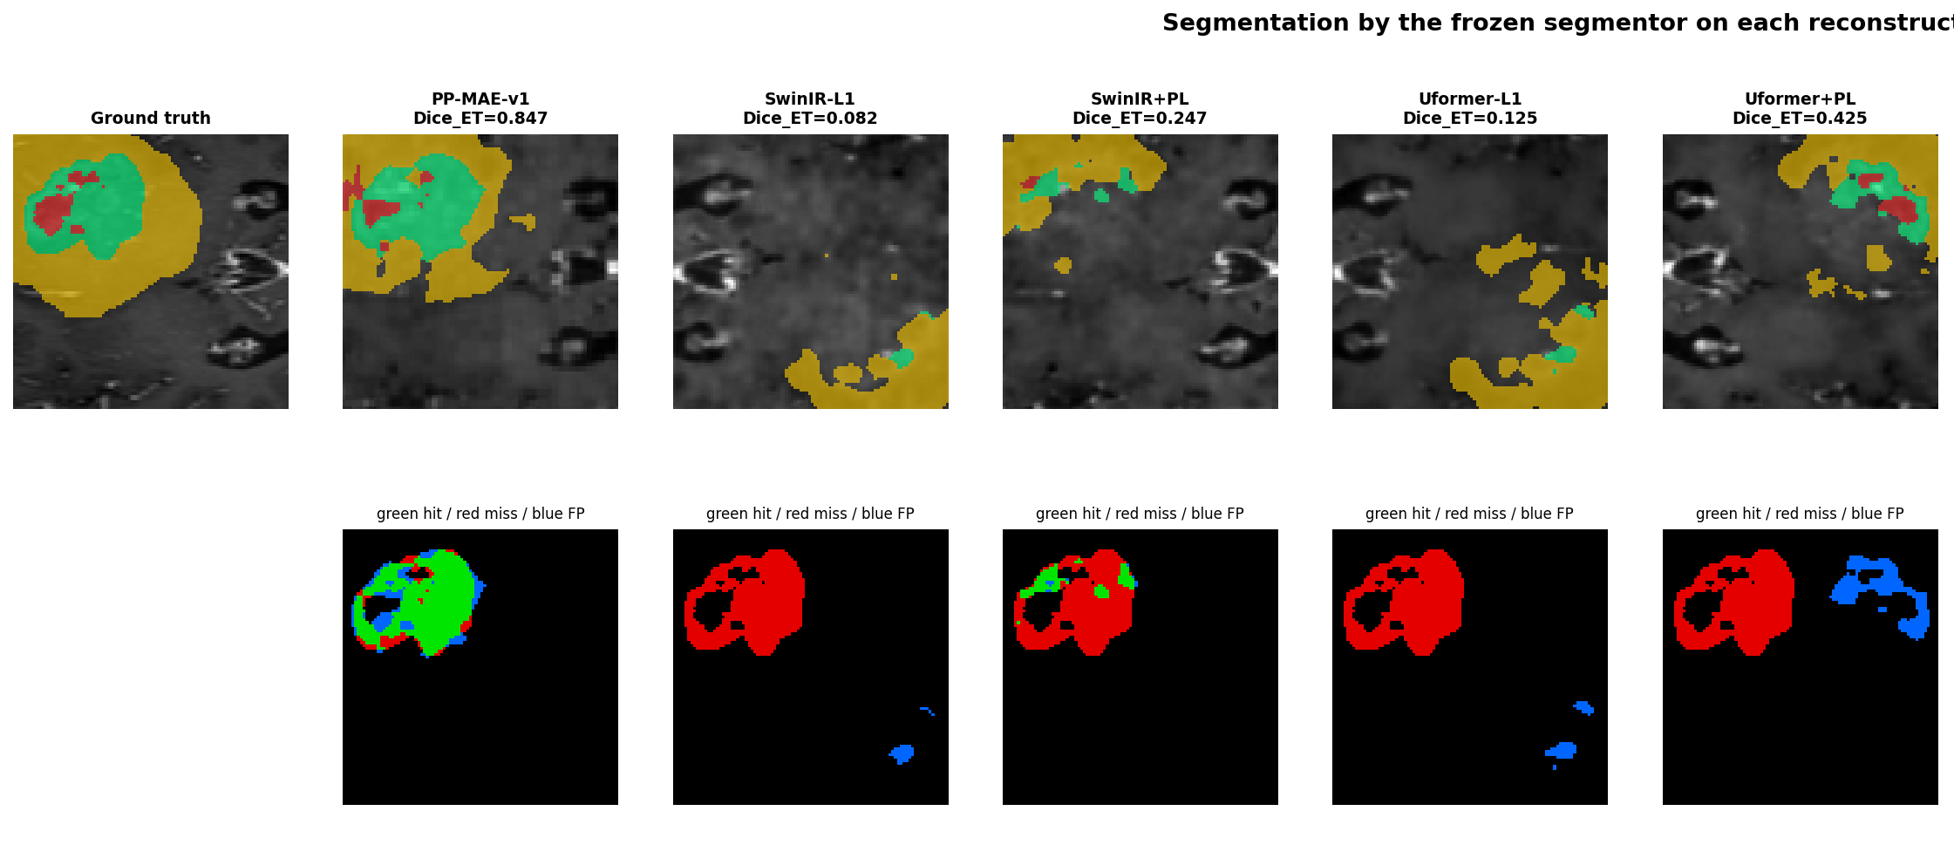
What the segmentor finds afterwards
Top row: the frozen segmentor on each restoration. Bottom: green where it found real enhancing tumour, red where it missed, blue where it invented tumour that is not there.
Uformer+PL finds the most real tumour — and also paints the largest false region.
Notes:
The single most important image in the deck. PathologyLoss recovers more green AND more blue. That trade is invisible in any Dice table.

Slide 12
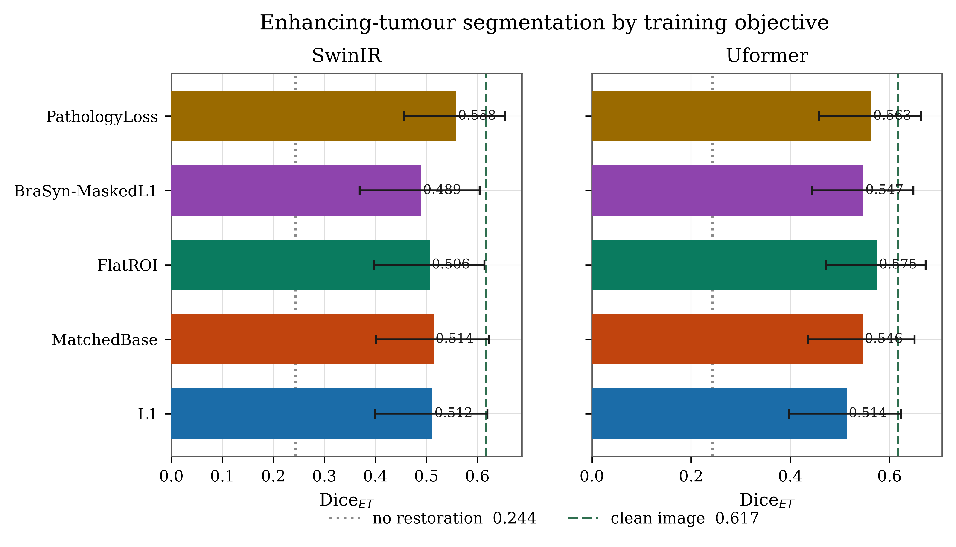
Every objective, both backbones
Subject-level means with bootstrap 95% confidence intervals. Dotted line: no restoration. Dashed line: clean image.
Notes:
The backbones disagree about which rival is best — but PathologyLoss is the only region-aware objective above plain L1 on both.

Slide 13
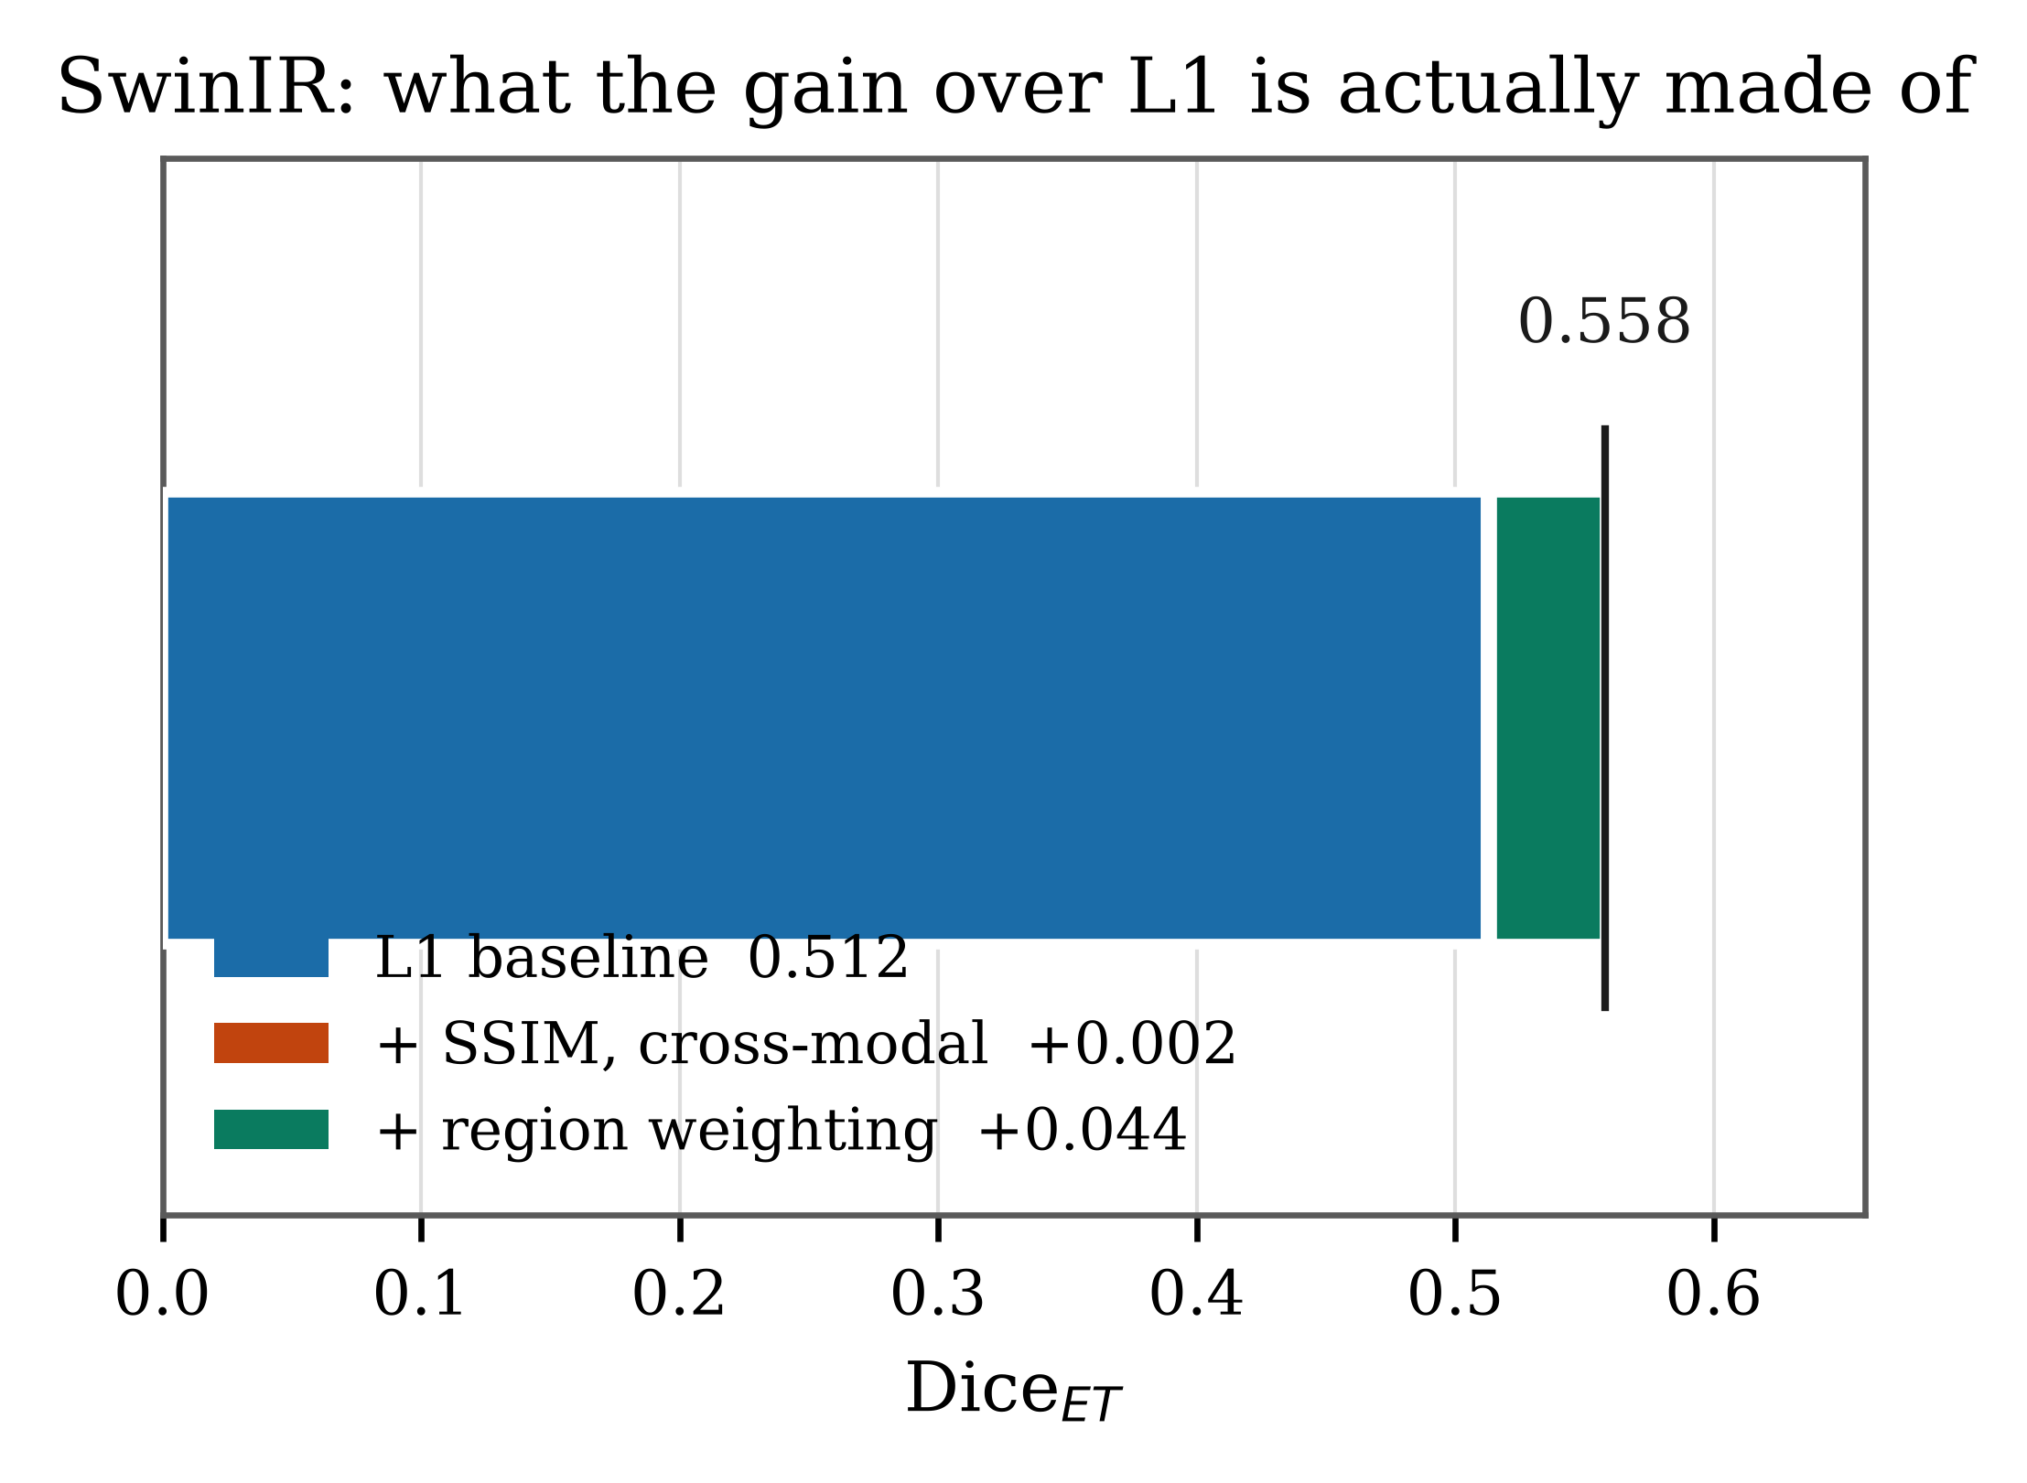
What the improvement is actually made of
Verifying the code against the manuscript showed the published treatment also carried an SSIM term that its L₁ control did not.
So the comparison was never isolating the region weighting.
The fix: a matched control carrying every non-pathology term, and the whole comparison re-run against that instead.
A result you cannot attribute is not a result.
Notes:
This slide is what makes the talk credible. Admitting the confound and showing the fix beats a clean result with no self-criticism.

Slide 14
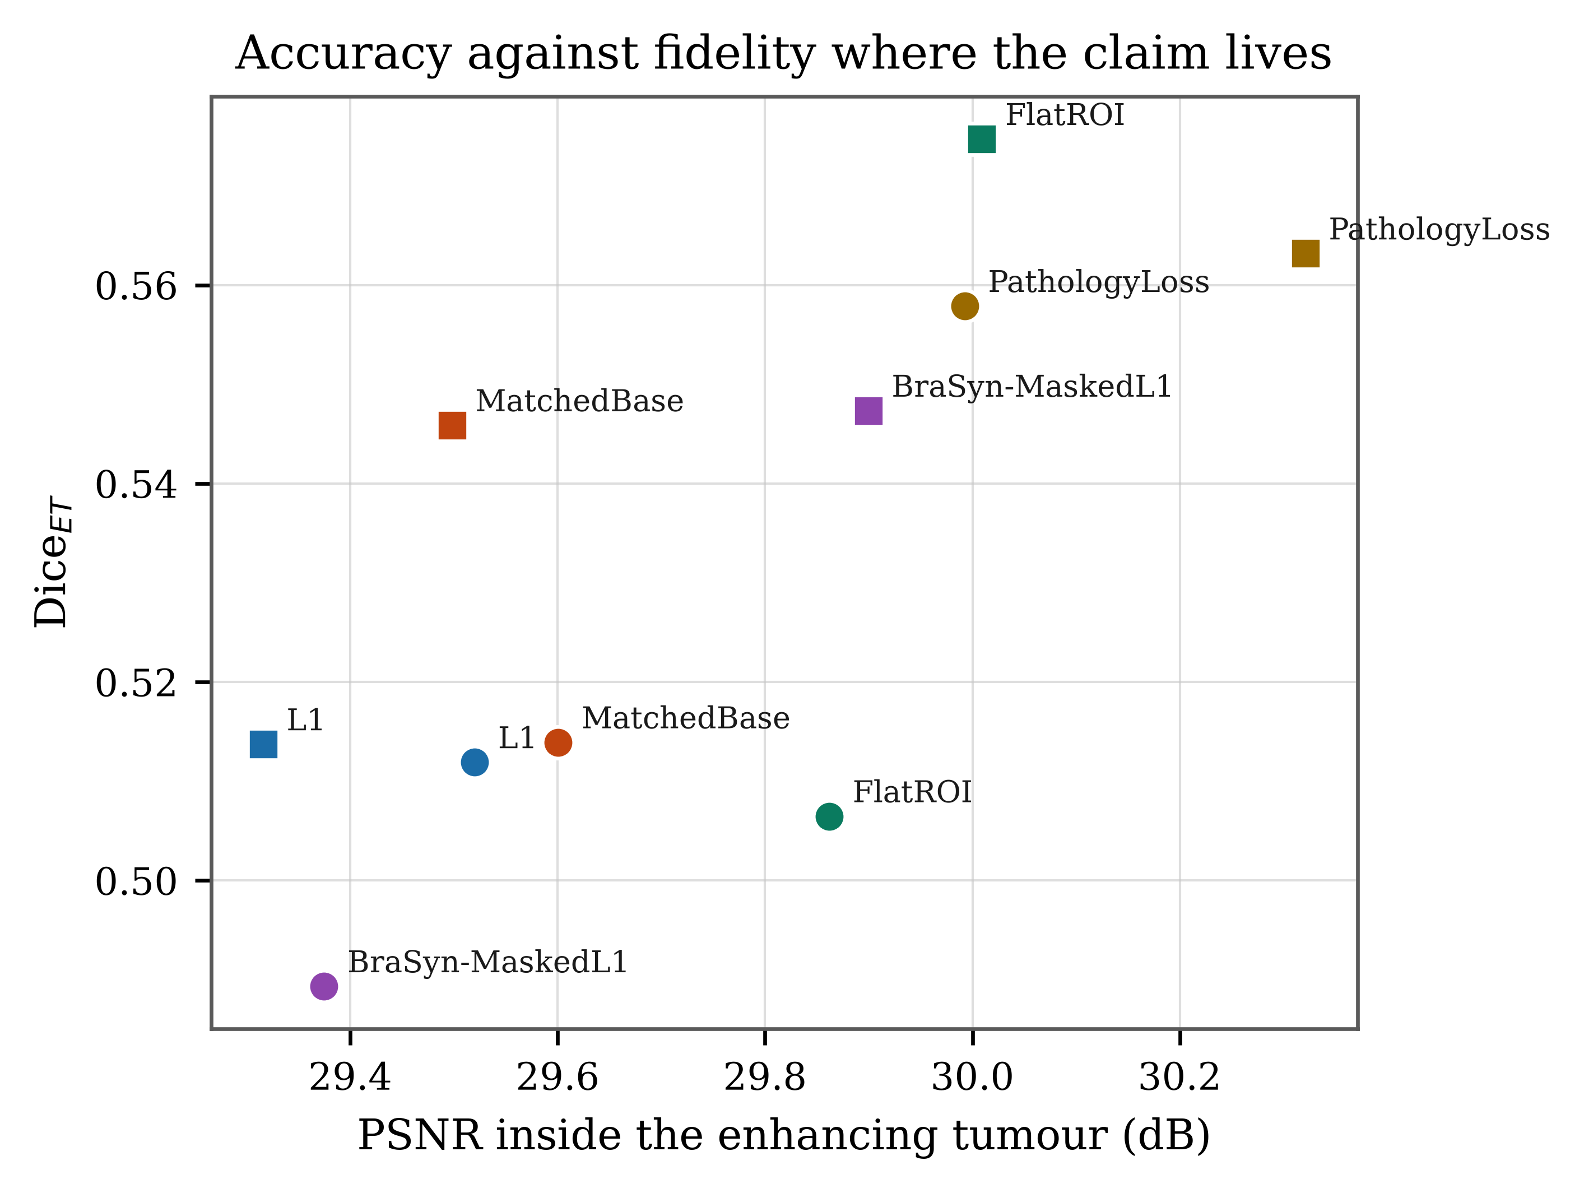
Where the method genuinely wins
The original claim was that PathologyLoss reconstructs the tumour more faithfully. The study never measured that — whole-image PSNR averages over healthy brain.
So we measured PSNR inside the enhancing tumour.
Uformer
30.32 dB
best of all objectives
SwinIR
29.99 dB
best of all objectives
Highest tumour-region fidelity on both backbones — a claim confirmed by a measurement that did not previously exist.
Notes:
The positive finding. It only emerged because we added a region-restricted metric, which is itself part of the contribution.

Slide 15
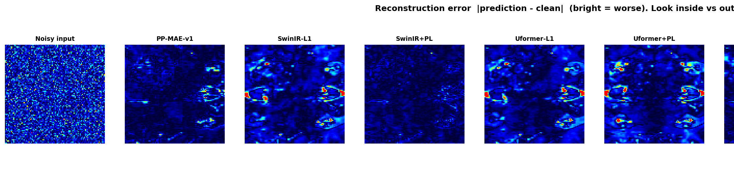
Where the error actually lives
Absolute error against the clean image, one shared colour scale. Brighter is worse.
All objectives suppress noise comparably across the brain. The argument is not whether restoration works — it is what the residual error costs downstream.
Notes:
Reinforces slide 10: global fidelity is not where these methods differ.

Slide 16
What I would not yet claim
One run, twenty patients
It raises false positives
An earlier five-seed sweep had one seed in five reverse direction. This shows where things point, not how far.
Across that sweep the enhancing-tumour false-positive rate rose in ten runs out of ten. Dice alone hides this.
The backbones disagree
Convergence is untested
The strongest rival on Uformer falls below plain L₁ on SwinIR. Portability is not settled.
Ten epochs here; a separate hundred-epoch run suggested the gap may close. That experiment is still to run.
Notes:
Say these out loud. A reviewer who finds them first is a far worse outcome than an author who names them.

Slide 17
What happens next
1
Run to convergence
Fifty epochs on one seed, with the loss curves as evidence that the budget was sufficient.
2
Widen the cohort
Seed-to-seed variation traced to which patients land in the held-out set, not to training instability. More patients, not more seeds.
3
Report the trade honestly
Dice beside the false-positive rate and tumour-region PSNR, so sensitivity and specificity are both visible.
Notes:
Three concrete next steps, each tied to something the data showed.

Slide 18
A baseline is not a formality
WHAT THIS PROJECT TAUGHT ME
Almost everything that changed here came from asking what the result was being compared against. A floor and a ceiling turned an unanchored number into a meaningful one. A matched control revealed a confound. A region-restricted metric confirmed a claim the study had only asserted.
Notes:
Close on the methodological lesson rather than the effect size. It generalises beyond this project, and it is what the audience will remember.

