Slide 1

GRADUATION QUALIFICATION PROJECT Research and Development of method to detect deepfake using Neural Networks
10.04.01 Computer System Information Security
Student: parth chawla, group N42503c
Supervisor: Vorobeva Alisa Andreevna, associate professor, PhD
St. Petersburg
2022

Slide 2
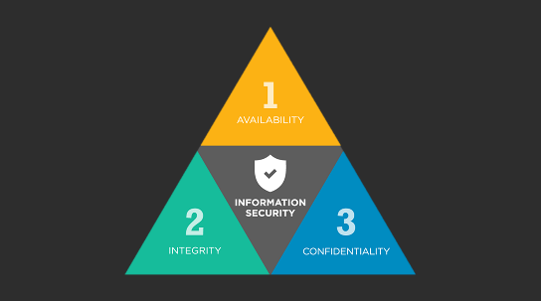
Relevance
The relevance of the research topic is due to the following facts:
1. CIA Triad breach – Integrity
2. Authentication Validation
3. Dis-Information
Limitation and Disadvantages of Disadvantages of Existing solutions:
1. Only certain methods of validations are considered
2. Large dataset required for high accuracy.
Application of Convolution Neural Network using Two Streamed Inflated 3D Convolution Network will increase the accuracy of Synthetic media detection.
2

Slide 3
Aim
The Aim of the thesis is to improve the accuracy of detecting Synthetic Media.
TASKS
Literature Review
Development of Model for detecting Deepfakes
Comparison of Results to current scientific Research
3

Slide 4
Related research
Name | Algorithm/Model Used | Advantages | Disadvantages
Detecting eye blinking Add refrences Make conclusion after the table | MTCNN AND LSTM | MTCNN provides reliable and is one of the top methods to detect faces | 1. Eye blinking can be fixed by using frame as training dataset.
Face Manipulation Detection | XceptionNet | Can detect deepfake of low quality images. | Accuracy is only good on the dataset which it is trained on.
Emotion to detect Deepfakes | Siamese Network | Used Multiple dataset to train the model | Misclassification of the videos Model wont work if multiple people are there If there is no audio the model is useless
Table 1 - comparison of the analyzed algorithms
5

Slide 5
Related research
Name | Algorithm/ Model Used | Advantages | Disadvantages
Body Posture to detect Synthetic Media | LSTM | Has both long term and short term memory | Wont work if face video is there Will only work for the person the model is trained on Intraframe Inconsistency
Texture of Eye, Face and Teeth | CNN | Fast High precision | Trained on different Affine model Low Accuracy
Neural ODE to predict Heart Rate | SVM | Heart Rate cant be manipulated | Results are not reliable Loses effectiveness when processing low quality video

Slide 6
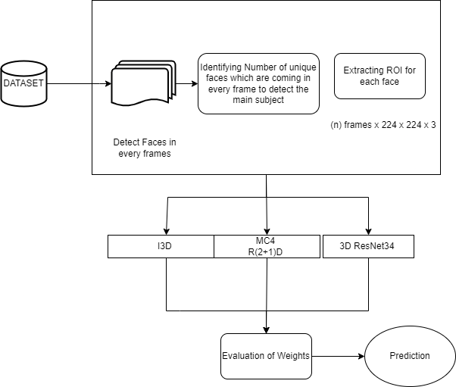
Method for Detecting Deepfake Videos
Figure 1 – Proposed Model
6

Slide 7
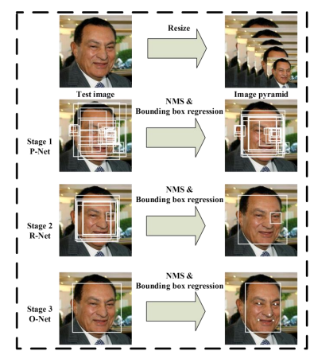
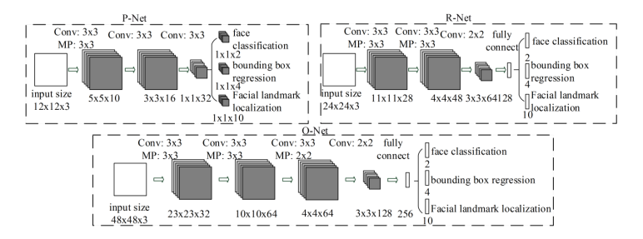
Face Detection
Figure 2 – MTCNN for face detection
Figure 3 – P-Net, R-Net, O-Net
7

Slide 8

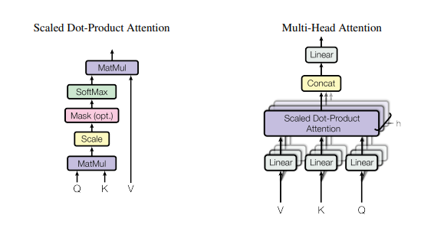
ROI
Figure 4 – ROI Formula
Figure 5 – Architecture of ROI

Slide 9
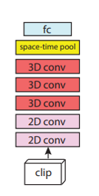
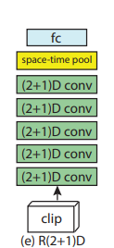
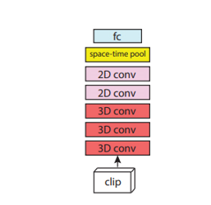
Model Proposed
Figure 6 – MC4
Figure 7 – rMC3
Figure 8 – R(2+1)D
8

Slide 10
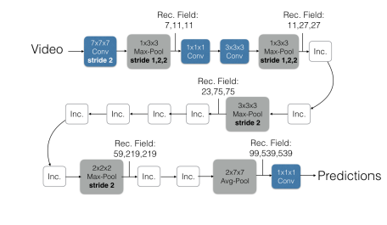
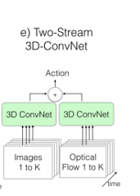
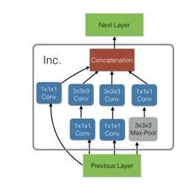
Figure 9 – I3D
Figure 10 – Architecture of I3D
Figure 11 – Inception Module

Slide 11
Preparation of data for experimental research
The model was trained on DFDC dataset.
The DFDC dataset consists of deepfake videos of 960 subjects.
Models used in DFDC are as follows:
1.DFAE
2.MM/NN FaceSwap
3.FSGAN
4.NTH
5.StyleGAN
9

Slide 12
Progress of Experimental Studies
Training of Model
Processing and Analysis of Videos
Filling the missing prediction
Classification
10

Slide 13










Programming Languages
Python3
Tools and Technologies
Programming Frameworks
PyTorch
Keras
IDE
Google
Jupyter Notebook
Visual Studio Code

Slide 14
Results of experimental studies
Table 2 - Results of experimental studies (in points and refrences)
Name | Accuracy
Detecting eye blinking | ~94.8%
Face Manipulation Detection | ~74.3%
Emotion to detect Deepfakes | ~84.4%
Body Posture to detect Synthetic Media | ~86%
Texture of Eye, Face and Teeth | ~52.1%
Neural ODE to predict Heart Rate | ~94.3%
Deepfake Detection Using Neural Networks | ~95.3%
11

Slide 15
Conclusions on work
A model to detect Deepfake was developed.
Experimental studies have been carried out to assess the accuracy of the developed model.
Analysis of the results showed that the model can improve the accuracy of detecting deepfakes.
Comparison of the results obtained with the current scientific and technical level showed that the proposed model is more accurate, versatile and requires less computational power.
All tasks set in the work have been completed.
The goal of the work has been achieved.
12

Slide 16

Thank you!

