Slide 1

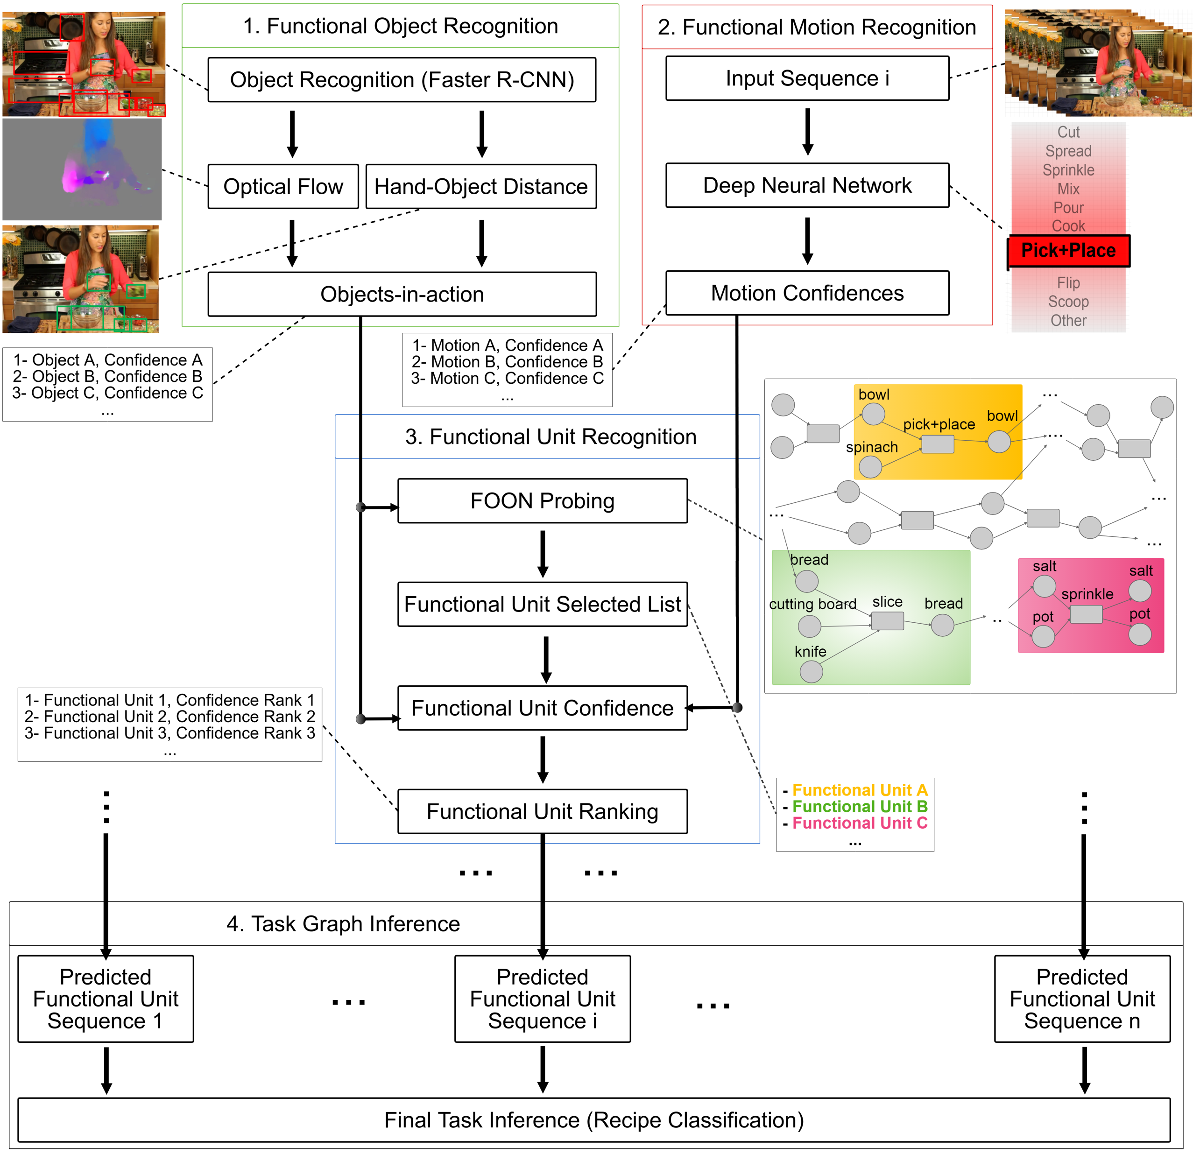
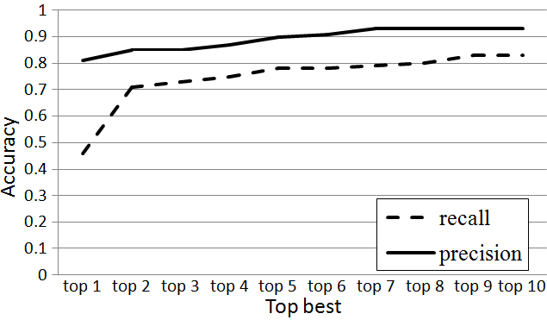
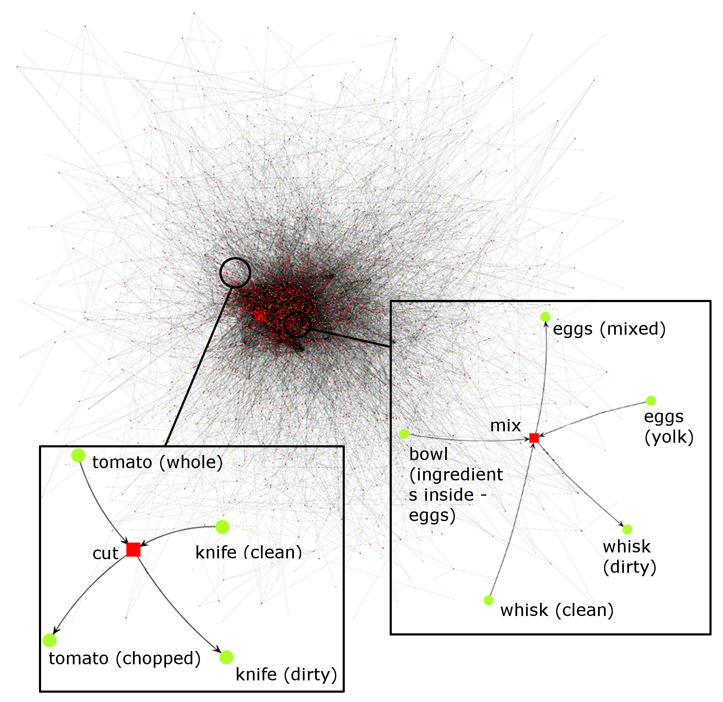
Video Understanding for Cooking Activities
Ahmad Babaeian Jelodar, Yu Sun
University of South Florida
Introduction
Four stage video understanding pipeline to simultaneously recognize all atomic actions and the single ongoing activity in a video.
Uses a graph-based knowledge representation network, named functional object oriented network, two deep networks and low level image features to identify objects and motions in each video sequence associated with an action.
Experiments show that using functional object-oriented network improves video understanding.
Functional Object Oriented Network
Directed acyclic bipartite graph encoding knowledge about manipulation tasks and, in extension, object affordances.
Figure 1 depicts an entire FOON graph and two instances of functional units, the basic building block of a FOON.
Figure 1 – An entire FOON graph.
Each functional unit contains two types of nodes called object and motion nodes and describes a single, atomic action as seen in an activity.
Video Understanding Pipeline
Functional Object Recognition identifies objects with their associated usefulness confidence scores.
Functional Motion Recognition classifies each short action into its corresponding motion classes.
Functional Unit Recognition utilizes the first two stages and their FOON accordance, to associate each action with a functional unit.
Task Graph Inference associates the sequence of actions from a single video with a whole activity (recipe) by looking them up in the FOON.
Figure 2 – Four stage pipeline for video understanding.
Experimental Results
Videos used and annotated from
the creation of the FOON [Paulius et al., 2016].
the MPII Cooking Activities Dataset [Rohrbach et al., 2012].
Experimented on video understanding.
Calculated the precision and recall metric based on the overlap of object and motion nodes between the identified and ground truth functional unit. Figure 3 shows individual precision and recall calculated for top 1 to top 10 results using only the FOON.
Figure 3 –Precision and recall for functional unit recognition.
Conclusion & Future Work
The pipeline is a big step towards automatically extending the knowledge representation graph, which presents a significant improvement to applications such as robots solving manipulation problems given a target goal. In future work, we would like to explore:
Other methods of identifying objects-in-action,
Incorporate object recognition confidences to handle misidentified objects,
Utilize states of objects,
Incorporate history of events for inference,
Generalize the knowledge contained within a FOON to achieve more generic video inferences.
Funding provided by the National Science Foundation #1421418.

