Slide 1

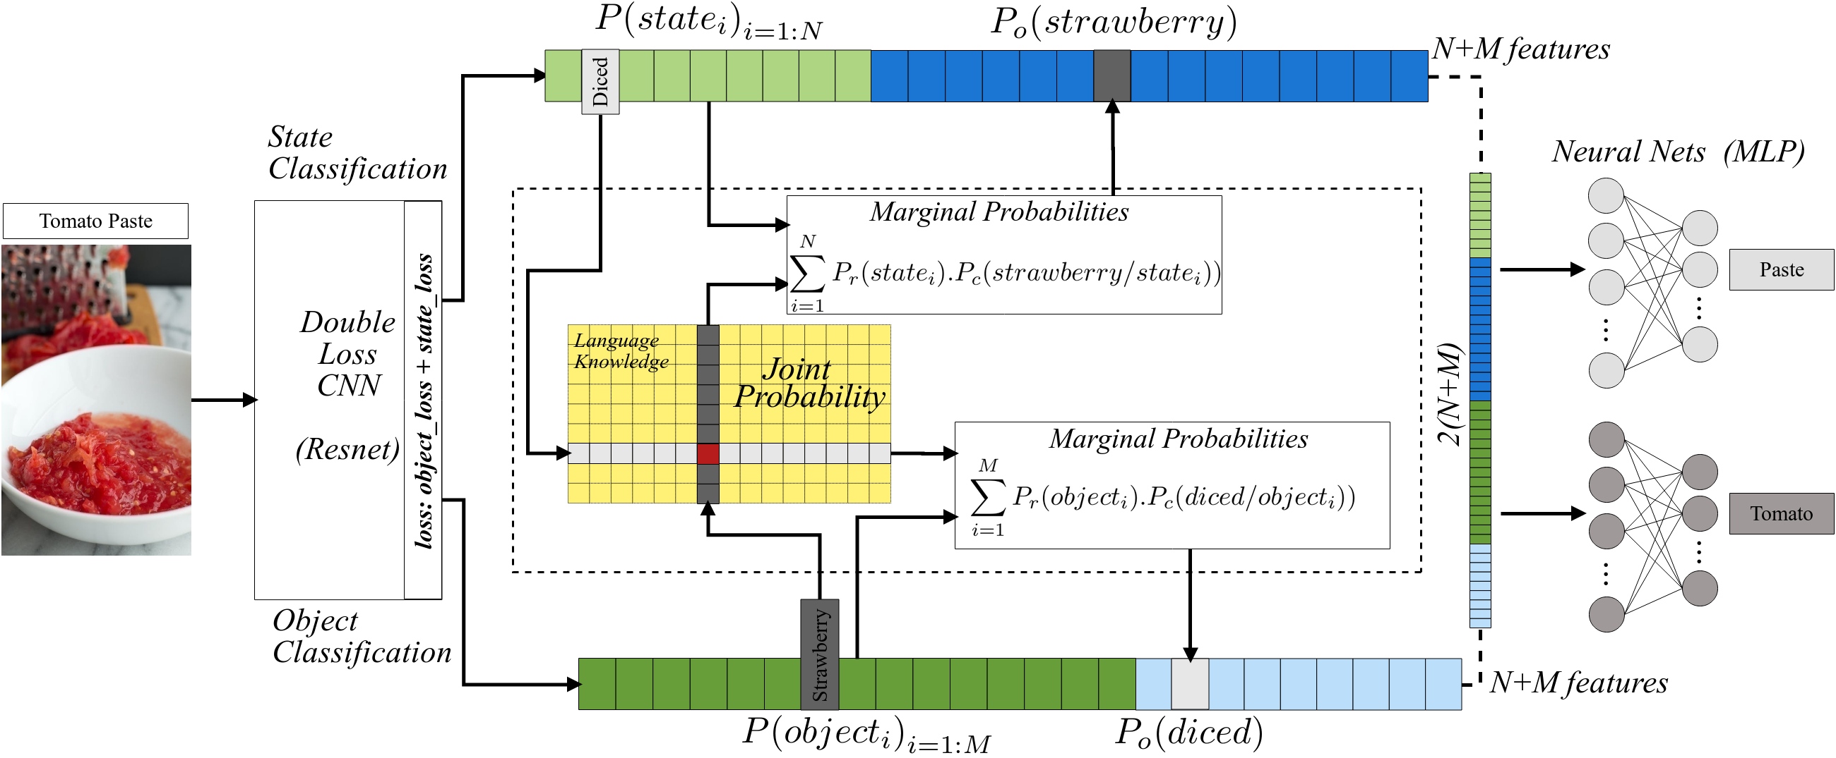
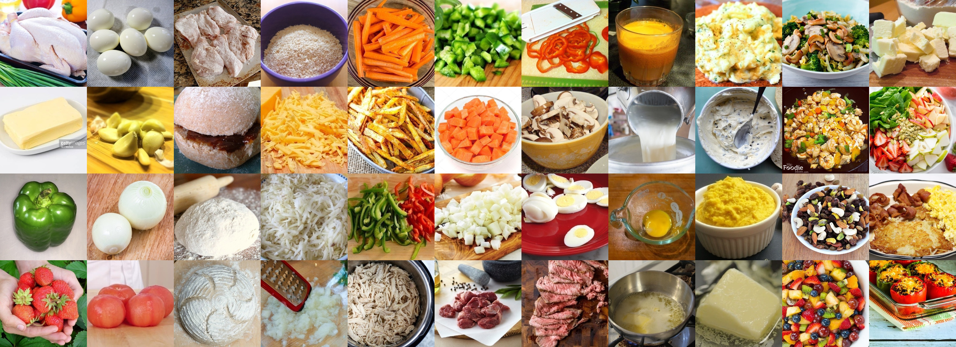
Identifying Object States in Cooking-Related Images
Ahmad Babaeian Jelodar, Yu Sun
University of South Florida
Introduction
Understanding object states is as important as object recognition for robotic task planning and manipulation.
Eleven states from the most frequent cooking objects are examined and a dataset of images containing objects and their states is created.
A deep based solution to the state identification problem, is proposed and evaluated on a the cooking dataset, and a subset of the Imagenet dataset.
The State Identification Challenge
A smart robotic system to perfectly manipulate the environment, needs to acquire accurate knowledge of the environment, objects, their affordances and status.
We define a state of an object (such as a tomato) as the various physical shapes (diced, paste, juice, or whole) into which the object can be transformed as a consequence of human or robot activity.
We propose and anticipate that by solving the state identification challenge, we can step towards accurately understanding and executing robot manipulation tasks such as grasping.
Dataset: Dataset images were crawled through the Google search engine using a keyword combination of each object and state (such as “tomato” and “sliced”) and annotated (Figure 1).
Figure 1- Instances from the states dataset.
Methodology
State image classification using a deep model.
Transfer Learning using the Resnet base, pre-trained on Imagenet with 11 classes associated with 11 states.
Object Specific Fine Tuning, one state classification model for each object in the dataset. Each object has a different number of states; garlic has 5 states, but carrot has 7 states. These fine-tuned networks can be used hierarchically after an object classification model.
Figure 2- The state classification model.
Experimental Results
Experiment 1: State Identification model trained without prior object based fine-tuning (Table 1). Two models trained and weighted voting performed.
Table 1- The state identification results.
Experiment 2: Fine-tuned a model for each object. State classification accuracies of the model for objects with highest number of states shown in Table 2.
Table 2- The object specific fine-tuning results.
Experiment 3: In the Imagenet Test, 50 random images associated with each object category were selected from the Imagenet dataset and the trained model was run on the Imagenet subset (Table 3).
Table 3- The fine-tuning results for Imagenet subset.
Conclusion
A useful dataset of cooking ingredients was gathered for the challenge.
Using a proposed Resnet based deep model a good accuracy was reached for state identification.
We further tested our model on Imagenet images and semi-automatically provided state labels for images in Imagenet that are related to cooking ingredients. We showed that fine-tuning the model for each known object improves the average accuracy significantly.
In future work, we will explore detection of all states inside an image, tracking the states in a video and providing continuous state labels for objects.
Object | Top 1 | Voting | States | Test set
onion | 80.2% | 85% | 7 | 86
carrot | 78.5% | 84.9% | 8 | 135
potato | 84% | 88.3% | 9 | 106
average | 86.9% | 88.3% | 5.4 | 86.1
Object | Top 1 | Top 2 | Top 3
onion | 86% | 94% | 96%
carrot | 96% | 100% | 100%
potato | 72% | 94% | 96%
average | 78.5% | 89.6% | 94.5%
Model | States Dataset |  | Imagenet Subset
single | 80.4% | 91.5% | 78.5% | 89.6%
voting | 82% | 92% | - | -
Funding provided by the National Science Foundation #1421418.

