Slide 1

Generics & Collection Framework
[19ECSP301]
“The Unity” - Chapter 4. of “The Programming Series”
Mohammed Moin Mulla
SoCSE

Slide 2
Agenda
Introduction to Collections
Interfaces: List, Set, Queue
Classes: ArrayList, LinkedList and HashSet, Map
Generic Programming

Slide 3
Introducing Collections
The Collection in Java is a framework that provides an architecture to store and manipulate the group of objects.
Create group
Delete group
Update group
Java Collections can achieve all the operations that you perform on a data such as searching, sorting, insertion, manipulation, and deletion.

Slide 4
Introducing Collections [Cont..]
Java Collection means a single unit of objects.
Java Collection framework provides many interfaces (Set, List, Queue, Dequeue) and classes (ArrayList, Vector, LinkedList, PriorityQueue, HashSet, LinkedHashSet, TreeSet).

Slide 5
Collections – What it is ?
A Collection represents a single unit of objects, i.e., a group.

Slide 6
Defining Framework in Java
It provides readymade architecture.
It represents a set of classes and interfaces.
It is optional.

Slide 7
Collection Framework - Together
The Collection framework represents a unified architecture for storing and manipulating a group of objects.
It has:
Interfaces and its implementations, i.e., classes
Algorithm

Slide 8
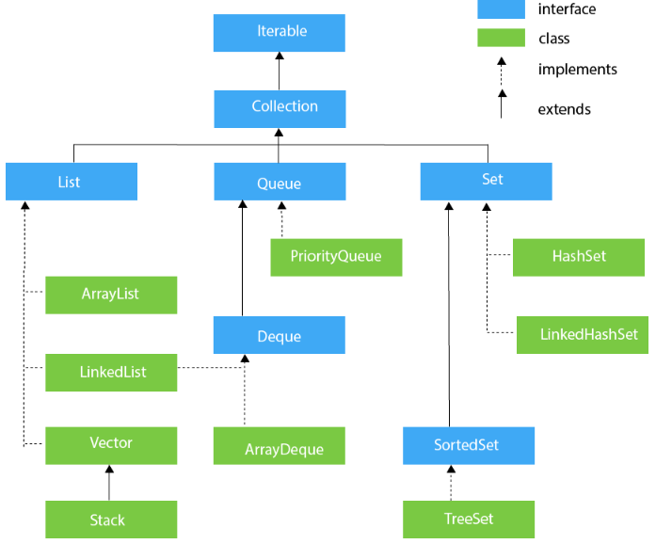
Collections – Hierarchy
The java.util package contains all the classes and interfaces for the Collection framework.

Slide 9
Collections - Methods
Method Name | Description
Boolean add(E obj) | Adds objects to invoking collection, returns true if added, false if it fails.
Boolean addAll(Collection c) | Adds all the elements of c to the invoking collection
Void clear() | Removes all the elements from the invoking collection
Boolean contains(Object obj) | Returns true if the invoking collection contains object, returns false if it does not contain
Int size() | Returns the number of elements held in the invoking collection
Boolean remove(Object obj) | Removes specified object from collection and returns true if it is success else false
Boolean removeAll(Collection c) | Removes all elements of c from the invoking collection

Slide 10
Interface - Iterator
Iterator interface provides the facility of iterating the elements in a forward direction only.
Methods of Iterator interface
Method | Description
public boolean hasNext() | It returns true if the iterator has more elements otherwise it returns false.
public Object next() | It returns the element and moves the cursor pointer to the next element.
public void remove() | It removes the last elements returned by the iterator. It is less used.

Slide 11
Interface - Iterable
The Iterable interface is the root interface for all the collection classes.
The Collection interface extends the Iterable interface and therefore all the subclasses of Collection interface also implement the Iterable interface.
It contains only one abstract method. i.e.,
Iterator<T> iterator()
It returns the iterator over the elements of type T.

Slide 12
Interface - Collection
The Collection interface is the interface which is implemented by all the classes in the collection framework.
It declares the methods that every collection will have.
In other words, we can say that the Collection interface builds the foundation on which the collection framework depends.

Slide 13
Interface – Collection [Cont..]
Some of the methods of Collection interface are:
Boolean add ( Object obj)
Boolean addAll ( Collection c)
void clear()
Above are implemented by all the subclasses of Collection interface.

Slide 14
Interface - List
List interface is the child interface of Collection interface.
It inhibits a list type data structure in which we can store the ordered collection of objects.
It can have duplicate values.
List interface is implemented by the classes ArrayList, LinkedList, Vector, and Stack.

Slide 15
Interface – List [Cont..]
To instantiate the List interface, we must use :
List <data-type> list1= new ArrayList();
List <data-type> list2 = new LinkedList();
List <data-type> list3 = new Vector();
List <data-type> list4 = new Stack();
There are various methods in List interface that can be used to insert, delete, and access the elements from the list.

Slide 16
ArrayList
The ArrayList class implements the List interface.
It uses a dynamic array to store the duplicate element of different data types.
The ArrayList class maintains the insertion order and is non-synchronized.
The elements stored in the ArrayList class can be randomly accessed.

Slide 17
Example – Array List

Slide 18
Linked List
LinkedList implements the Collection interface.
It uses a doubly linked list internally to store the elements.
It can store the duplicate elements.
It maintains the insertion order and is not synchronized.
In LinkedList, the manipulation is fast because no shifting is required.

Slide 19
Example

Slide 20
Vector
Vector uses a dynamic array to store the data elements.
It is similar to ArrayList.
However, It is synchronized and contains many methods that are not the part of Collection framework.

Slide 21
Example

Slide 22
Stack
The stack is the subclass of Vector.
It implements the last-in-first-out data structure.
The stack contains all of the methods of Vector class and also provides its methods like:
boolean push()
boolean peek()
boolean push(object o)
which defines its properties.

Slide 23
Example

Slide 24
Interface - Queue
Queue interface maintains the first-in-first-out order.
It can be defined as an ordered list that is used to hold the elements which are about to be processed.
There are various classes like PriorityQueue, Dequeue, and ArrayDequeue which implements the Queue interface.

Slide 25
Interface – Queue [Cont..]
Queue interface can be instantiated as:
Queue<String> q1 = new PriorityQueue();
Queue<String> q2 = new ArrayDeque();
There are various classes that implement the Queue interface

Slide 26
Priority Queue
The PriorityQueue class implements the Queue interface.
It holds the elements or objects which are to be processed by their priorities.
PriorityQueue doesn't allow null values to be stored in the queue.

Slide 27
Example

Slide 28
Dequeue Interface
Dequeue interface extends the Queue interface.
In Dequeue, we can remove and add the elements from both the side.
Dequeue stands for a double-ended queue which enables us to perform the operations at both the ends.
Dequeue can be instantiated as:
Deque d = new ArrayDeque();

Slide 29
Array Dequeue
ArrayDeque class implements the Deque interface.
It facilitates us to use the Deque.
Unlike queue, we can add or delete the elements from both the ends.
ArrayDeque is faster than ArrayList and Stack and has no capacity restrictions.

Slide 30
Example

Slide 31
Interface - Set
Set Interface in Java is present in java.util package.
It extends the Collection interface.
It represents the unordered set of elements which doesn't allow us to store the duplicate items.
We can store at most one null value in Set.

Slide 32
Interface – Set [Cont..]
Set is implemented by HashSet, LinkedHashSet, and TreeSet.
Set can be instantiated as:
Set<data-type> s1 = new HashSet<data-type>();
Set<data-type> s2 = new LinkedHashSet<data-type>();
Set<data-type> s3 = new TreeSet<data-type>();

Slide 33
HashSet
HashSet class implements Set Interface.
It represents the collection that uses a hash table for storage.
Hashing is used to store the elements in the HashSet.
It contains unique items.

Slide 34
Example

Slide 35
LinkedHashSet
LinkedHashSet class represents the LinkedList implementation of Set Interface.
It extends the HashSet class and implements Set interface.
Like HashSet, It also contains unique elements.
It maintains the insertion order and permits null elements.

Slide 36
Example

Slide 37
SortedSetInterface
SortedSet is the alternate of Set interface that provides a total ordering on its elements.
The elements of the SortedSet are arranged in the increasing (ascending) order.
The SortedSet provides the additional methods that inhibit the natural ordering of the elements.
The SortedSet can be instantiated as:
SortedSet<data-type> set = new TreeSet();

Slide 38
TreeSet
Java TreeSet class implements the Set interface that uses a tree for storage.
Like HashSet, TreeSet also contains unique elements.
However, the access and retrieval time of TreeSet is quite fast.
The elements in TreeSet stored in ascending order.

Slide 39
Example

Slide 40
Introducing Generics
The Java Generics programming is introduced in J2SE 5 to deal with type-safe objects.
It makes the code stable by detecting the bugs at compile time.
Before generics, we can store any type of objects in the collection, i.e., non-generic.
Now generics force the java programmer to store a specific type of objects.

Slide 41
Advantages – Generics
There are mainly 3 advantages of generics.
They are as follows:
Type-Safety
Type casting is not required
Compile time checking

Slide 42
Type-Safety
We can hold only a single type of objects in generics.
It doesn’t allow to store other objects.
Without Generics, we can store any type of objects.
Example:

Slide 43
Type Casting Is Not Required
There is no need to typecast the object.
Before Generics, we need to type cast.
Example:

Slide 44
Compile Time Checking
It is checked at compile time so problem will not occur at runtime.
The good programming strategy says it is far better to handle the problem at compile time than runtime.
Example:

Slide 45
A complete Generic Example

Slide 46
Generics Using Maps

