Slide 1

Introduction To
Git and GitHub

Slide 2
About Me
Abin Joseph
KMEA Engineering College
Full Stack Developer & DevOps Engineer
Currently working as an devops intern at Emvigo Technologies

Slide 3

Introduction to
Git and GitHub
@abjs
Abin Joseph
👋👋Adi Shankara

Slide 4


Before we start...
Git Installed (Install from git-scm.org)
GitHub account
Your favorite editor

Slide 5
Why Vs Code ?

Slide 6
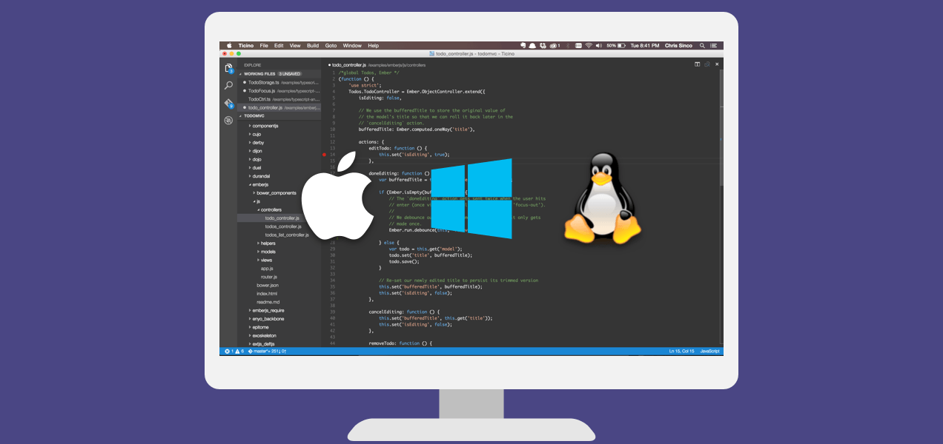

Slide 7
Vs Code Built-In GIT Support

Slide 8
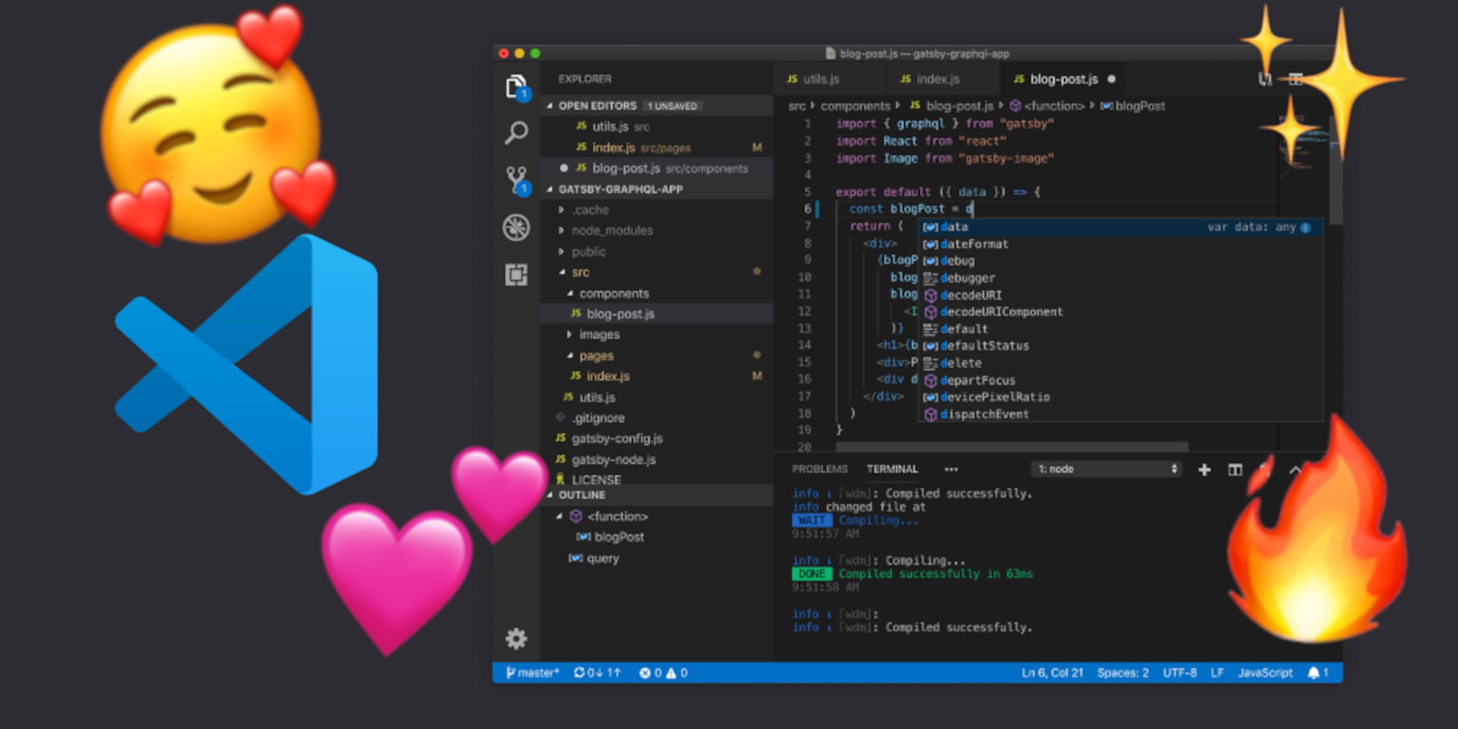

Slide 9
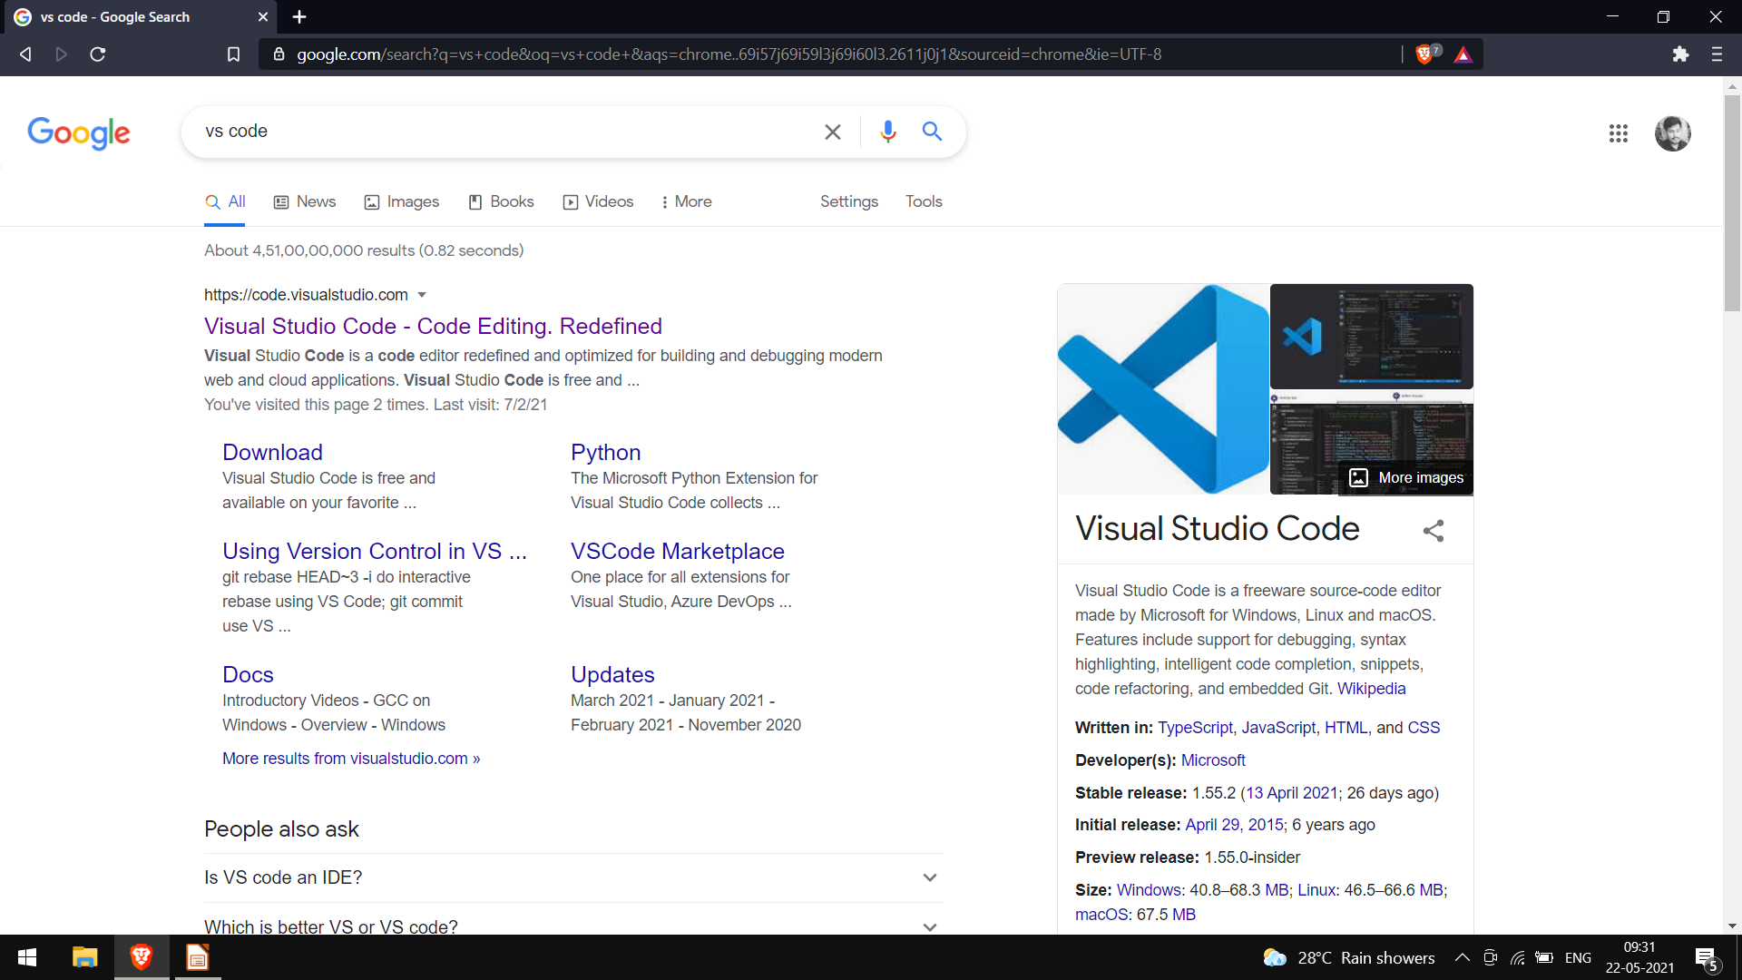

Slide 10
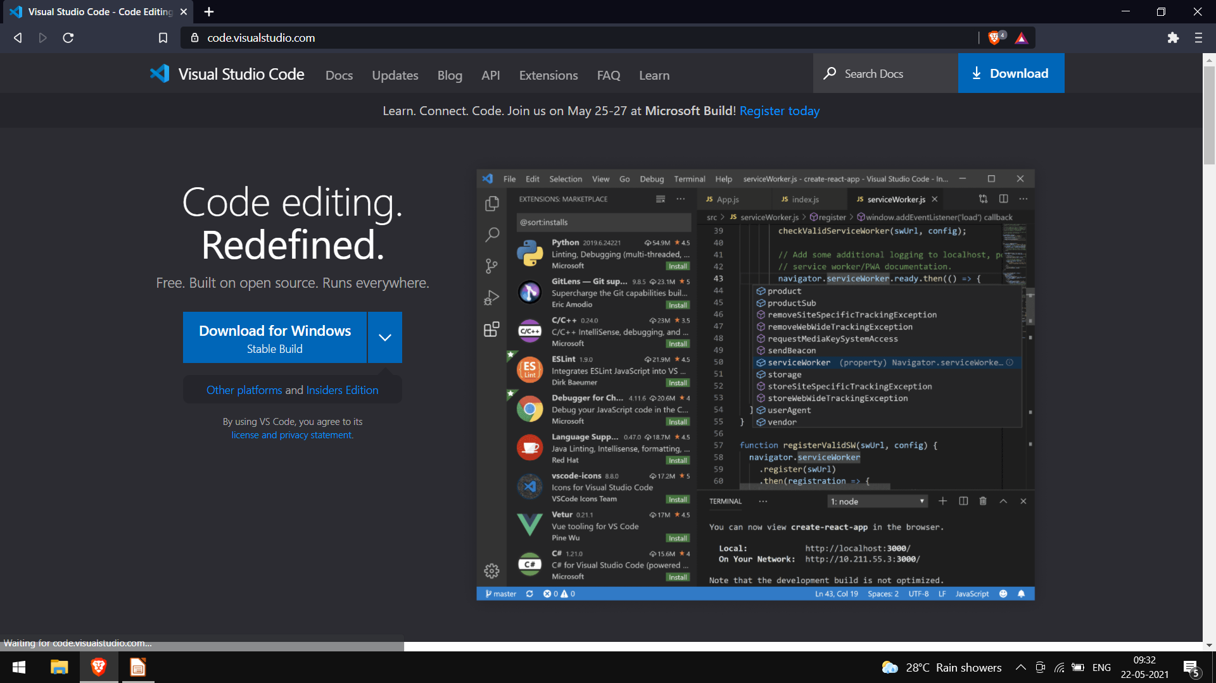

Slide 11
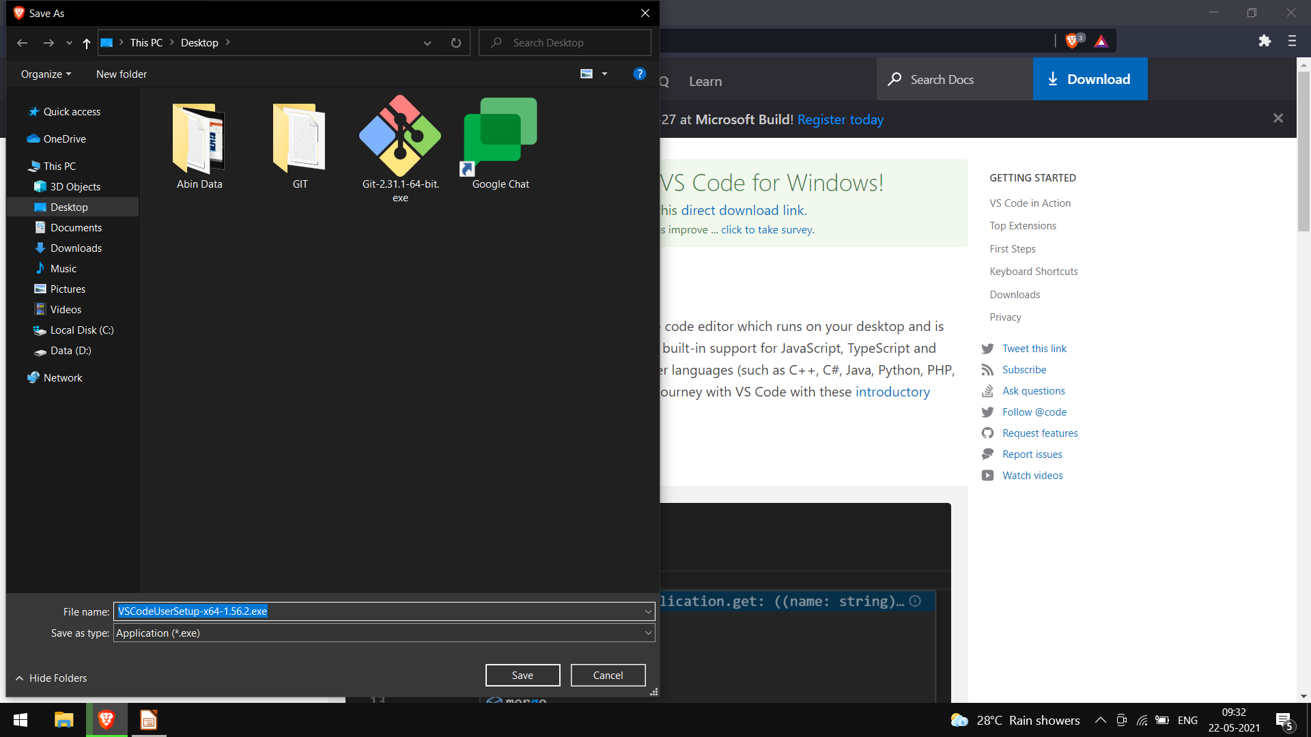

Slide 12
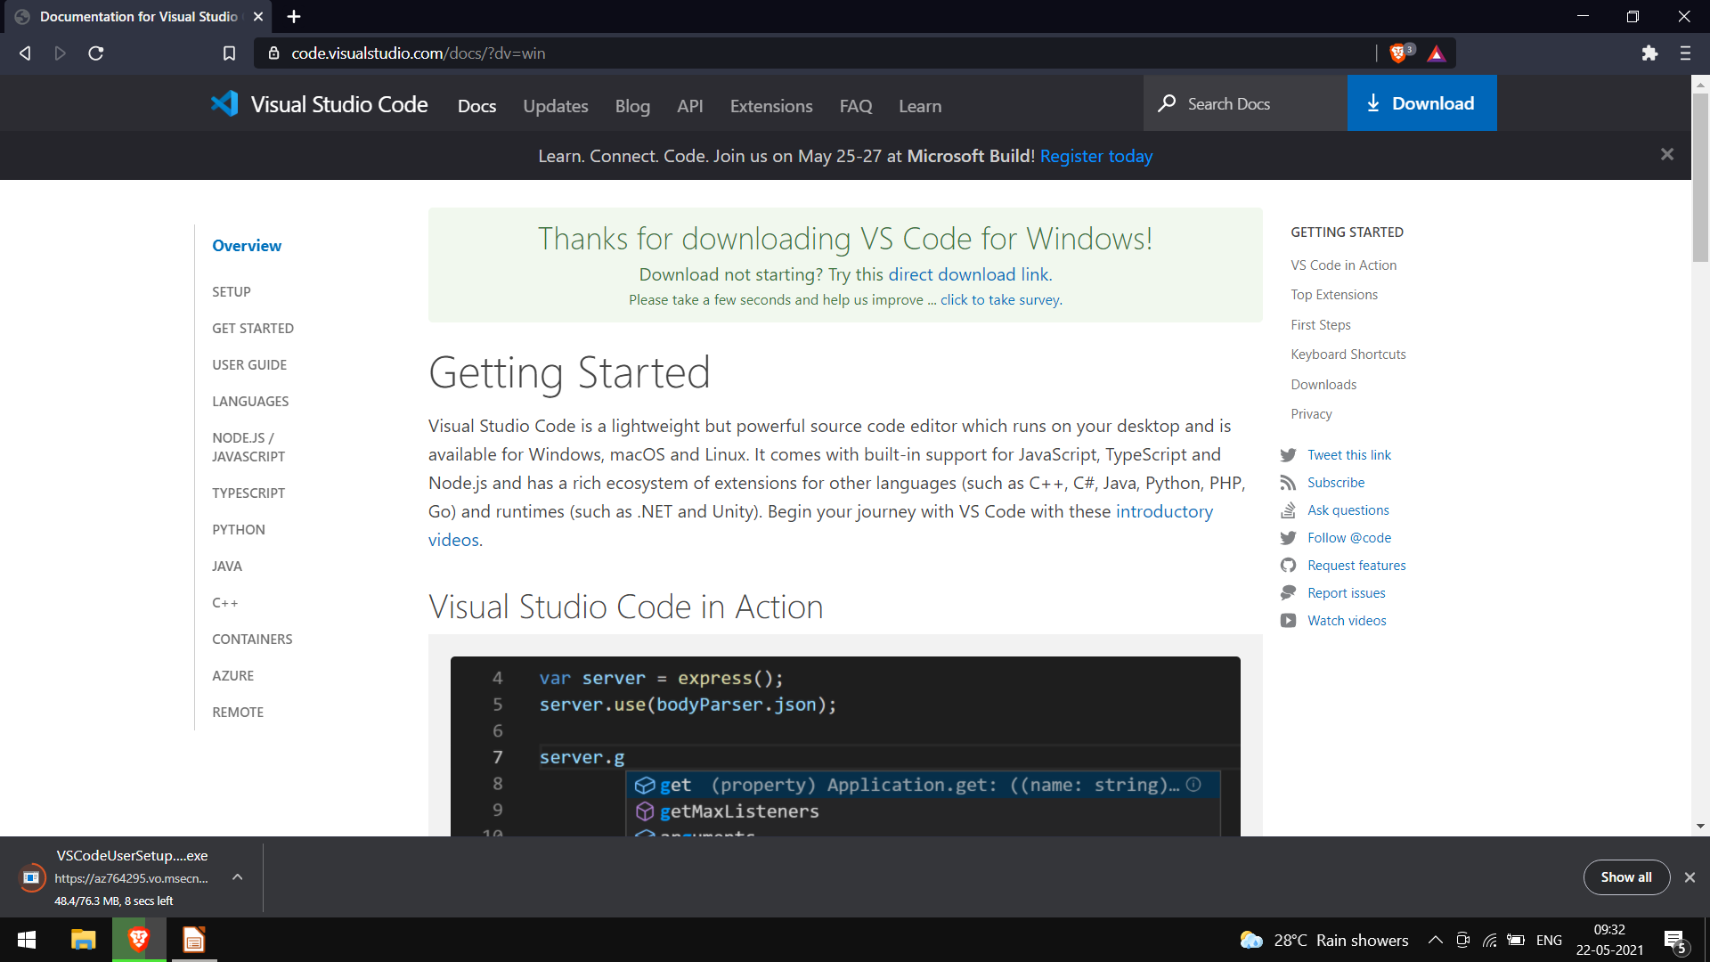

Slide 13


Slide 14
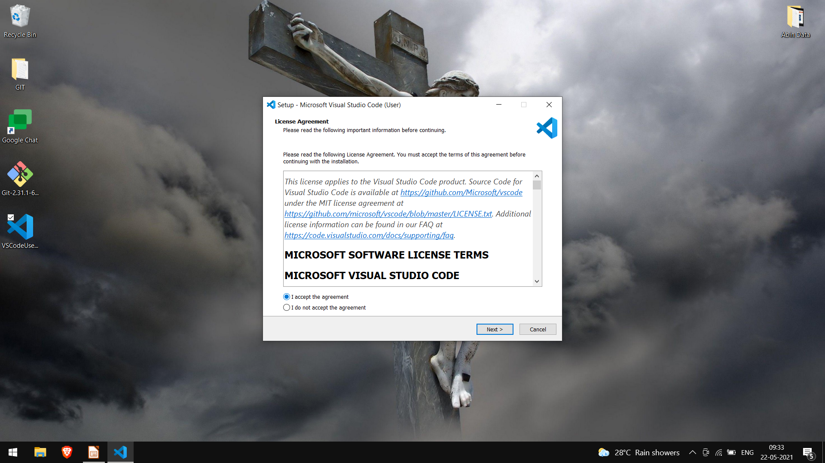

Slide 15
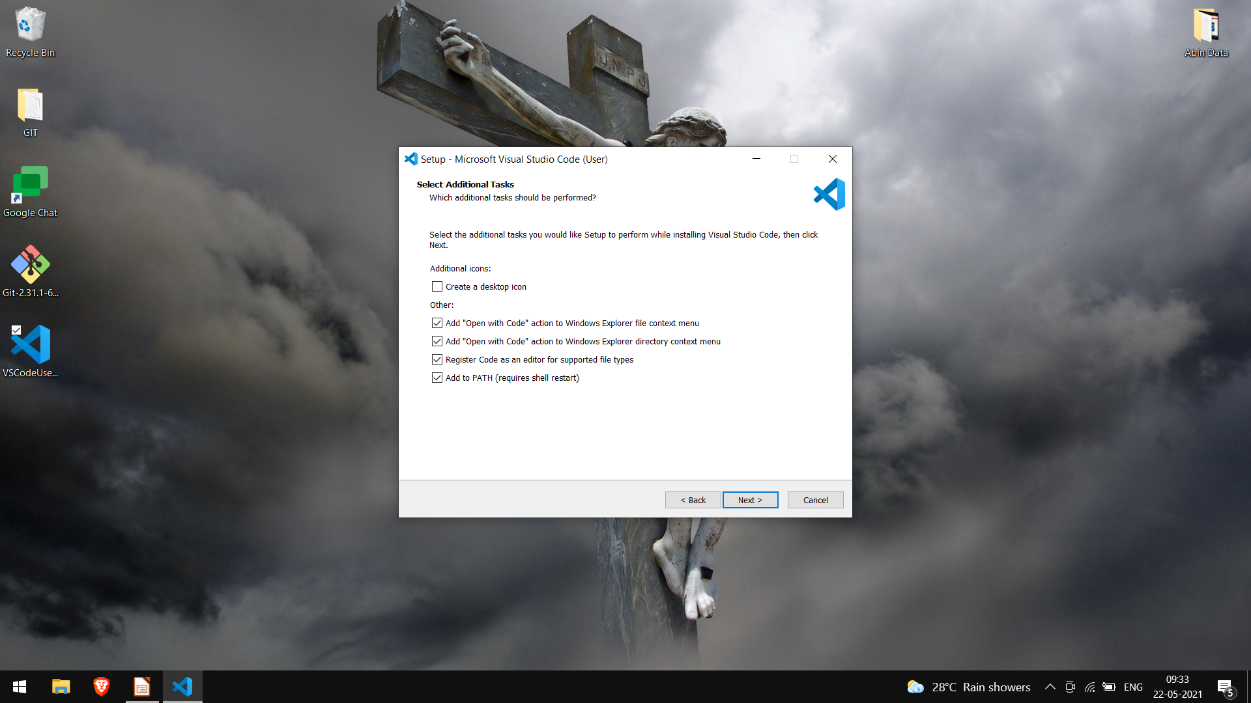

Slide 16
GIT

Slide 17
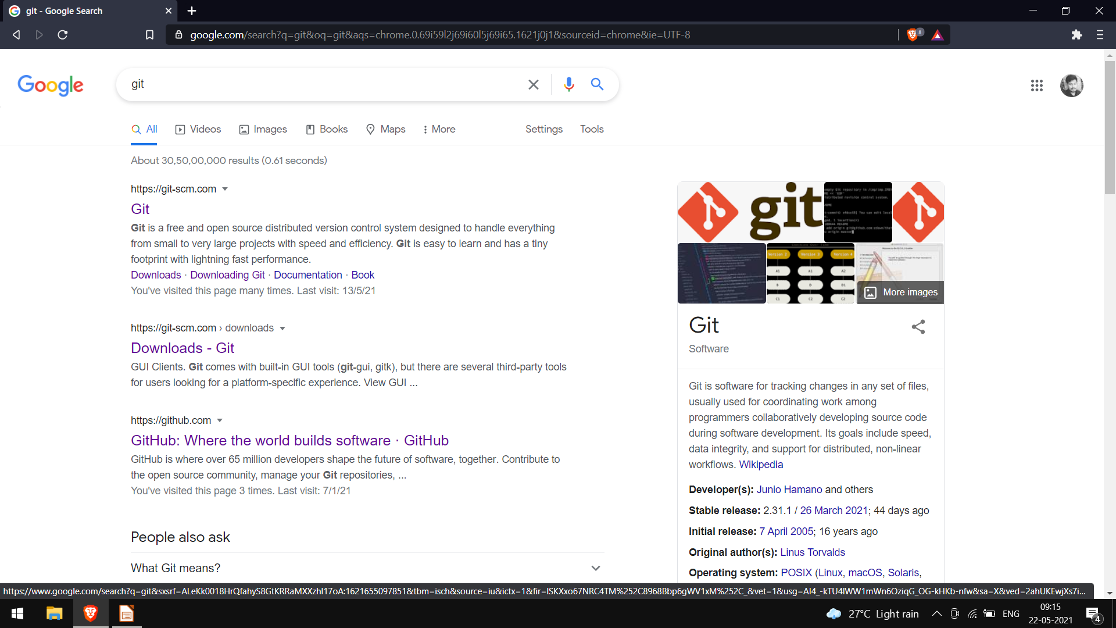

Slide 18
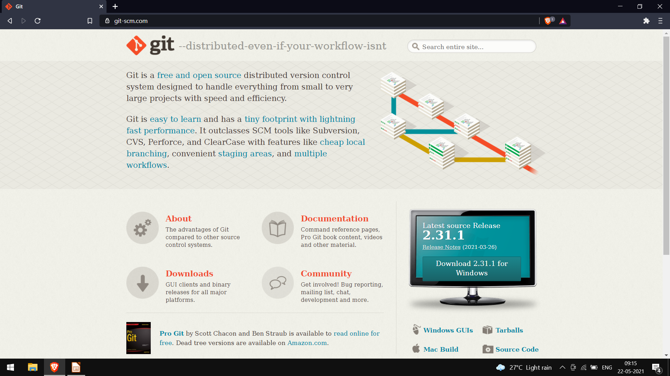

Slide 19
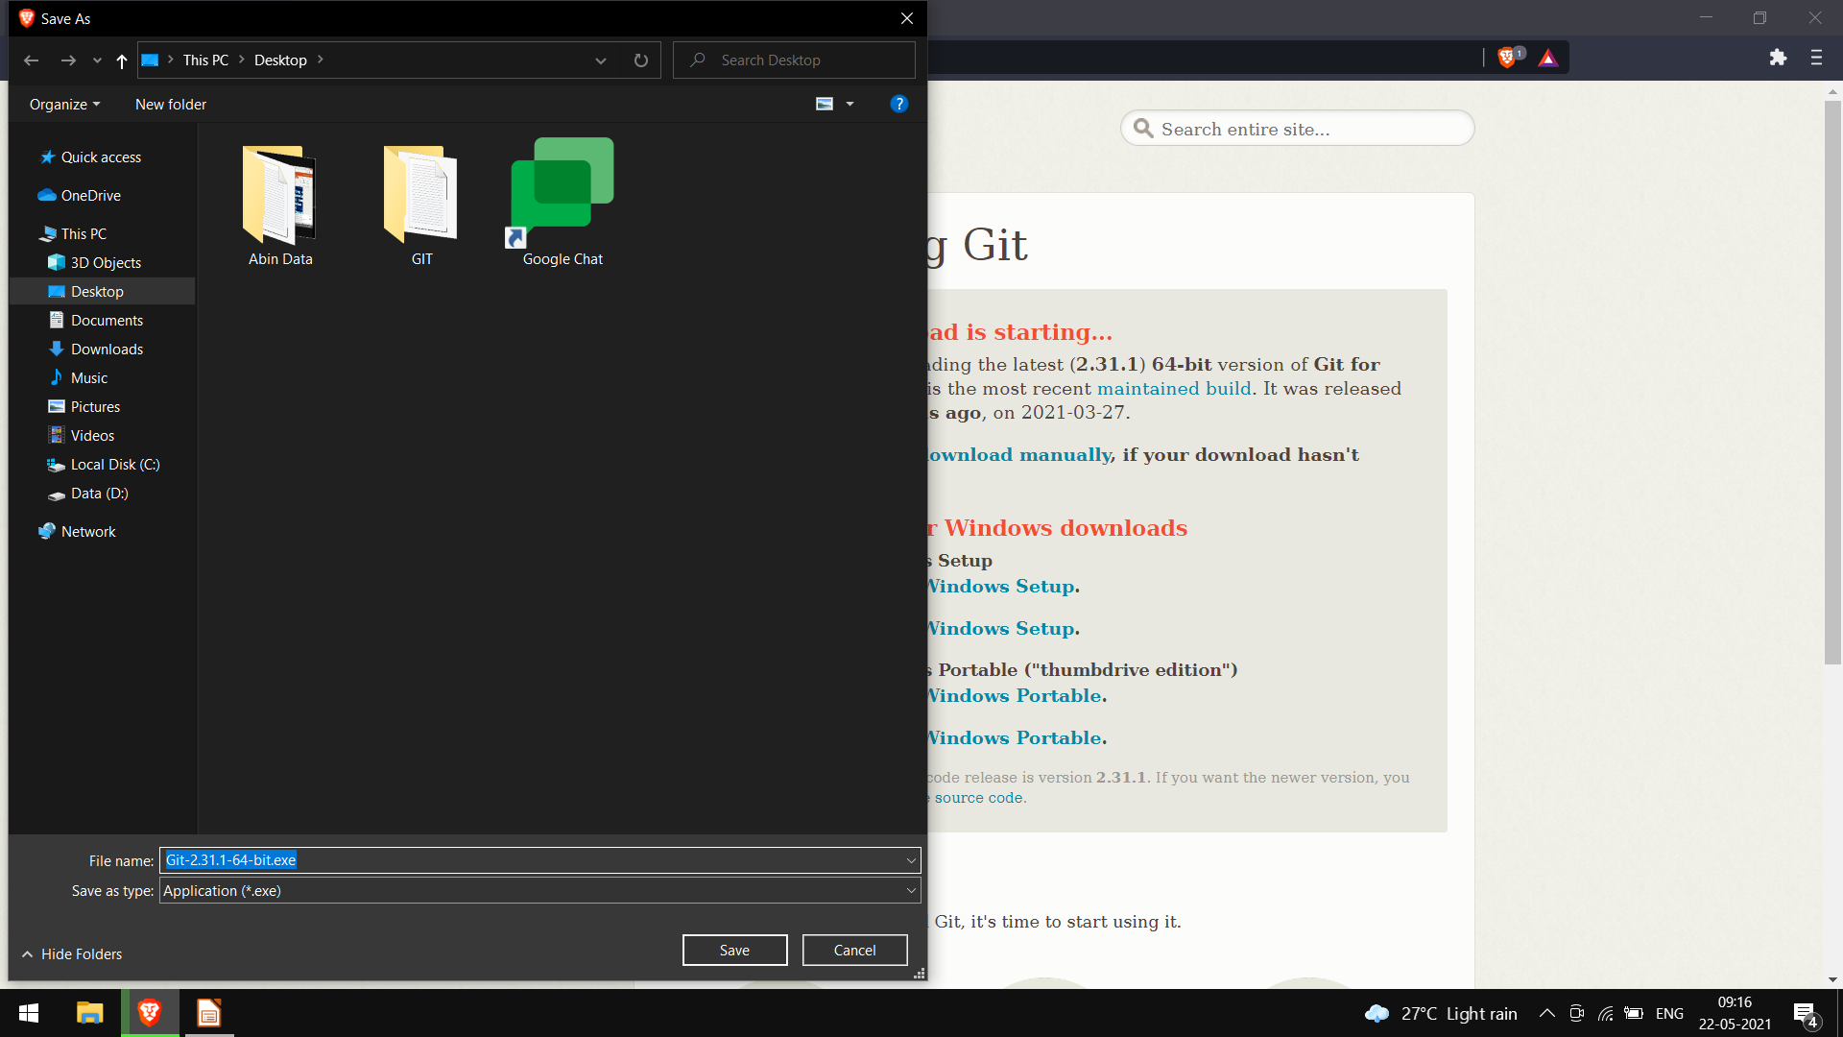

Slide 20
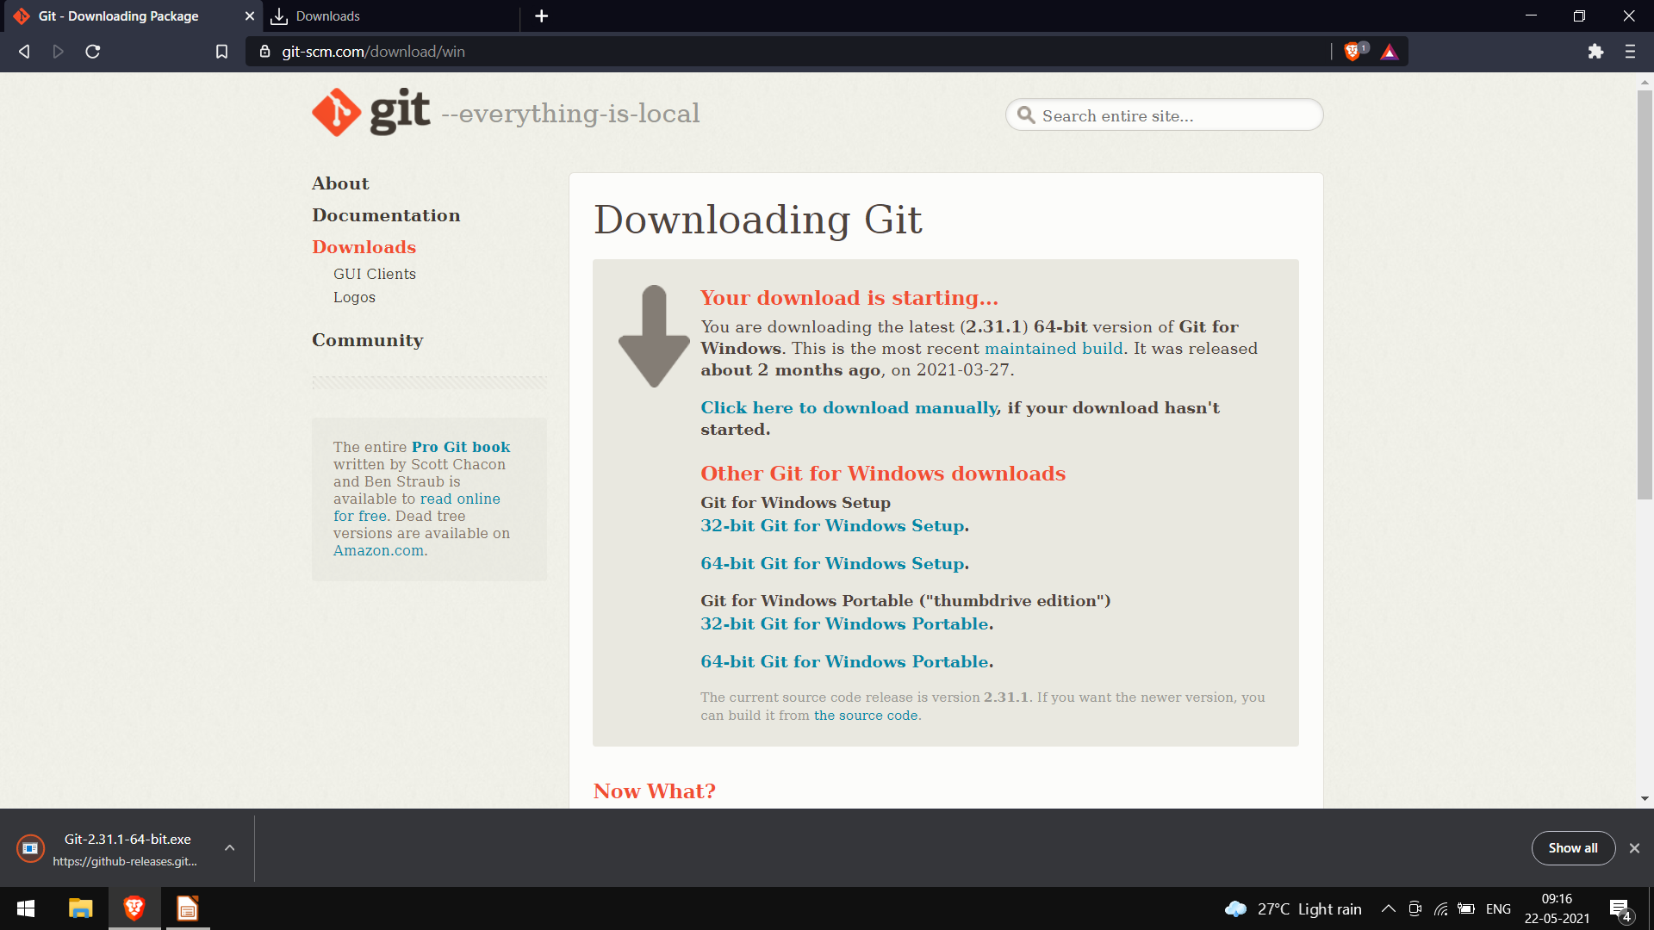

Slide 21
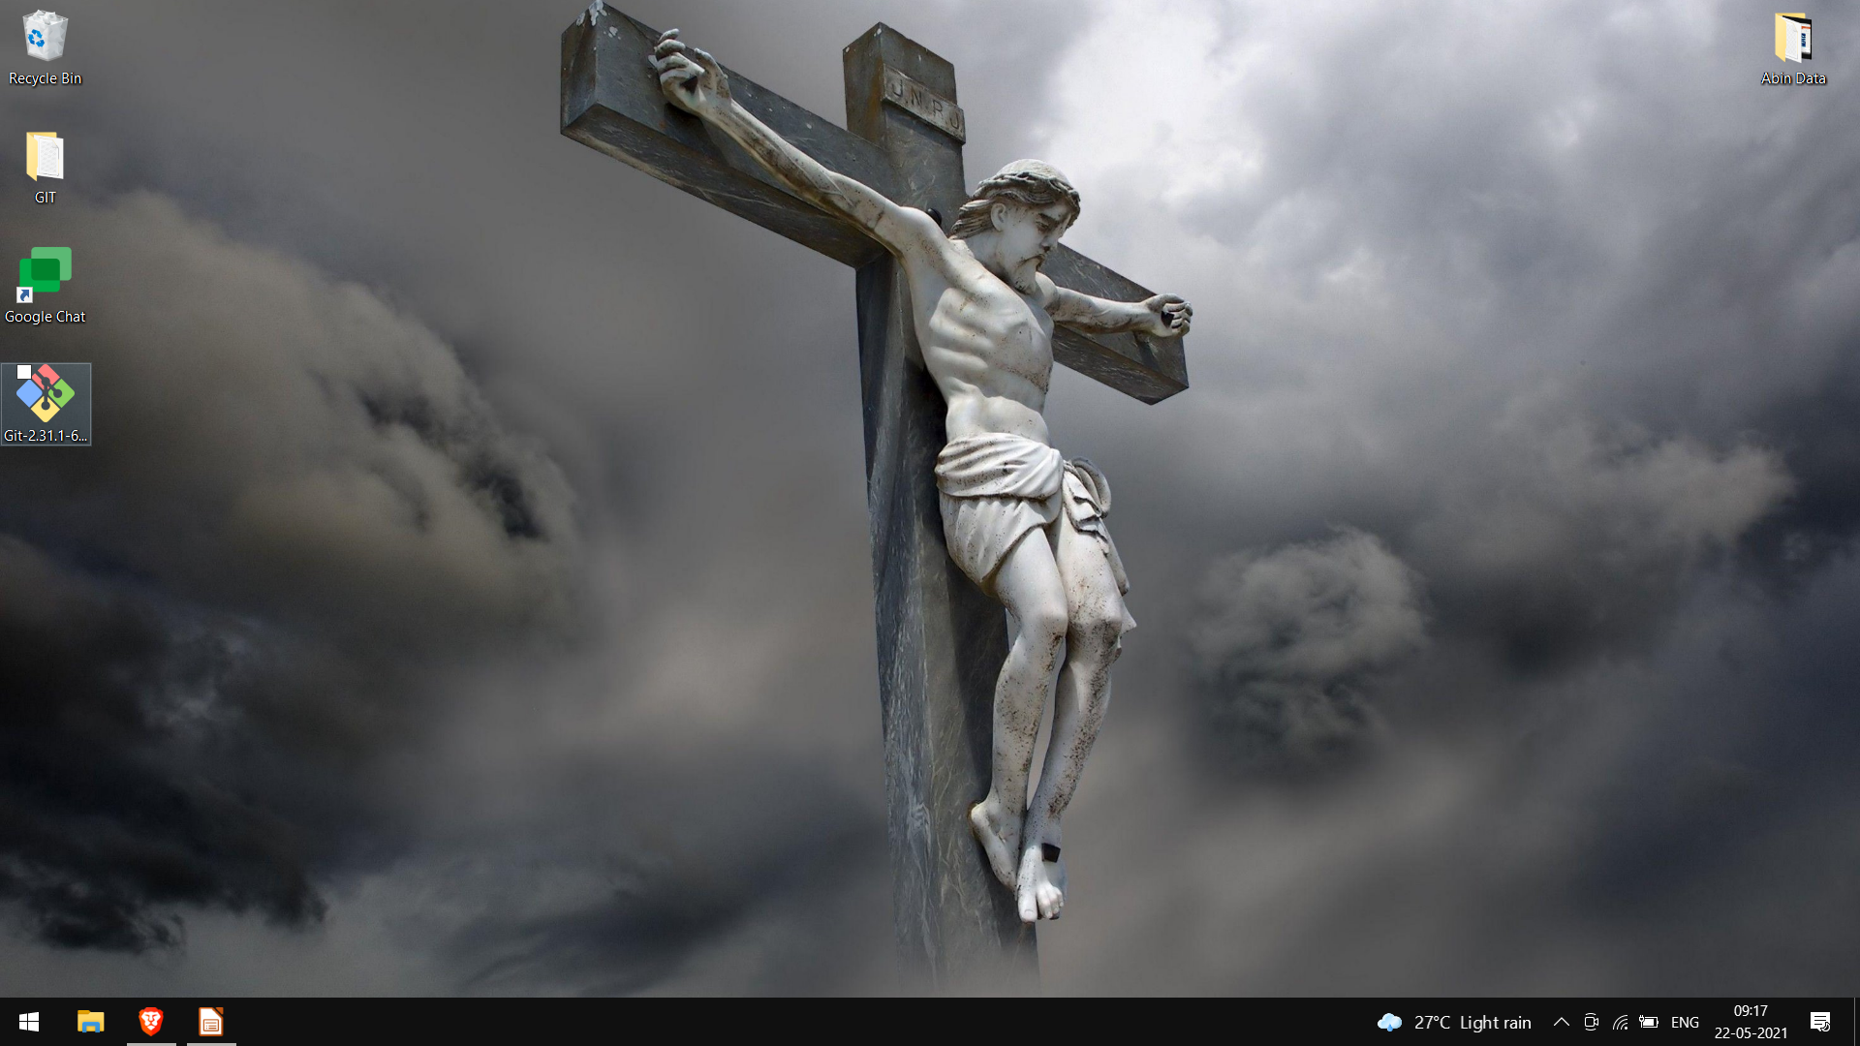

Slide 22
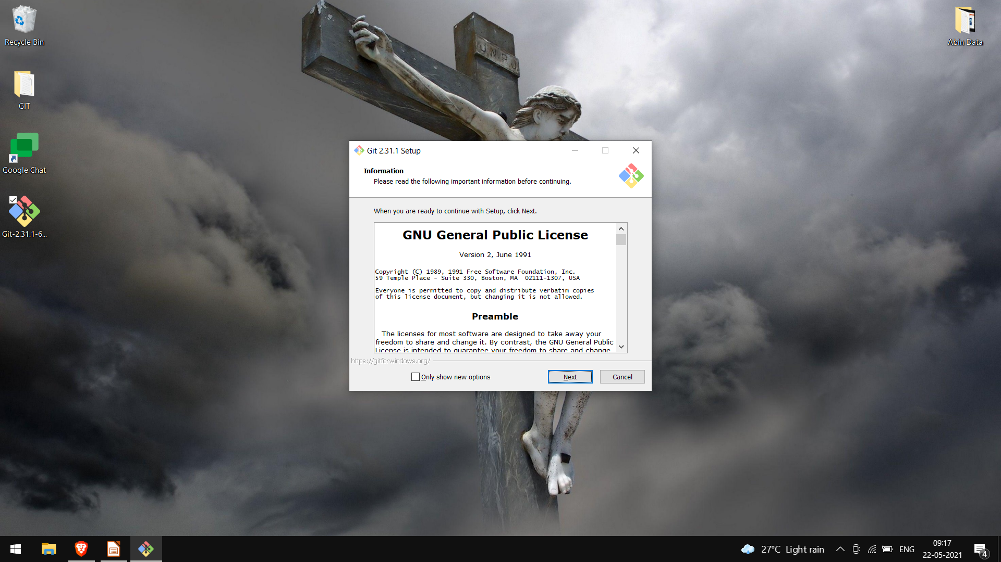

Slide 23
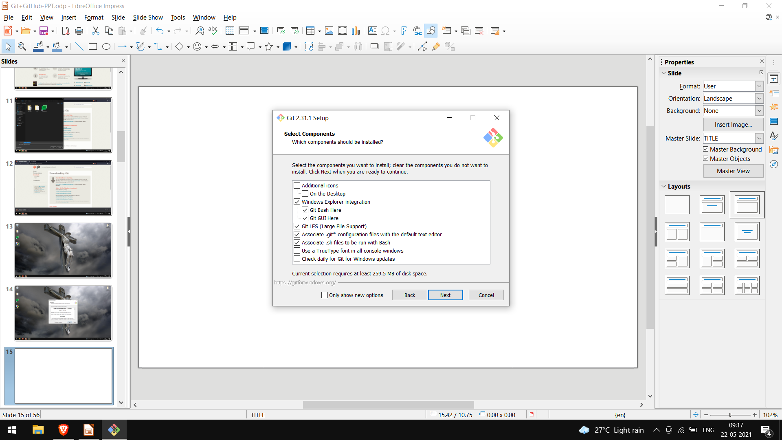

Slide 24
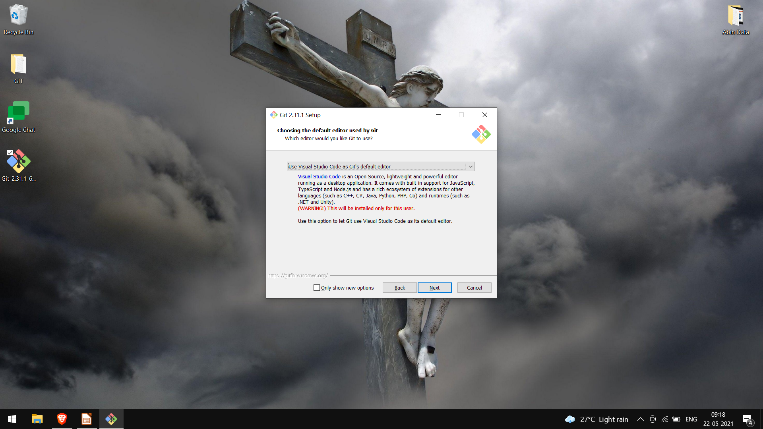

Slide 25
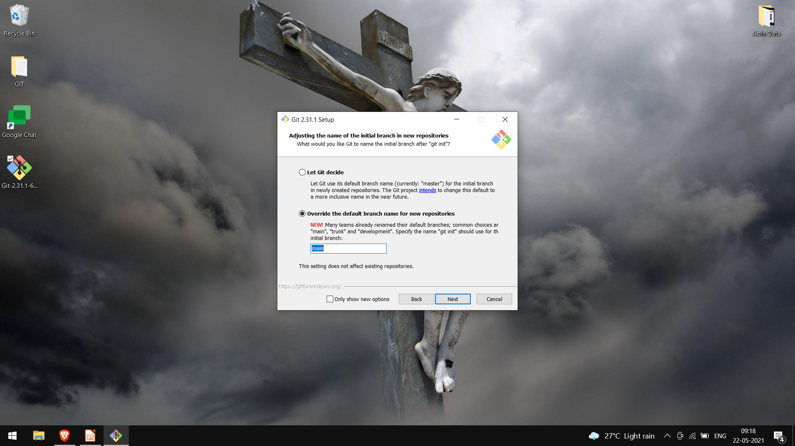

Slide 26
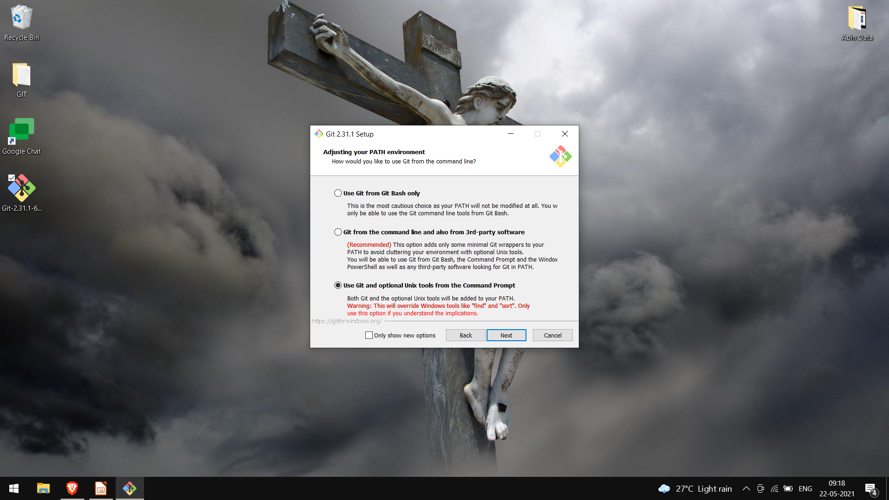

Slide 27
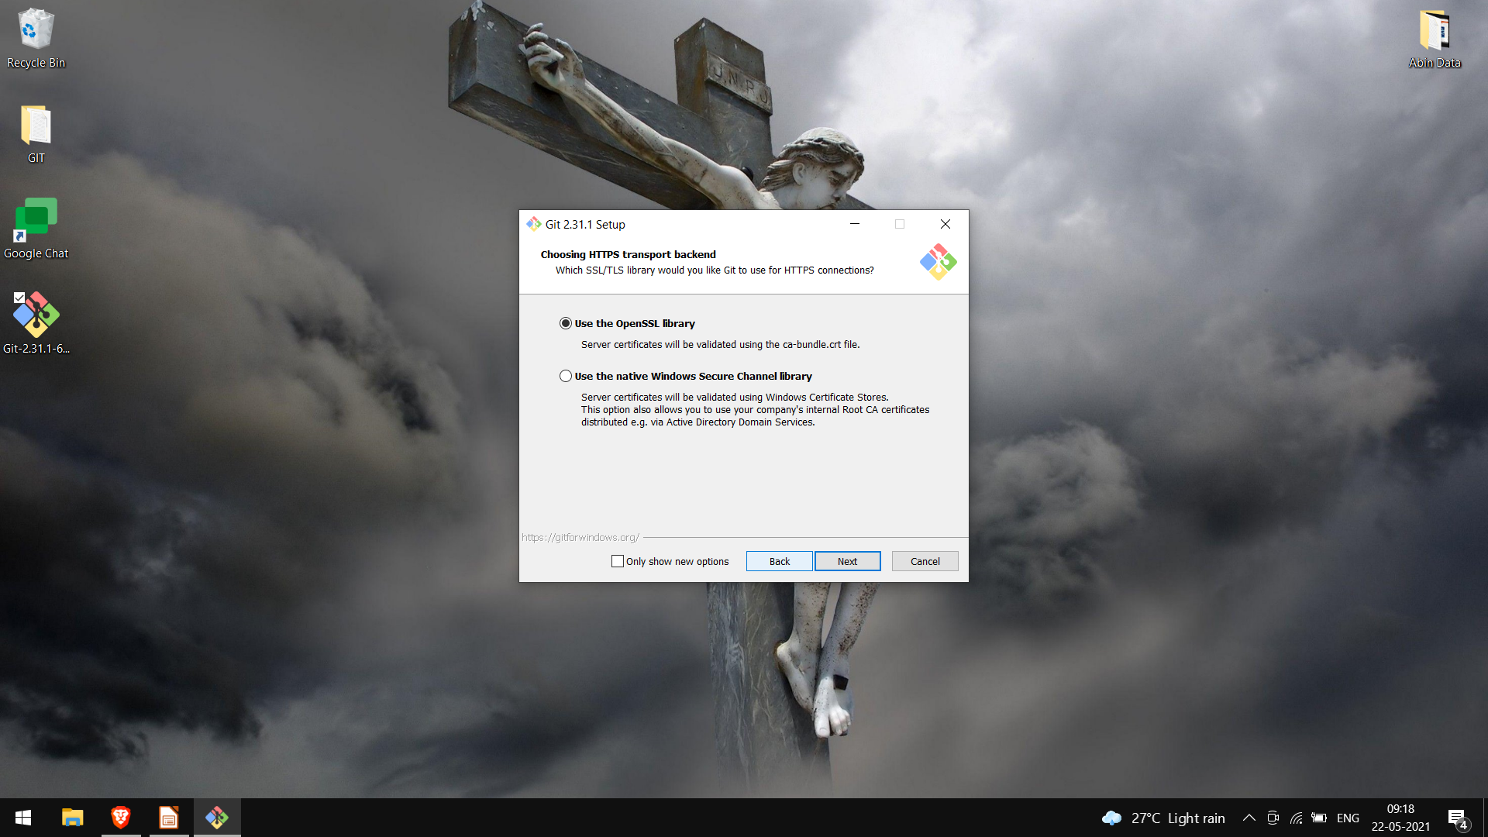

Slide 28


Slide 29


Slide 30


Slide 31
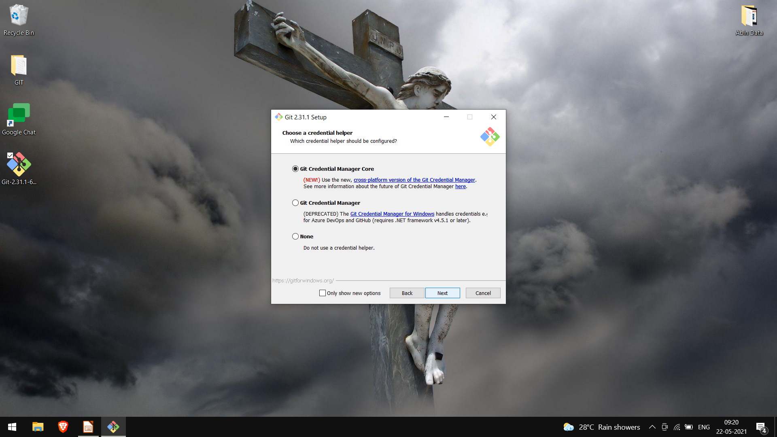

Slide 32


Slide 33
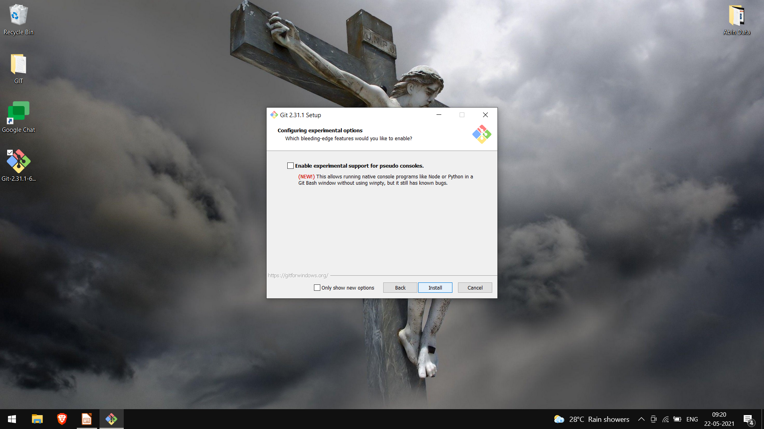

Slide 34


Slide 35
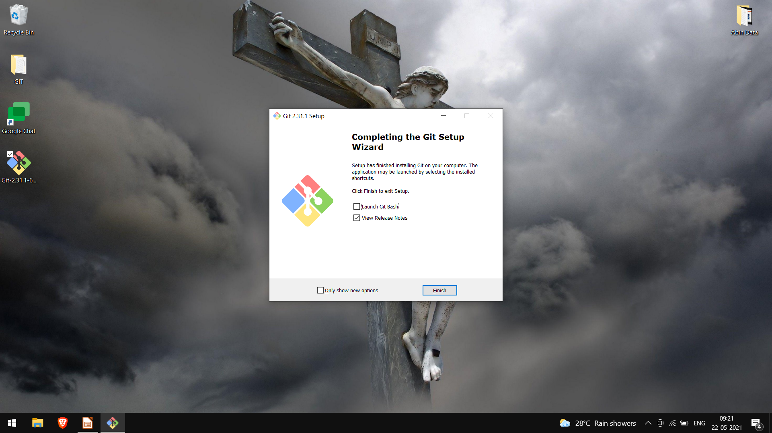

Slide 36
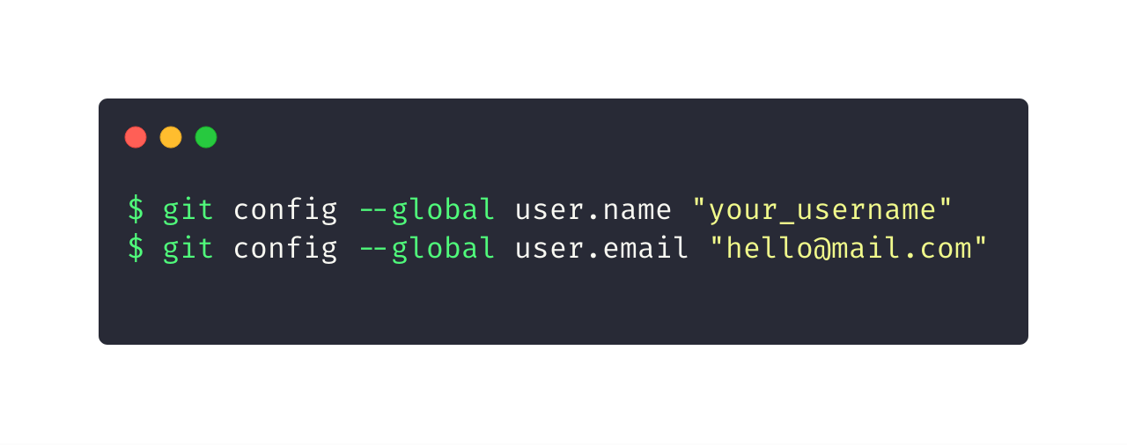
Let git know who you are
GitHub uses the email address set in your local Git configuration to associate commits pushed from the command line with your GitHub account.

Slide 37


Slide 38
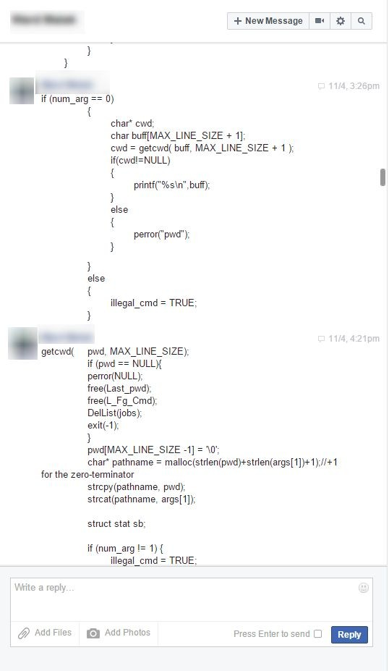

Slide 39
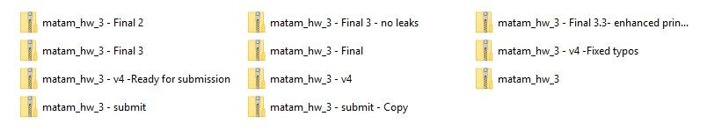

Slide 40
Use cases
Consider this scenario:
You have a homework submission in Matam for today and the assignment is ready for submission
While testing it you discovered a minor bug and decided to fix it

Slide 41
After attempting to do so, you accidentally changed a working code and got yourself in a big mess
You no longer remember what was and what wasn’t there
It is 23:58 PM

Slide 42

Now you realize that CTRL + Z won’t solve your
problems

Slide 43

What is git?

Slide 44

What is git?
Open source project originally developed in 2005 by Linus Torvalds
A command line utility
You can imagine git as something that sits on top of your file system and manipulates files.
A distributed version control system - DCVS

Slide 45

What is Git?
A Distributed Version Control System.
Any project which uses Git will have a .git folder which stores all the history of the project.

Slide 46



History:
Know exactly which files changed, who made those changes, and when those changes occured.
Backup:
Ability to have different versions of the code in different places.
Collaboration:
Collaborate easily with other people on the same project by uploading and receiving changes
Notes:
Git tracks the History
GIt acts as a Backup
Git Helps in Collaboration with several people

Slide 47
What is GitHub?
GitHub is a website that allows us to use git and create repositories online. It can also store all your projects online for free.
Notes:
GitHub was founded in 2008. Works on the Git Protocol. Can save upto 1GB of stuff. Some popular projects on GitHub. Home of Open Source.

Slide 48

My First Repo!
What is Git and GitHub?

Slide 49

What is a repository?
A repository is a container that houses your project and its history. If your project folder contains the “.git” folder you’re working with a repository!

Slide 50


Slide 51



If you are on windows, open Git-Bash.
If you are on linux or Mac, fire up a terminal.
Let’s get
started!

Slide 52
git commands
git init
git clone
git log
git diff
git status
git add
git commit

Slide 53
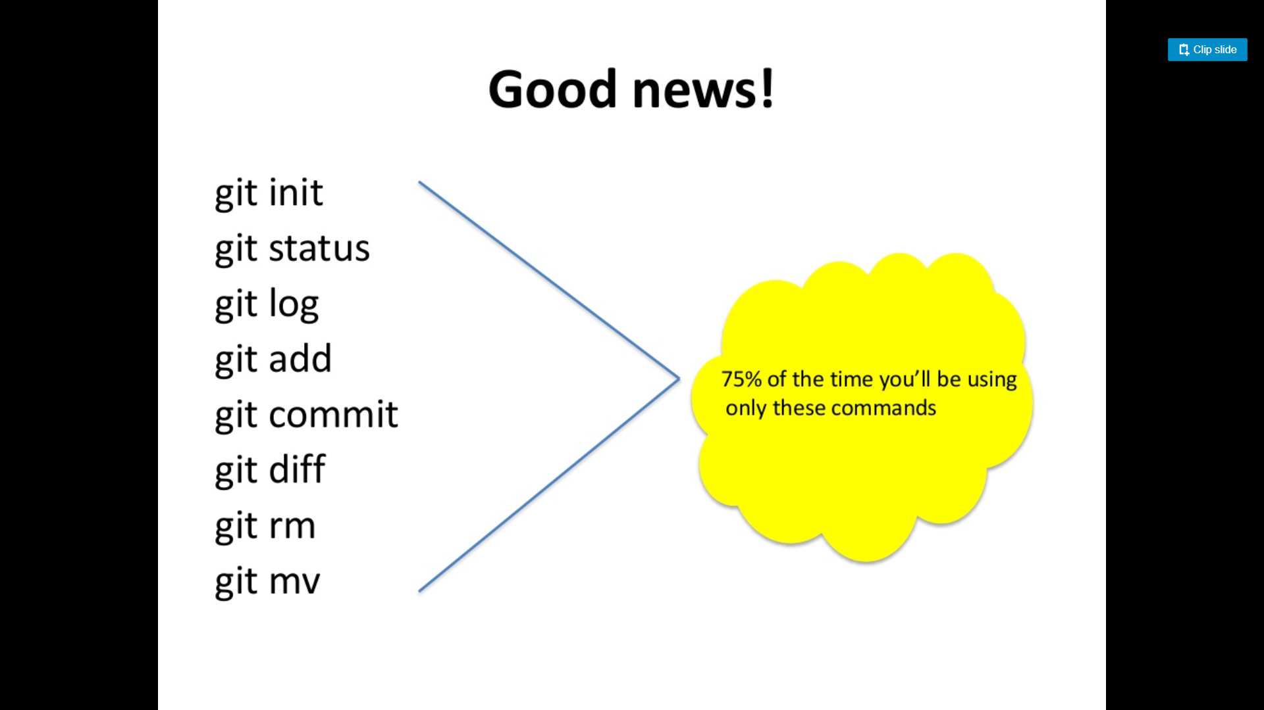

Slide 54
git init
Creates a new git repository
Can be used to convert an existing, unversioned project to a git repository or initialize a new empty repository

Slide 55
git clone
Copies an existing git repository

Slide 56
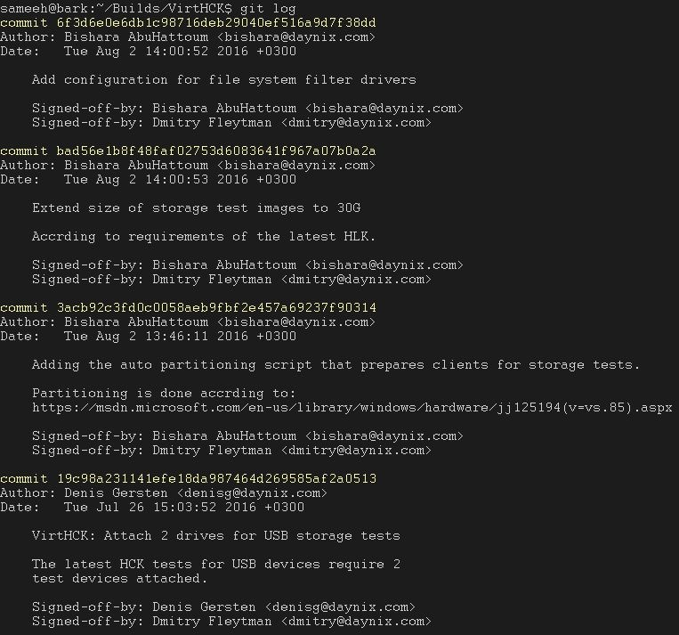
git log
Shows the commit logs

Slide 57
git add
Adds changes
Introduce a change
git add
Add the change to staging area
git commit
Make that change “permanent”

Slide 58
git commit
Creates a commit out of the changes that had been added
Introduce a change
git add
Add the change to staging area
git commit
Make that change “permanent”

Slide 59

Commits
Checkpoints/Snapshot of the state of your repository (project) at a particular time.

Slide 60
git diff
Displays the change that was introduced
Useful flag:
--cached:
Displays the change that was added using “git add”

Slide 61
git status
Displays the file names that has been modified, added and untracked

Slide 62
Bonus command: git checkout
Checking out a commit makes the entire working directory match that commit

Slide 63
Q&A

Slide 64
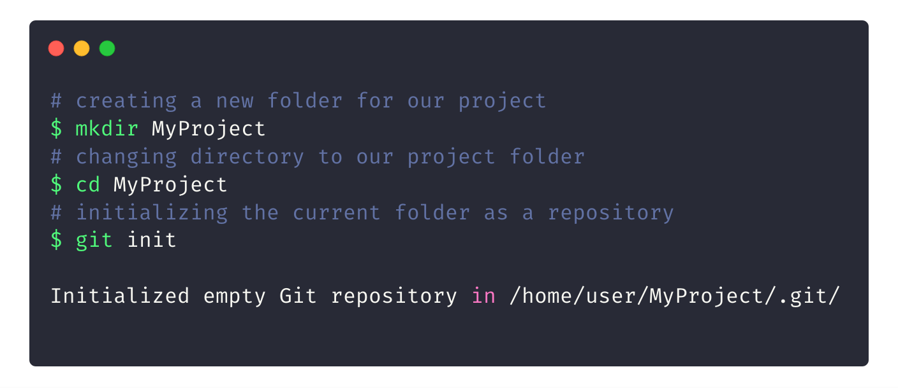
Initializing a new repository

Slide 65
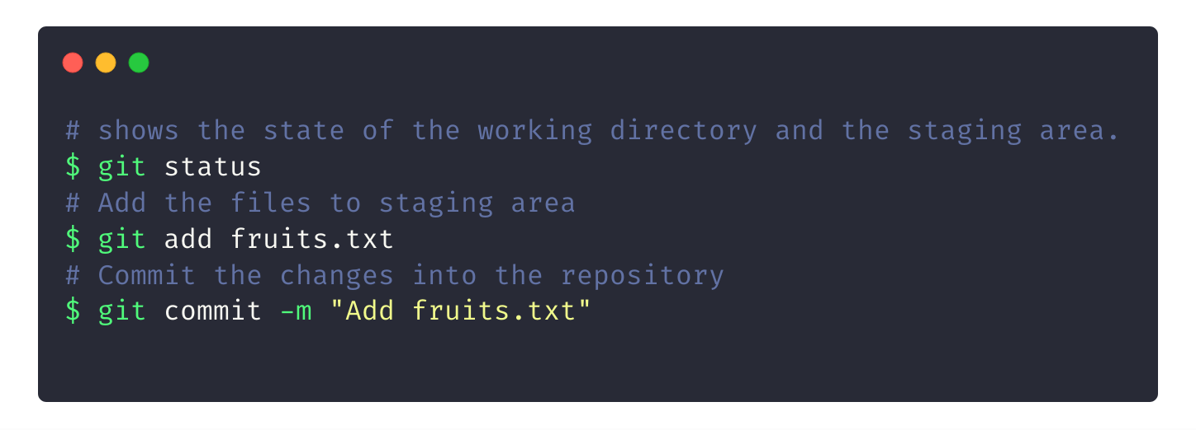
Creating your first commit
Notes:
Add some more fruits :)

Slide 66
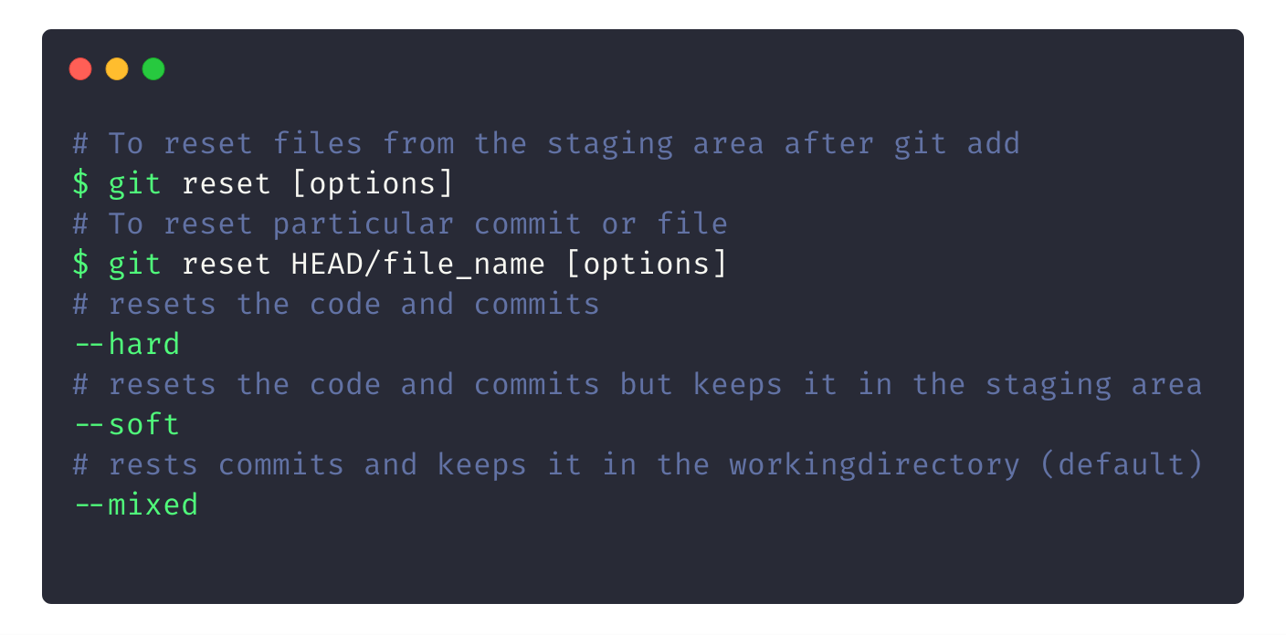
To Reset your Commits

Slide 67

Working with GitHub and fundamentals of Git 101.
Git Good!

Slide 68
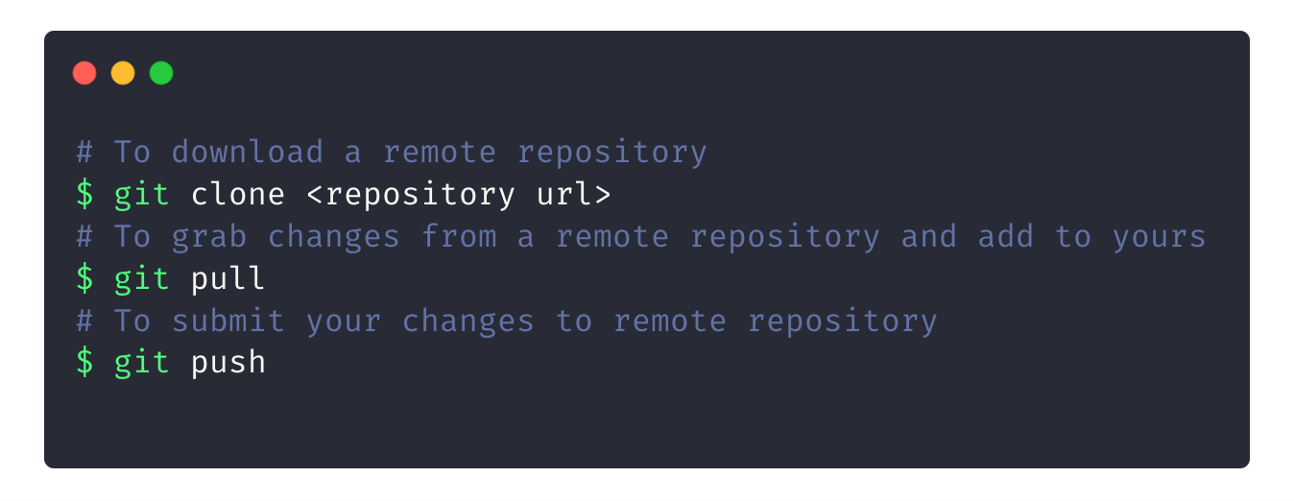
Downloading/Updating repos

Slide 69
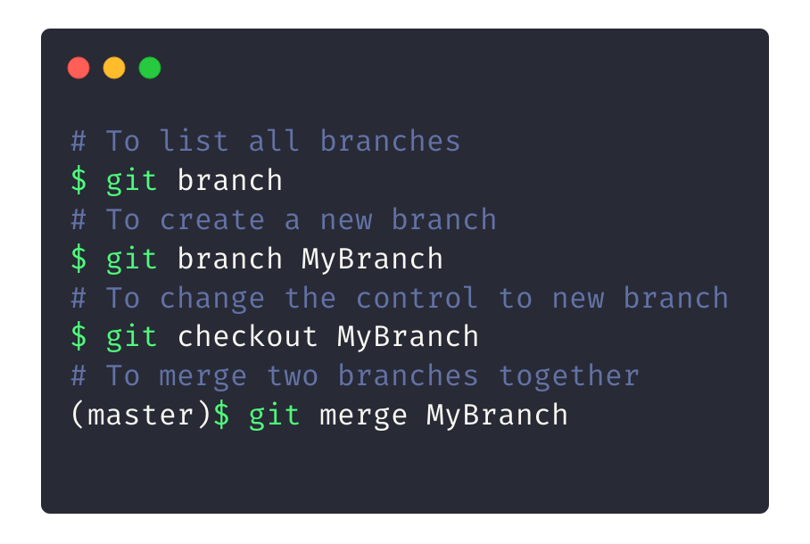
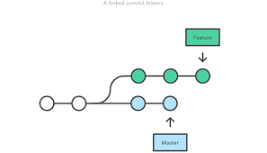
Git Branches
Notes:
Branches are

Slide 70

What can we do with GitHub?
Well, what not?

Slide 71





GitHub Education
Programs and technology leadership at your school
Campus Advisors

Slide 72

The GitHub Student
Developer Pack
Get the Pack at
https://education.github.com/pack
“To give students free access to the best developer tools in one place so they can learn by doing.”

