Slide 1

Introduction To
Git and GitHub

Slide 2
About Me
Abin Joseph
KMEA Engineering College
Full Stack Developer & DevOps Engineer
Currently working as an devops intern at Emvigo Technologies

Slide 3

Introduction to
Git and GitHub
@abjs
Abin Joseph
👋👋 Hii All

Slide 4


Before we start...
Git Installed (Install from git-scm.org)
GitHub account
Your favorite editor

Slide 5
Why Vs Code ?

Slide 6
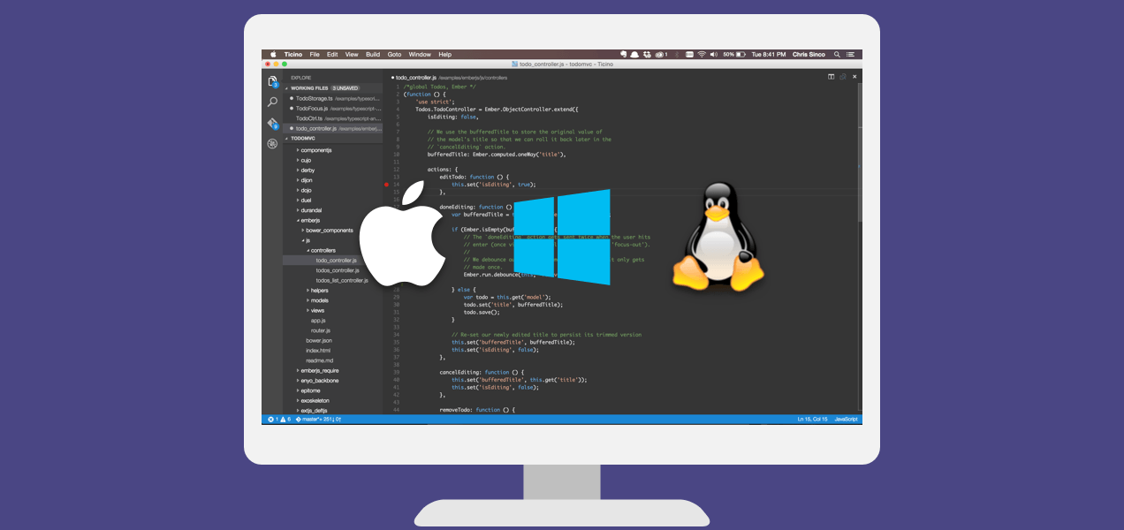

Slide 7
Vs Code Built-In GIT Support

Slide 8
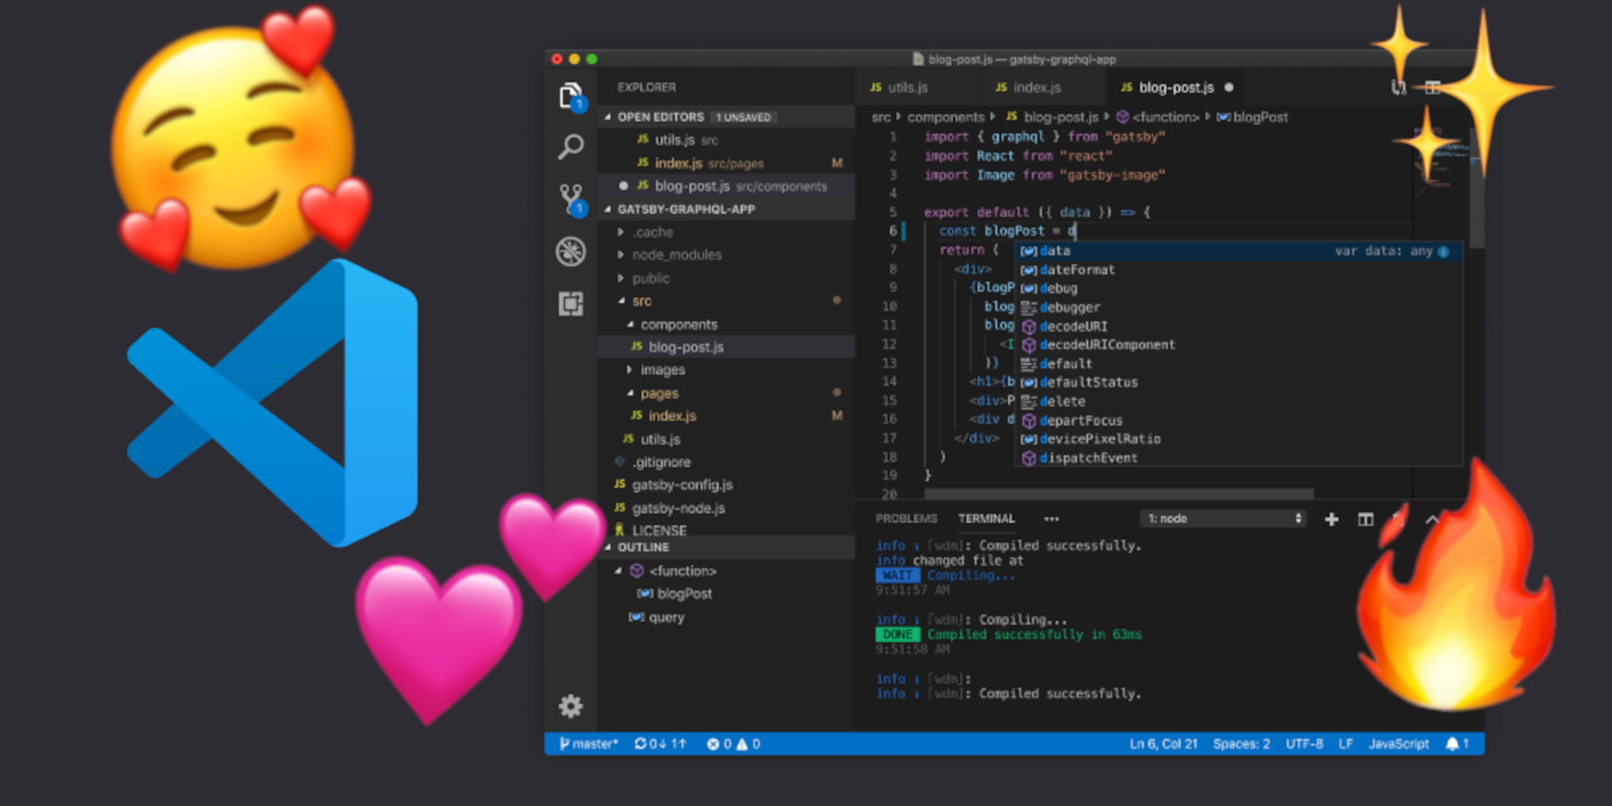

Slide 9
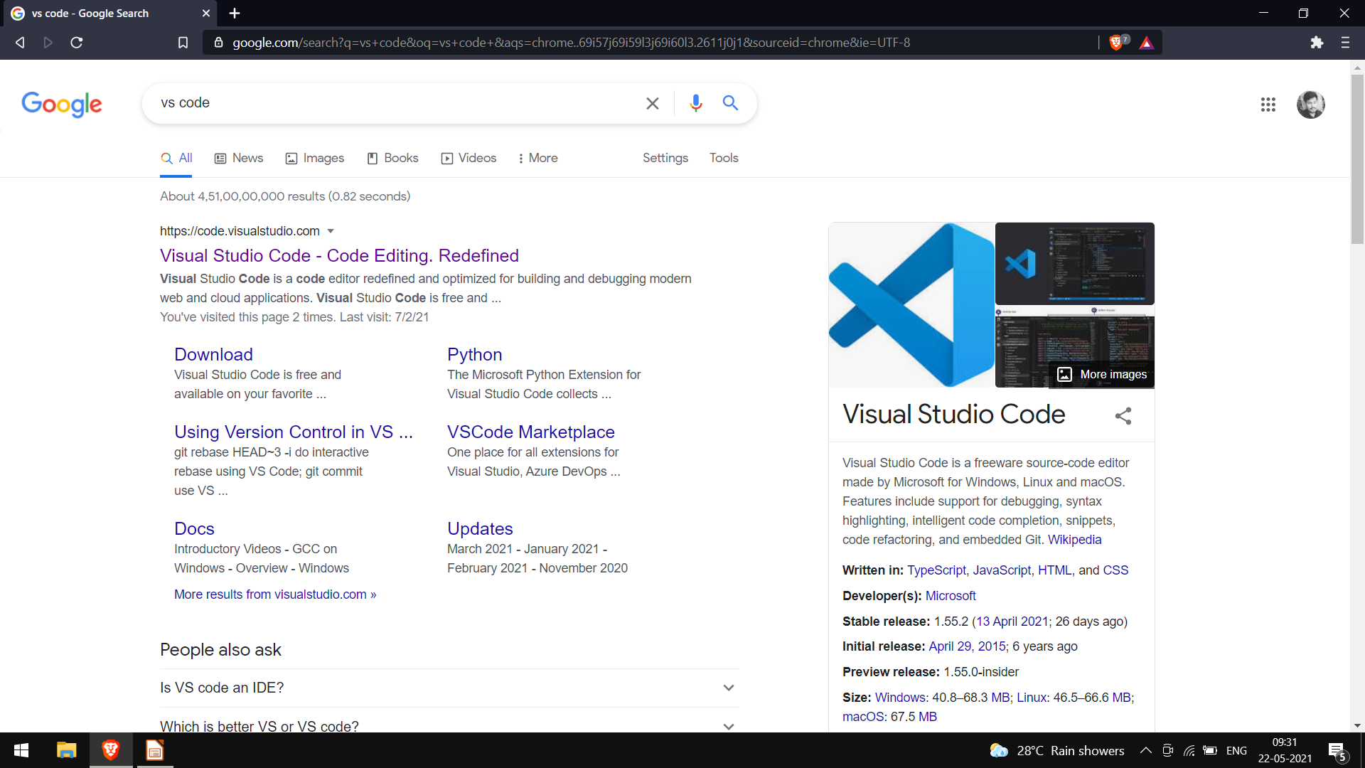

Slide 10
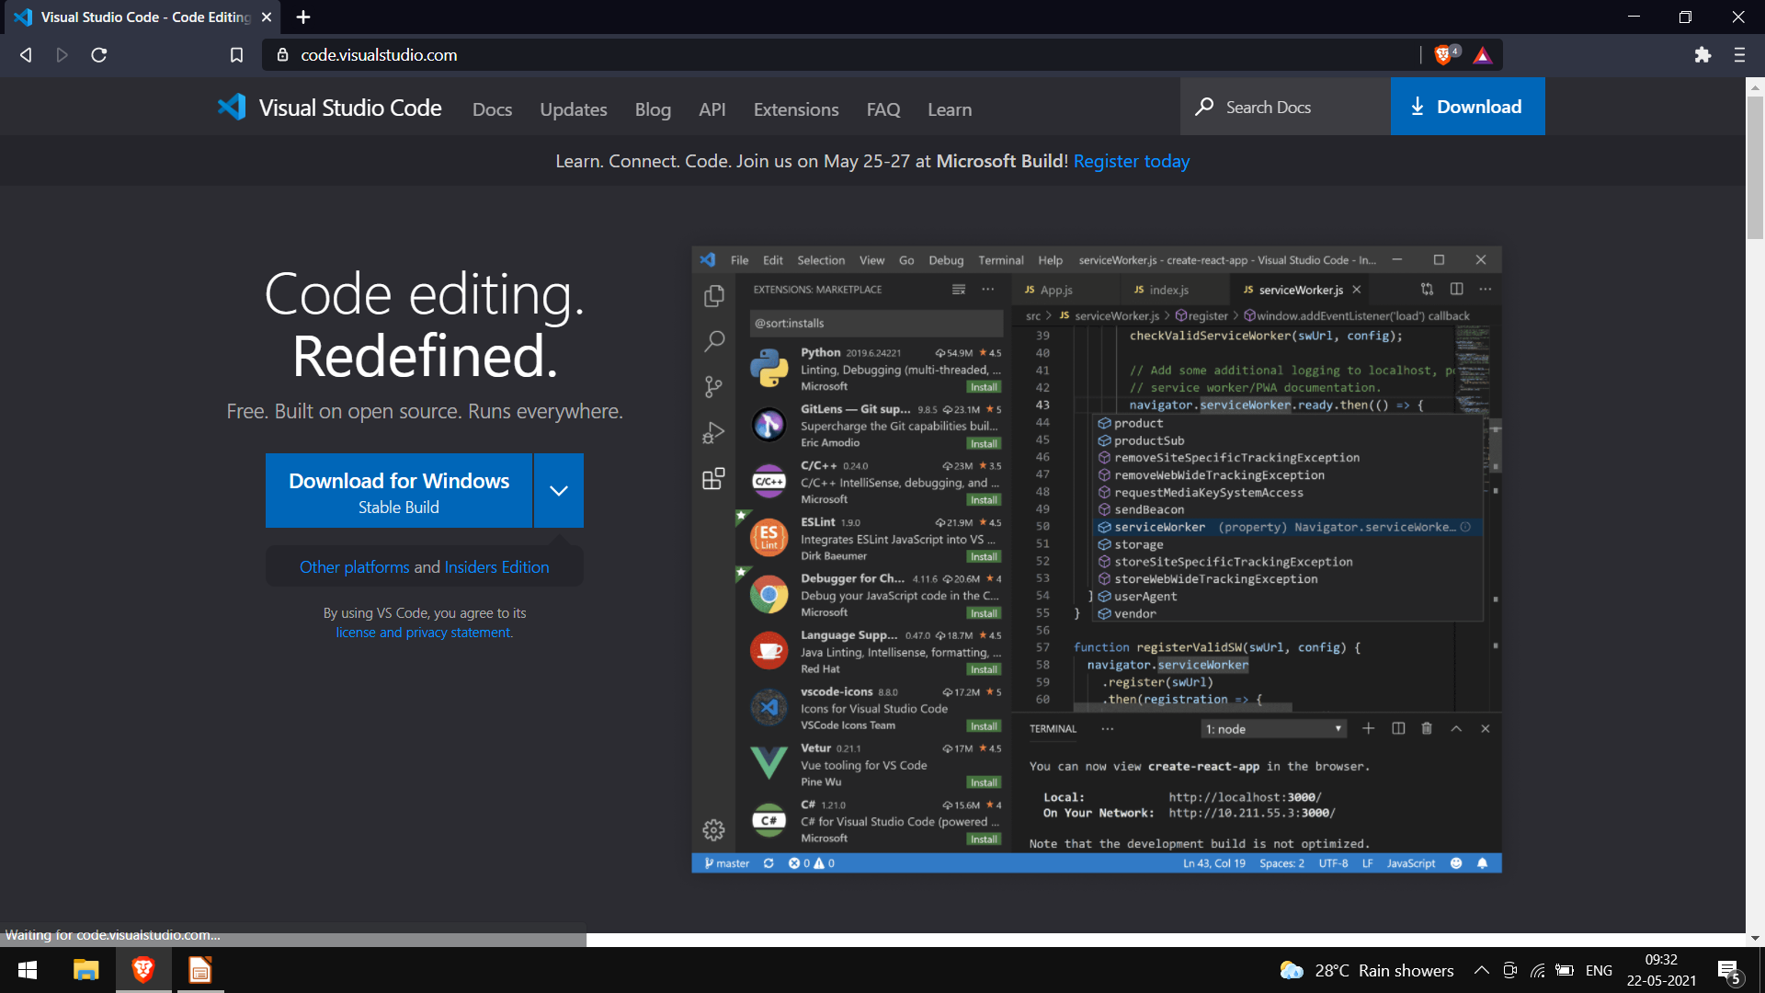

Slide 11
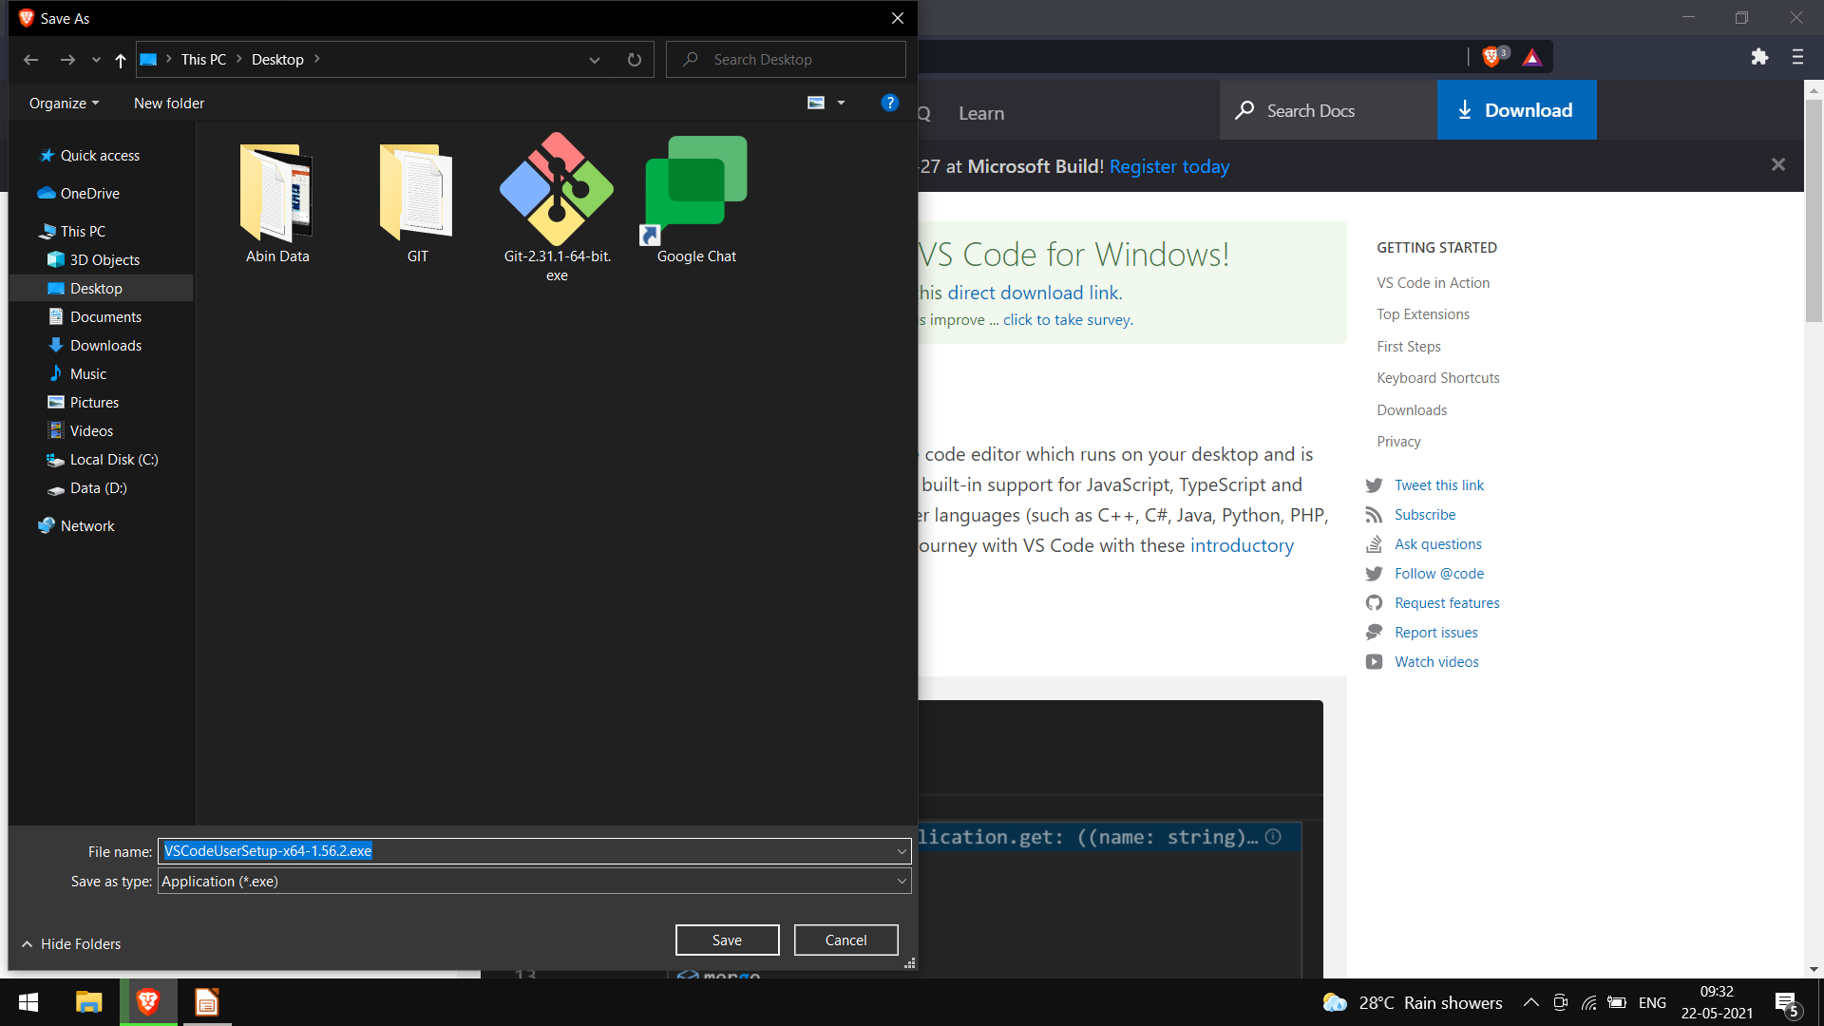

Slide 12
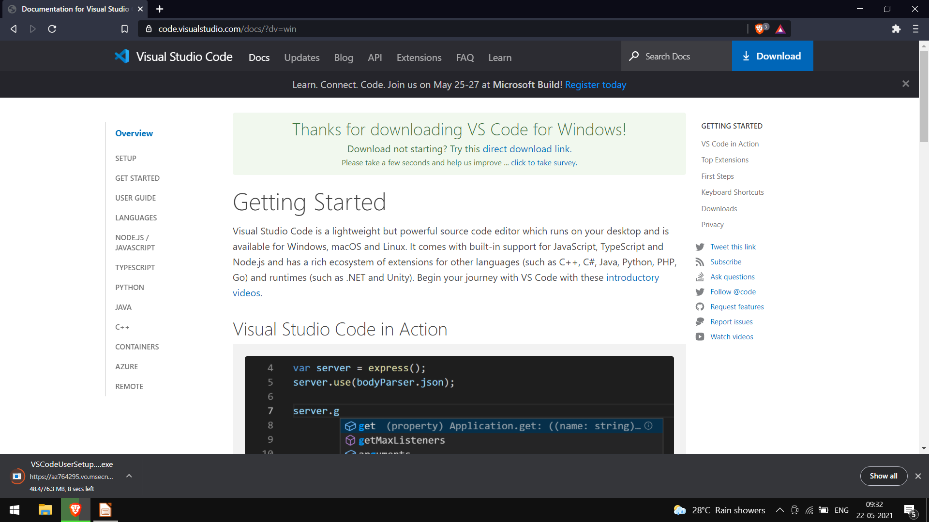

Slide 13


Slide 14
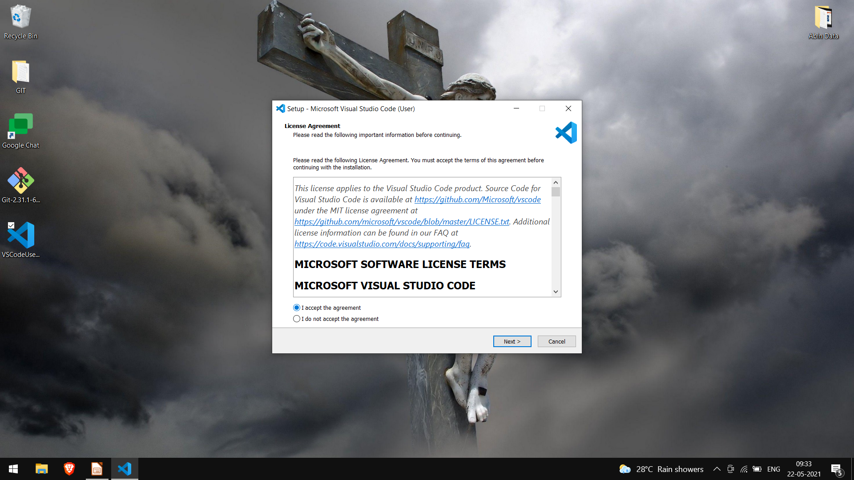

Slide 15
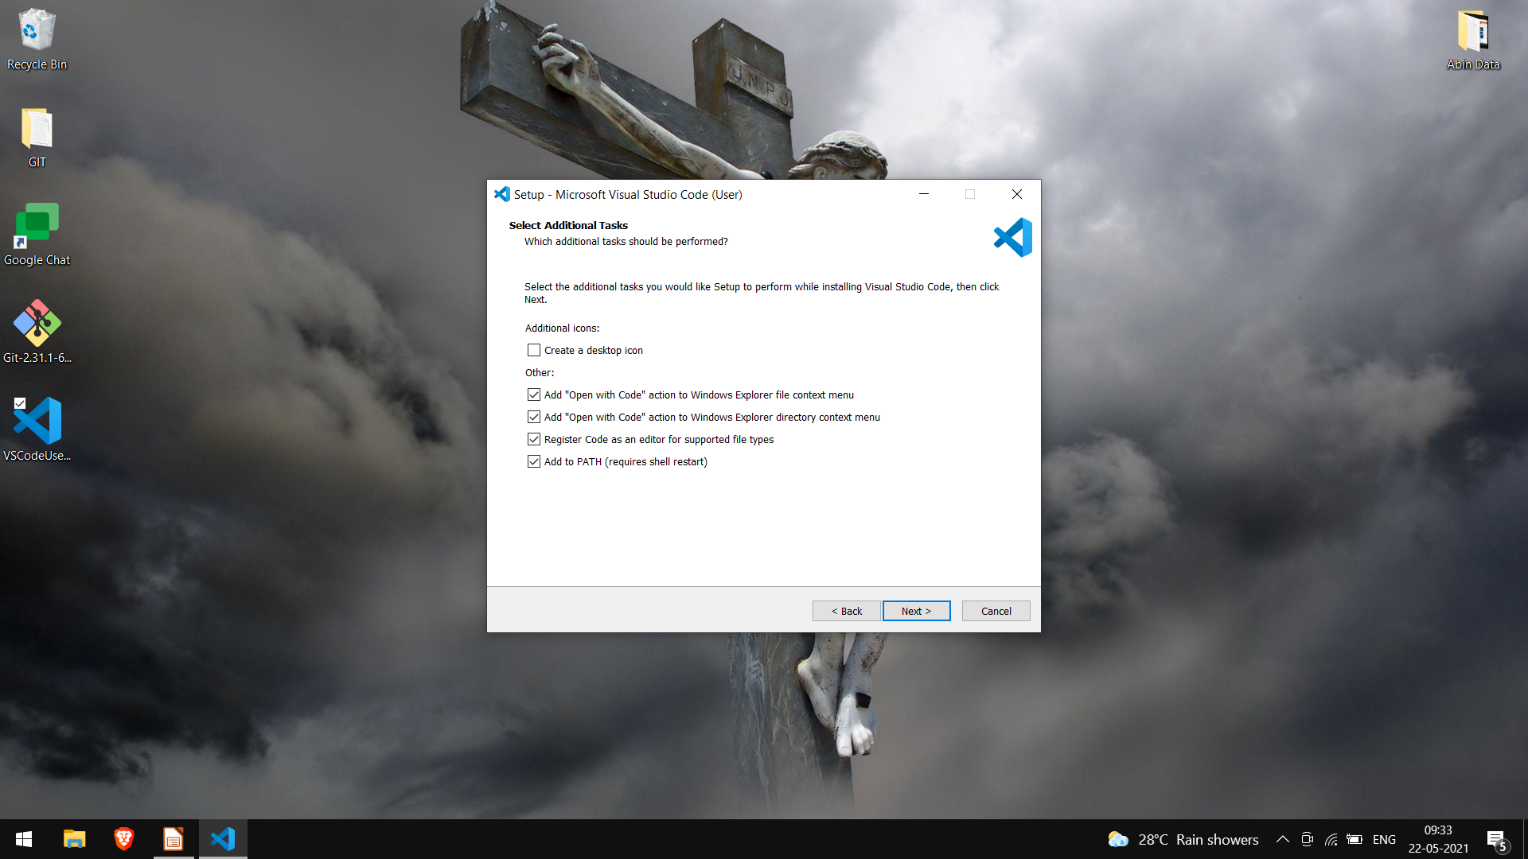

Slide 16
GIT

Slide 17
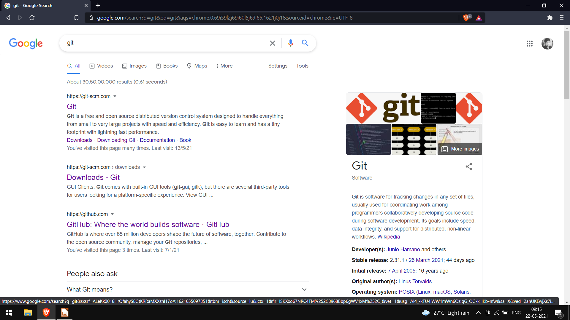

Slide 18
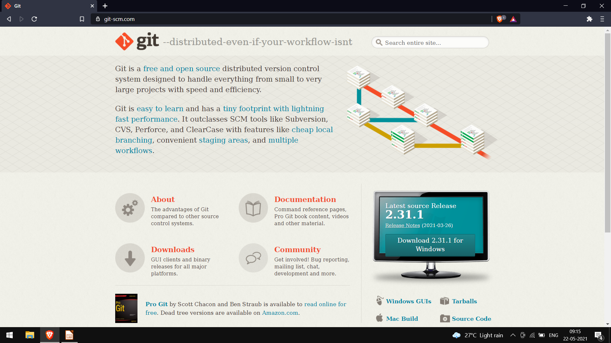

Slide 19
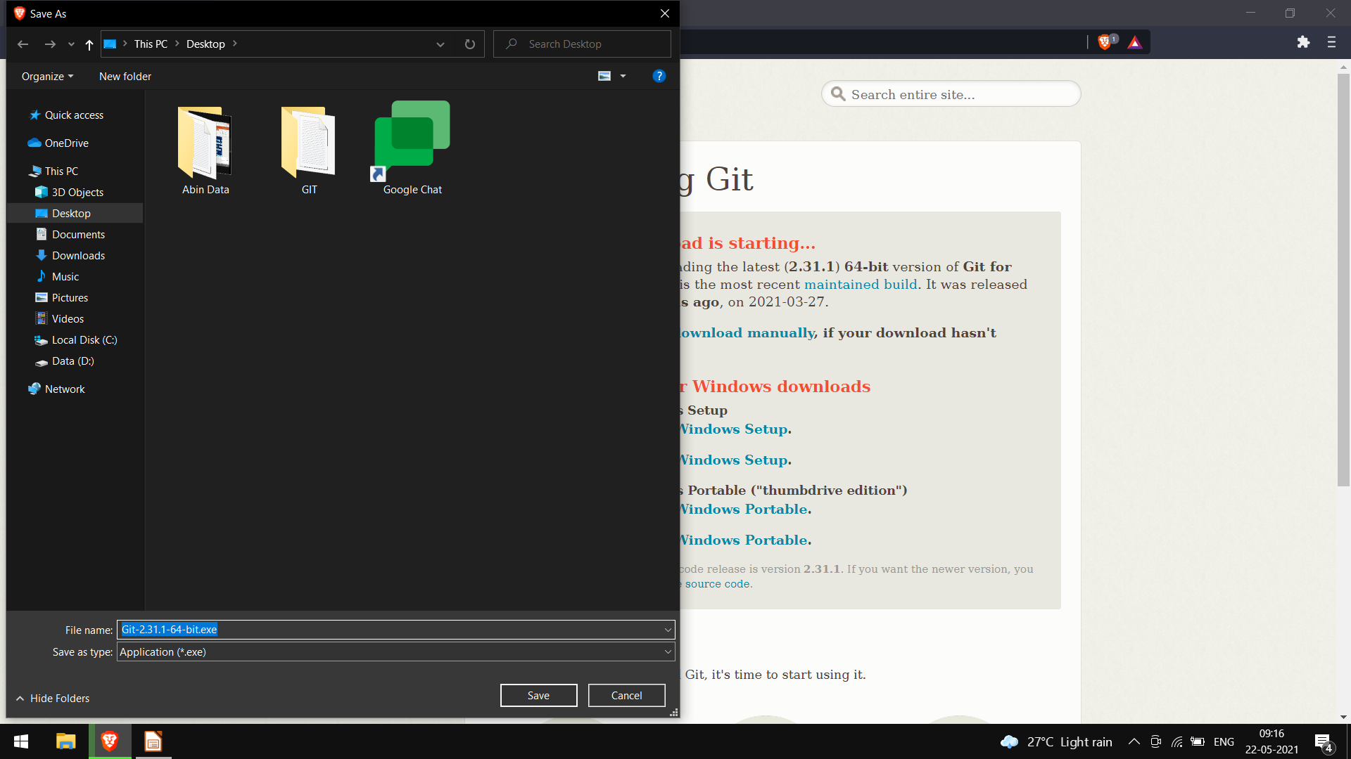

Slide 20
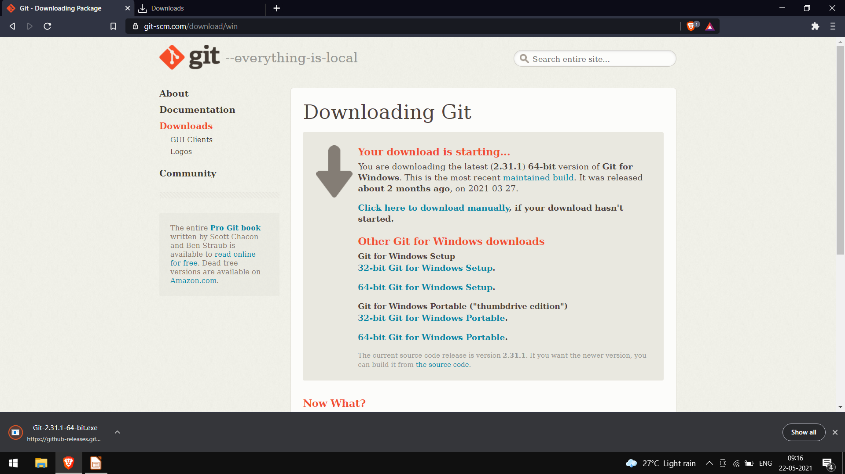

Slide 21
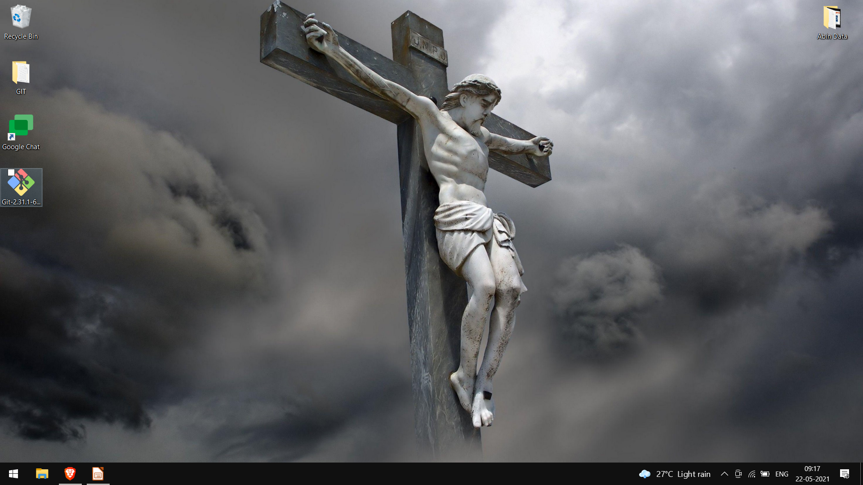

Slide 22
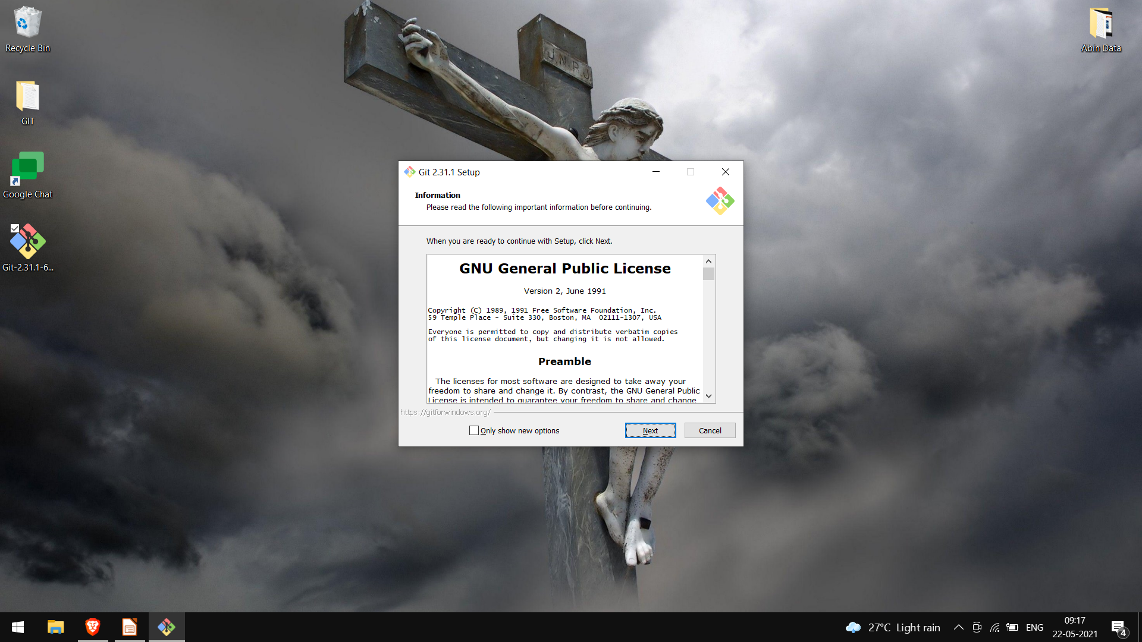

Slide 23
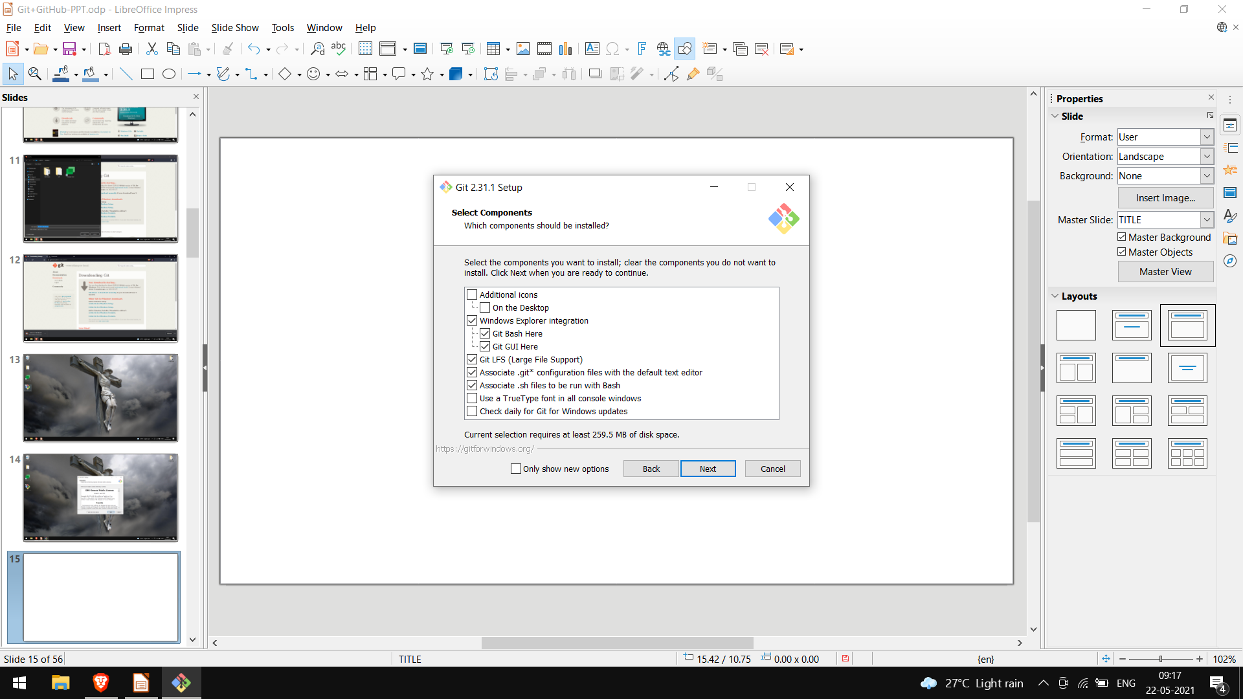

Slide 24
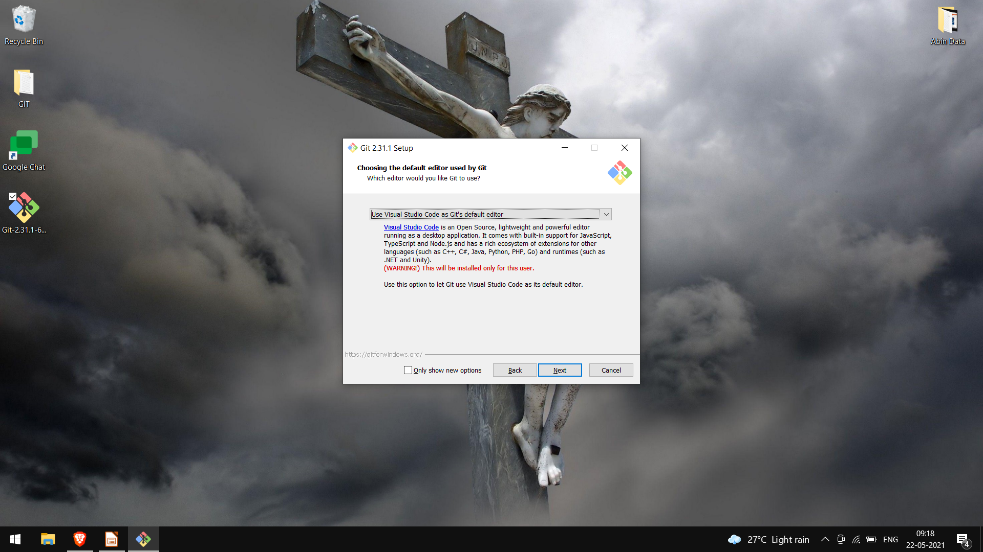

Slide 25
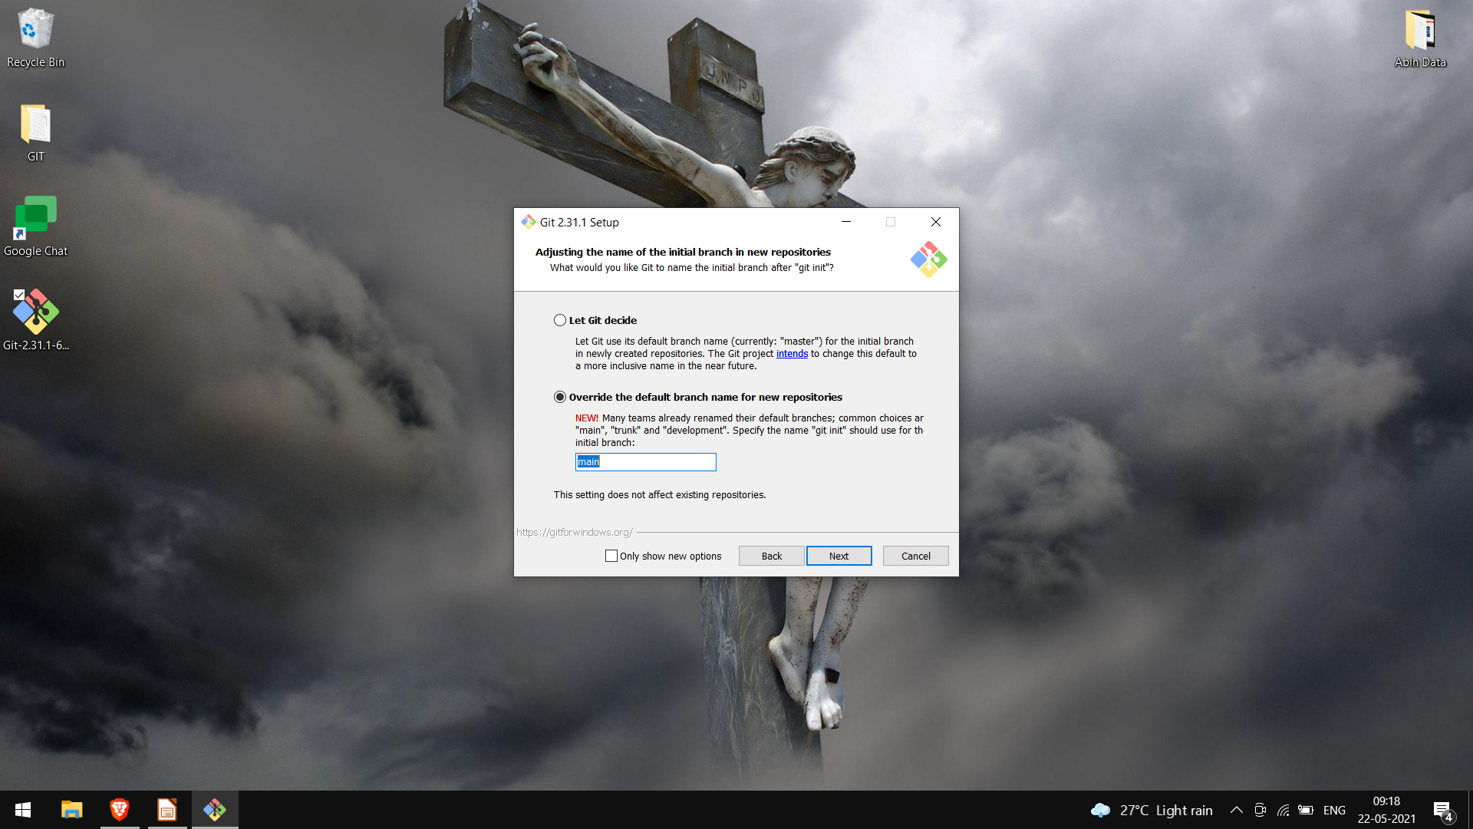

Slide 26
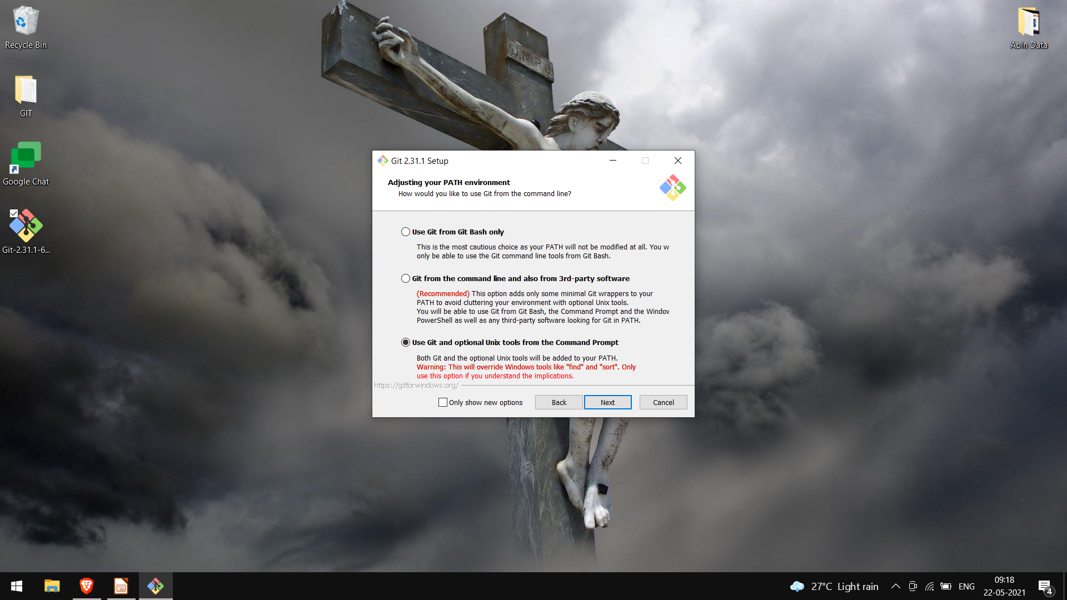

Slide 27
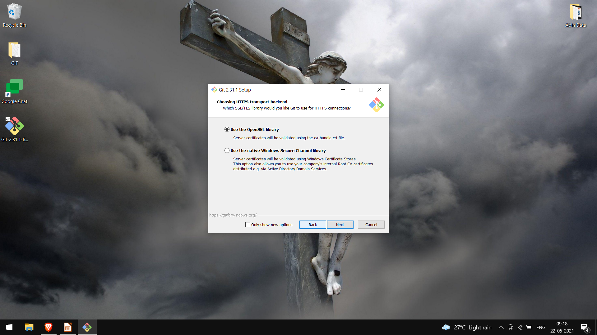

Slide 28


Slide 29


Slide 30


Slide 31
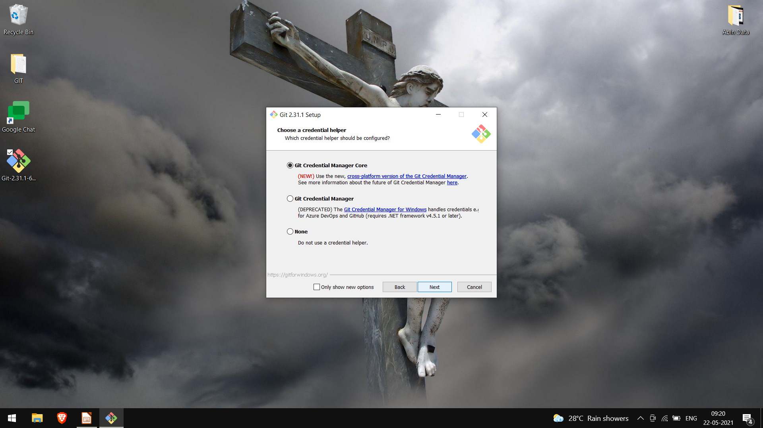

Slide 32


Slide 33
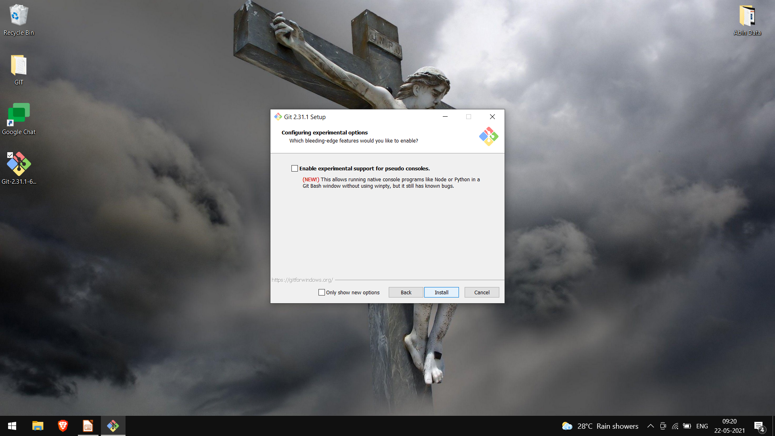

Slide 34


Slide 35
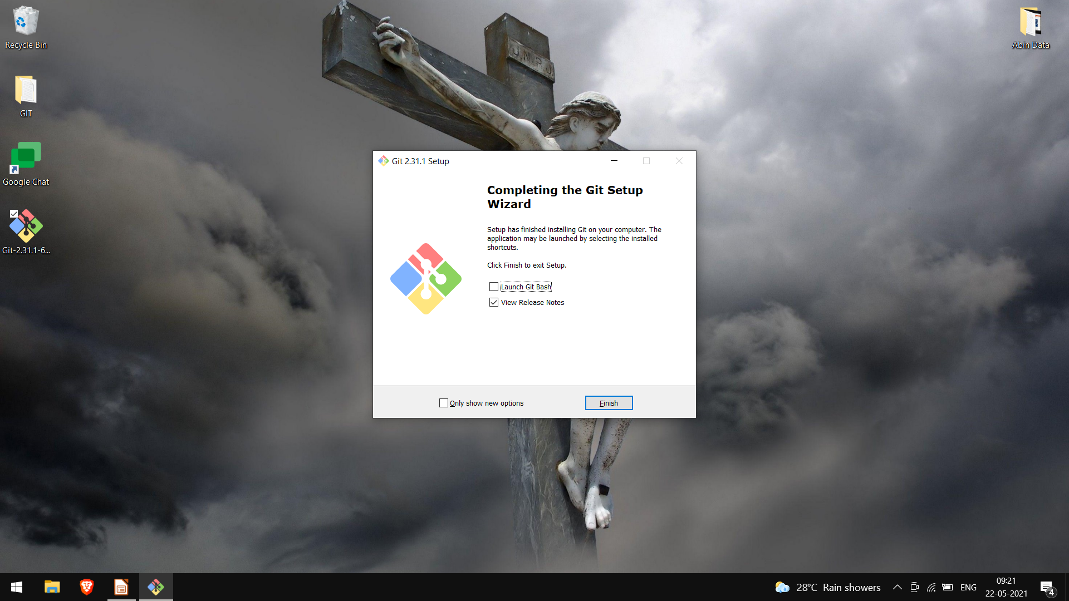

Slide 36
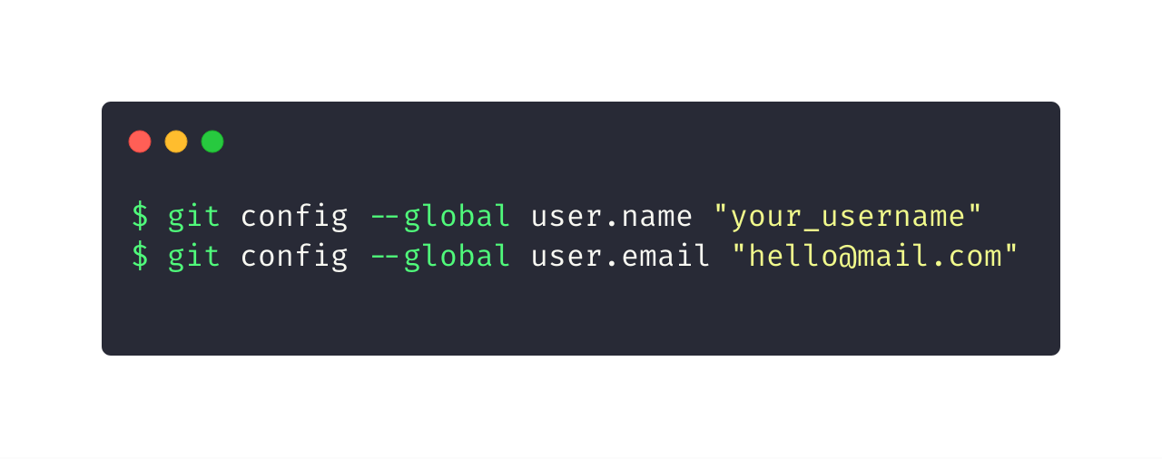
Let git know who you are
GitHub uses the email address set in your local Git configuration to associate commits pushed from the command line with your GitHub account.

Slide 37
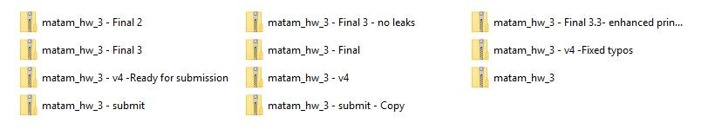

Slide 38
Use cases
Consider this scenario:
You have a homework submission in Matam for today and the assignment is ready for submission
While testing it you discovered a minor bug and decided to fix it

Slide 39
After attempting to do so, you accidentally changed a working code and got yourself in a big mess
You no longer remember what was and what wasn’t there
It is 23:58 PM

Slide 40

Now you realize that CTRL + Z won’t solve your
problems

Slide 41

What is Git?
A Distributed Version Control System.
Any project which uses Git will have a .git folder which stores all the history of the project.

Slide 42



History:
Know exactly which files changed, who made those changes, and when those changes occured.
Backup:
Ability to have different versions of the code in different places.
Collaboration:
Collaborate easily with other people on the same project by uploading and receiving changes
Notes:
Git tracks the History
GIt acts as a Backup
Git Helps in Collaboration with several people

Slide 43
What is GitHub?
GitHub is a website that allows us to use git and create repositories online. It can also store all your projects online for free.
Notes:
GitHub was founded in 2008. Works on the Git Protocol. Can save upto 1GB of stuff. Some popular projects on GitHub. Home of Open Source.

Slide 44

My First Repo!
What is Git and GitHub?

Slide 45

What is a repository?
A repository is a container that houses your project and its history. If your project folder contains the “.git” folder you’re working with a repository!

Slide 46



If you are on windows, open Git-Bash.
If you are on linux or Mac, fire up a terminal.
Let’s get
started!

Slide 47
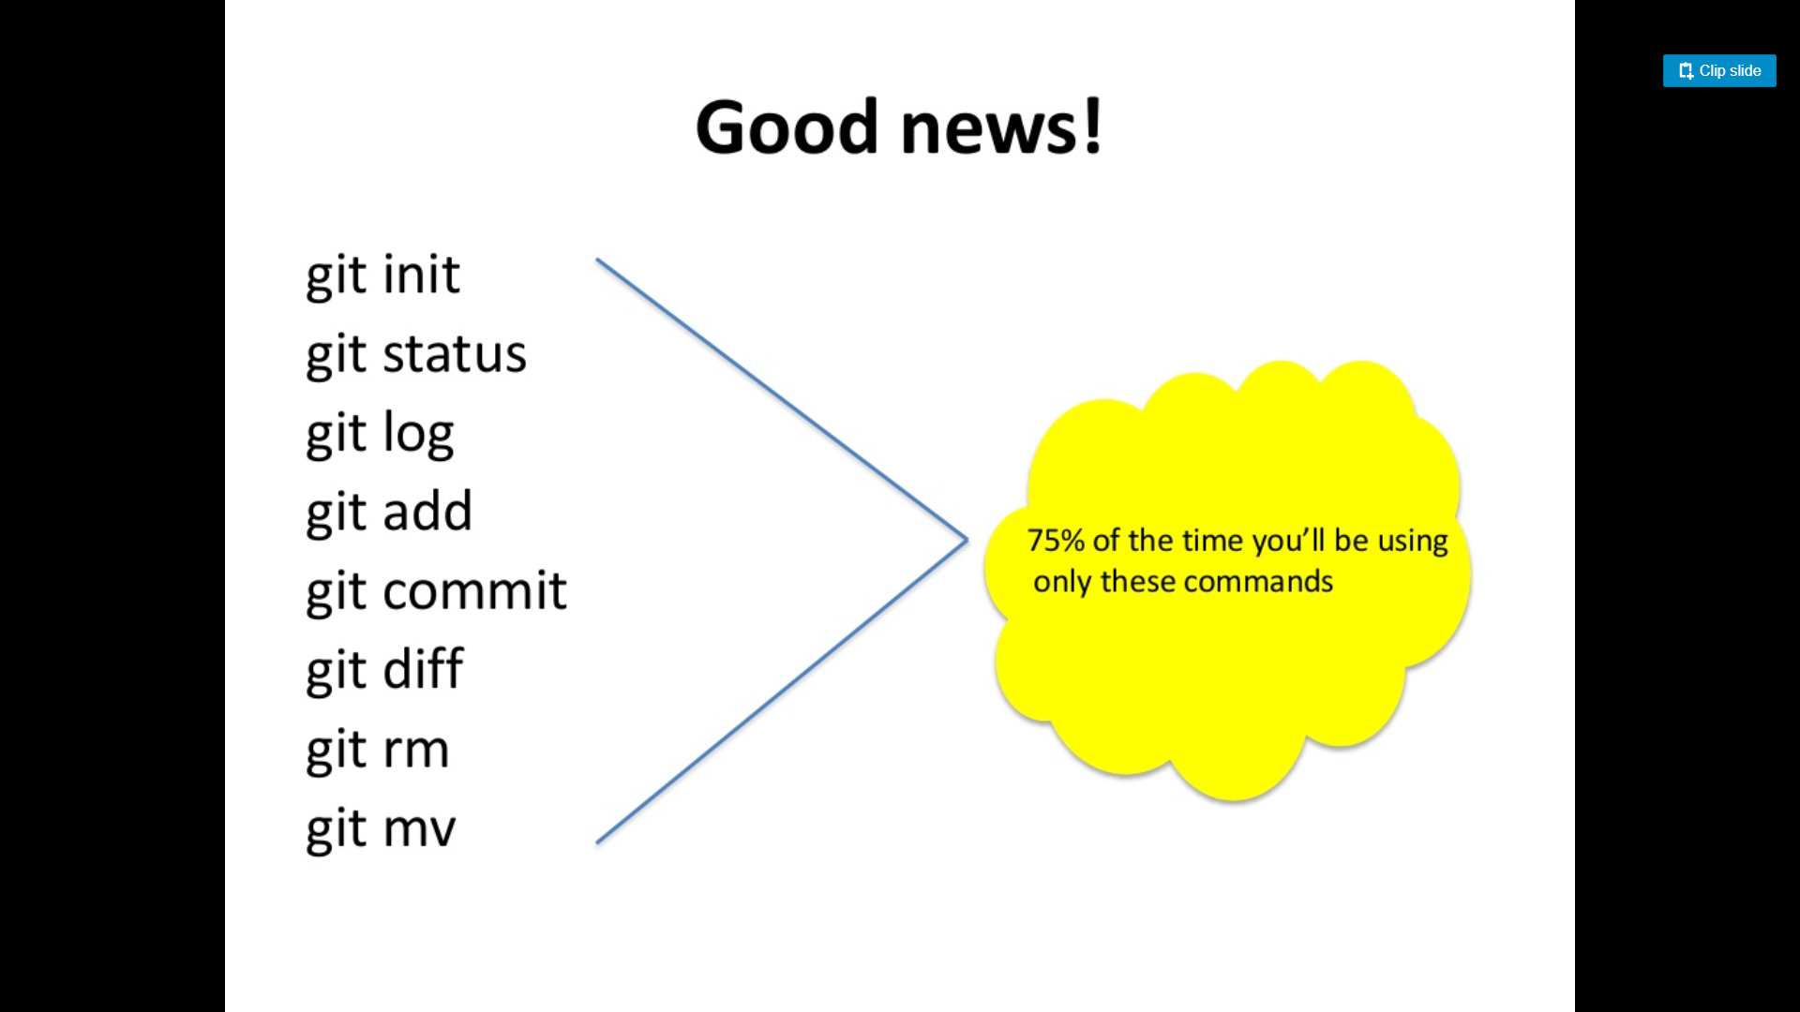

Slide 48
git add
Adds changes
Introduce a change
git add
Add the change to staging area
git commit
Make that change “permanent”

Slide 49
git commit
Creates a commit out of the changes that had been added
Introduce a change
git add
Add the change to staging area
git commit
Make that change “permanent”

Slide 50

Commits
Checkpoints/Snapshot of the state of your repository (project) at a particular time.

Slide 51
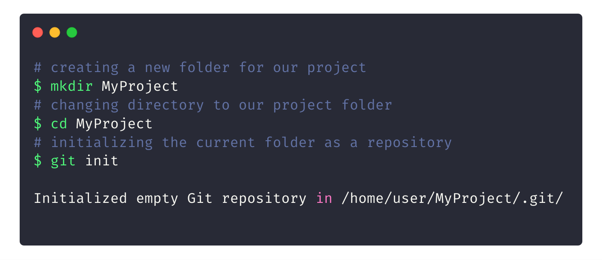
Initializing a new repository

Slide 52
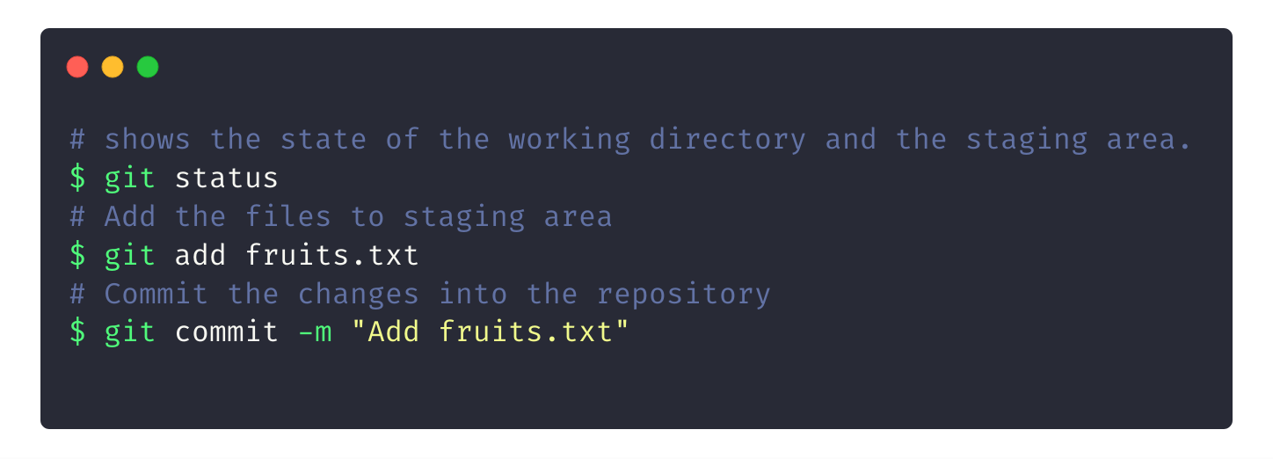
Creating your first commit
Notes:
Add some more fruits :)

Slide 53
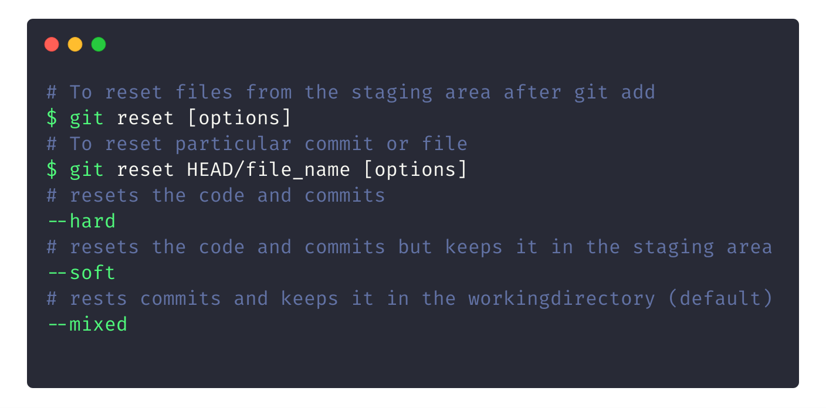
To Reset your Commits

Slide 54

Working with GitHub and fundamentals of Git 101.
Git Good!

Slide 55
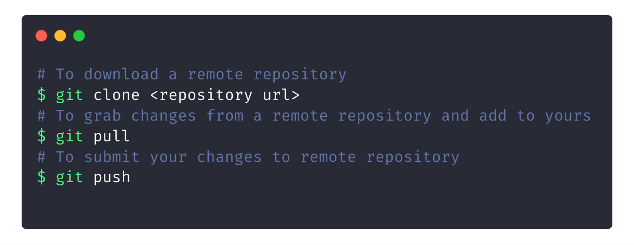
Downloading/Updating repos

Slide 56
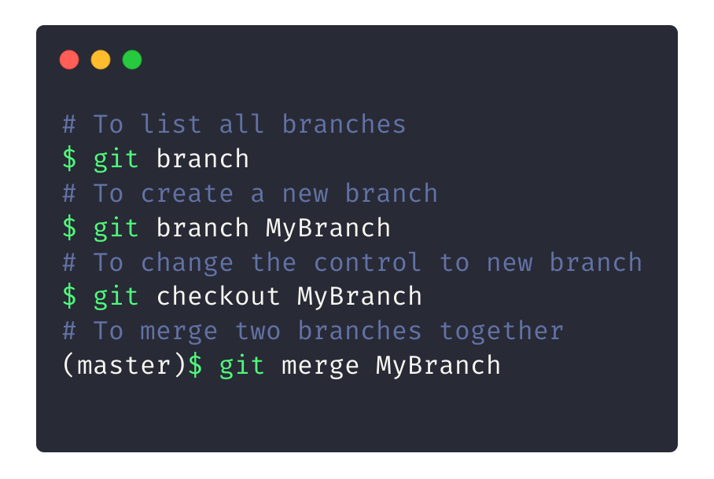
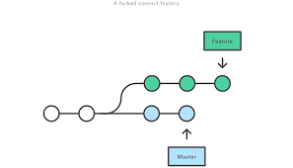
Git Branches
Notes:
Branches are

Slide 57

What can we do with GitHub?
Well, what not?

Slide 58

The GitHub Student
Developer Pack
Get the Pack at
https://education.github.com/pack
“To give students free access to the best developer tools in one place so they can learn by doing.”

