Slide 1
Through the Radar Looking Glass: Revealing Earth Processes with SAR

Slide 2
Chess Strategies for Anomaly Detection
Iterative Deepening & Alpha-Beta Pruning on SAR Data:
Requires multiple SAR acquisitions of the same region at different times.
Uses phase and polarization combinations to enhance anomaly detection.
Even for a single dataset, ~12 repeated operations are needed.
For high-dimensional time-series data, computation becomes extremely heavy.
Results in hours of processing and very high CPU consumption.

Slide 3
Why is Time Data Analysis important?
Importance of the SAR data anomalies → Highlight significant changes (flood, fire, deforestation).
Why it is hard to discover week anomalies → Delicate signs, usually masked in noise.
Traditional methods' shortcomings → Naïve methods lose rare/noisy data points.

Slide 4
Adapted from Stockfish engine search in chess.
Iterative deepening → shallower start, deeper only in regions that look suspicious.
Alpha-beta pruning → reduce useless computation soon.
Quiescence refinement → pay attention only to borderline anomalies.
Converts hours of CPU-crunched work into wiser, quicker analysis.

Slide 5
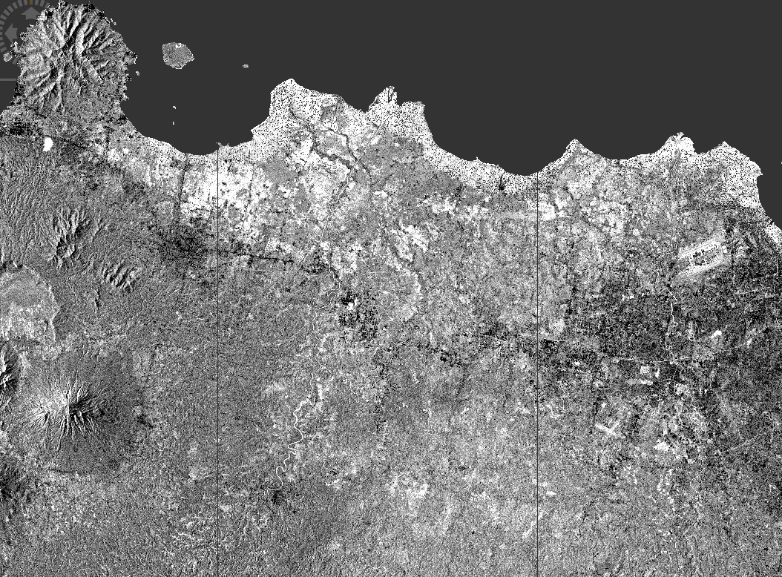
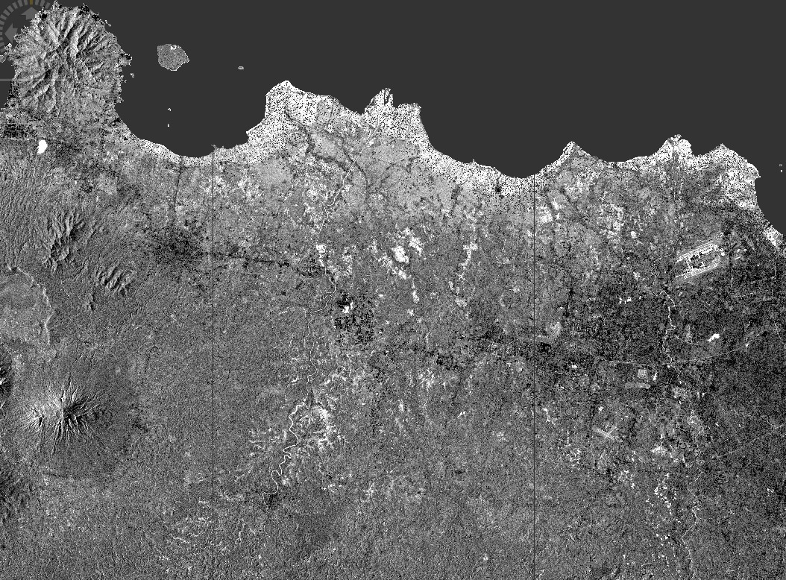
Standard anomaly detectors — after 40 seconds of processing

Slide 6
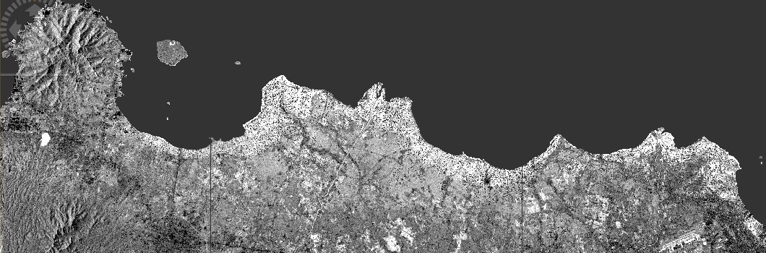
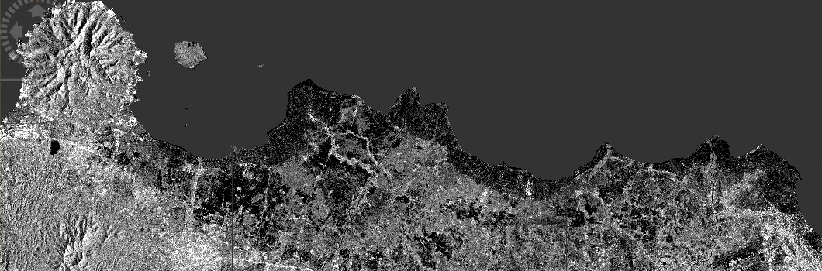
12 December 2018
Our method after 40 seconds of processing
22 December 2018
Domas coast after tsunami.

Slide 7
Faster & Smarter: Captures both strong and week-level anomalies.
Efficient: Reduces intensive computation with search-oriented pruning.
Scalable: Excisable for use on time-series and high-dimensional SAR data.
Future: Incorporate AI models and move beyond real-time detection of anomalies.

