Slide 1
MVC
Aban Khan

Slide 2
What is MVC?
Model, View, Controller
Architectural design format for back-end programming
Provides standardized framework for our code
Allows us to separate our code into sections similar to OOP
Prevents code-breaking, difficult to parse through
Allows easy access to code, quicker debugging, easier to look at it

Slide 3

Model
Interacts with our database
Adds/deletes/updates our database
Isolated to manage our database
Returns to the Controller

Slide 4
View
Renders out HTML the user will see
Can use anything to render out HTML
Returns to the Controller

Slide 5
Controller
Takes request from the router and redirects request to the appropriate controller
Intermediary between the router and View/Model
Each “page” has its own Controller as a hub that redirects to the Model and View
Controller receives some file or information back from Model and View which will return to the user

Slide 6
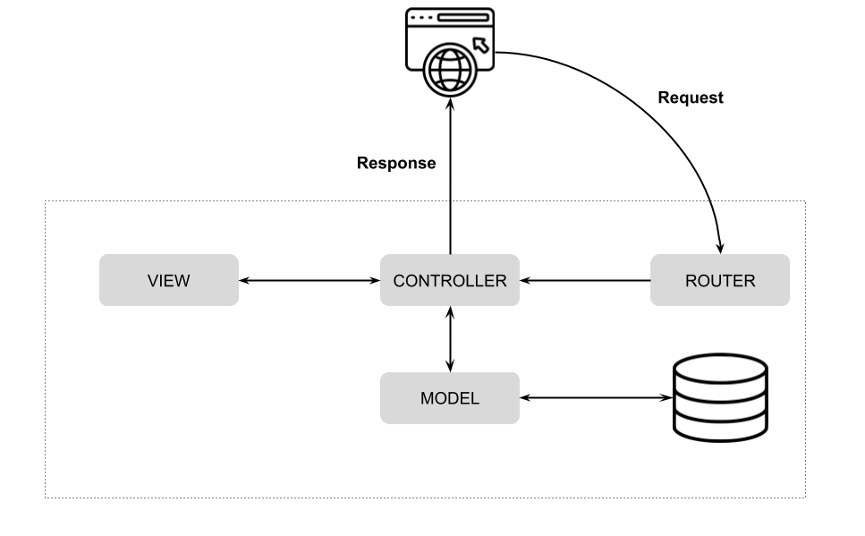

Slide 7
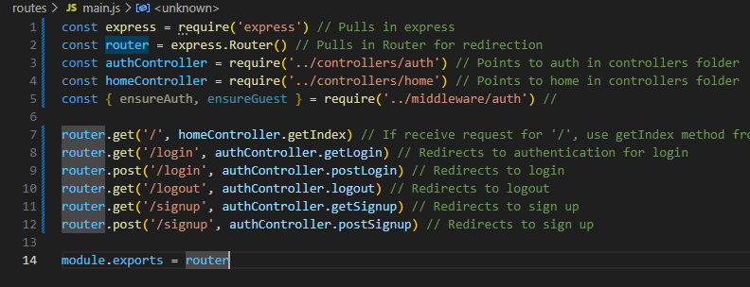
Additional tool.. Router
Redirects incoming requests to appropriate Controller
Adds an extra layer of abstraction used to refine directories
Provides finer control over routing in back-end services

Slide 8
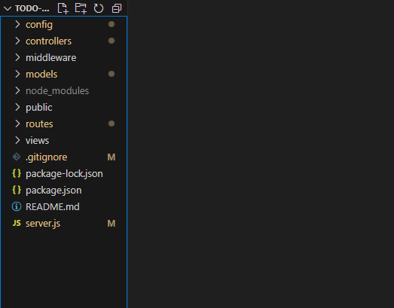
How can we effectively employ MVC?
Create folders which contain each element of our MVC
Have unique controllers for each page which will redirect to its own unique M and V

Slide 9
Mongoose + Schema’s
MongoDB is a schema-less database- this means that we can store JSON documents on it but we cannot enforce the structure of these database
Mongoose allows us to enforce consistency between our documents (Object Data Modeling) by using a template (schema)
Therefore, SchemaTypes in Mongoose define what the structure of that schema looks like
Acts as middle-ware between objects in our backend and the objects in MongoDB

