Slide 1
Testing
Kuppuraju.B

Slide 2

Software Testing:-

Slide 3
Manual Testing:-
Manual testing is a software testing process in which test cases are executed manually without using any automated tool. All test cases executed by the tester manually according to the end user's perspective. It ensures whether the application is working, as mentioned in the requirement document or not.
Manual Testing is a process in which you compare the behavior of a developed piece of code (software, module, API, feature, etc.) against the expected behavior (Requirements).

Slide 4
Manual Testing Example:-
Manual testing has many real-life applications, and is especially handy for assessing usability and accessibility. For example, if you were launching an ecommerce website, you would need to check things like:
Optimization for a range of browsers and devices
Smooth checkout process
Fast-loading hi-res images
Links to social media channels

Slide 5
Tools to Automate Manual Testing:-
Selenium
QTP
Jmeter
Loadrunner
TestLink
Quality Center(ALM)

Slide 6
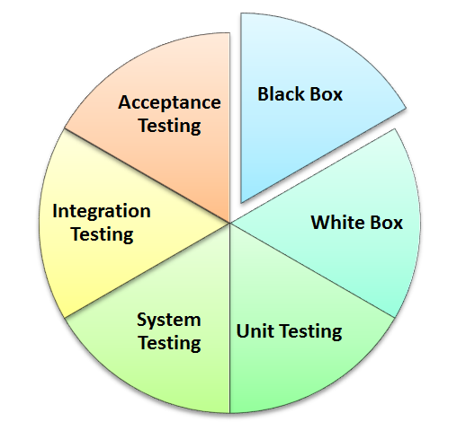
Types of Manual Testing:-
Black Box Testing
White Box Testing
Unit Testing
System Testing
Integration Testing
Acceptance Testing

Slide 7

Also known as behavioral testing, this method aims to analyze an application’s functionality from the end-user’s perspective. The internal code structure is not visible during testing (hence the name “Black Box”), so testers are only aware of the inputs and expected outputs of the software.
Black Box Testing has several subdivisions, including functional testing for requirement compliance, smoke testing to assess basic functionality, and partitioning (dividing software into groups that are expected to exhibit similar behavior).

Slide 8
White Box Testing:-
Sometimes called transparent box testing or structural testing, this is a method of testing the internal structures or workings of an application. It is performed by the developer, who checks the software’s internal codes before passing it to a test engineer.
The main focus of White Box Testing is on strengthening security and improving the software’s design and usability. A combination of Black Box and White Box testing is known as Gray Box Testing.

Slide 9
Unit Testing:-
This is when the individual units or components of an application’s source code are tested, to make sure each function performs as expected. It is usually carried out by developers rather than engineers, as it requires detailed knowledge of the internal program design and code.
Also known as module testing or component testing, it simplifies the debugging system and helps to detect and protect against bugs in the future

Slide 10
System Testing:-
System Testing means testing the system as a whole, once all its components have been unit-tested and integrated. It checks that the complete application works as intended, by comparing it against the original requirements.
Also called end-to-end testing, it typically involves installability testing (does the software install correctly?) and recovery testing (can the application recover from hardware crashes and network failures?).

Slide 11
Integration Testing:-
Integration Testing is the process of testing an application with two or more integrating components. It is performed once the individual components have been unit-tested, and aims to identify problems with the interfaces and the interactions between them.
The two main methods are the Bottom-Up Approach (moving steadily from the bottom module to the top module) and Top-Down Approach (the opposite).

Slide 12
Acceptance Testing:-
User Acceptance Testing (UAT) is performed by the client or end-user, to confirm that the software meets the agreed requirements. Sometimes called pre-production testing, it takes place during the final phase before releasing the product to market.

Slide 13
Other Types of Testing:-
Regression testing
Sanity Testing
Smoke Testing
Adoc Testing

Slide 14
Regression Testing:-
Regression testing is a black box testing technique. It is used to authenticate a code change in the software does not impact the existing functionality of the product.
Ex:-There are three modules in project named Admin, Personal Information and Employment module. Suppose bugs are occurs in the admin module. Existing user not able to login admin interface with valid login credentials.
Then testing team sends the mentioned bug to the development team. Once development team fixed the bug hand over to testing team. Then testing team checks that fixed bug does not affect the remaining functionality of the other modules and also check the functionality of the same module.

Slide 15
Sanity Testing:-
Tester Acceptance Testing
Sanity testing is a subset of regression testing. After receiving the software build, sanity testing is performed to ensure that the code changes introduced are working as expected. This testing is a checkpoint to determine if testing for the build can proceed or not.
If sanity test fails the build is rejected to save time and cost of testing

Slide 16
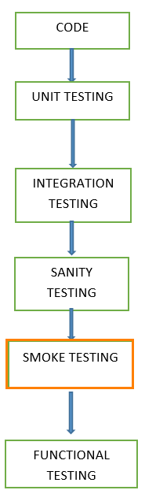
Smoke Testing:-
Once new build received from development team tester perform the smoke testing on the build. Smoke testing done to check whether the critical functionality of the application (new build) working fine or not.
The purpose is to reject the badly broken application. So that testing team does not waste time for testing the application.
Test cases are chosen from cover the most important functionality or component of the application.

Slide 17
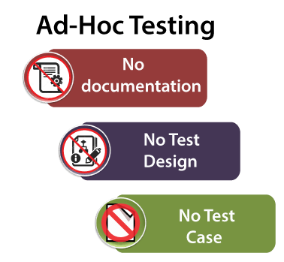
Adhoc Testing:-
This testing we do when the build is in the checked sequence, then we go for Adhoc testing by checking the application randomly.
Adhoc testing is also known as Monkey testing and Gorilla testing.
It is negative testing because we will test the application against the client's requirements.

Slide 18
Thankyou

