Slide 1

Green Pace
Security Policy Presentation
Developer: Andrew Laipple

Slide 2

OVERVIEW: DEFENSE IN DEPTH
The security policy at Green Pace outlines our top security principles and coding standards. By following the policy, it allows our developers to create secure programs that use the defense in depth strategy. This strategy provides multiple layers of security to give us the best chance at preventing attacks.

Slide 3
THREATS MATRIX⁴
Likely Buffer Overflows String Manipulation Errors Wrap Around/Truncation | Priority SQL Injection Data Theft Unauthorized access
Low priority System crashes Exceptions Out of Memory | Unlikely Denial of Service Insider Attack Phishing

Slide 4
10 PRINCIPLES
Validate Input Data - STD-SQI-001
Heed Compiler Warnings - STD-DDT-001, STD-DTV-001, STD-STC-001, STD-MEP-001, STD-ASS-001, STD-DTV-002, STD-MEP-002
Architect and Design for Security Policies
Keep It Simple - STD-DDT-001, STD-MEP-001, STD-ASS-001, STD-MEP-002
Default Deny - STD-SQI-001
Adhere to the Principle of Least Privilege
Sanitize Data Sent to Other Systems
Practice Defense in Depth - STD-DTV-001, STD-STC-001, STD-SQI-001, STD-MEP-001, STD-EXC-001, STD-DTV-002, STD-STC-002, STD-MEP-002
Use Effective Quality Assurance Techniques – all
Adopt a Secure Coding Standard

Slide 5
CODING STANDARDS
LEVEL 1:
STD-SQI-001
STD-STC-002
STD-MEP-001
STD-STC-001
STD-MEP-002
LEVEL 2:
STD-DTV-001
STD-DTV-002
STD-DDT-001
LEVEL 3:
STD-EXC-001
STD-ASS-001

Slide 6
ENCRYPTION POLICIES¹
ENCRYPTION AT REST
Data not currently being used or sent over a network
Sensitive data (usernames, passwords)
Strong encryption algorithm
ENCRYPTION IN FLIGHT
Data transmitted across a network
Sensitive data (login credentials, account creation information)
TLS or other industry standard algorithm
ENCRYPTION IN USE
Data loaded into memory and used during program execution
Sensitive data (usernames, account information, payment information)
Analysis done to determine encryption algorithm

Slide 7
TRIPLE-A POLICIES³
AUTHENTICATION
Determines if users have access to the system
Username/password system
Two factor authentication should be used
Data encrypted
AUTHORIZATION
Limits the actions of the users of the system
Principle of least privilege should be followed
Administrator should be allowed to set privileges
ACCOUNTING
Records information and activity when users are logged in
Logs can be reviewed if attack occurs to determine the source and cause
Tools such as Logic Monitor or DynaTrace should be considered²

Slide 8
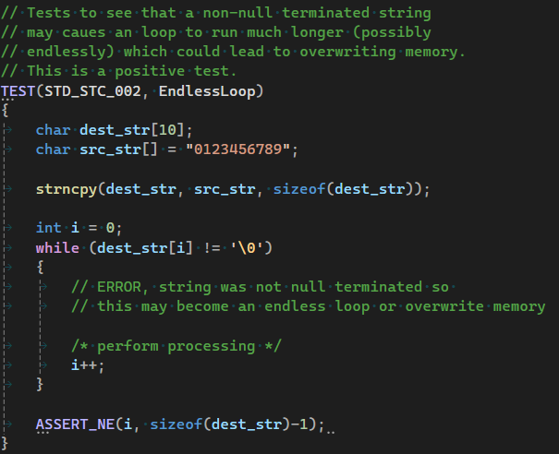
Unit Testing
STD-STC-002 – null terminate strings before use
Test 1: Non-null terminated string used in loop

Slide 9
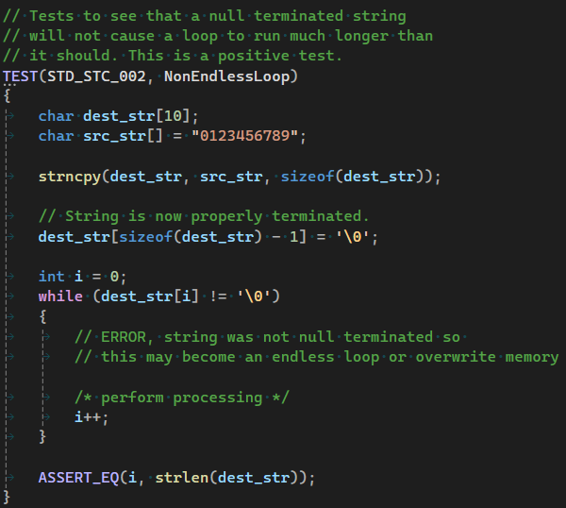
Unit Testing
Test 2: Null terminated string used in loop

Slide 10
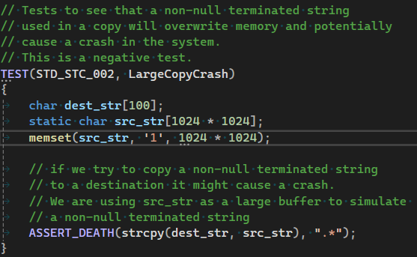
Unit Testing
Test 3: Large copy of non-null terminated string

Slide 11
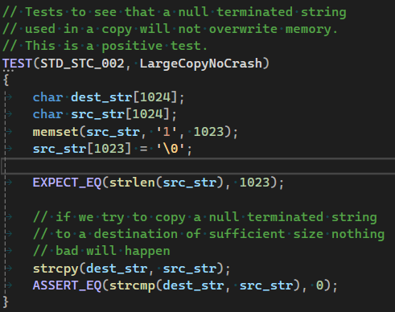
Unit Testing
Test 4: Large copy of null terminated string

Slide 12
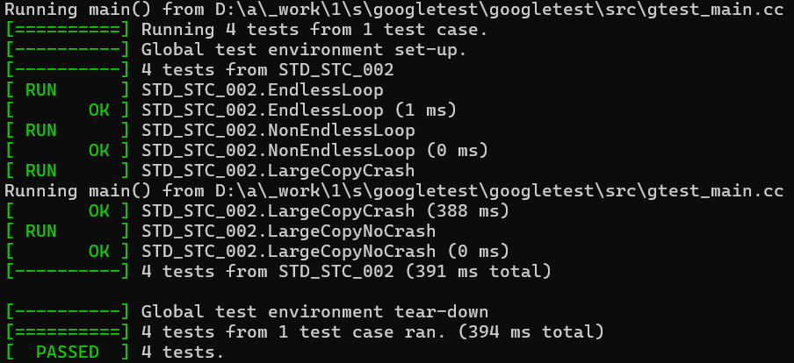
Unit Testing Results

Slide 13

AUTOMATION SUMMARY

Slide 14
TOOLS⁵
The DevSecOps pipeline is used to incorporate security into all phases of the software development lifecycle (SDLC). Security should not be limited to the coding or testing phase, it needs to be thought of at every phase for a robust security policy.
Tools in Requirements phase: SQUARE tool
Tools in Design phase: SDL Threat Modeling Tool
Tools in Code phase: Static Analysis Tools (cppcheck, polyspace bug finder), Compiler Warnings
Tools in Verify phase: Failure Observation Engine, Attack Surface Analyzer
Tools in Release phase: Logging Software (DynaTrace, Logic Monitor)²

Slide 15
RISKS AND BENEFITS
Identifying and fixing problems earlier in development saves money. The later an issue is found, the more costly it is to fix.
It is not worth it to ignore an issue just to save money, or release on schedule.
Releasing a product with a known vulnerability has the potential for catastrophic consequences.
SQL Injection example.

Slide 16
RECOMMENDATIONS
Policy should be updated to include code standards for all principles (Current version has no code standard for principles 3, 6, 7, and 10)
Policy should be updated to recommend a specific tool for static analysis instead of multiple. That way developers will have a consistent tool set on their machines and won’t have to have multiple programs installed.
Policy should be updated periodically based on experience (If an attack occurs after a product has been released, once the vulnerability has been identified and corrected a new policy/code standard may be added).
Current policy is only for C/C++. It may be beneficial to incorporate other programming languages or create separate security policy documents for them.

Slide 17
CONCLUSIONS⁶
SEI Cert Provides many standards for different categories
Expressions
Floating Point numbers
Input/Output
Environment
Signals
Application Programming Interfaces
Concurrency
Each subcategory should be reviewed for relevant coding standards to incorporate into the existing policy.

Slide 18
REFERENCES
Dinic, M. (2024, March 25). A Comprehensive Guide to Data Encryption. Jatheon. https://jatheon.com/blog/data-at-rest-data-in-motion-data-in-use/
Jenda Tovarys, J. (2024, October 18). 10 Best Log Monitoring Tools in 2024. BetterStack. https://betterstack.com/community/comparisons/log-monitoring-tools/
Mylonas, L. (2018, November 27). What is AAA security? An introduction to authentication, authorisation and accounting. CodeBots. https://codebots.com/application-security/aaa-security-an-introduction-to-authentication-authorisation-accounting

Slide 19
REFERENCES
OWASP Threat and Safeguard Matrix (TaSM). (2023). OWASP. https://owasp.org/www-project-threat-and-safeguard-matrix/
Seacord, R. C. (2013). Secure Coding in C and C++ (2nd ed.). Pearson Technology Group. https://mbsdirect.vitalsource.com/books/9780132981972
SEI CERT C Coding Standard. (2024, April 4). Carnegie Mellon University. https://wiki.sei.cmu.edu/confluence/display/c/SEI+CERT+C+Coding+Standard

