Slide 1
Lecture 09 Exercise
Web Game Development Course
February 2015
Model Associations

Slide 2
ActiveRecord
http://guides.rubyonrails.org/active_record_basics.html
ActiveRecord is an “ORM”
  Connects objects to tables in a relational database
Basic Operations:
  User.find(primary_key_id)
  User.all
  User.new
  User.create
  User.save
  User.where

Slide 3
Associations
http://guides.rubyonrails.org/association_basics.html
Associations allow to model the relationships in a relational database
Two basic relationships:
  Belongs to
  Has Many

Slide 4
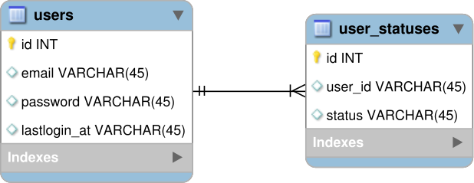
Example

Slide 5
Example Code
class User
has_many :statuses
end
class UserStatus
belongs_to :user
end

Slide 6
Implement User Status Feature
Create user status model
  bundle exec rails generate model UserStatus user_id:integer status:text
  bundle exec rake db:migrate

Slide 7
Create the association
Add has_many association to User model
  class User
  has_many :user_statuses
  end
Add belongs_to association to UserStatus model
  class UserStatus
  belongs_to :user
  end

Slide 8
Add input form for creating new statuses
<form class="form-inline" method="post" action="/users/status">
<input name="authenticity_token" value="<%= form_authenticity_token %>" type="hidden">
<div class="form-group">
<div class="input-group">
<div class="input-group-addon">Status</div>
<input type="text" class="form-control" id="status" name="status" placeholder="What's up?">
</div>
</div>
<button type="submit" class="btn btn-primary">Add</button>
</form>

Slide 9
Create Action for processing new statuses
UserStatus.create(user_id:@user.id, status: params[:status])
redirect_to '/welcome'

Slide 10
Show list of statuses
Fetch all statuses in the welcome action
  @statuses = UserStatus.all
Display in the view of the welcome action:

Slide 11
<table class="table table-stripped">
<thead>
<tr>
<th>Email</th>
<th>Status</th>
</tr>
</thead>
<tbody>
<% @statuses.each do |status| %>
<tr>
<td><%= status.user.email %></td>
<td><%= status.status %></td>
</tr>
<% end %>
</tbody>
</table>

