Slide 1
Lecture 06
Web Game Development Course
February 2015
TestDrivenDevelopment

Slide 2
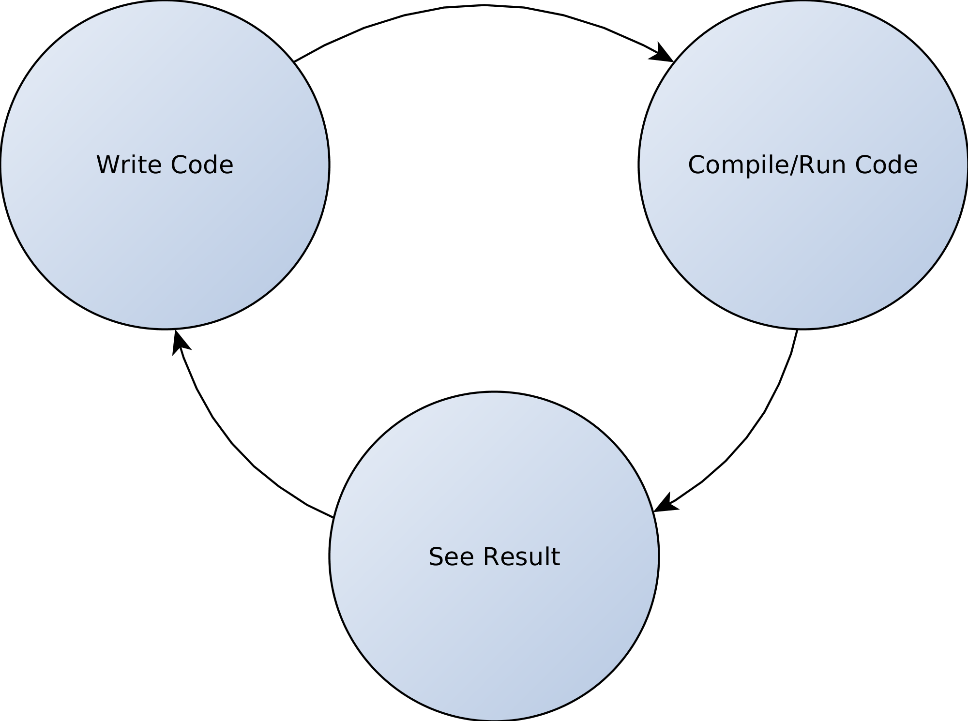
“The Common” Development Cycle

Slide 3
Shortcomings of “The Common” cycle
Large portions of code get written and only a fraction of it gets tested
Design mistakes are discovered later and are thus more costly to fix
Changes to code tend to break other code and thus the whole application/system
Documentation usually lags behind and easily becomes obsolete

Slide 4
What is TDD?
Writing a test before writing the actual code
Both a testing technique as well as a design technique

Slide 5
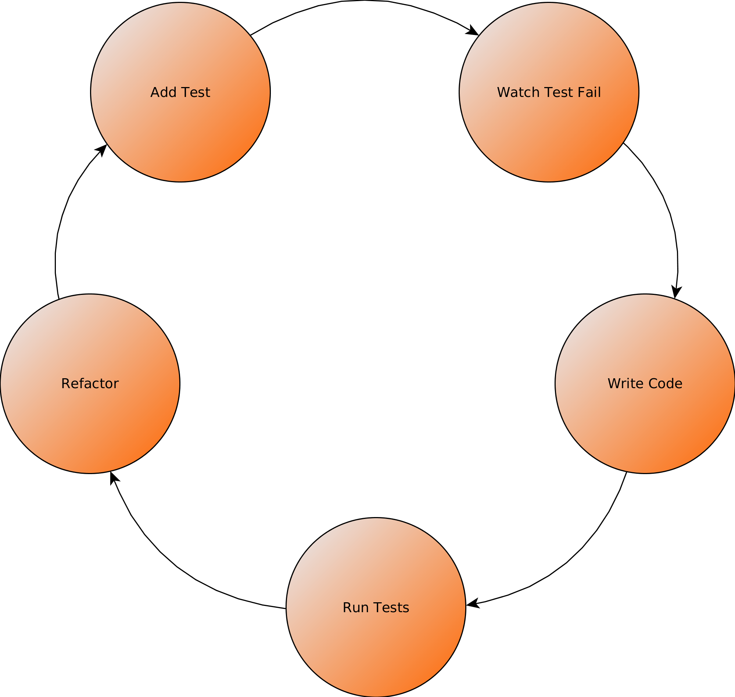
The TestDrivenDevelopment (TDD) Cycle

Slide 6
Refactoring
Improve existing code without chaning its external behavior
Improves code readability
Reduces complexity
Examples:
  Break apart complex functions/methods/classes into smaller functions/methods/classes
  Rename variables/functions/methods/classes

Slide 7
Red – Green - Refactor
RED
  Write a test that fails (doesn't work)
GREEN
  Write the minimal amount of code which makes the test work
Refactor
  Improve the code, design, readability

Slide 8
Example
<?php
class UserTest extends PHPUnit_TestFramework_TestCase {
public function testLoginTrueOnCorrectUsernamePasswordCombination() {
$user = new User();
$this->assertTrue($user->login('Username', 'Password'));
}
public function testLoginFalseOnWrongUsername() {
$user = new User();
$this->assertFalse($user->login('Wrong Username', 'Password'));
}
}

Slide 9
Why use TDD?
Leads to better “design”
Forces the developer to think more about the interface of the code, i.e how to use it, instead of the actual implementation
Leads to a set of tests which can verify the correctness of an application/system at any time
Allows easier modification of existing code
Tests can be used as documentation of existing code
Leads to more focused code
Boost confidence in the written code

Slide 10
How to use TDD?
Start with a test
  Think of what the class/function/method needs to do
  Think about the necessary interface of that class/function/method
  Think about the different cases and outcomes, which will need to be tested
  Write the test (test for the expected result of using the class/function/method)
Write the necessary code to cover the test
Run the tests often
Refactor

Slide 11
Best practices
Keep tests small and fast
Do not write overly complicated tests
  Complicated tests are a sign of bad design that can be improved
Use a framework for the tests (phpunit, rspec, jUnit, etc.)
Automate the running of the tests
  Use a tool which runs the tests automatically when you change code (Guard)
Generate documentation based on the tests

Slide 12
Myths about TDD
Writing tests slows down the development
  Might be true for really “small” applications (scripts)
  The bigger the complexity, the harder to fix bugs, TDD leads to faster bug fixing
  TDD cuts down on the change/break/fix cycle when modifications are made

Slide 13
Shortcomings of TDD
Writing tests for interfaces/databases/networking is hard
Tests are actual code, so can have the problems that normal code can
  Too complex
  Unmaintainable
  Unreadable
Bad tests can lead to false confidence, which can lead to shipping buggy code

Slide 14


Thank you!

