Slide 1
Web Game Development Course January 2015
Welcome!

Slide 2
Who am I?
Name: Alexander Blagoev
Occupation: CAO (Chief Annoyance Officer)
Email: alexander.i.blagoev@gmail.com
Company: XS Software

Slide 3
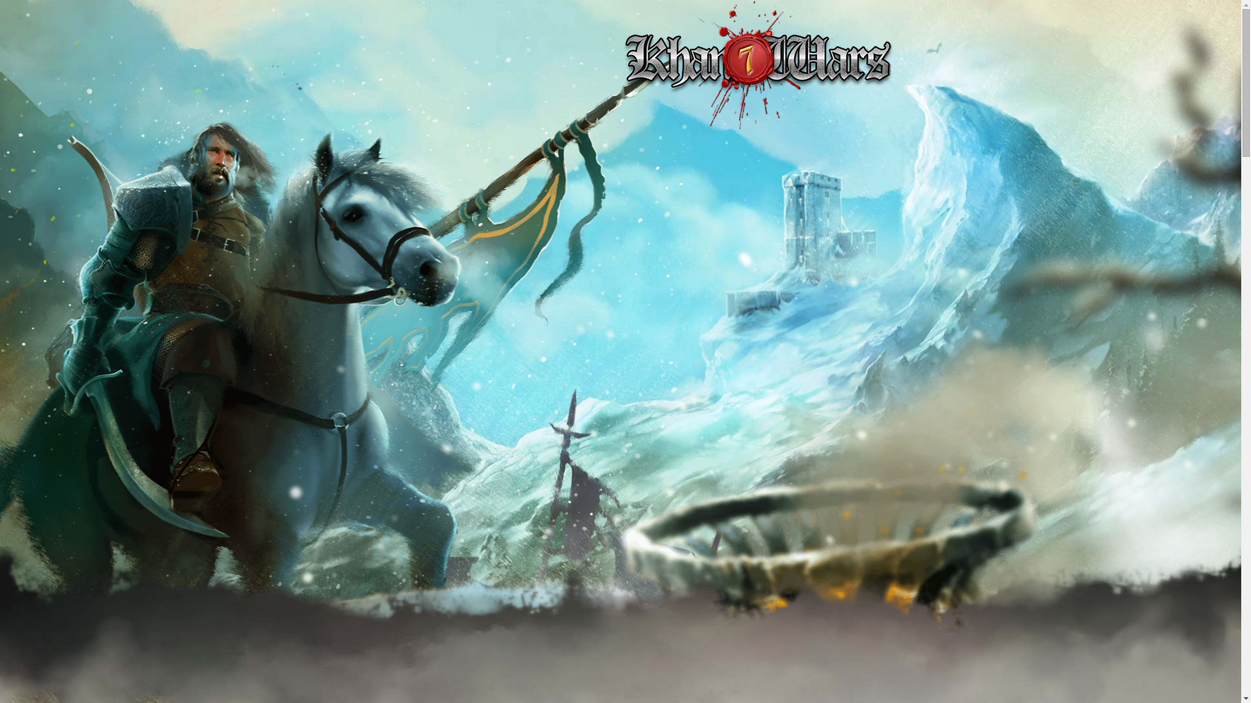

Who are XS Software?
www.xs-software.com

Slide 4
Who are you?
:)

Slide 5
Why is game development different?
Performance Requirements
Project Complexity
Code Complexity
Larger Teams
Always pushing the boundaries

Slide 6
What are we learning (hopefully) in this course?
The Art of Software Development
How to become a Software Engineer (or how not to be a hacker)
What skills are needed for game development

Slide 7
Contents (draft)
Clean Code
  Environment setup
  TDD
  Style
  Best practices
Linux
Git
HTTP
Databases
Authentication and Authorization principles
Security principles in web apps (web games)
Backend development principles
Consolidation

Slide 8
What makes a good developer?
Fluent English

Slide 9
What makes a good developer?
Fast Typer

Slide 10
What makes a good developer?
Problem Solver
  Code writing is only 10% of the job
Thinks about maintenance
Knows how to read code
Knows when to reuse code
Experiments
Is Up-To-Date
Is not a technology hipster in commercial projects (daily job)
Scientific approach
Is not a hacker
Writes Tests
Writes Tests
Writes Tests (I am not a good developer)
Has Style (and fashion sense)
Constant learner
Learns from others' experience
Does not only cling to what he already knows
Knows what he does not know
Communicates (can actually talk without biting people)
Shares and passes on the knowledge
I am not a good developer

Slide 11
Web Development Technologies
Assembler + Fortran (not)
PHP (oh yeah!)
PHPUnit
Ruby
Ruby on Rails
Rspec
HTML & CSS & Javascript (big surprise!)
jQuery
Node.js
MySQL
PostgreSQL
Nginx/Lighttpd
Linux
Unity

Slide 12
The Future of the Web
Angular/Ember/Knockout
NodeWebkit
WebGL

Slide 13
Where to learn?
github.com
news.ycombinator.com
www.slashdot.org
www.codecademy.com

Slide 14
What is next?
I don't know

Slide 15


Thank you!

