Slide 1
Lecture 02
Web Game Development Course
February 2015
Linux

Slide 2
History
First version of the linux kernel was created in 1991 by Linus Torvalds
Heavily influenced by Minix, which in turn is a Unix like operating system
Written specifically for the i386 processor (first 32-bit processor)
From 10,239 in 1991 to 15,803,499 LOC in 2013
Probable usage: 75,627,570 (linuxcounter.net)
Notes:
- Unix 1969 AT&T Bell Laboratories, first Assembly after that in C
- AT&T was required to license Unix to anyone who asked
- In 1984 AT&T obtain the right to sell the system

Slide 3
Interesting Facts
Android is based on the linux kernel
36.72% percent from web servers are running Linux
46,903 software packages in Ubuntu's repositories
Mac OS X and Linux both share a common ancestor Unix
Linux runs on at least 30 platforms

Slide 4
Why Linux?
Enormous amounts of free software
Powerful development tools
Powerful shell
Very efficient package management
Expert community and vast information online
It's fun
Notes:
Show list of available packages: apt list | wc -l
Grep some logs
Install build-essential, php and ruby in one go

Slide 5
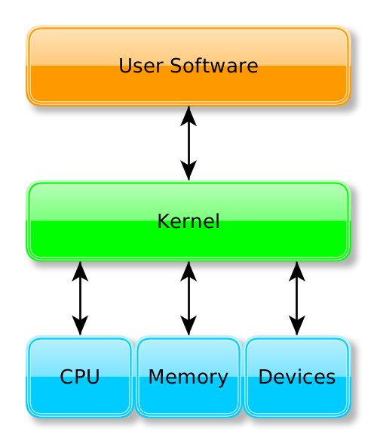
What is a kernel?

Slide 6
What is a kernel?
Manages CPU scheduling
Manages Memory
Manages I/O from Software
Manages user processes (programs)
Manages interprocess communication and synchronization
Services System Calls

Slide 7
What is a system call?
Interface between a process (program) and the operating system
Categories of system calls:
  Process Control
  File Management
  Device Management
  Communication
Provided as an API (wrapper functions, libc)

Slide 8
Examples of System Calls
chdir() - Change working director
open() - Open or create a file
read() - Read from a file descriptor
close() - Close a file descriptor
fsync() - Synchronize a file's state with storage
stat() - Get file status
fork() - Create a child process
exit() - Terminate a process

Slide 9
What is POSIX?
Portable Operating System Interface
Defines a standard for the API for system calls in operating systems
Additionally deals with shells, standard user-level programs and other APIs

Slide 10
Posix Compliant Operating Systems
Mac OS X
Linux*
Android*

Slide 11
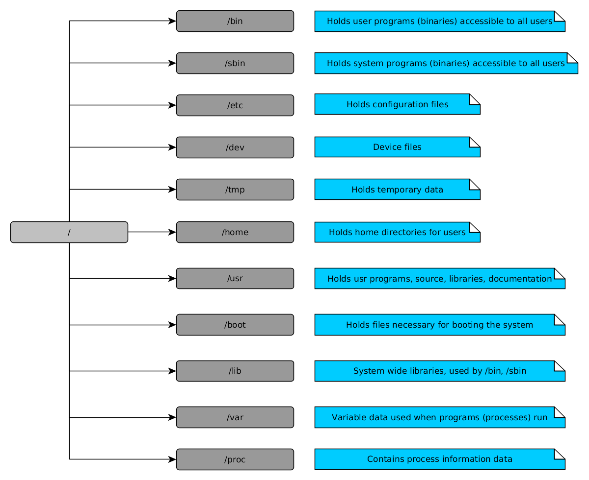
Linux Directory Structure

Slide 12
Basic Linux commands
cd – Change working directory
ls – List directory contents
cat – Display file contents
mkdir – Create directory
touch – Create a file
pwd – Display current directory
nano – Edit file in the “nano” editor

Slide 13
Basic Linux commands
grep – search text or pattern
find – find files
more – pages text
ps – List running processes

Slide 14
Standard Input/Output/Error
All of the above are special types of files which programs read and write to
Most programs display their results sending data to “Standard Output”, which by default displays the results on the screen
Most programs collect their input from “Standard Input”, which by default collects keyboard input
Most programs send errors to “Standard Error”, which by default displays the results on the screen
Notes:
Show that everything is a file in linux

Slide 15
I/O Redirection
Standard Input/Output/Error can be “redirected”
ls -la > result.txt
ls -la >> result.txt
ls < options.txt
ls -qwewrefd 2> errors.txt
ls -la > results.txt 2>&1

Slide 16
Pipes
Connect multiple commands together
The standard output of one command is fed to the standard input of another
cat file.txt | grep “search”
cat file.txt | wc -l
cat file.txt | sort | uniq -c
mysqldump | gzip > dump.sql
Notes:
Bash as a programming language

Slide 17
Package Managers
Systems for installing, upgrading and configuring software packages
apt-cache search php
apt-get install php
apt-get install mysql

Slide 18
What is next?
  The HTTP Protocol around all web applications (and more) are built

Slide 19


Thank you!

