Slide 1

Lecture 03
Web Game Development Course
February 2015
HTTP Protocol

Slide 2
What is HTTP?
HyperText Transfer Protocol
Communication protocol used for exchanging data between a client and a server
The underlaying protocol used by the World Wide Web
Defines how messages are formatted and transmitted between a client and a server
Hypertext – structured text with links to other structured text
HTML – HyperText Markup Language

Slide 3
History
First proposed along with HTML in 1989 by Tim Berners-Lee for the World Wide Web project
1991 first documented version of the protocol HTTP v0.9
Expansion of the protocol in 1996 HTTP v1.0
HTTP1/1.1 released in 1997 (currently the most common version used by clients)
Improvements released in 1999
Notes:
Note about the age of technologies used today
Everything new is something well forgotten

Slide 4
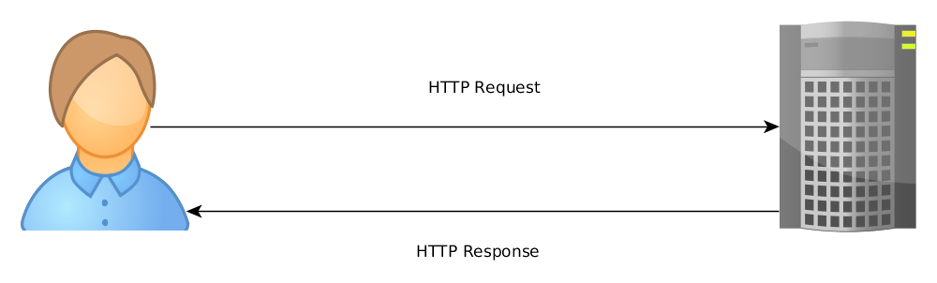
The Protocol
Plain text messages exchanged between a client and a server
The protocol is “stateless”

Slide 5
HTTP Resources
Clients request HTTP resources
Anything with an identity can be a resource:
  Images
  Files
  HTML documents
  More abstract stuff like web services (search, upload file, fetch profile info, JSON/XML feeds, etc.)

Slide 6
URL
Uniform Resource Locator
Specifies the location of a resource on a computer network and the mechanism of retrieving it (not the same as URI)
URL consists of:
  A scheme name (protocol)
  A host (domain)
  Path of the Resource
Examples:
  http://www.google.bg/
  http://static.xs-software.com/khanwars/gate7.0/img/v70/logos/logo_en.png

Slide 7
Request Methods
Methods (verbs) which define the action to take on a given HTTP Resource
GET
  Retrieves a resource
HEAD
  Retrieves only the meta information about a resource without fetching it
POST
  Used to modify a given resource
PUT, DELETE, TRACE, OPTIONS, CONNECT, PATCH

Slide 8
Headers
Headers define parameters for an HTTP request/response exchange
Name – Value pairs in plain text, separated by a colon
Each header is terminated by a CR – LF (Carriage Return and Line Feed, \r\n)
Examples:
  Content-Type: image/png
  Content-Length: 1000
  User-Agent: Mozilla/5.0 (X11; Linux x86_64) AppleWebKit/537.36 (KHTML, like Gecko) Chrome/41.0.2272.76 Safari/537.36
  Host: www.google.bg
Notes:
\r, \n Special characters signigfying to reset the cursor position to the beginning of a line and insert a new line

Slide 9
The Protocol v2
Request/Response Line
HTTP Headers
Body
Trailer

Slide 10
The Request
A request has the following format:
  A request line containing the request method (verb), the path of the resource on the server, the HTTP protocol version used
  Request Headers
  An empty line
  An optional message body

Slide 11
Request Example
---------------------------
GET / HTTP/1.1
Host: www.google.bg
---------------------------

Slide 12
The Response
A response has the following format;
  A Status-Line, includes the HTTP version, status code and a status message
  Response Headers
  An empty line
  An optional message body

Slide 13
Response Example
---------------------------
HTTP/1.1 200 OK
Content-Type: text/html
<html><head><title>Hello!</title></head></html>
---------------------------

Slide 14
HTTP Status Codes
Response status codes which return information about the request/response
Most common codes:
  200 OK – The request was OK
  301 Moved Permanently – The requested resource has moved to a new URL
  400 Bad Request – The request was malformed
  404 Not Found – The requested resource was not found
  500 Internal Server Error – An error occurred serverside
  502 Bad Gateway – The server acted as a proxy or gateway and recevied an invalid response from the third side

Slide 15
Query String
Key – Value pairs separated by the “=” character
Pairs are separated by the “&” character
Query Strings can be added to an URL
Usually used to pass additional parameters to a request, which are used by the server
Examples:
  title=Test&body=TestBody
  http://en.wikipedia.org/w/index.php?search=http

Slide 16
POST requests
Usually used when a resource needs to be modified in the server
Adds the data needed for the modification in the request body
Used in web forms
Usually data in the request body is encoded like a query string

Slide 17
POST Example
POST / HTTP/1.1
Content-Type: application/x-www-form-urlencoded;charset=utf-8
Content-Length: 29
username=test&password=123456

Slide 18
HTTP Security
Data between the client and the server is transferred in plain text and can be read freely by a third party (See example from previous slide for why this is not good)
HTTPS can be used for transferring data between a client and server more securely

Slide 19
HTTP Cookies
A cookie is a small piece of data transferred from the server to the client
Used to remember stateful information for a user (user settings, language, tracking activity, etc.)
Set with the “Set-Cookie” header in an HTTP response
Example:
  Set-Cookie: username=Test; Expires=Mon, 09 Mar 2015 09:00:00 EET
Sent with the “Cookie” header in an HTTP request
Example:
  Cookie: username=Test

Slide 20
HTTP outside the browser
HTTP is not only used by browsers
The APIs for most modern web applications are using HTTP: Facebook, Twitter, Dropbox, Google APIs, Youtube
A lot of software uses the protocol for network communication: Riak (Distributed Database)
Mobile applications use HTTP most of the times to communicate with their backends

Slide 21
What's next?
Backend Development

Slide 22


Thank you!

