Slide 1
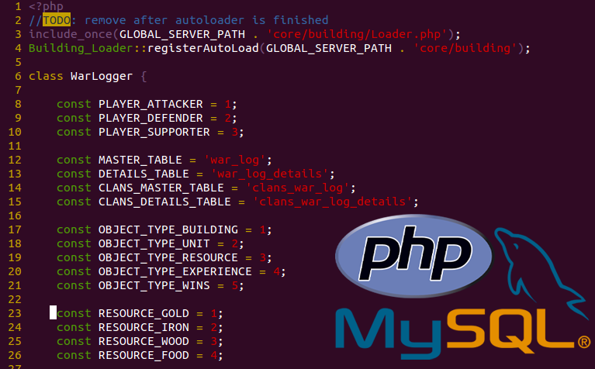
Lecture 04
Web Game Development Course
February 2015
Backend Development
(https://www.github.com/ablagoev/nbu-course-citb608)

Slide 2
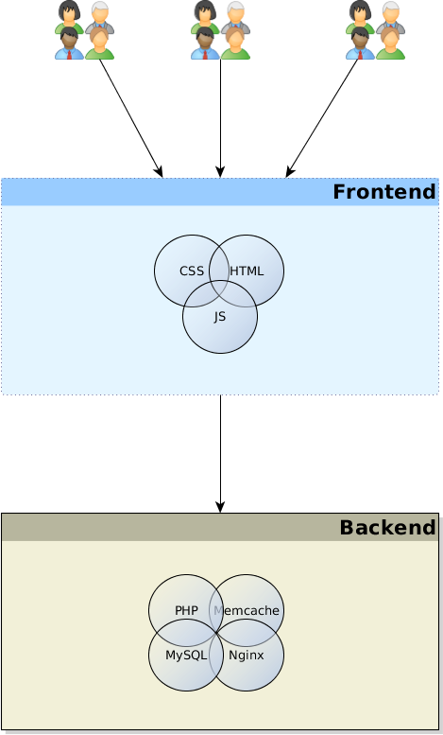
Frontends and Backends

Slide 3
What is an abstraction?
Hiding system complexity behind a well defined interface
Hides implementation details behind an interface
Everything can be an abstraction
It can be layered
Examples:
  Classes
  OS System Calls
  Applications
Notes:
Talk about the abstraction pyramid in modern software

Slide 4
What is a Frontend?
Abstraction for underlaying functionality
Presentation Layer of the Application
Layer which serves directly its clients
Interface between the user and the backend
The “front” facing part of an application
Notes:
Show what a frontend and backend is using the Linux commands and GUI

Slide 5
What is a Backend?
Abstraction for underlaying functionality
The implementation of an abstraction
Usually the data access layer
Usually runs serverside
Handles data operations such as edit, delete, insert
Implements the “business logic” of the application
Provides servcices for the frontend
Notes:
Guess how frontend and backend communicate in Web development?

Slide 6
Frontend and Backend
Both are abstractions and in certain situations can be swapped
Both enable separation of concern
A web page can be a frontend for typical users
A web page can be part of a backend, when for example parsed by a service for information
A database can be a part of the backend, the library with which to communicate with the database is a part of the frontend

Slide 7
What connects a frontend with a backend?
A communication protocol
Guess which protocol usually connects frontend and backend in web development?

Slide 8
Parts of a traditional WEB backend

Slide 9
Parts of a traditional WEB backend
A server running the whole backend software
A web server used for serving and communicating with the backend
An application written in a serverside language implementing the business logic
A database

Slide 10
The server
Usually a computer connected to a network
Supports the installation and maintenance of the backend software
Provides the necessary hardware for the backend

Slide 11
The WEB server
Handles HTTP communication with the frontend
  Handles the low level implementation of the HTTP protocol
Serves static resources like images/css/javascript
Serves multiple clients simultaneously
Examples:
  nginx, Apache, lighttpd, IIS

Slide 12
Serverside Language (Application)
Used to implement the business logic of the application
Handles data access for the applications
Handles data passed on from the frontend through the webserver
Based on data generates the needed output/frontend
Can be any programming language
Examples:
  PHP, Ruby, Javascript (Node.js), Python, C#, Java

Slide 13
The Database
Layer which is used to store and modify the application data
Manages the actual access of the data
Examples:
  Plain Files, MySQL, NoSQL, Oracle Database, Microsoft SQL Server

Slide 14
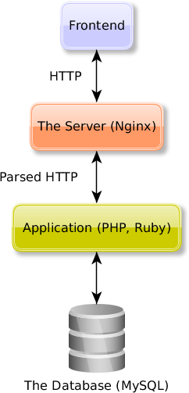
The Backend

Slide 15
Programming Patterns
Reusable solutions to common problems
Provide abstract tools for deconstructing complex problems into smaller more manageable parts
Patterns provide a core solution which can be adapted to a wide set of problems
Examples:
  MVC (Model-View-Controller), Factory, Iterator

Slide 16
MVC (Model-View-Controller Pattern)
The defacto pattern for development of web applications at the moment
Used most commonly in the Application Layer for the actual implementation of the app
Separates the presentation (View) logic from the business logic (Model)
Uses a component (Controller) for communication between the two layers

Slide 17
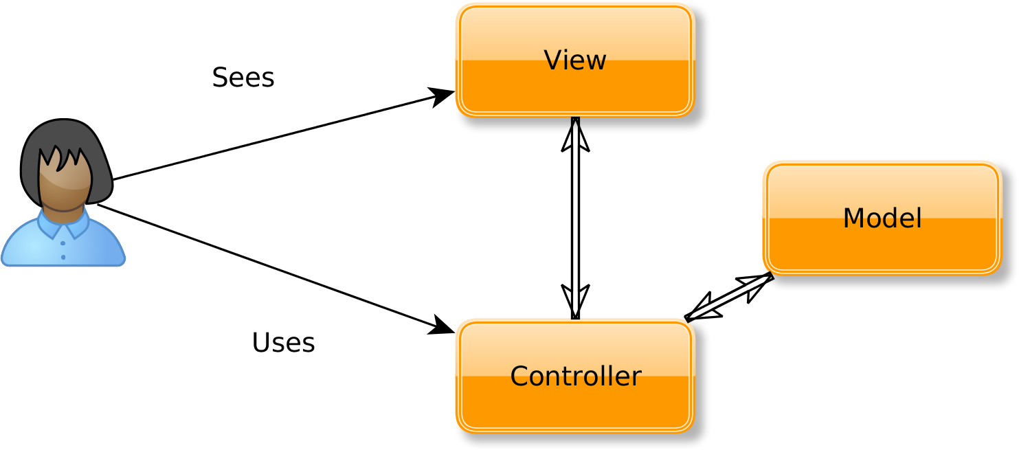
MVC

Slide 18
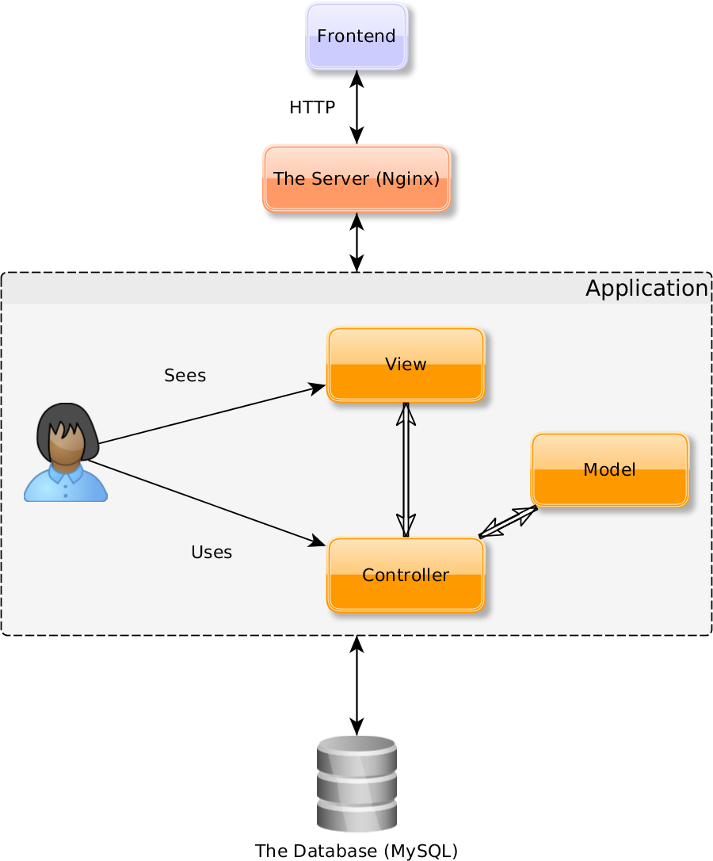
Backend Revisited

Slide 19
The View in MVC
Handles all presentation logic
“Presents” the data in the model
Provides mechanisms for input (usually to the user
Examples:
  HTML pages generated by the application are part of the view layer
  JSON generated by an API call is a part of the view layer

Slide 20
The Model in MVC
Implements the application logic
Provides methods for accessing and modifying application data
Examples:
  Logic for accessing the database is implemented in the Model
  Logic handling validation of new entities (resouces) is implemented in the Model
    Validating the uniqueness of a username when creating a user
    Validating the password length when creating a user

Slide 21
The Controller in MVC
The glue between the View and the Model
Handles the passing of data between the other two
Acts as a manager, passing around needed data
Should not contain business logic
Examples:
  Gathering all parameters in an HTTP request and assigning them to the proper Model
    Gathering the username and password parameters in a request for a new user and passing them to a model, which handles the validation and creation of the user

Slide 22
Why is MVC good?
Provides a clear separation of roles in an application (generally a good concept in development)
  Separation of the View and Model allows for multiple different Views
    An application can easily generate both HTML and JSON (web app and native mobile app with the same codebase)
  The separation allows easier testing
  The separation allows different teams/people to work on different parts of the app
Most modern apps implement MVC, which in turn allows new developers to become more effective on those projects faster

Slide 23
Popular MVC Frameworks
Ruby on Rails (Ruby)
Laravel (PHP)
Zend (PHP)
Symfony 2 (PHP)
Django (Python)
ASP .NET MVC (C# and .NET languages)
Spring MVC (Java)

Slide 24
What is Next?
Frontend Development

Slide 25

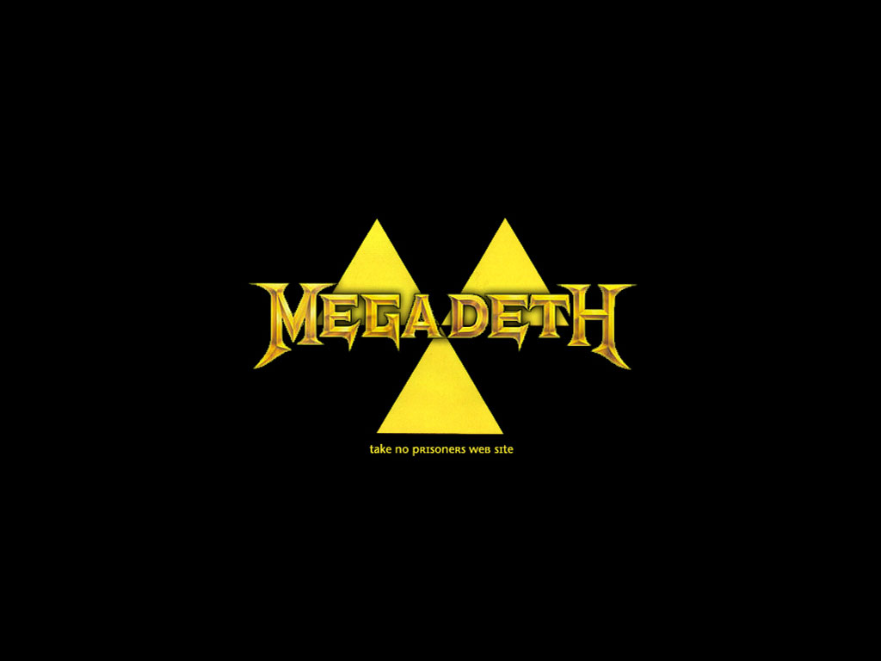
Thank you!

