Slide 1
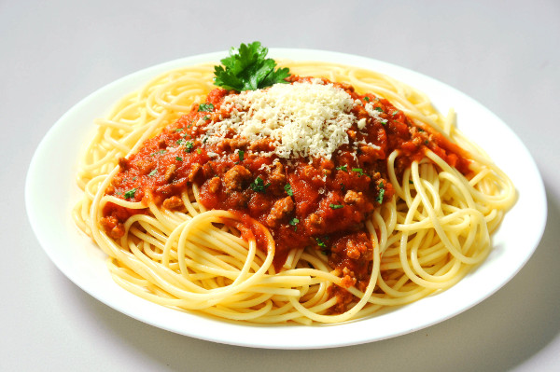
Lecture 05
Web Game Development Course
February 2015
Clean Code

Slide 2
What is Clean Code?
“Working code is not the same as good code”
Clean code is readable
Clean code has a good naming policy
Clean code has proper formatting
Clean code has meaningful comments
Clean code is structured code
Clean code does not surprise you
Clean code adheres to a standard (convention)
Clean code is simple code
Clean code is one of the ingredients of quality code

Slide 3
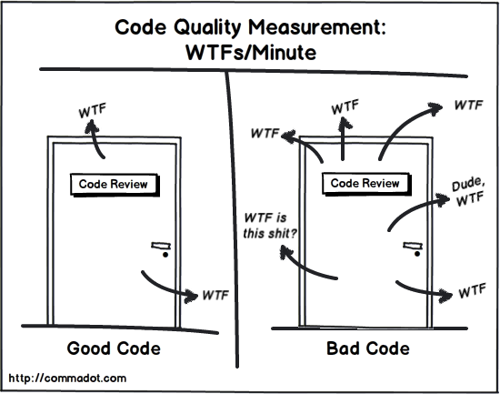
Code Quality

Slide 4
Why Clean Code matters?
80% - 90% of developer time is spent on maintenance
Time spent reading code is at least 5x more than time spent coding
To change code you need to understand code
Big projects require big teams, big teams need to communicate efficiently

Slide 5
Examples (Bad Code)
<?php
if(isset($_REQUEST['user'] && isset($_REQUEST['password'])){
$u=$_REQUEST['user'];
$p=$_REQUEST['password'];
$q="SELECT * FROM users WHERE username=:s_username AND password=:s_password";
$s=$d->prepare($q);
$s->bindParam('s_username',$u);
$s->bindParam('s_password',$p);
$s->execute();
if($s->rowCount()>1){
$a=true;
}
}

Slide 6
Examples (Cleaned Up)
<?php
// Try and login the user
if (isset($_REQUEST['user'] && isset($_REQUEST['password'])) {
$username = $_REQUEST['user'];
$password = $_REQUEST['password'];
$query = "SELECT * FROM users WHERE username = :s_username AND password = :s_password";
$stm = $db->prepare($query);
$stm->bindParam('s_username', $u);
$stm->bindParam('s_password', $p);
$stm->execute();
// Success user found
If ($stm->rowCount() > 1) {
$authenticated = true;
}
}

Slide 7
Formatting
Bad formatting is the first sign of incompetency
No excuse for bad formatting, ever!
Bad formatting should be fixed when spotted
Watch out for proper identation
Watch tabs vs. spaces, check what the project uses
Most common practices:
  $variable = 1; $variable1 - $variable2; $variable1 + $variable2;
  If ($value > 0)
  functionCall($argument1, $argument2, $argument3)
  if (true) {

Slide 8
Example (Bad)
<?php
// Try and login the user
if (isset($_REQUEST['user'] && isset($_REQUEST['password'])) {
$username = $_REQUEST['user'];
$password = $_REQUEST['password'];
$query = "SELECT * FROM users WHERE username = :s_username AND password = :s_password";
$stm = $db->prepare($query);
$stm->bindParam('s_username', $u);
$stm->bindParam('s_password', $p);
$stm->execute();
// Success user found
If($stm->rowCount() > 1){
$authenticated=true;
}
}

Slide 9
Example (Good)
<?php
// Try and login the user
if (isset($_REQUEST['user'] && isset($_REQUEST['password'])) {
$username = $_REQUEST['user'];
$password = $_REQUEST['password'];
$query = "SELECT * FROM users WHERE username = :s_username AND password = :s_password";
$stm = $db->prepare($query);
$stm->bindParam('s_username', $u);
$stm->bindParam('s_password', $p);
$stm->execute();
// Success user found
If ($stm->rowCount() > 1) {
$authenticated = true;
}
}

Slide 10
Naming
What does it do?
Why it exists?
Hot it is used?
Good naming allows the code to explain itself
Good names do not mislead the intent of the code
Good names are searchable names
Be consistent

Slide 11
Naming (Bad)
<?php
class Shit {
public function doIt($a, $b) {
if ($a == 'Test' && $b == 'asdf') {
return true;
}
return false;
}
}
$a = new Shit();
$a->doIt('Test', 'asdf');

Slide 12
Naming (Good)
<?php
class User {
const ADMIN_USERNAME = 'Test';
const ADMIN_PASSWORD = 'asdf';
public function login($username, $password) {
if ($username == self::ADMIN_USERNAME && $password == self::ADMIN_PASSWORD) {
return true;
}
return false;
}
}
$user = new User();
$user->login('Test', 'asdf');

Slide 13
Structure
Good structured code separates different logical parts, similarly to paragraphs in a text
Improves readability
Cuts down time when searching for a particular code block

Slide 14
Structure (Bad)
<?php
// Try and login the user
if (isset($_REQUEST['user'] && isset($_REQUEST['password'])) {
$username = $_REQUEST['user'];
$password = $_REQUEST['password'];
$query = "SELECT * FROM users WHERE username = :s_username AND password = :s_password";
$stm = $db->prepare($query);
$stm->bindParam('s_username', $u);
$stm->bindParam('s_password', $p);
$stm->execute();
// Success user found
If ($stm->rowCount() > 1) {
$authenticated = true;
}
}

Slide 15
Structure (Good)
<?php
// Try and login the user
if (isset($_REQUEST['user'] && isset($_REQUEST['password'])) {
// Gather credentials
$username = $_REQUEST['user'];
$password = $_REQUEST['password'];
// Check credentials against db
$query = "SELECT * FROM users WHERE username = :s_username AND password = :s_password";
$stm = $db->prepare($query);
$stm->bindParam('s_username', $u);
$stm->bindParam('s_password', $p);
$stm->execute();
// Success user found
If ($stm->rowCount() > 1) {
$authenticated = true;
}
}

Slide 16
Simplicity
Strive for simple, precise and focused methods/functions/classes
Do only one thing but do it well
Breakdown long functions/classes/methods into smaller functions/classes/methods with more focus

Slide 17
Example (Bad)
<?php
class User {
public function login($username, $password) {
$db = new PDO('mysql:host=127.0.0.1;dbname=application', 'db_user', 'db_pass');
// Check the database
$query = 'SELECT * FROM users WHERE username = :s_username AND password = :s_password';
$stm = $db->prepare($query);
$stm->bindParam('s_username', $username);
$stm->bindParam('s_password', $password);
$stm->exexcute();
$user = $stm->fetch(PDO::FETCH_ASSOC);
if ($stm->rowCount() == 0) {
return false;
}
// Update the lastlogin of the user
$query = 'UPDATE users
SET lastlogin_at = NOW()
WHERE id = :i_user_id';
$stm = $db->prepare($query);
$stm->bindParam('i_user_id', $user['id'], PDO::PARAM_INT);
$stm->execute();
$stm->closeCursor();
return true;
}
}

Slide 18
Example (Better)
<?php
class User {
protected $db;
public function login($username, $password) {
// Check the database
$user = $this->findUser($username, $password);
if (!$user) {
return false;
}
// Update the lastlogin of the user
$this->updateLastLogin();
return true;
}
// Rest of the implementation
...
}

Slide 19
Comments
Strive for meaningful comments
Avoid obvious comments
  $variable = 2; // Assign to variable the value of
Add short comments for classes/methods/functions describing what they do
Can be used to divide logical parts of the code
Explain more intricate code
Explain why certain decisions in code were made

Slide 20
Example (Bad)
<?php
class User {
protected $db;
public function login($username, $password) {
$user = $this->findUser($username, $password);
if (!$user) {
return false;
}
$this->updateLastLogin();
return true;
}
// Rest of the implementation
...
}

Slide 21
Example (Better)
<?php
// Class dealing with user authentication and registration
class User {
// Needs it's own instance since users reside on a different database
protected $db;
/*
* Login a user with a username and password combination
* @param string $username
* @param string $password
* @return bool
*/
public function login($username, $password) {
// Check user against the db
$user = $this->findUser($username, $password);
if (!$user) {
return false;
}
// Mark login
$this->updateLastLogin();
return true;
}
// Rest of the implementation
...
}

Slide 22
No Surprises
Methods/Functions/Classes should not hold hidden functionality
Methods/Functions/Classes should do what their name says they do

Slide 23
Example (Bad)
<?php
class User {
protected $username;
protected $password;
public function exists($username, $password) {
// Check the database
$user = $this->findUser($username, $password);
if (!$user) {
return false;
}
// Send a welcome email to the user if he has been inactive
// for 1 week
if (strtotime($user['lastlogin_at']) <= time() * 3600 * 24 * 7) {
$this->sendWelcomeEmail();
}
return true;
}
}

Slide 24
Example (Better)
<?php
class User {
protected $username;
protected $password;
public function exists($username, $password) {
$user = $this->findUser($username, $password);
if (!$user) {
return false;
}
return true;
}
public function isInactive() {
if (strtotime($user['lastlogin_at']) <= time() * 3600 * 24 * 7) {
return true;
}
return false;
}
public function sendWelcomeEmail() {
}
}

Slide 25
Convention
Clean code adheres to the projects conventions
Formatting and styling should be consistent within the project

Slide 26
Example (Bad)
<?php
class User
{
public function login_with_username_and_password($username, $password) {
}
}
class Employee extends User {
public function calculateSalary($hoursWorked) {
}
}

Slide 27
Example (Good)
<?php
class User
{
public function login_with_username_and_password($username, $password) {
}
}
class Employee extends User
{
public function calculate_salary($hours_worked) {
}
}

Slide 28
Resources
http://www.amazon.com/Clean-Code-Handbook-Software-Craftsmanship/dp/0132350882

Slide 29


Thank you!

