Slide 1
INCEPTION
A Board Game - Team 7

Slide 2
Project Vision
Our objective is to develop a game to rekindle childhood memories of playing board games, but with a modern touch of strategic gameplay. It will be a 2D board game with various characters, powerups, and interesting graphic design. The game will not be an online multiplayer game. However, you can play against AI or with your friend using the same device.

Slide 3
Features
Features of a good board game:
Rules that are easy to understand and remember
Strategic decisions with an element of luck
Fun playing pieces
Can be played over and over again

Slide 4
Our Features
Game characteristics
2D
Offline
Single device multiplayer mode
Components
Tiles - road from start to finish
Characters - each player will play with 3 characters
Dice - to determine character movement
Simple Objective - Get all three of your characters to the end tile to win the game

Slide 5
Our Features
A mix of tactical play and luck - When a dice is rolled, the player can decide on which character to move. The strategy will be formed based on the location of the player’s characters, the location of the opponent’s characters, and the type of tiles nearby.
Engaging gameplay - When you land on a tile, an event will occur.
Forward or backward moves
Health damage and regeneration
Obtain event cards
Portals: Take the character to another tile
Quicksand: Capture the character until a certain dice number is rolled

Slide 6
Our Features
Event cards - Event Cards will be a form of powerups and special events in our game. We plan to devise different types of wildcards to make the game full of fun. Powerups can affect any characters on the board.
Freeze one of the opponent's characters
Double your next move
Choose your steps
Reduce opponent’s next move
Inflict damage
Heal a character
Characters - We will include a wide variety of fictional characters to choose from.

Slide 7
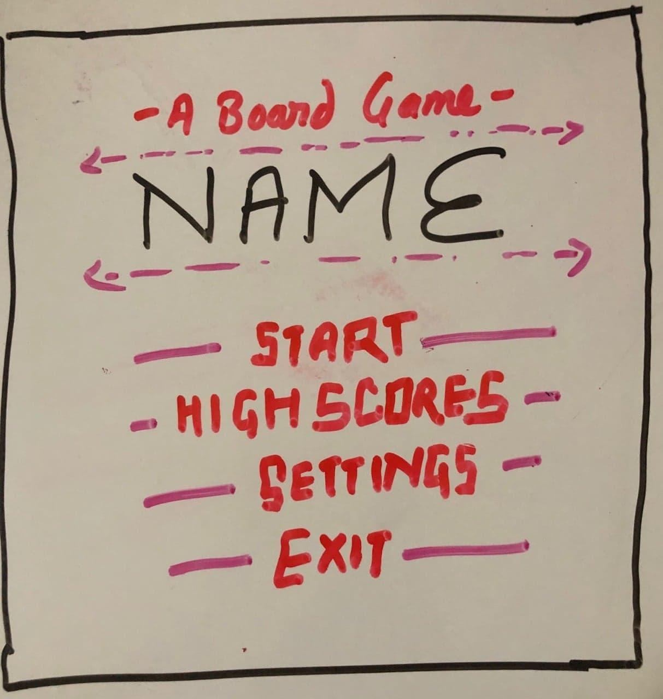
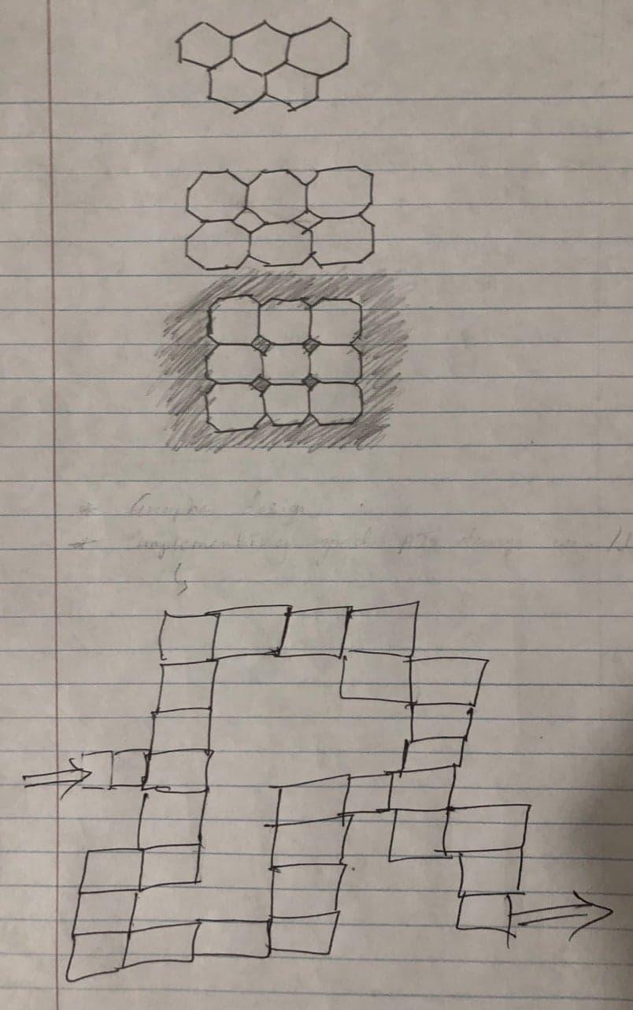
Our Features
Fig: Main menu concept
Fig: Board layout brainstorming

Slide 8
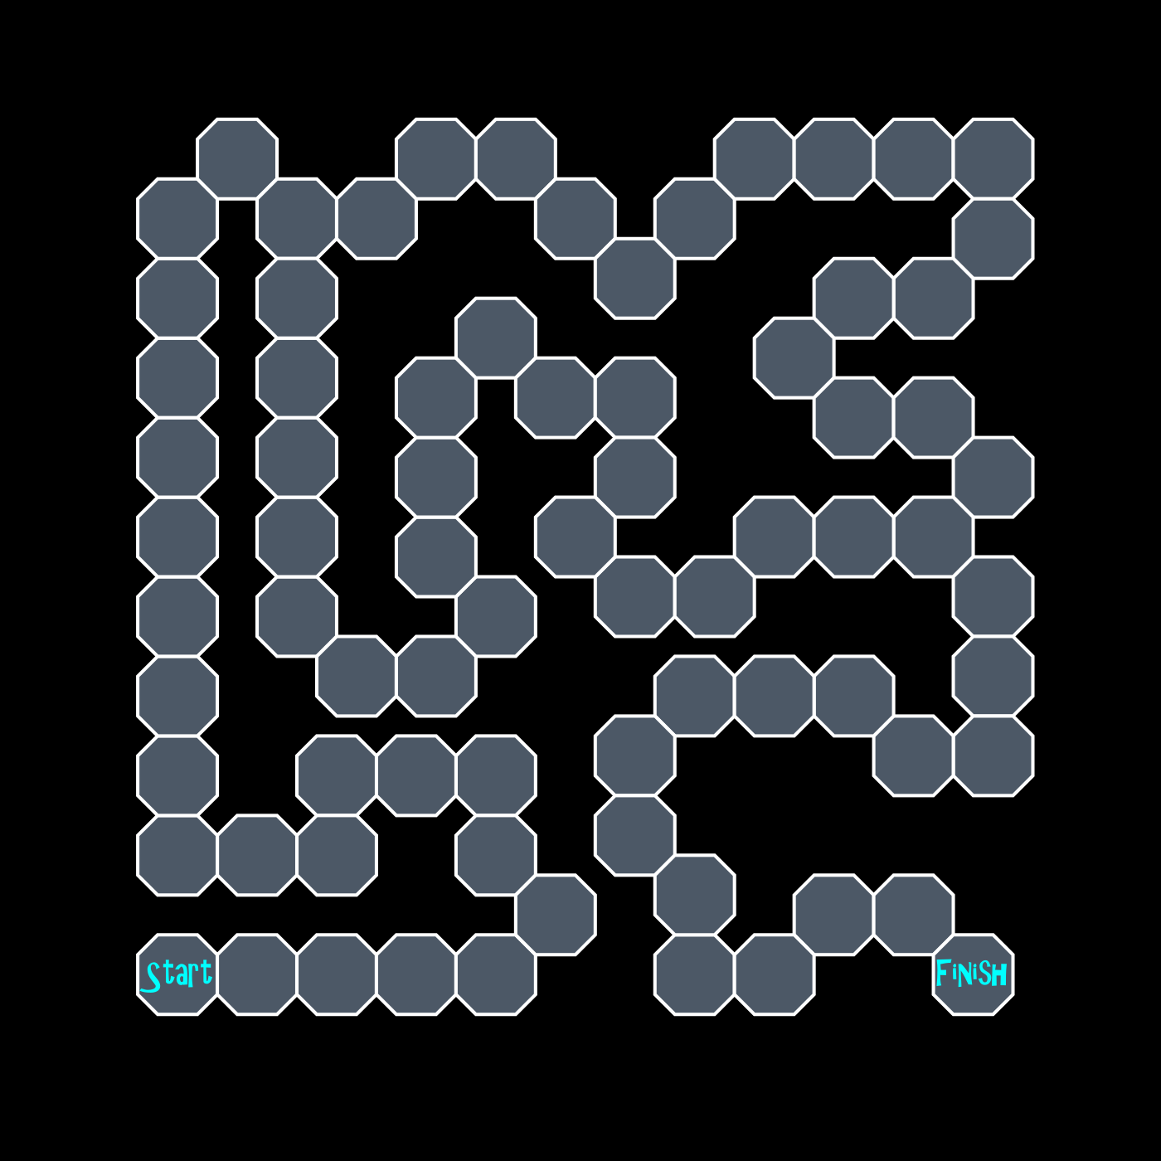
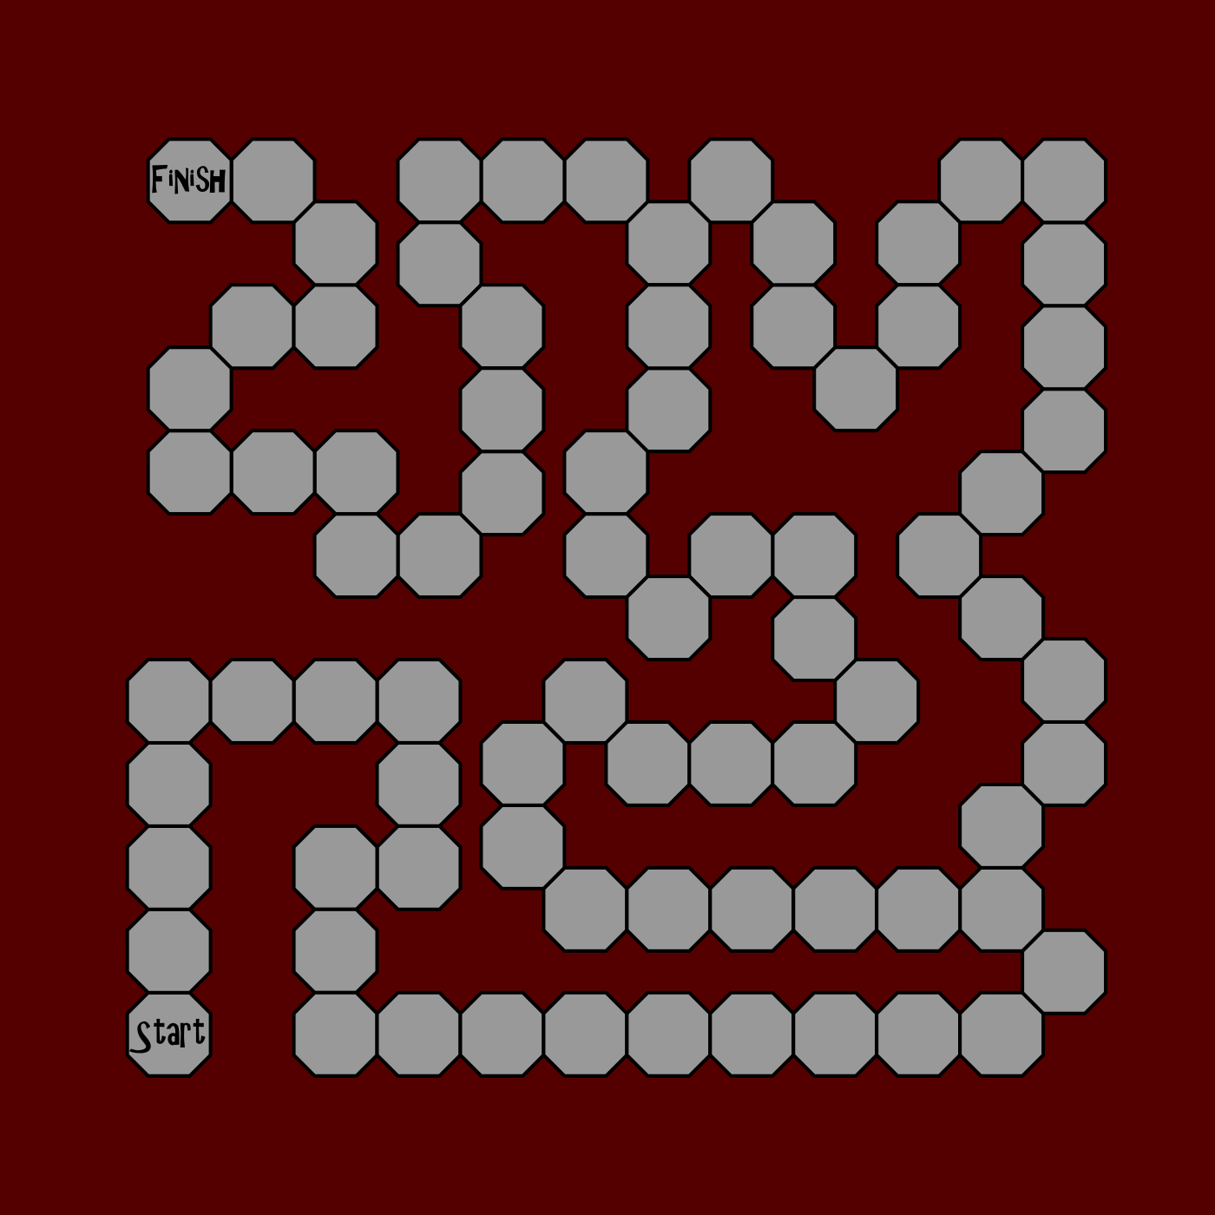
Our Features
Fig: Board layout design 1
Fig: Board layout design 2

Slide 9
Competitors
Everything has competitors, from food to tv shows to games.
Distinguishing oneself is key to be viable in the market.
Advantages of digital board games over physical games
No losing pieces
Play on the go
Foremost differences:
Our game is free
Event Cards

Slide 10
Snakes and Ladders
Similarities:
Roll-to-move
Move further up and down board if you land on certain spaces
How ours is different:
Choice of multiple characters to move after any given roll

Slide 11
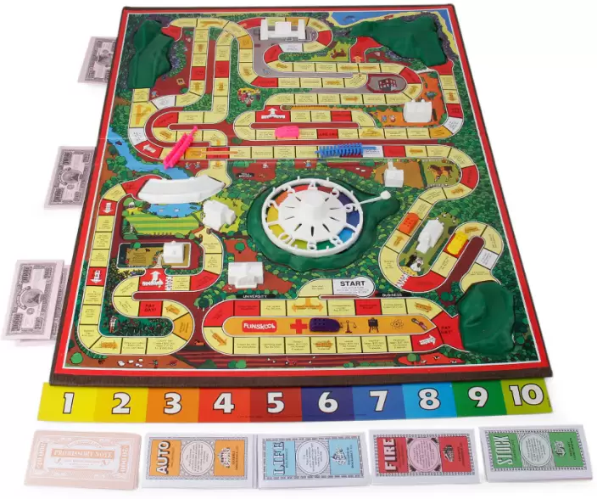
The Game of Life
Similarities:
Different route options
Randomized movement
Events on predetermined spaces
How ours is different:
Again, multiple characters to choose routes for
Character death and checkpoint system
https://www.flipkart.com/funskool-game-life-board/p/itmda5vynhbmkanh

Slide 12
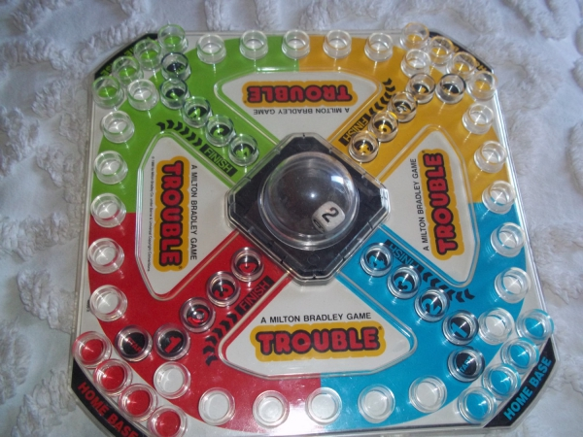
Trouble
Similarities:
Roll-to-move
Multiple characters
Goal is to reach the end with every character
How ours is different:
Characters are sent back to a checkpoint instead of the start if they are defeated.
Characters have hit points that determine when they are defeated.
https://lifestyle.allwomenstalk.com/of-the-greatest-classic-board-games-to-play-adult-style/7/

Slide 13
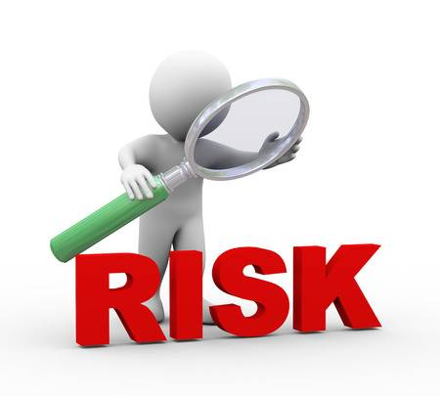
Risks
.
Basically, potential problems that could arise during the development of any kind of project.
Depending upon type of project, risks can be of various type.
https://www.rowanprepschool.co.uk/News/Rowan-News/year-6-life-skills-risk-assessment-presentation-4672

Slide 14
Possible risks during the creation of our 2D board game:
Functional and effective AI
Effective graphic design
Time management

Slide 15

Functional and Effective AI
Most of the time goes on designing effective AI in order to make game interesting .
Should not be too hard or too easy to defeat.
Mitigation:
Starting with simple functional AI, we will developed its effectiveness as we progress.
https://www.imperial.ac.uk/news/117709/doc-student-launches-video-game-that/

Slide 16
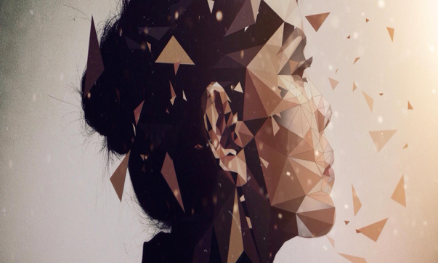
Effective graphic design
Since it's going to be 2D , graphic will play a very important role in understanding the character.
Color, space, alignment, balance are the main components of graphic which will be really hard to implement.
Mitigation:
Planned on creating simple yet good graphic.
https://www.theartcareerproject.com/careers/graphic-design/

Slide 17
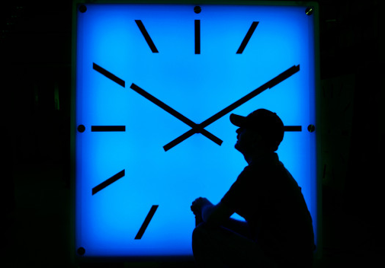
Time management
Since , this project need to be completed within this semester, time management can be a risk for us.
Poor time management can result in stress and frustration among team members, as well as heighten the risk of an incomplete project .
Mitigation:
Follow agile method and use scrum to track the work progress.
https://www.marinij.com/2018/10/01/california-isnt-the-only-state-debating-daylight-saving-time-forever/

Slide 18
Any Question?
GitHub - https://github.com/ablaze007/BoardGame

Slide 19
THANK YOU!

