Slide 1
Supervised Learning
Labelled data: inputs x paired with targets y
Regression = continuous output; classification = discrete label

Slide 2
Linear Regression
Prediction: y = w.x + b
Loss: mean squared error (MSE)
R squared = fraction of variance explained

Slide 3
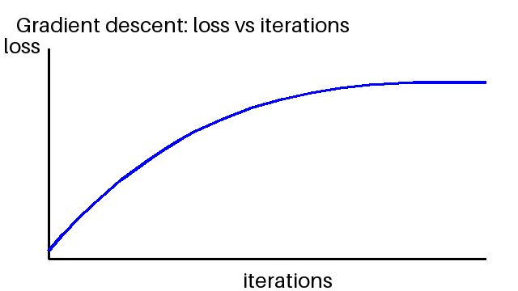
Gradient Descent
Update rule: w = w - alpha * gradient
Learning rate too large -> divergence; too small -> slow
SGD uses mini-batches

Slide 4
Logistic Regression and Classification
Sigmoid squashes scores into probabilities
Threshold 0.5 gives the class label
Trained with cross-entropy loss

Slide 5
Overfitting and Regularization
Overfitting: low training error, high validation error
L2 (ridge) shrinks weights; L1 (lasso) creates sparsity
Choose strength by cross-validation

Slide 6
Bias-Variance Tradeoff
Error = bias^2 + variance + noise
High bias -> underfitting; high variance -> overfitting

Slide 7
Neural Networks and Backpropagation
Neuron: weighted sum + non-linear activation (ReLU)
Backpropagation = chain rule applied layer by layer
Gradients feed gradient descent

Slide 8
Evaluation Metrics
Precision = TP / (TP + FP); recall = TP / (TP + FN)
F1 = harmonic mean of precision and recall

Slide 9
Clustering with K-Means
Unsupervised: no labels
Assign to nearest centroid, then update centroids
Elbow method helps choose k

