Slide 1
Housing and Crime in Houston
Levi Nielson
Abbey Allen

Slide 2
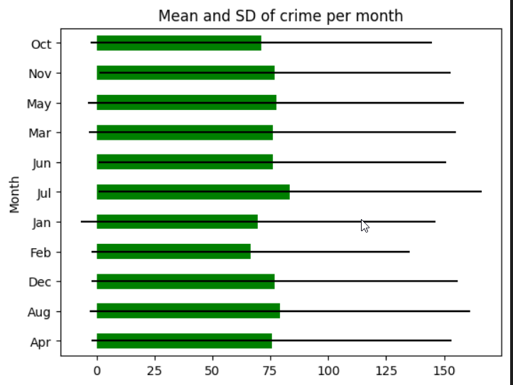
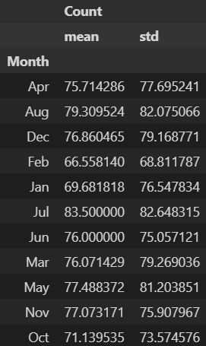
Crime per month
Lowest reports: Feb (66.6)
Highest monthly crime reports: July (83.5)

Slide 3
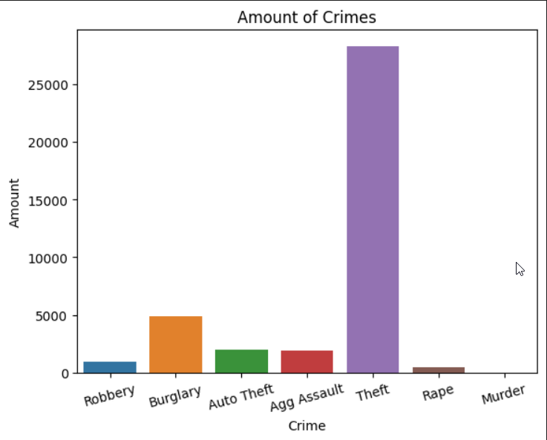
Most common crimes
Theft is by far the most common crime
Any type of stealing tends to be more common, burglary being less common than theft likely due to the “higher risk” nature

Slide 4
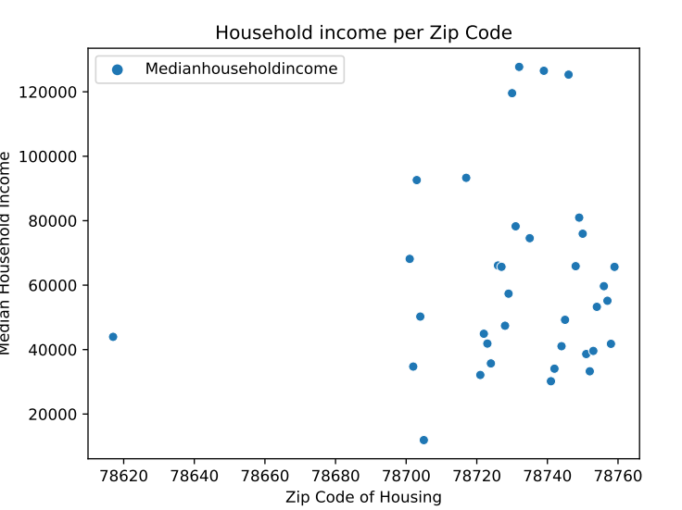
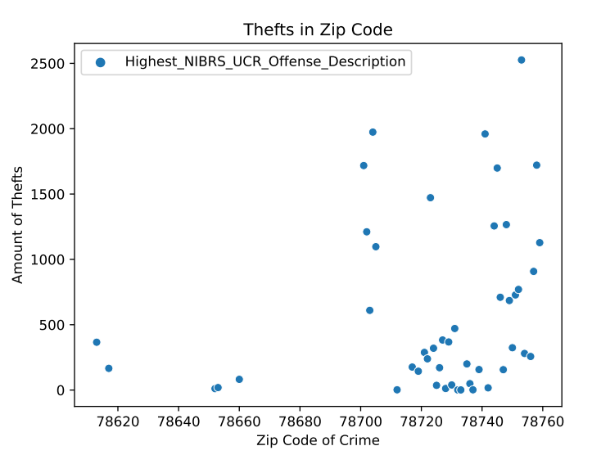
Income and crime rates
Pearson correlation shows positive correlation of 0.0388 with a p-value of 1.40835649699256e-10
Difference can especially be seen in zip codes between 78740 and 78760

Slide 5
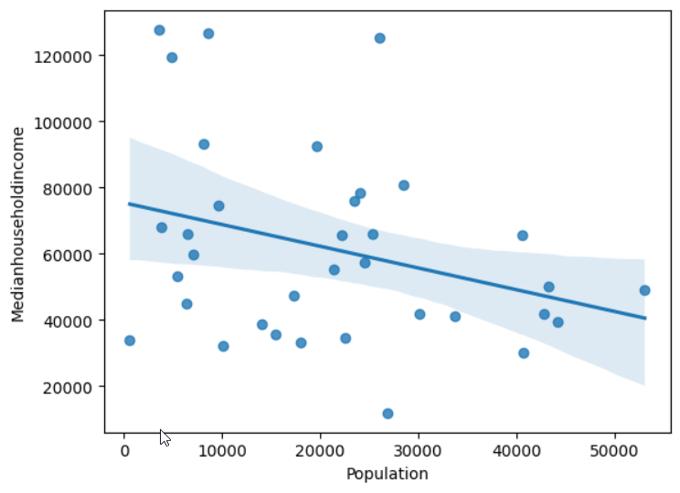
Population related to household incomes
There is a weak correlation that shows that as the population of a place increases, the median household income tends to decrease

