Slide 1


Heart Disease and Wine
Pouyan Saeidian & Abigail Allen

Slide 2
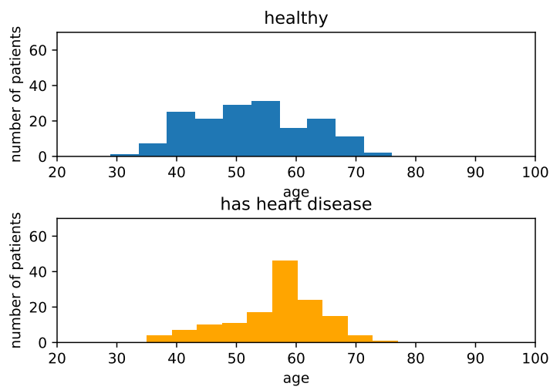
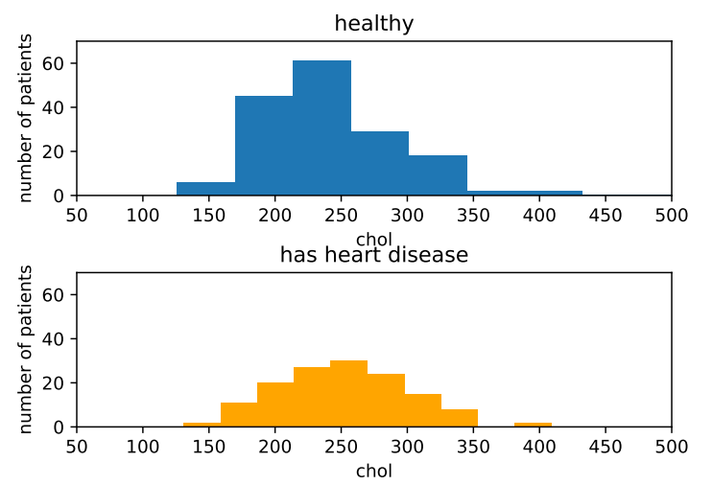
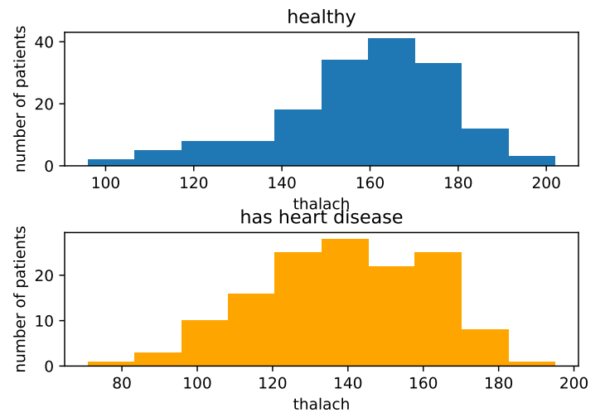
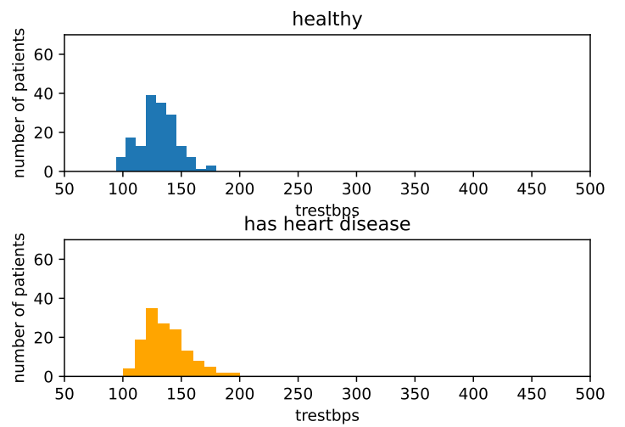
Heart Disease
Method
Graphed each attribute between persons with heart disease and persons without heart disease.
Based on graphs, attributes picked
Age
Resting blood pressure (trestbps)
Maximum heart rate achieved (thalach)
Cholesterol (chol)

Slide 3
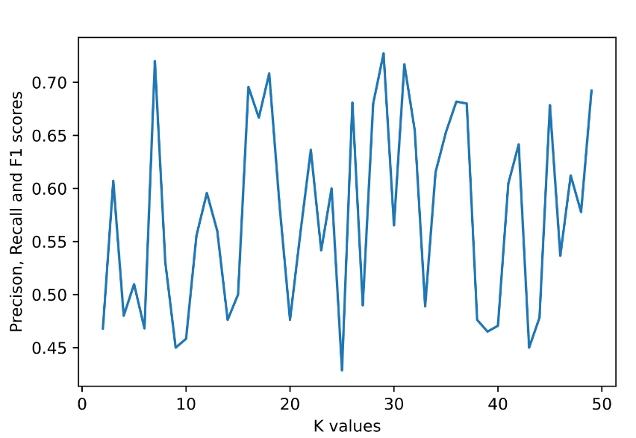
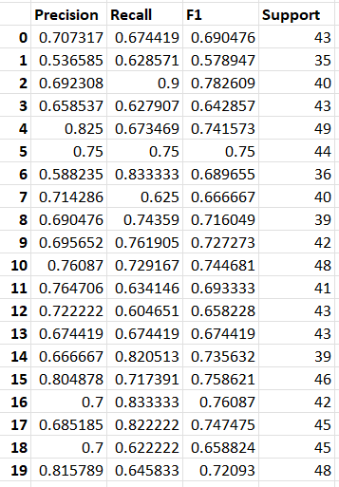
20-fold Cross-validation
k value of 23
Use n value of 50 to find k value
Highest average F1 value: 0.722380472189026

Slide 4
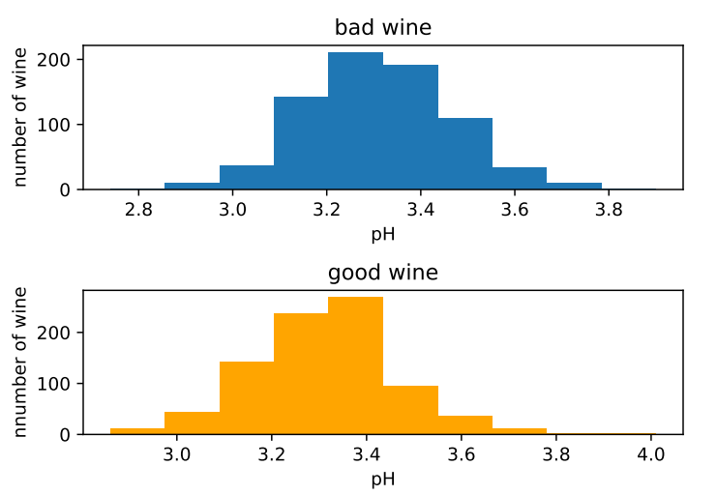
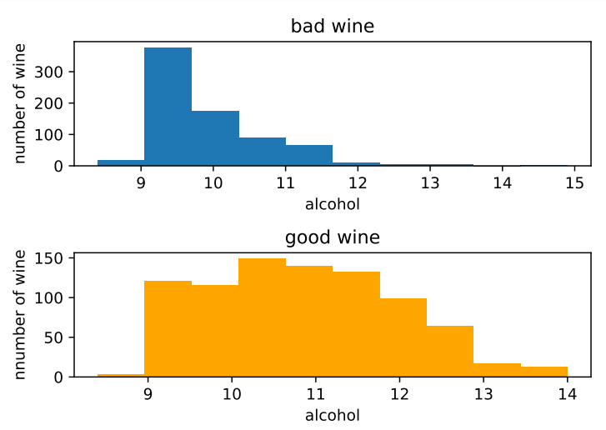
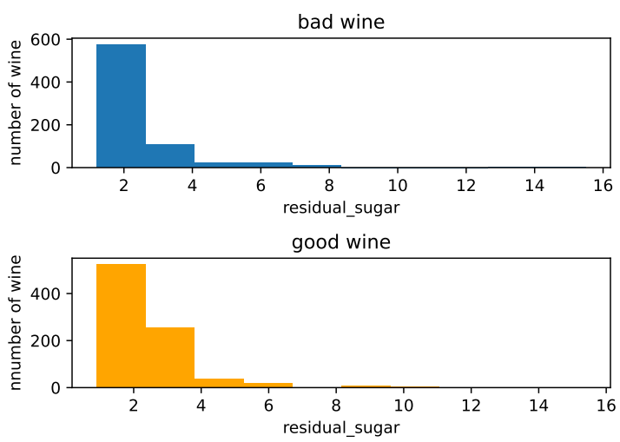
Wine Quality
Method
Graphed each attribute between wines with a quality above 5 and wines with a quality of 5 and below.
Based on graphs, attributes picked
pH
Alcohol
Residual Sugar (residual_sugar)

Slide 5
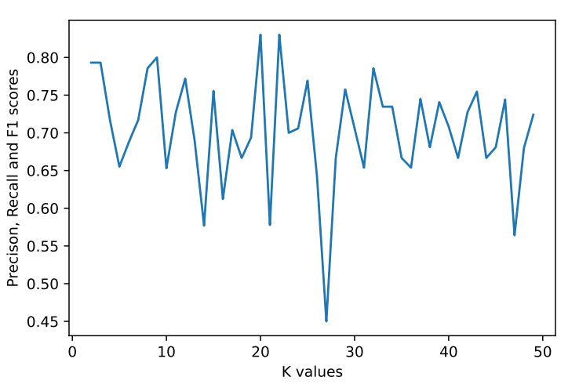
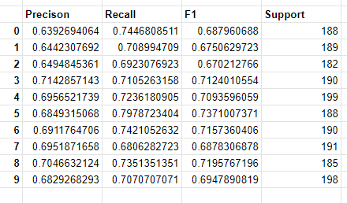
10-fold Cross-validation
k value of 25
Use n value of 50 to find k value
Highest average F1 value 0.7010030355

