Slide 1
Baseflow
Abigail Allen, James Seelos

Slide 2
Dataset
Contains information on baseflow for various river segments per month from 1939-2000
Includes details on the date, segment id, location of the gaging station, evapotranspiration, precipitation, irrigation pumping, and observed baseflow
The 'Segment_id' column was found to be more vital than the 'x' and 'y' columns and was used as the primary reference for the analysis

Slide 3
Analysis
Linear regression was used to model the relationship between evapotranspiration, precipitation, irrigation pumping, and observed baseflow to predict baseflow
No attribute was significantly more crucial than another
The date format was difficult to decipher, but was converted to a YYYY-MM-DD format for data analysis and visualization

Slide 4
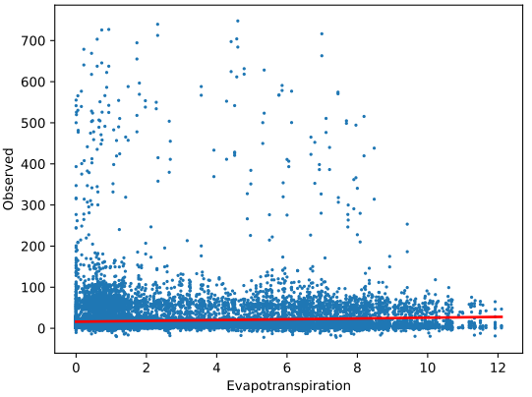
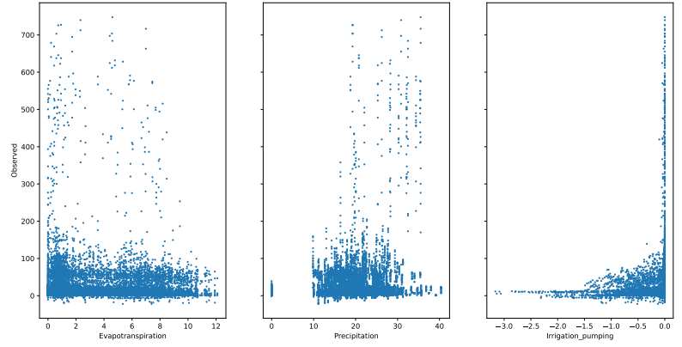
Results
Plotted all of data
R-squared value improved to 0.19656731732216504.
Root mean squared error was 47.764728250365025.

Slide 5
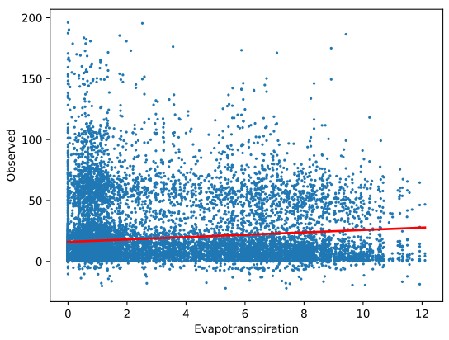
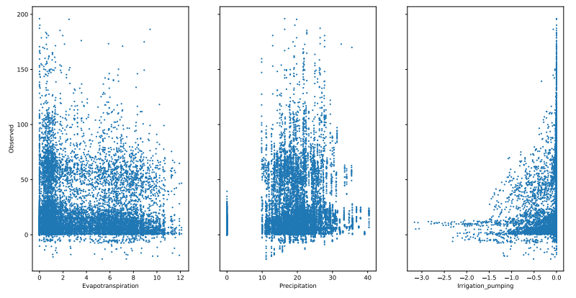
Results
Removed observed value above 200
R-squared value improved to 0.35377999139580485.
Root mean squared error was 21.108065068196808.
The change made doubled the result and provided a more accurate model to test for more accurate predicted values.

