Slide 1



X
Virtual Internship Experience - Final Project Data Engineer
Rakamin VIX Program
Presented by
Ricky Suhanry

Slide 2


Insert Your Experience
Ricky Suhanry
Kalbe Nutritionals - VIX Program
Data Engineer
Data Analytics | Engineer
July - August 2023
Enthusiast tech person with background in software engineer and specialist in big data engineering with cloud computing. I've applied my programming skills as data bootcamp student, where I produced clean, validation-ready code for various projects using pandas, numpy, numpy, and matplotlib. I'm well-equipped to contribute to challenging projects and drive innovation in the field of technology
Kimia Farma - VIX Program
Big Data Analyst
February - March 2023
Fintech Startup
Software Engineer - Backend
May - August 2022

Slide 3
Case Study I
Create a shell/bash script to check whether directory exists inside a given path.
Variables:
■ path=/hdfs/data/data1
name_of_directory=data1
○ Conditions:
■ If directory exists inside the path:
● Echo “There is [Directory Name] Directory
Exists!”
■ If not:
● Echo “[Directory Name] Directory Not
Exists!”
● Create a directory inside the path.
○ Final Step:
■ Create a crontab syntax to run the script at
07:00 AM Daily

Slide 4
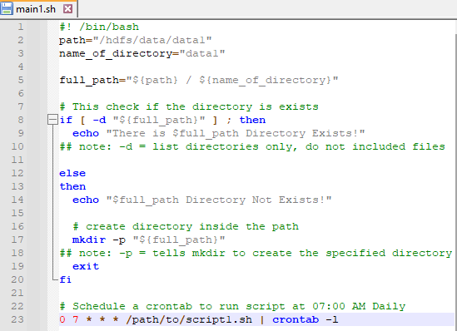

Slide 5
Case Study II
Using the question number 1 script, add another condition if directory exists inside the path
Variables:
■ filename_excel=daily_market_price.xlsx
■ source_dir=/local/data/market
■ target_dir=Refer to Question Number 1 Path
○ Conditions:
■ Copy file from source directory into target
directory.
■ Create a log file inside the same path with
“File Moved Successfully” as a log content if
success.

Slide 6
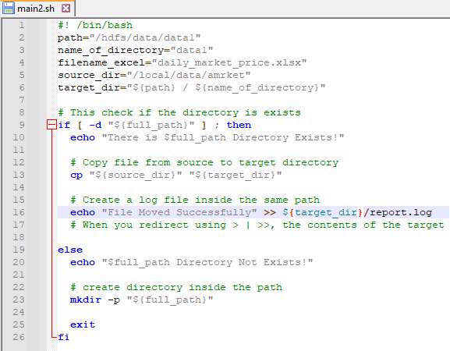

Slide 7

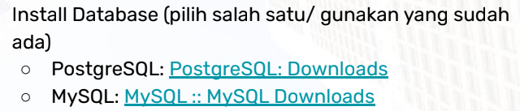
Case Study III

Slide 8
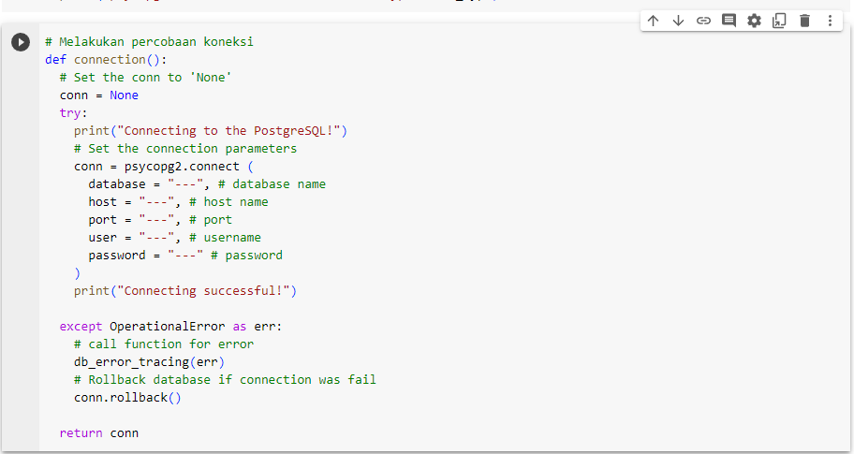
Code

Slide 9
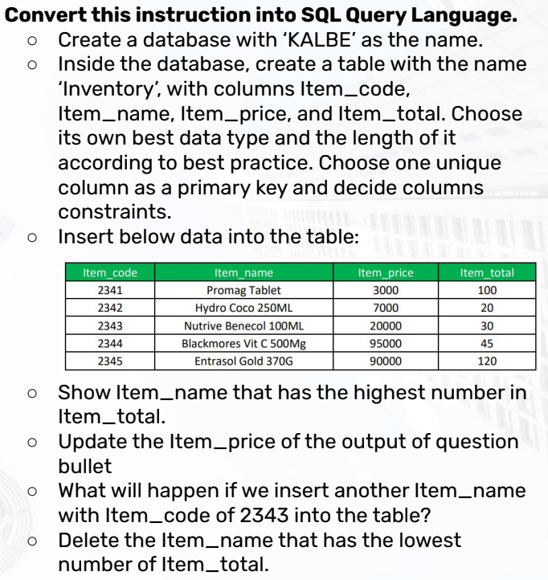
Case Study IV

Slide 10
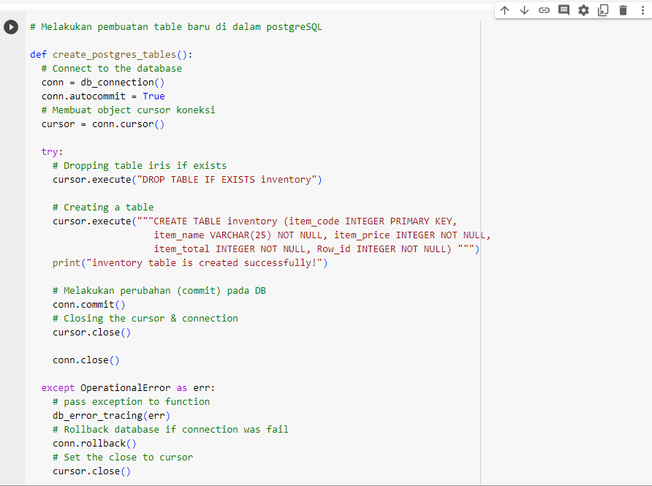
Code

Slide 11
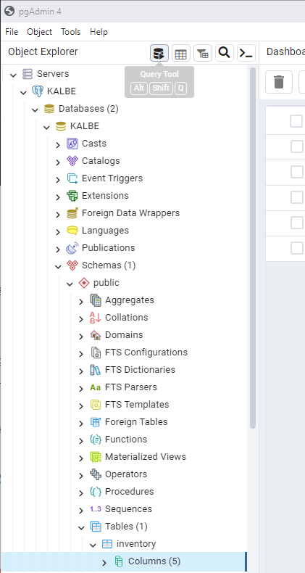
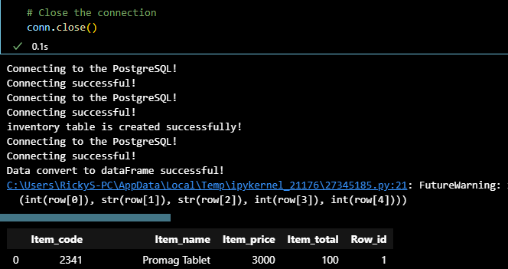
Output

Slide 12
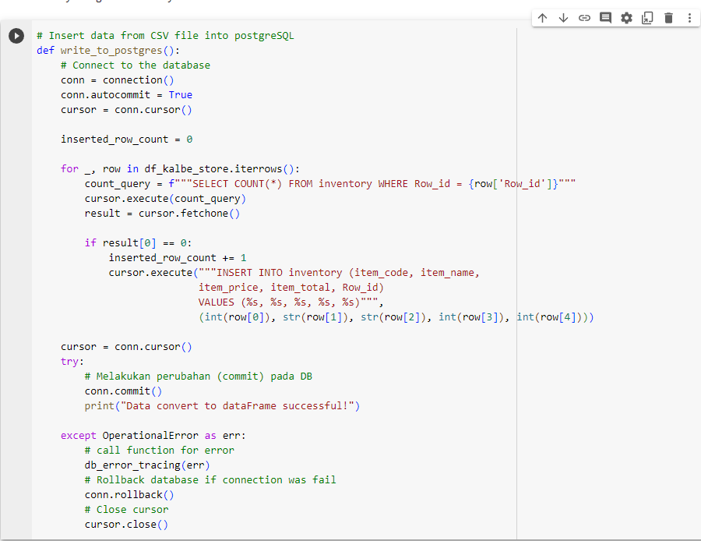
Code

Slide 13
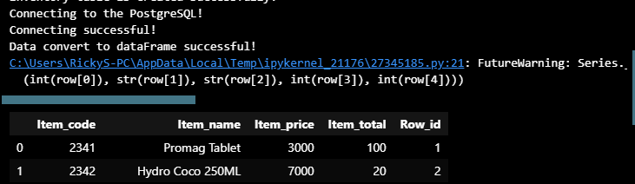
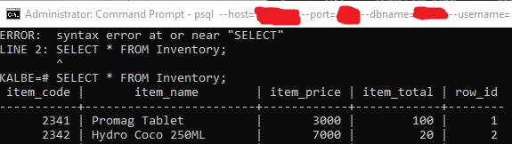
Output
Output
In VSCode
Output
In PostgreSQL
Terminal

Slide 14
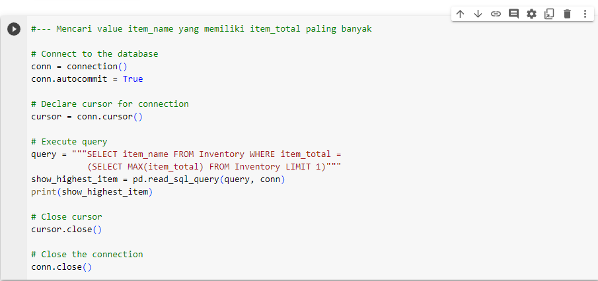
Code

Slide 15

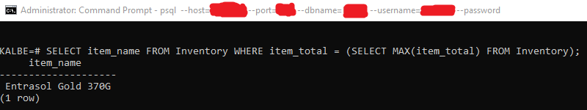
Output
Output
In VSCode
Output
In PostgreSQL
Terminal

Slide 16
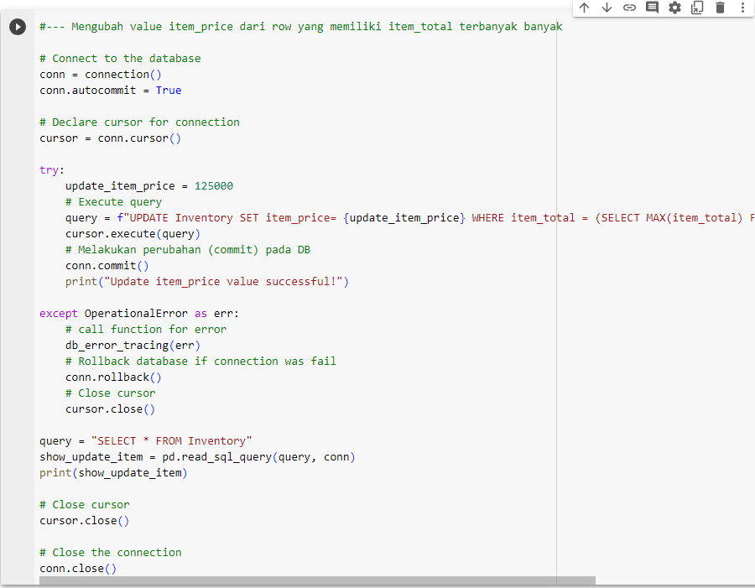
Code

Slide 17
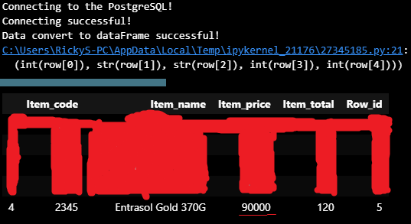
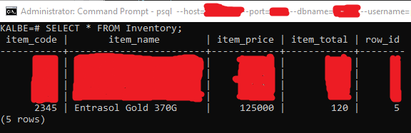
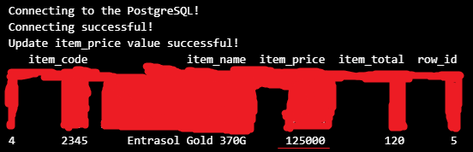
Output
Output
In VSCode
Output
In PostgreSQL
Terminal

Slide 18
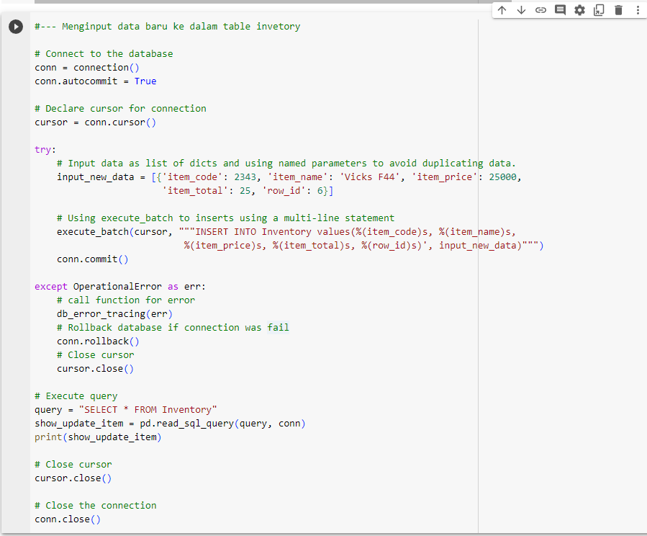
Code

Slide 19
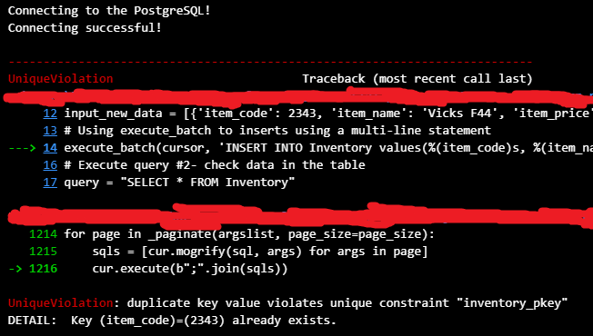
Output
Output
In VSCode

Slide 20
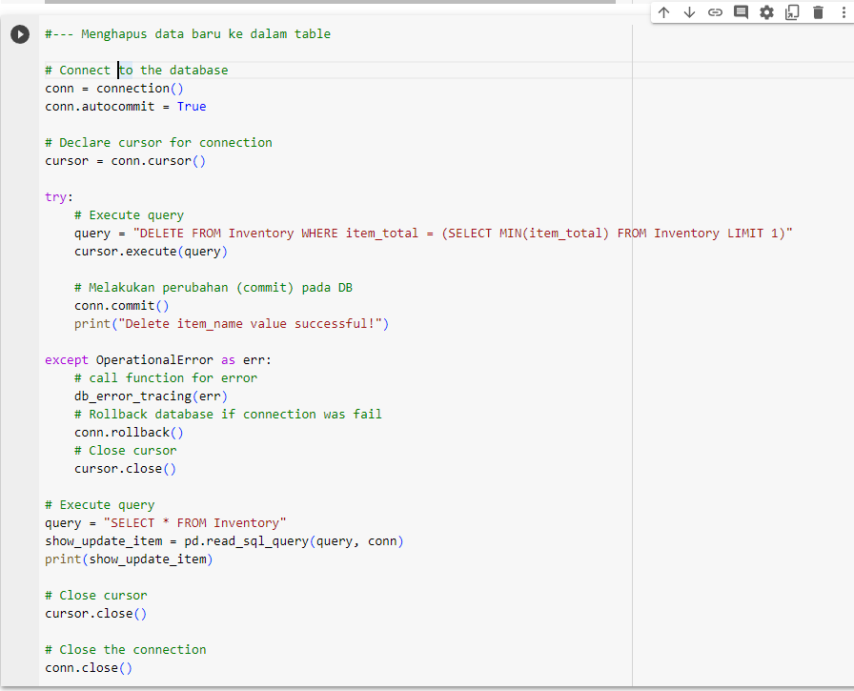
Code

Slide 21

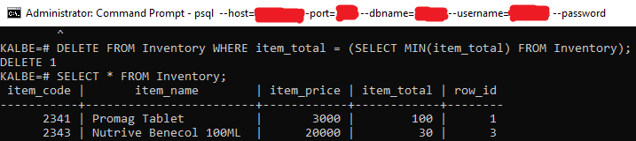
Output
Output
In VSCode
Output
In PostgreSQL
Terminal

Slide 22
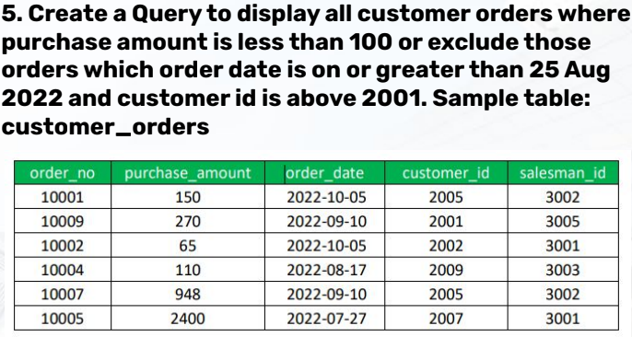
Case Study V

Slide 23
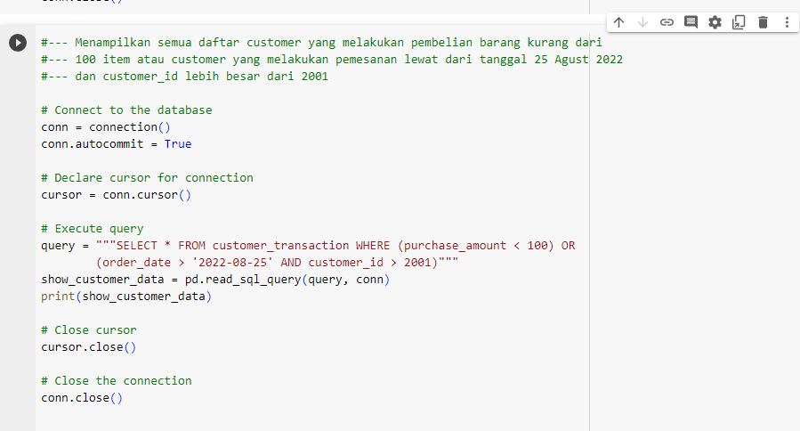
Code

Slide 24

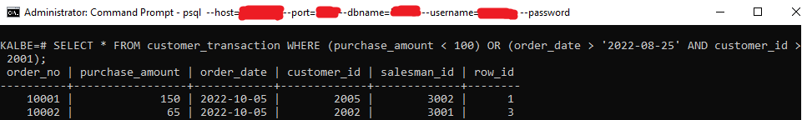
Output
Output
In VSCode
Output
In PostgreSQL
Terminal

Slide 25
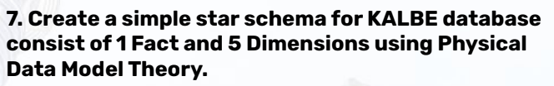
Case Study VII

Slide 26
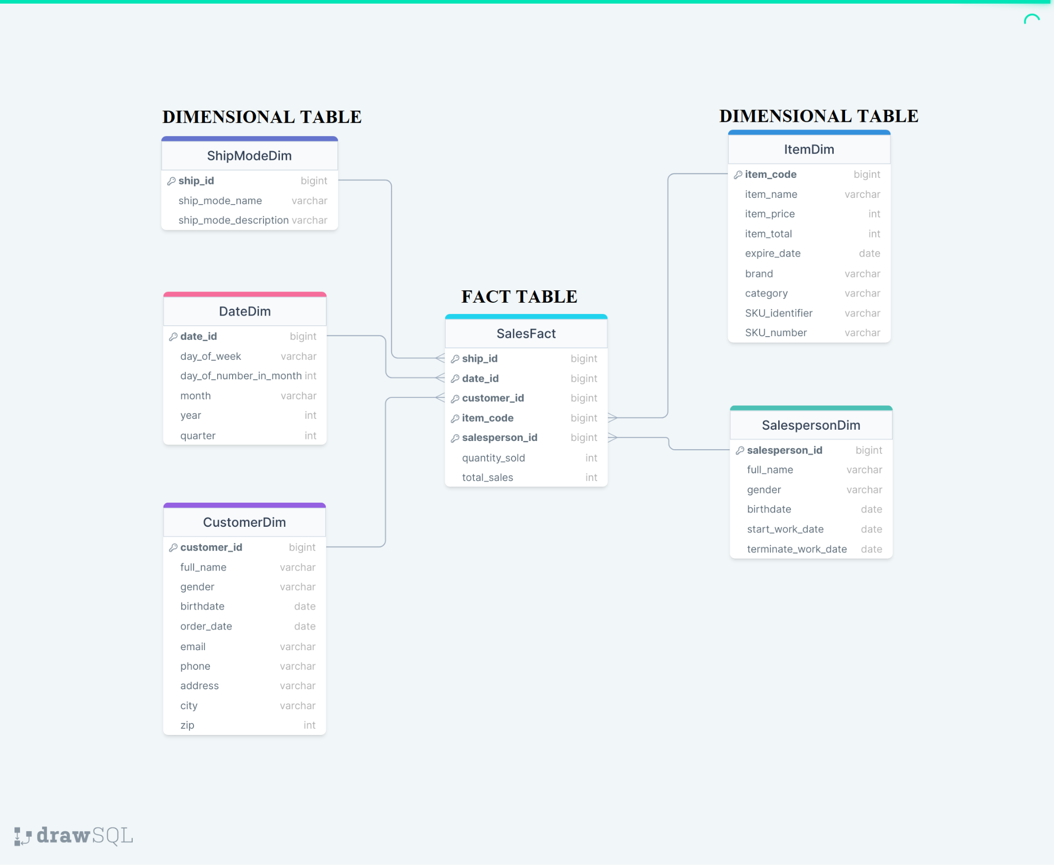
Output

Slide 27



My Work Contact:
www.linkedin.com/in/ricky-suhanry
https://github.com/abliskan
ricky.suhanry107@gmail.com
More detail of this project:
https://github.com/abliskan/Rakamin-VIX-Kalbe-Nutritionals-DE

Slide 28
Thank You
X

