Slide 1
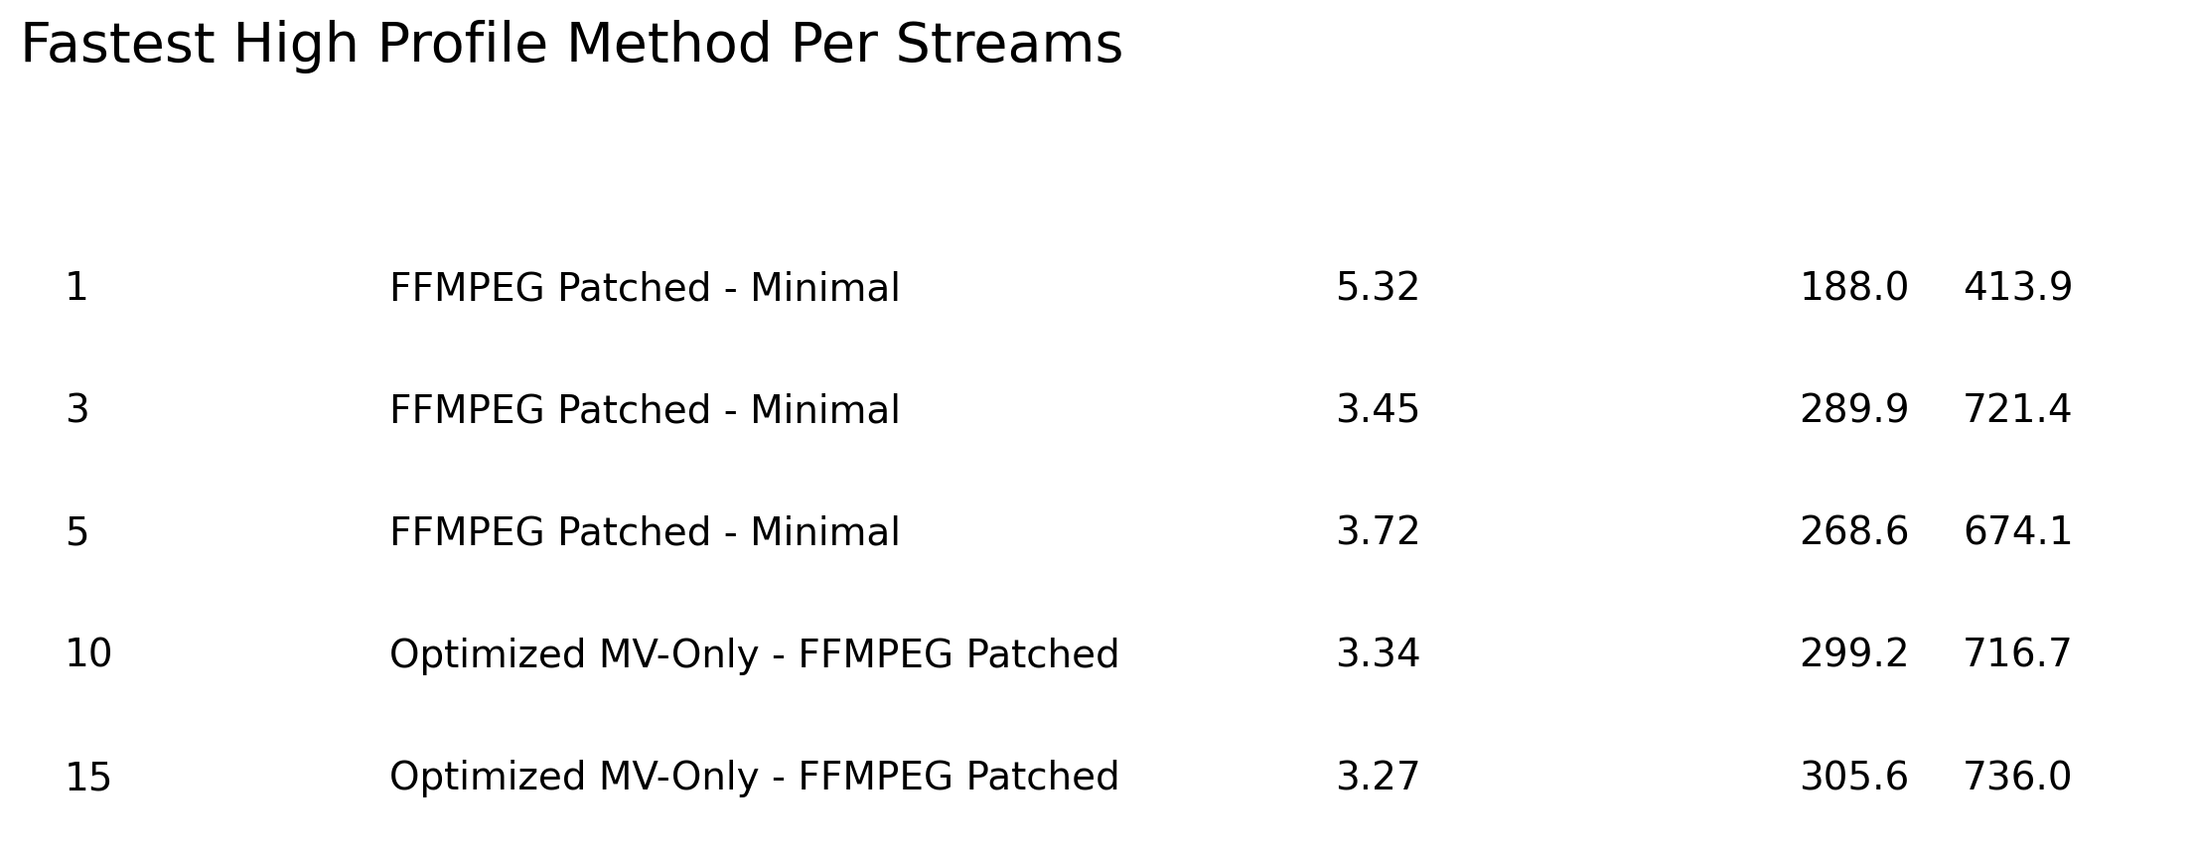
Fastest Methods
Best (lowest time/frame) method at each streams value

Slide 2
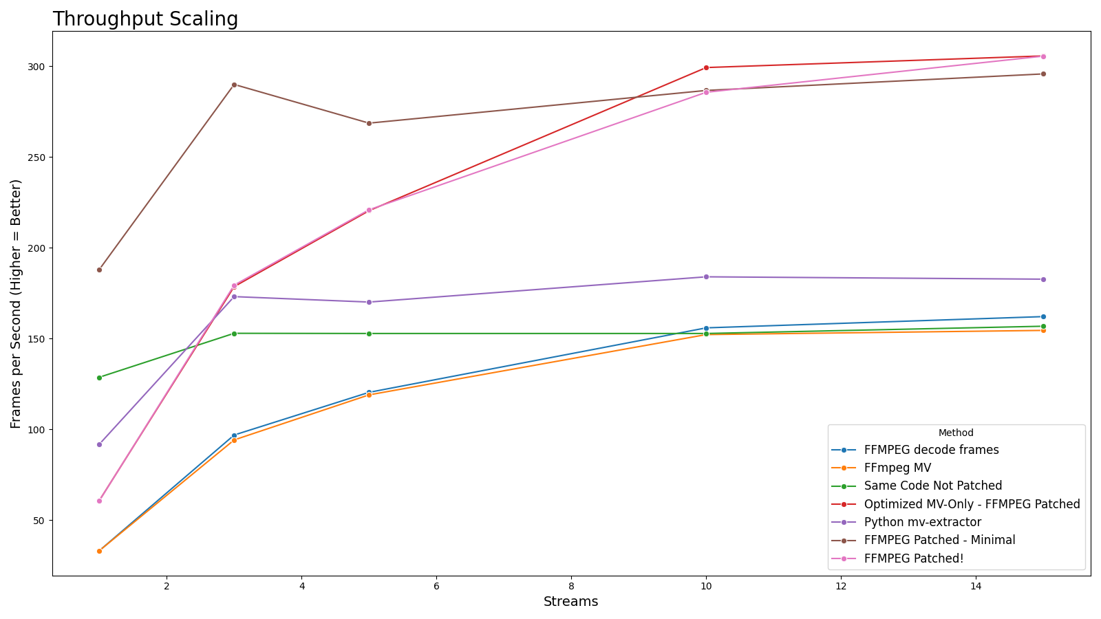
Throughput Scaling
High Profile Methods: FPS vs Streams

Slide 3
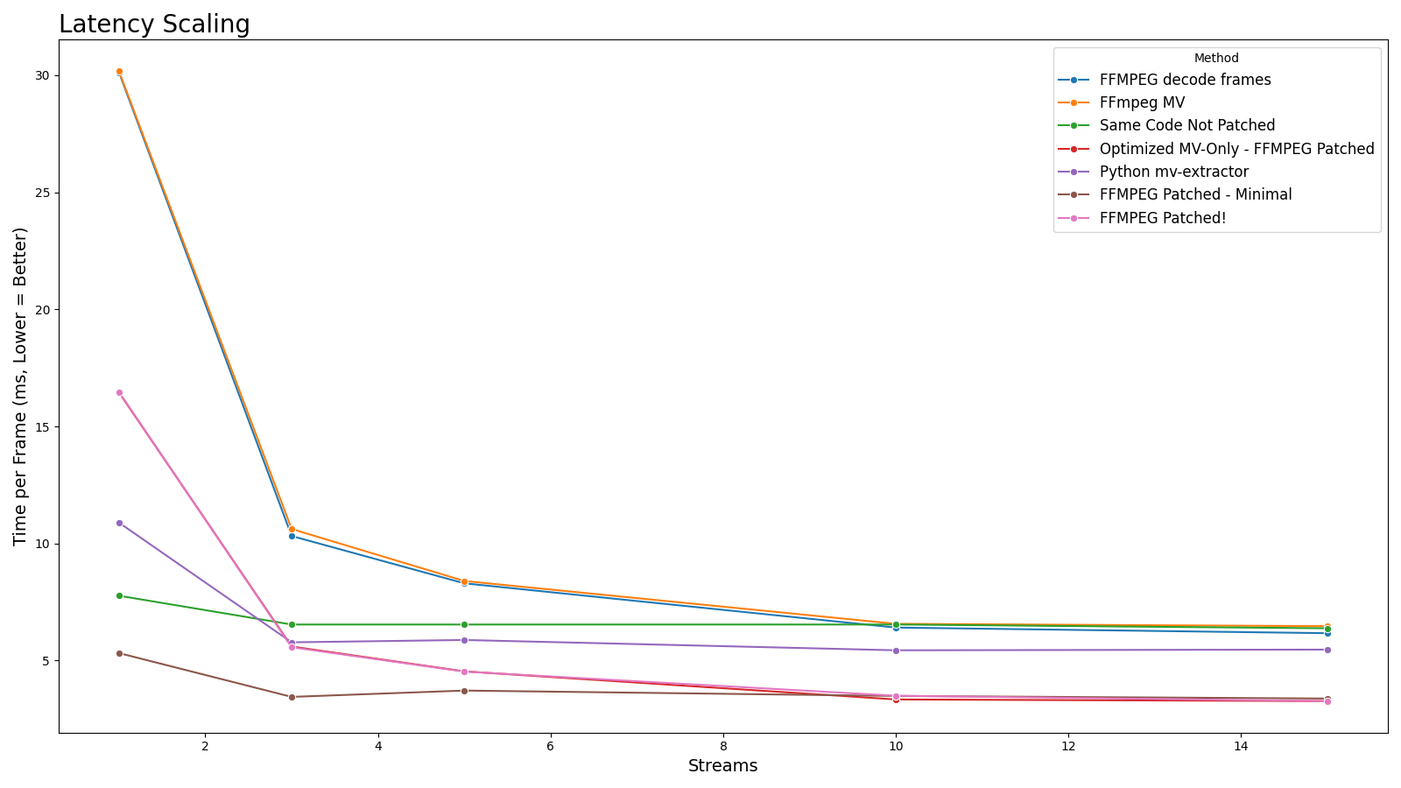
Latency Scaling
High Profile Methods: Time per Frame vs Streams

Slide 4
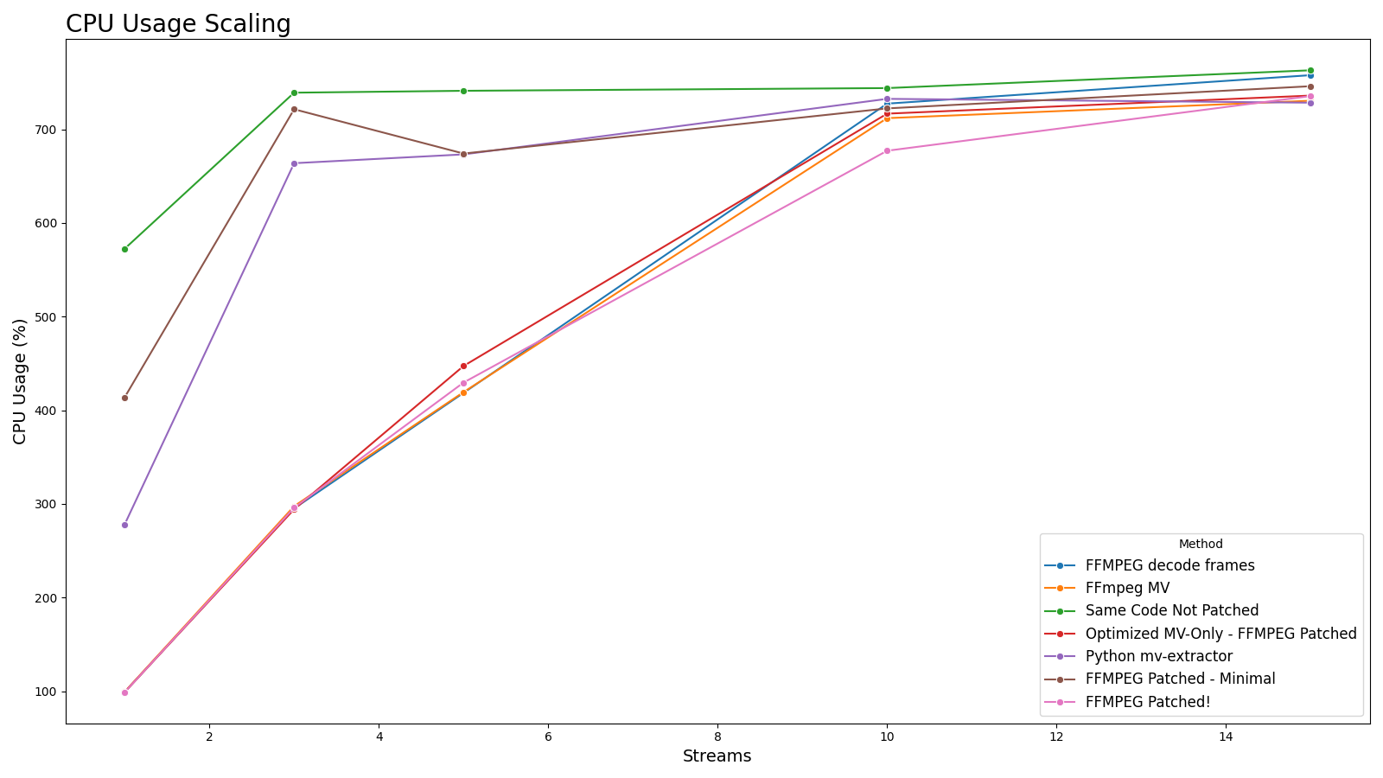
CPU Usage Scaling
High Profile Methods: CPU Usage (%) vs Streams

Slide 5
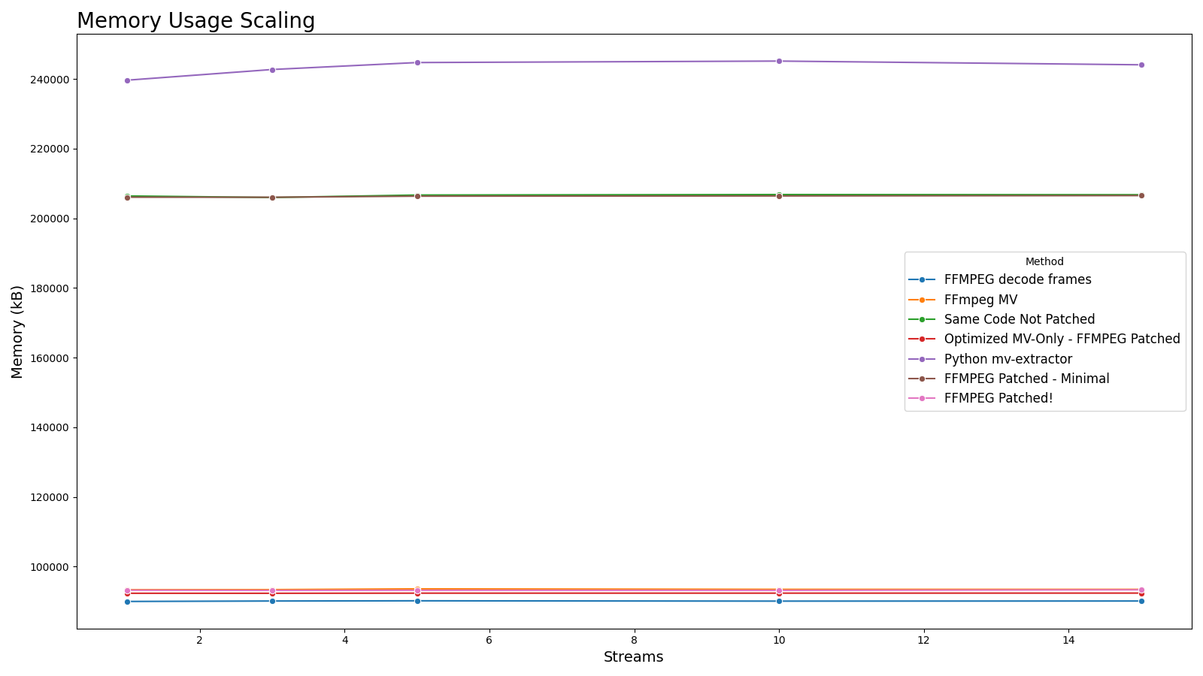
Memory Usage Scaling
High Profile Methods: Memory Usage (kB) vs Streams

Slide 6
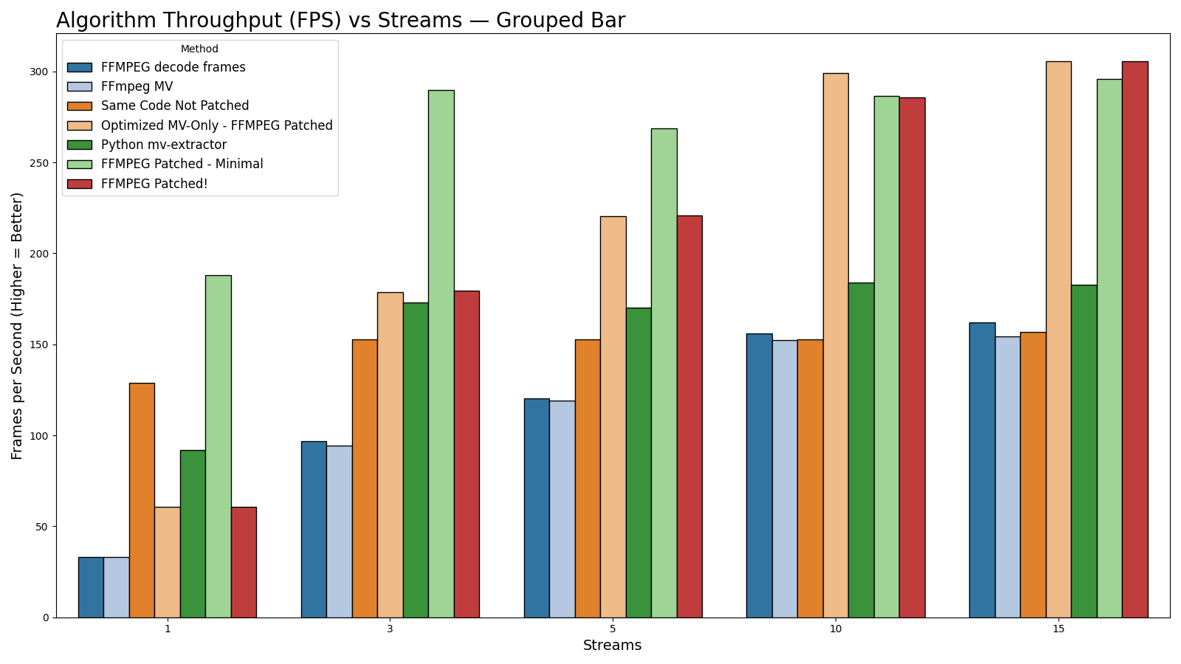
Grouped FPS Comparison (All Streams)
All High Profile Methods: FPS per Streams, Grouped Bar Chart

Slide 7
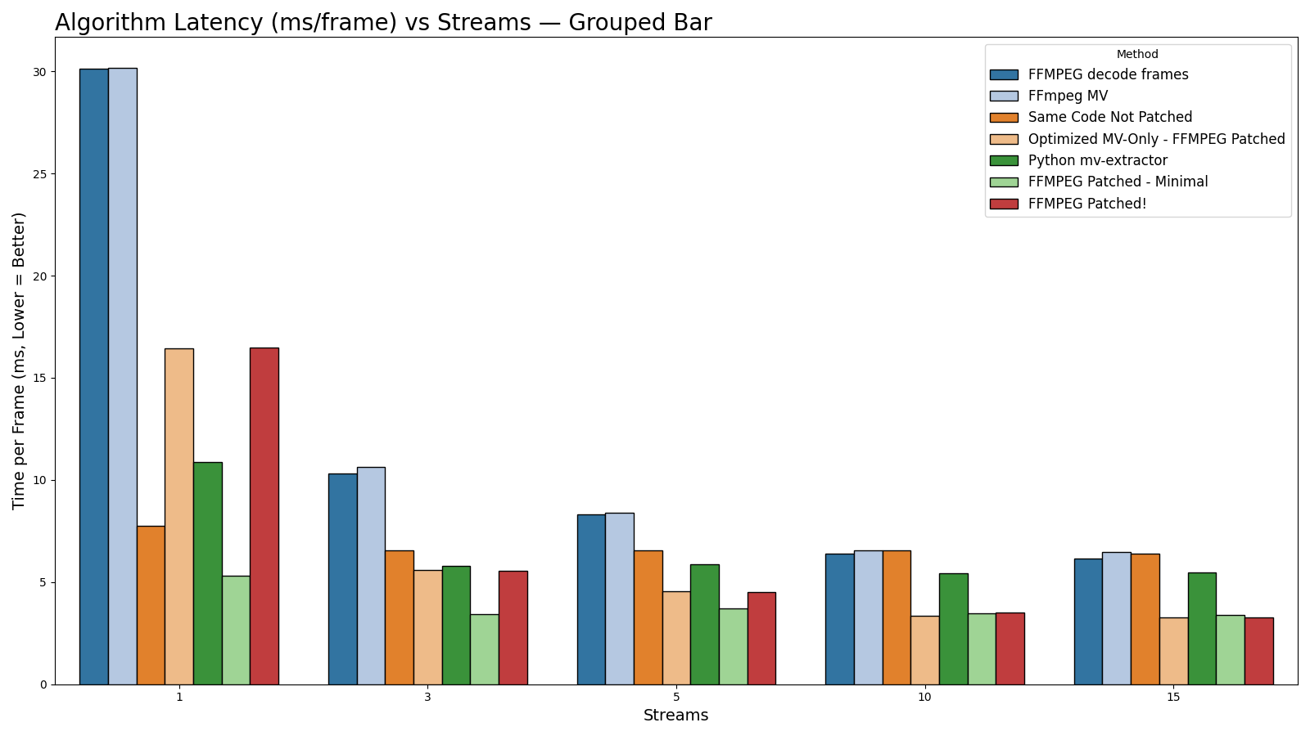
Grouped Latency Comparison (All Streams)
All High Profile Methods: Latency (ms/frame) per Streams, Grouped Bar Chart

Slide 8
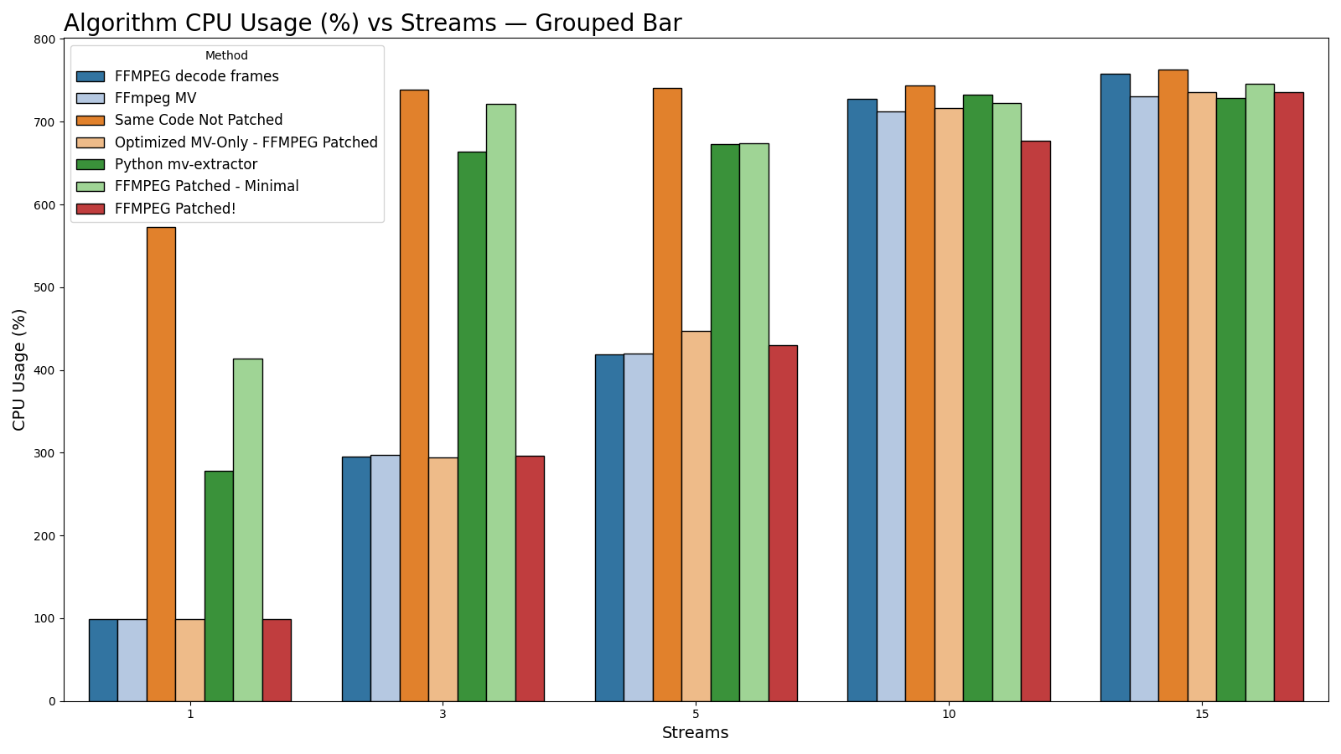
Grouped CPU Usage Comparison (All Streams)
All High Profile Methods: CPU Usage per Streams, Grouped Bar Chart

Slide 9
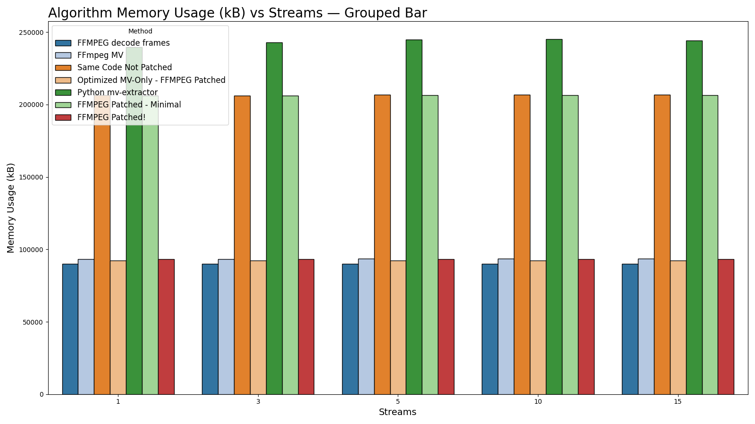
Grouped Memory Usage Comparison (All Streams)
All High Profile Methods: Memory Usage per Streams, Grouped Bar Chart

Slide 10

Detailed Tables
Full Per-Streams Benchmark Results

Slide 11
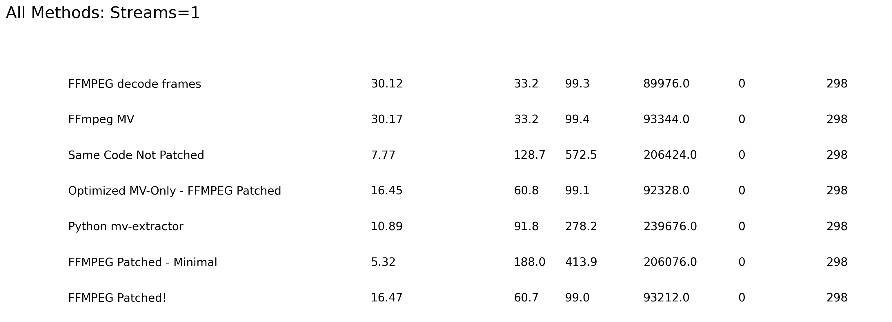
Detailed Table: Streams=1
All metrics for high-profile methods, streams=1

Slide 12
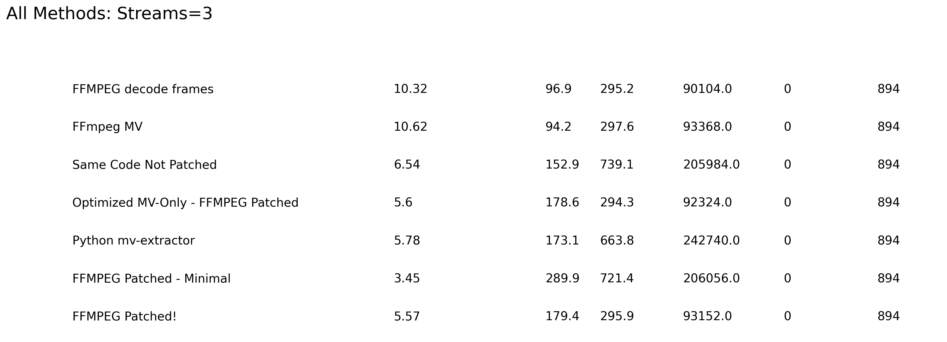
Detailed Table: Streams=3
All metrics for high-profile methods, streams=3

Slide 13
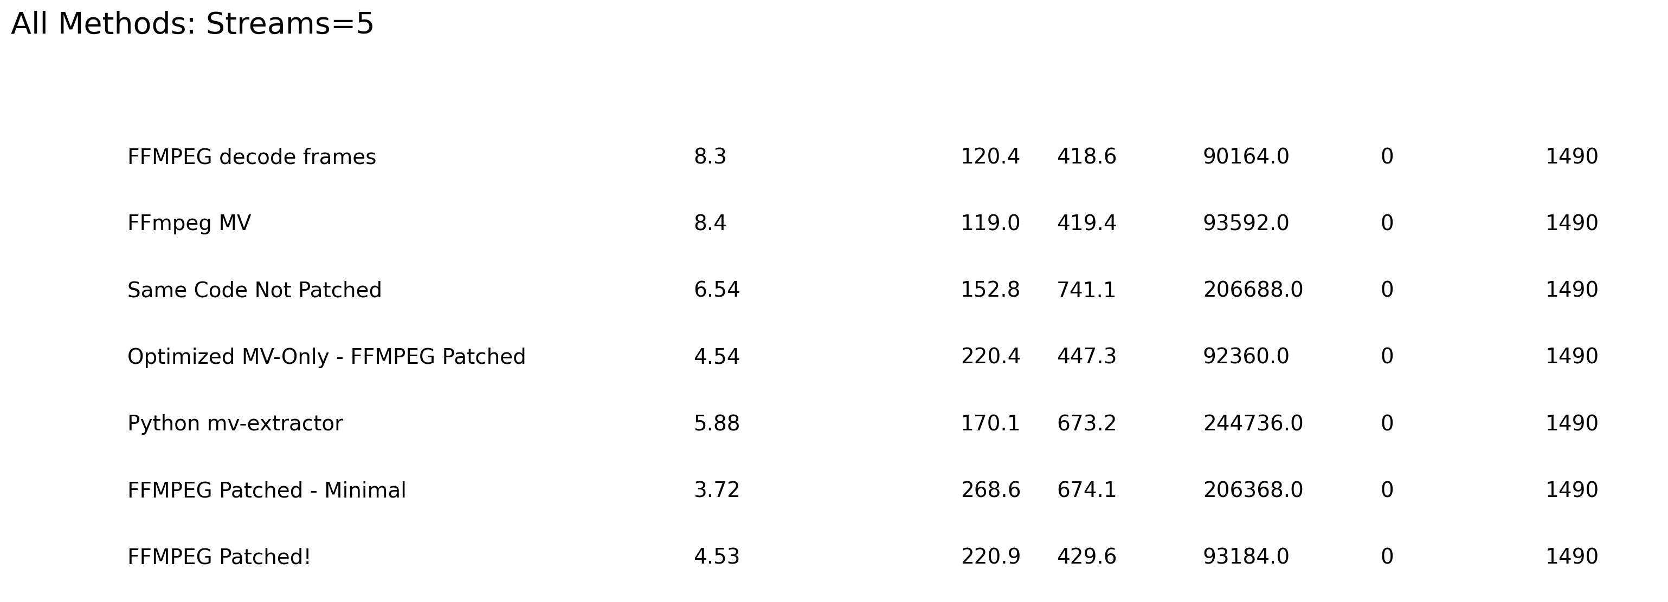
Detailed Table: Streams=5
All metrics for high-profile methods, streams=5

Slide 14

Detailed Table: Streams=10
All metrics for high-profile methods, streams=10

Slide 15
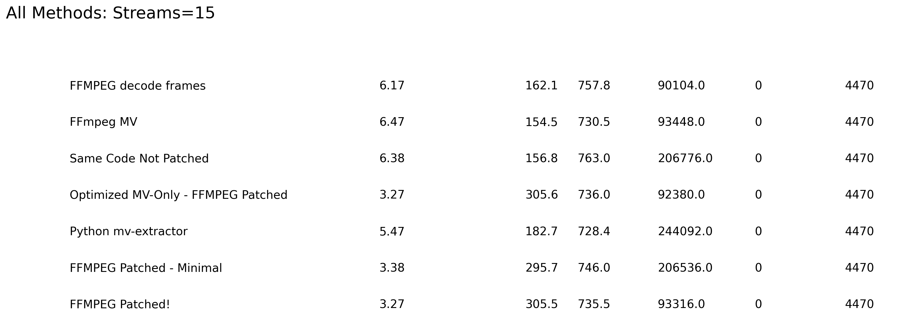
Detailed Table: Streams=15
All metrics for high-profile methods, streams=15

Slide 16
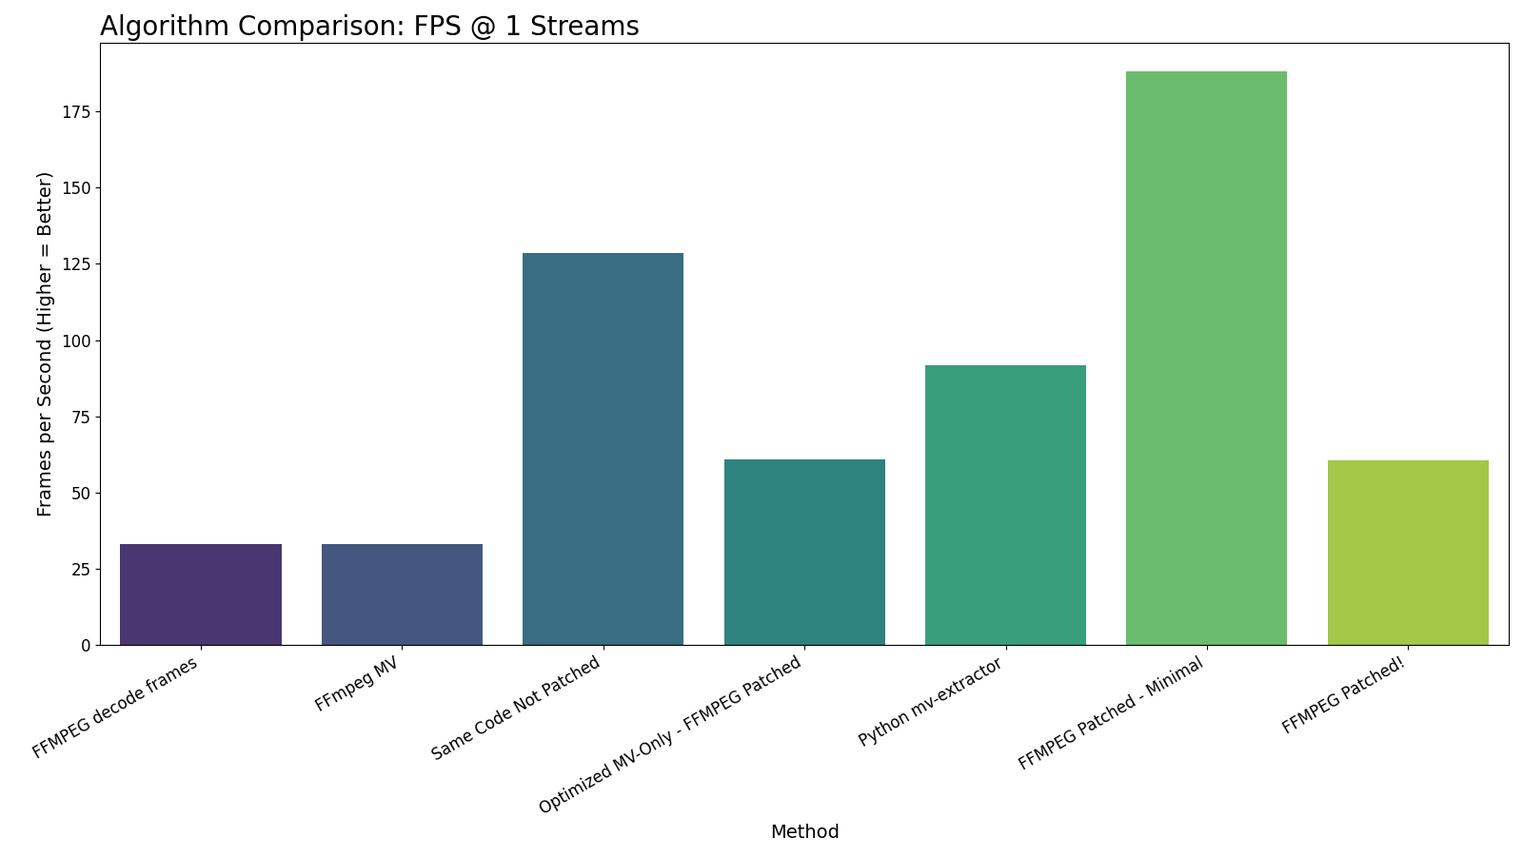
Algorithm FPS Comparison (1 Streams)
Throughput (FPS) by High Profile Method at 1 Streams

Slide 17
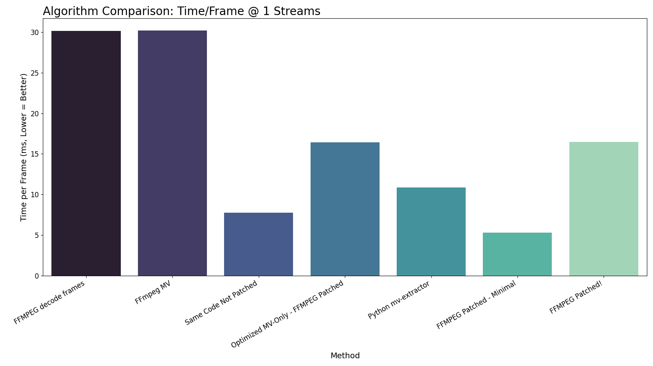
Algorithm Latency Comparison (1 Streams)
Time per Frame (ms) by High Profile Method at 1 Streams

Slide 18
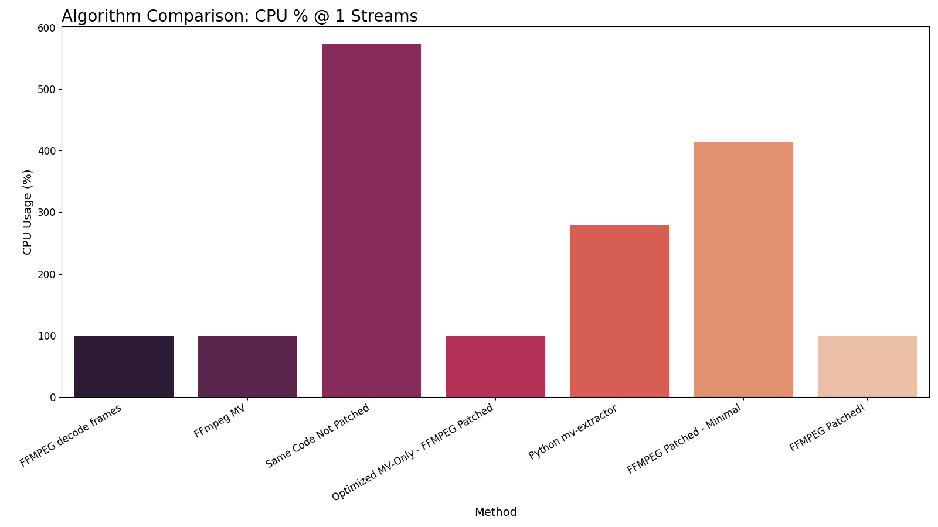
Algorithm CPU Usage Comparison (1 Streams)
CPU Usage (%) by High Profile Method at 1 Streams

Slide 19
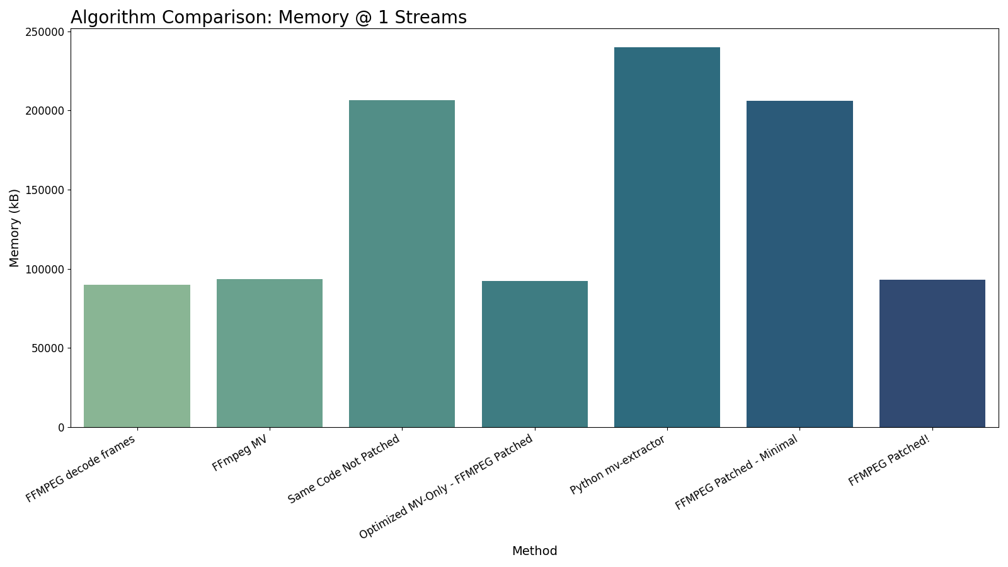
Algorithm Memory Usage Comparison (1 Streams)
Memory Peak (kB) by High Profile Method at 1 Streams

Slide 20
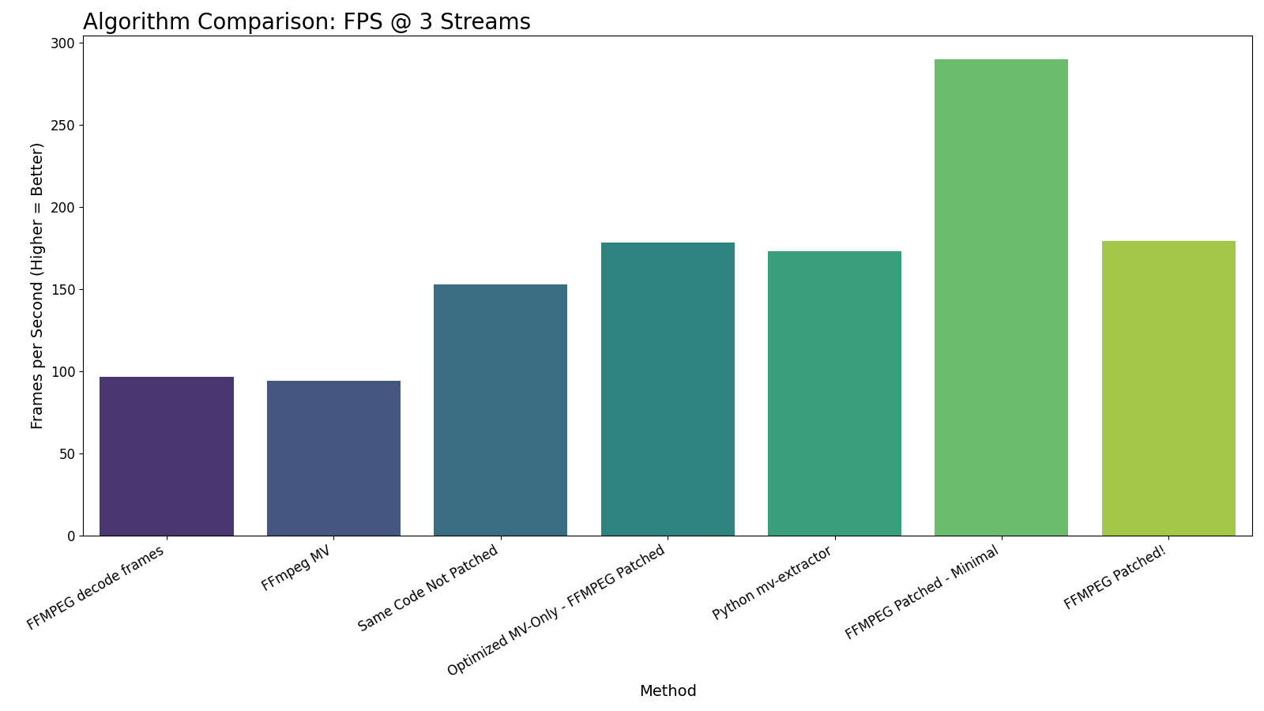
Algorithm FPS Comparison (3 Streams)
Throughput (FPS) by High Profile Method at 3 Streams

Slide 21
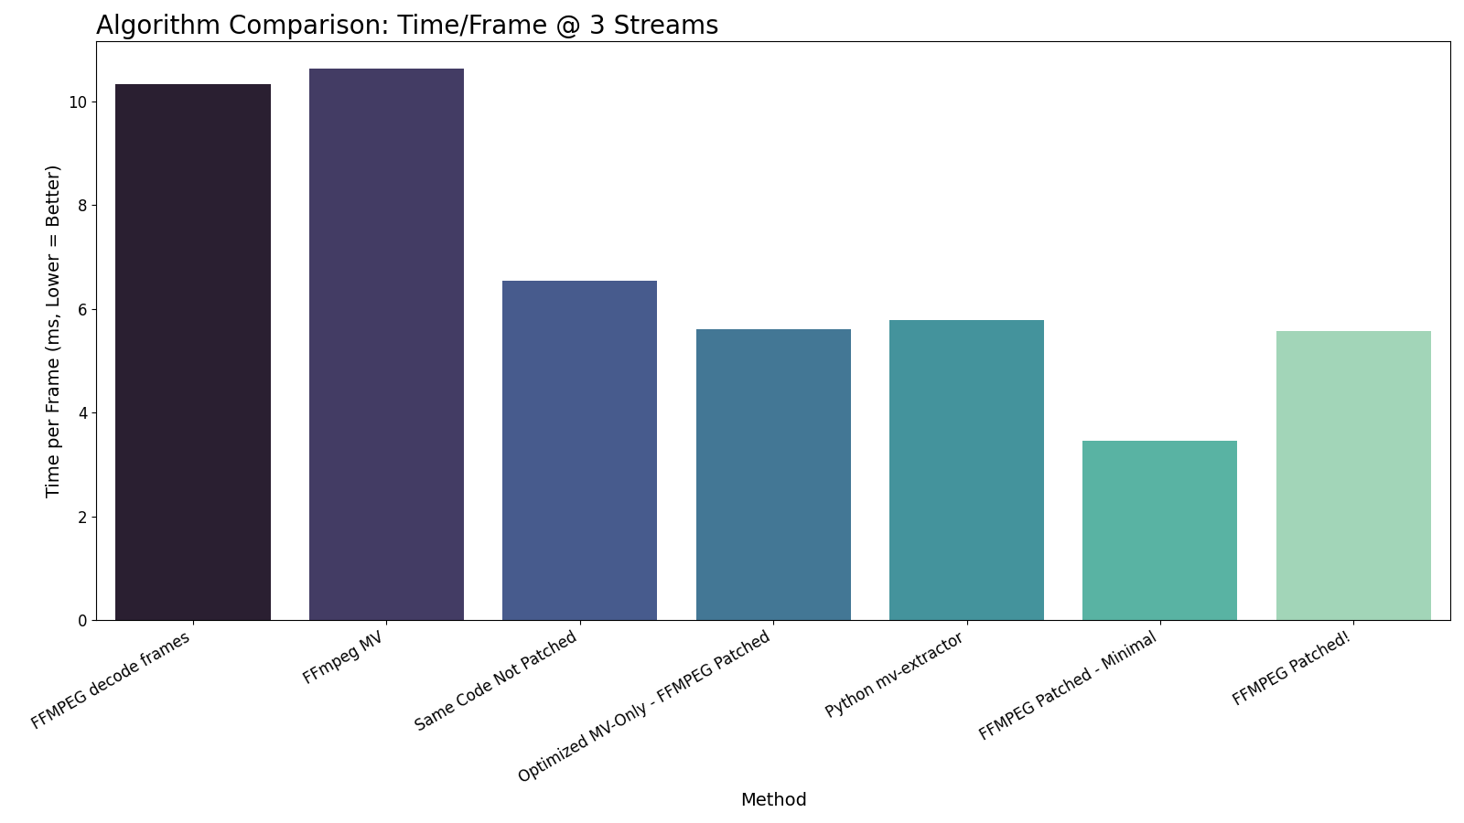
Algorithm Latency Comparison (3 Streams)
Time per Frame (ms) by High Profile Method at 3 Streams

Slide 22
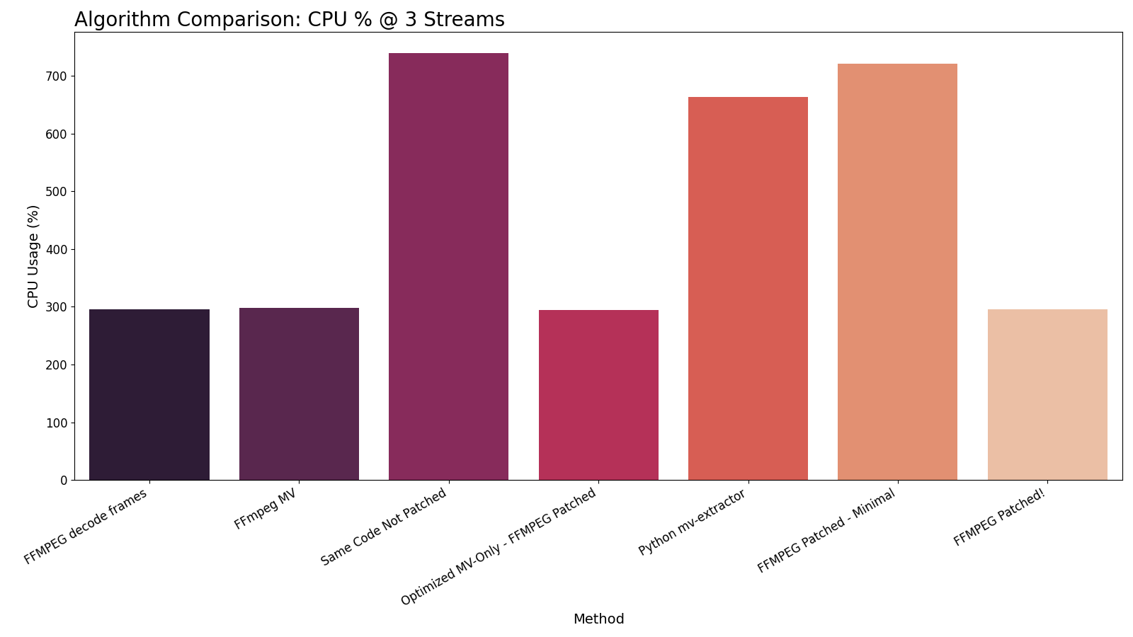
Algorithm CPU Usage Comparison (3 Streams)
CPU Usage (%) by High Profile Method at 3 Streams

Slide 23
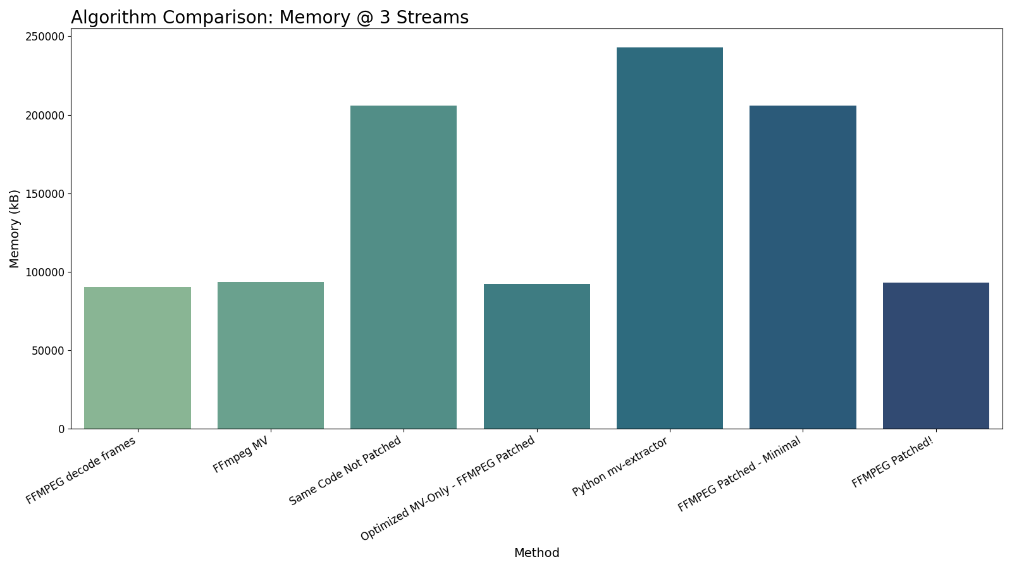
Algorithm Memory Usage Comparison (3 Streams)
Memory Peak (kB) by High Profile Method at 3 Streams

Slide 24
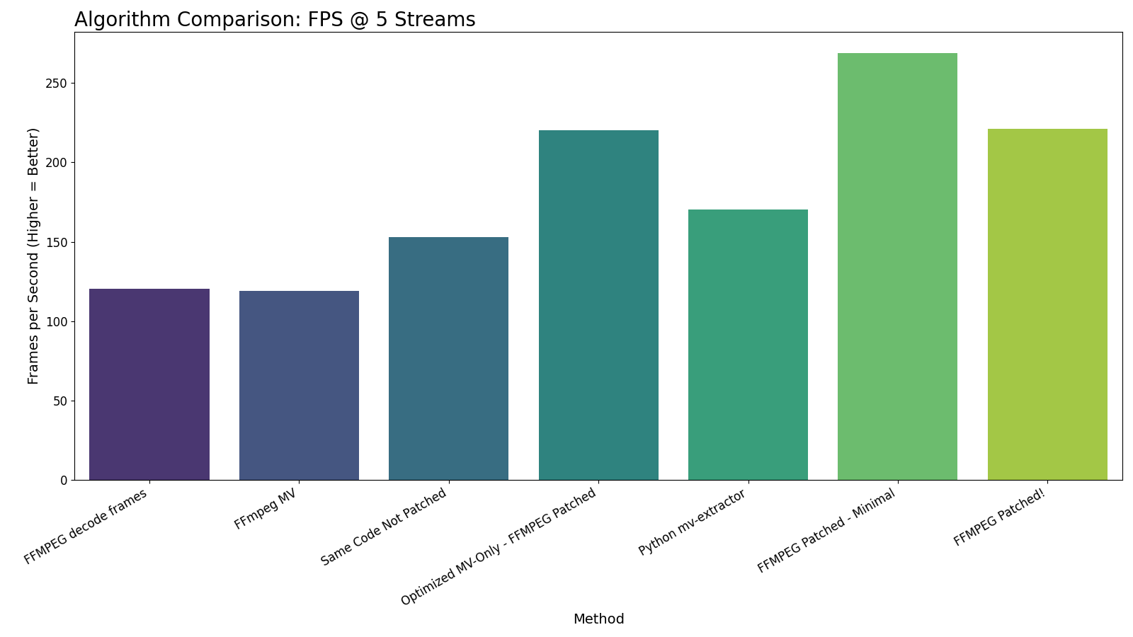
Algorithm FPS Comparison (5 Streams)
Throughput (FPS) by High Profile Method at 5 Streams

Slide 25
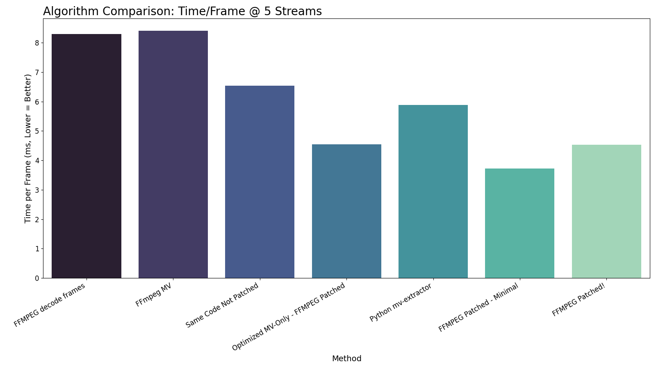
Algorithm Latency Comparison (5 Streams)
Time per Frame (ms) by High Profile Method at 5 Streams

Slide 26
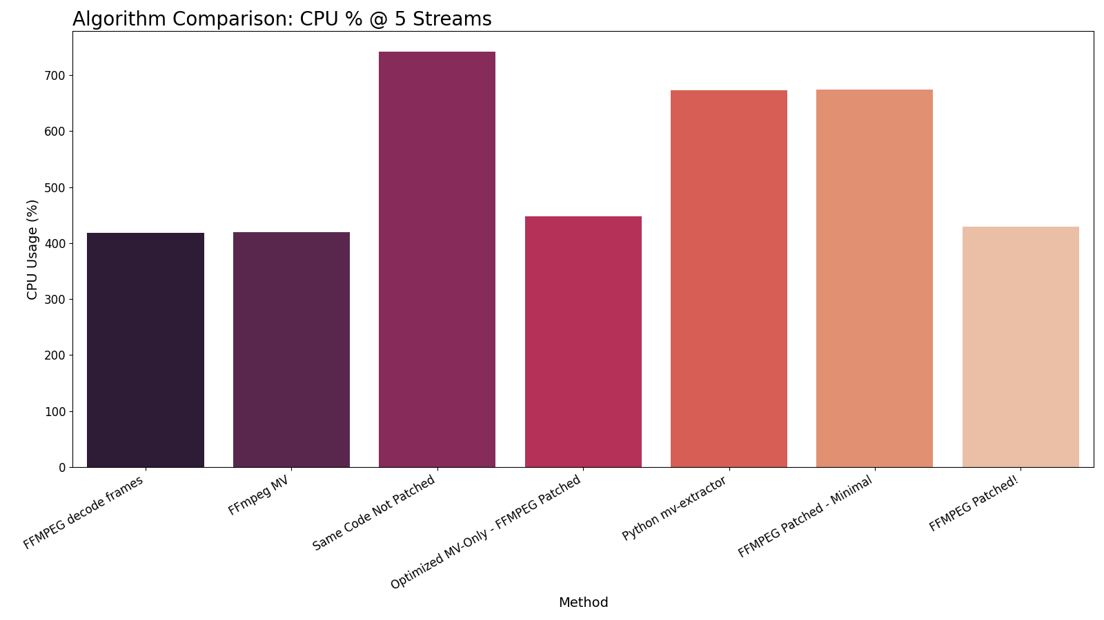
Algorithm CPU Usage Comparison (5 Streams)
CPU Usage (%) by High Profile Method at 5 Streams

Slide 27

Algorithm Memory Usage Comparison (5 Streams)
Memory Peak (kB) by High Profile Method at 5 Streams

Slide 28
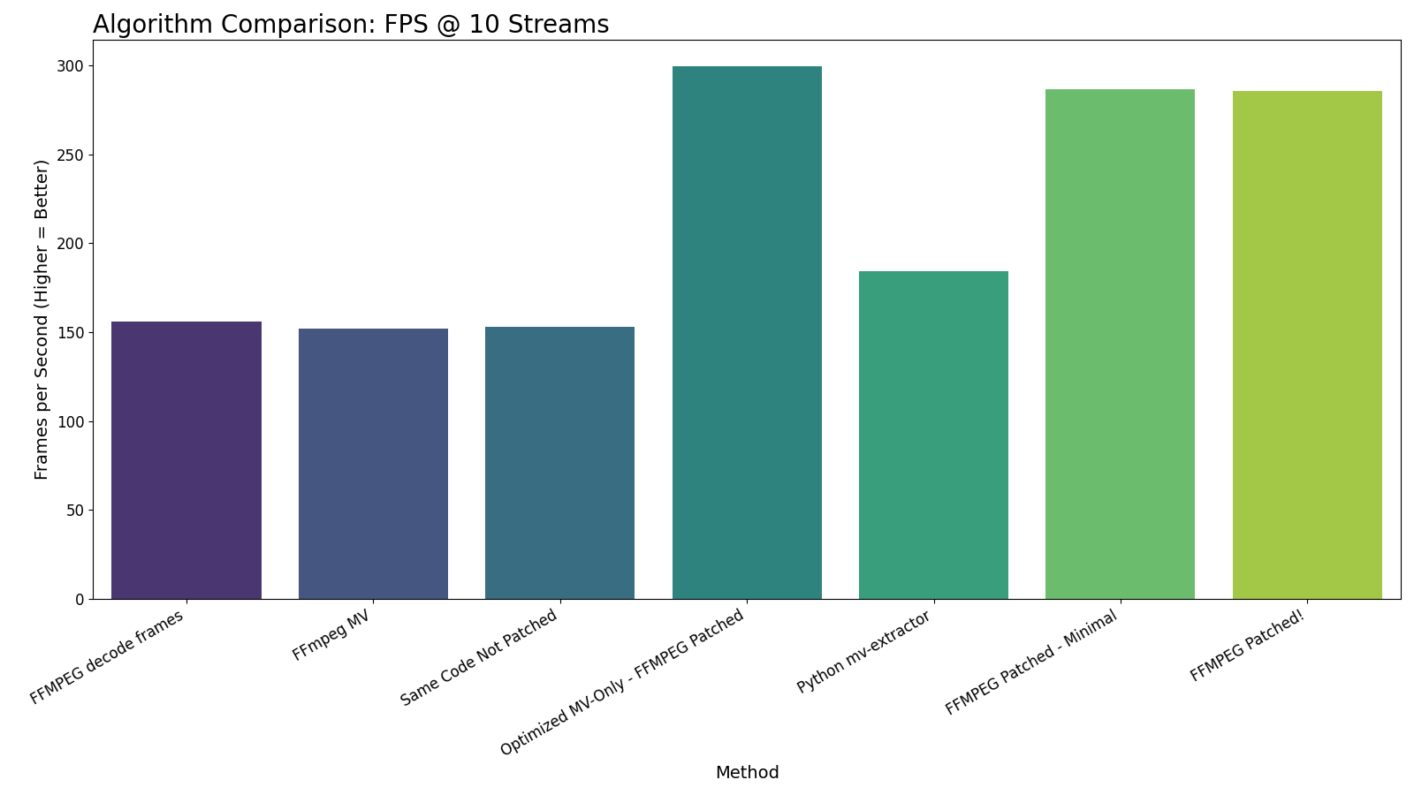
Algorithm FPS Comparison (10 Streams)
Throughput (FPS) by High Profile Method at 10 Streams

Slide 29
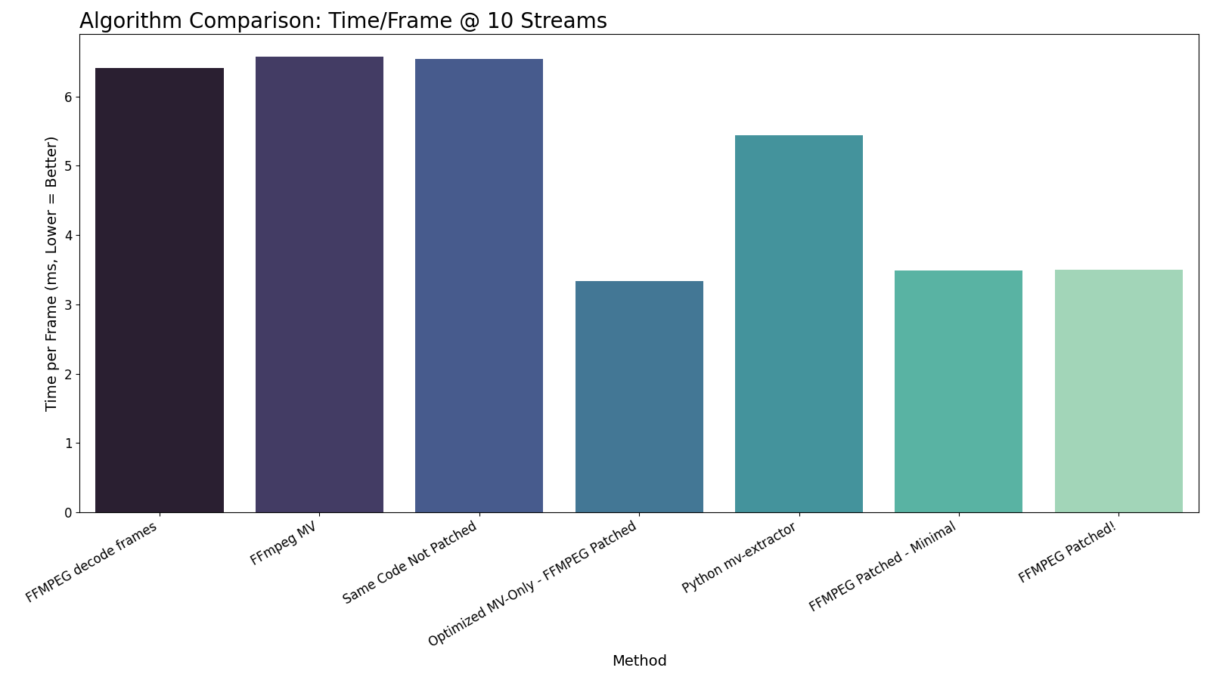
Algorithm Latency Comparison (10 Streams)
Time per Frame (ms) by High Profile Method at 10 Streams

Slide 30
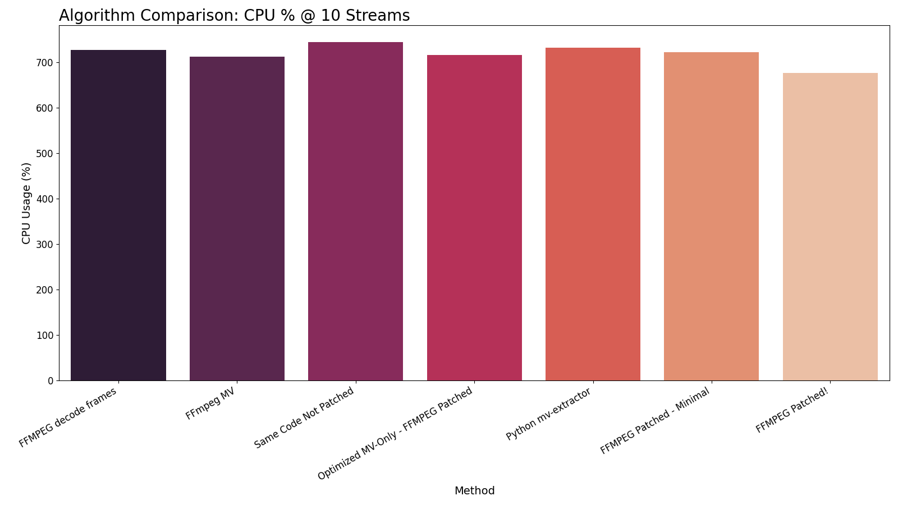
Algorithm CPU Usage Comparison (10 Streams)
CPU Usage (%) by High Profile Method at 10 Streams

Slide 31

Algorithm Memory Usage Comparison (10 Streams)
Memory Peak (kB) by High Profile Method at 10 Streams

Slide 32
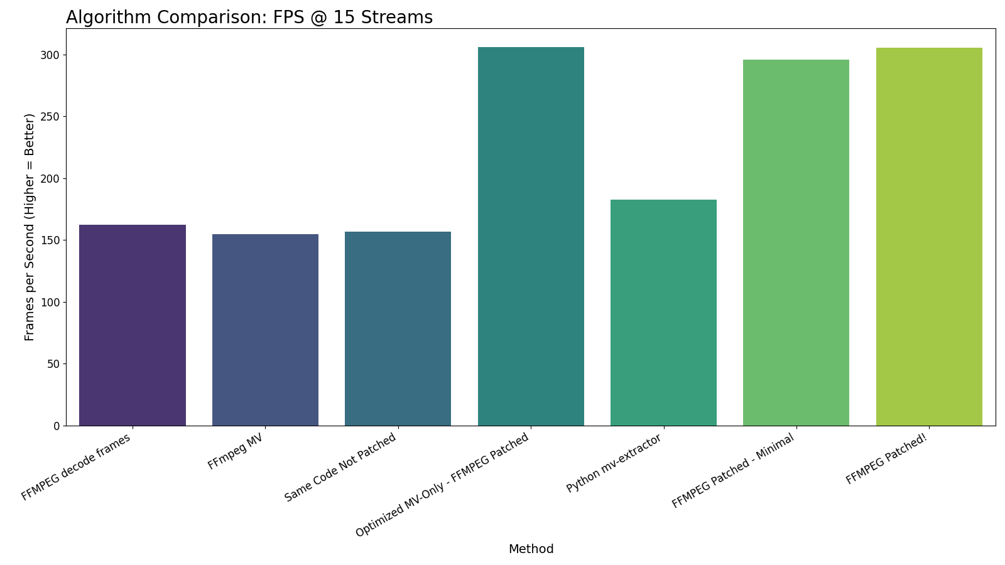
Algorithm FPS Comparison (15 Streams)
Throughput (FPS) by High Profile Method at 15 Streams

Slide 33
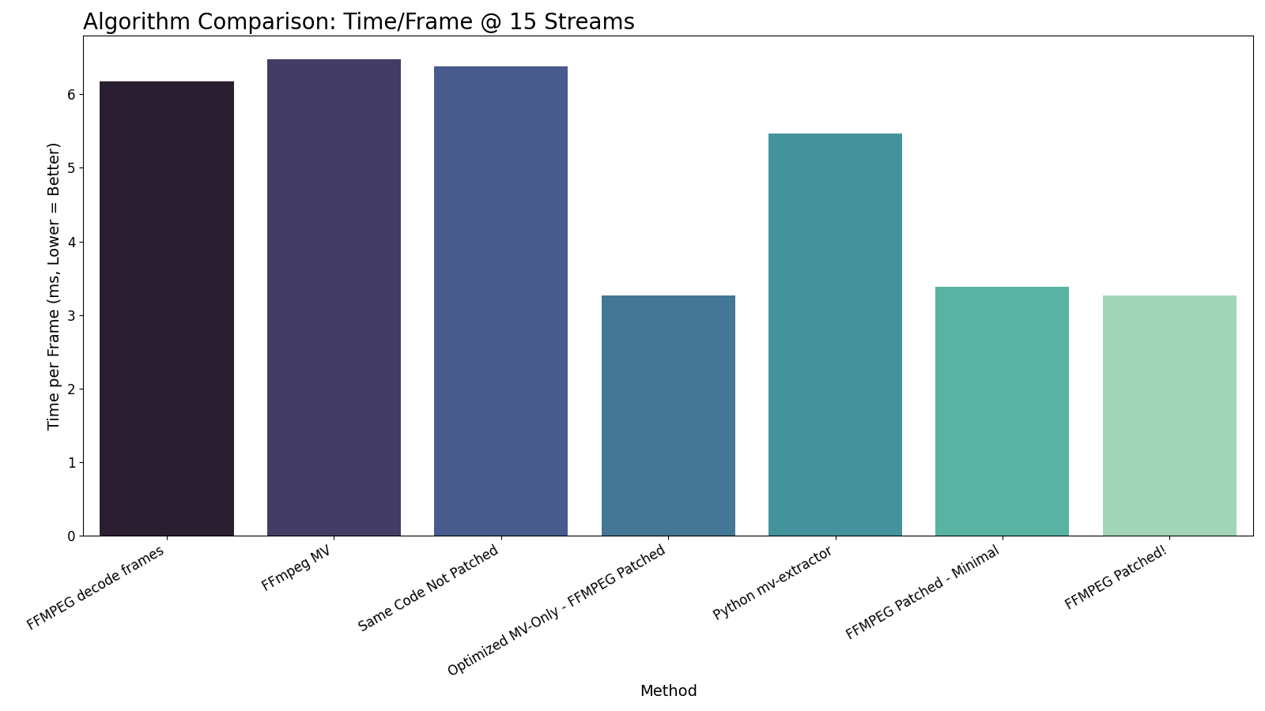
Algorithm Latency Comparison (15 Streams)
Time per Frame (ms) by High Profile Method at 15 Streams

Slide 34
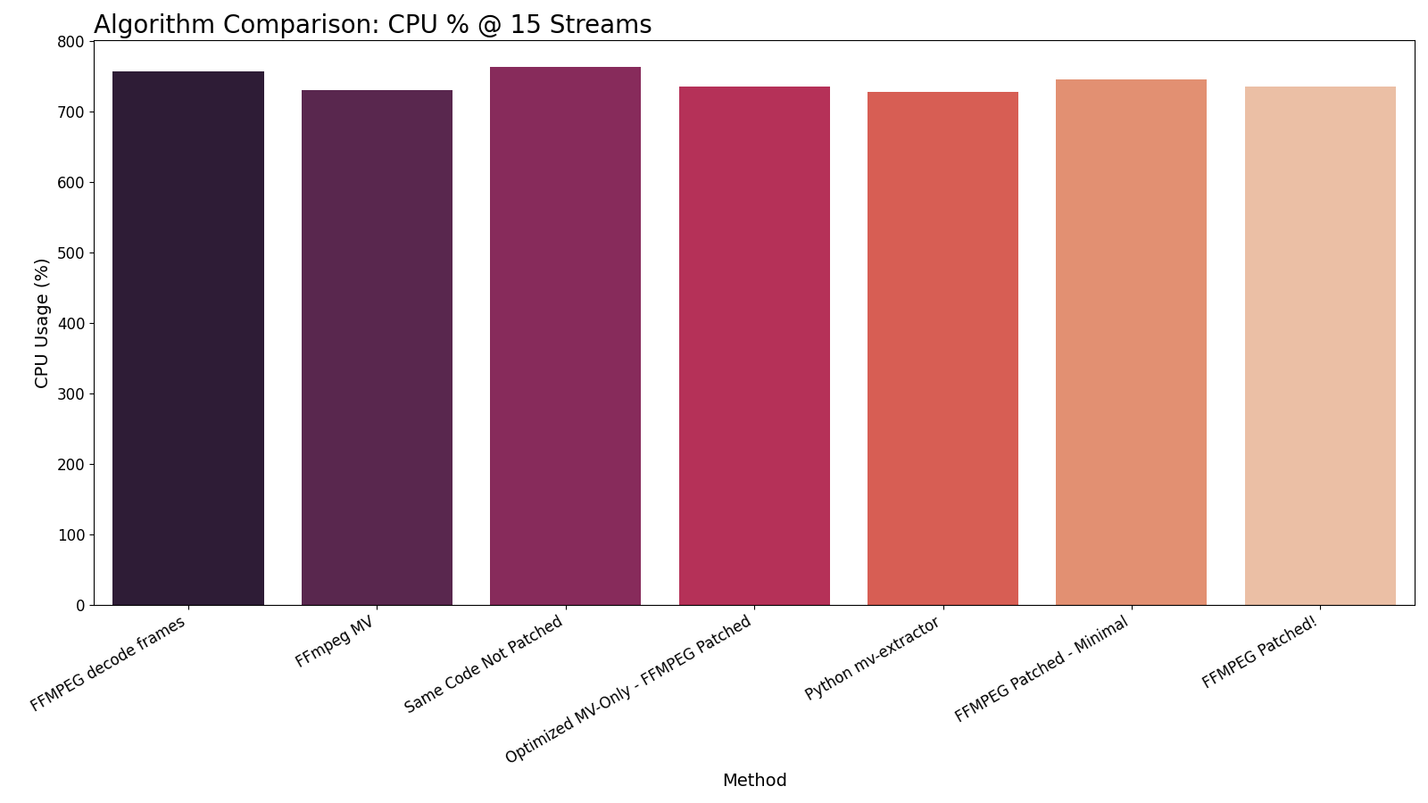
Algorithm CPU Usage Comparison (15 Streams)
CPU Usage (%) by High Profile Method at 15 Streams

Slide 35

Algorithm Memory Usage Comparison (15 Streams)
Memory Peak (kB) by High Profile Method at 15 Streams

