Slide 1
Git-keeping: The Many Technical Skills Beyond ‘Learning to Code’
Ashley Blewer
AV Preservation Specialist, Artefactual Systems
Notes:
Hi hi, this talk is called “Git-keeping”, the many technical skills beyond ‘learning to code’

Slide 2
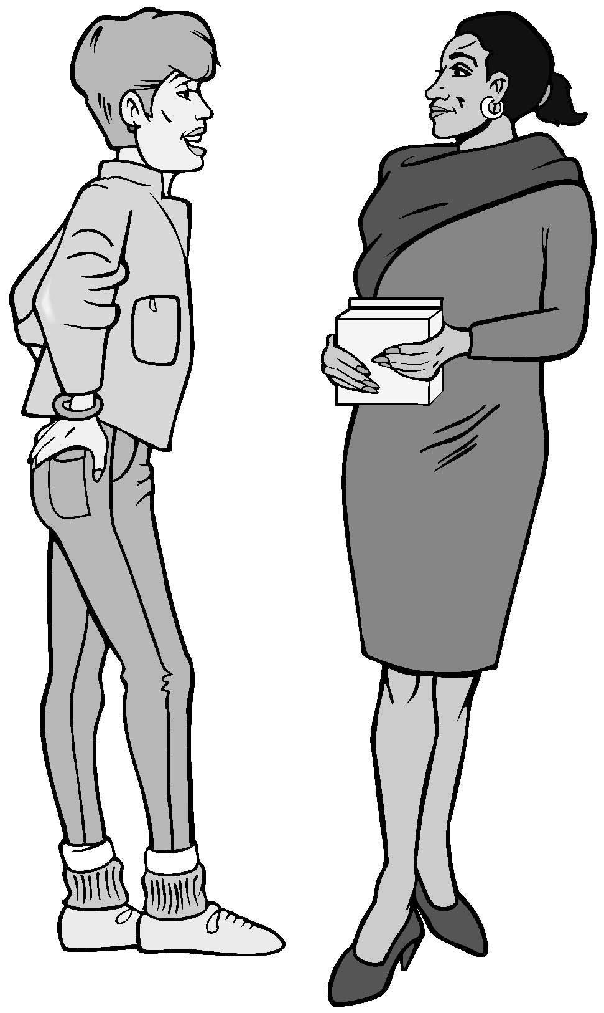
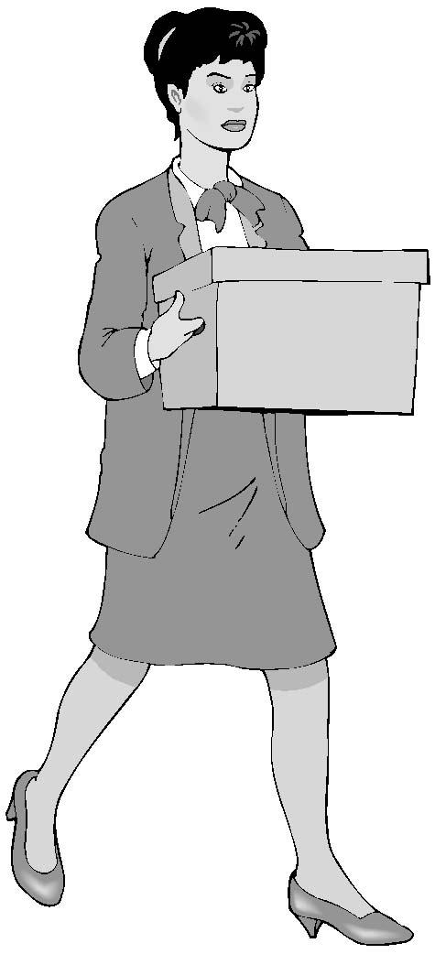
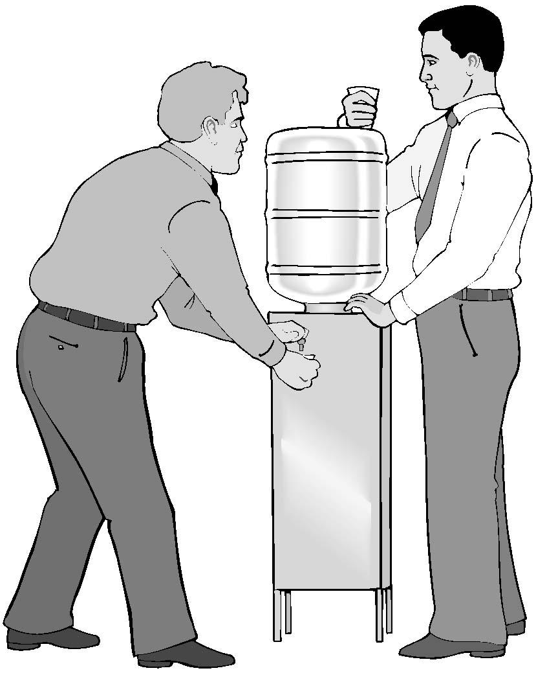
Technical work is more than writing code,
it’s about making technology work.
Notes:
Technical work is more than programming, it’s about making technology work, which takes many people and many different skills. And archivist jobs are very technical jobs, but you don’t have to be a programmer to successfully work with technology

Slide 3
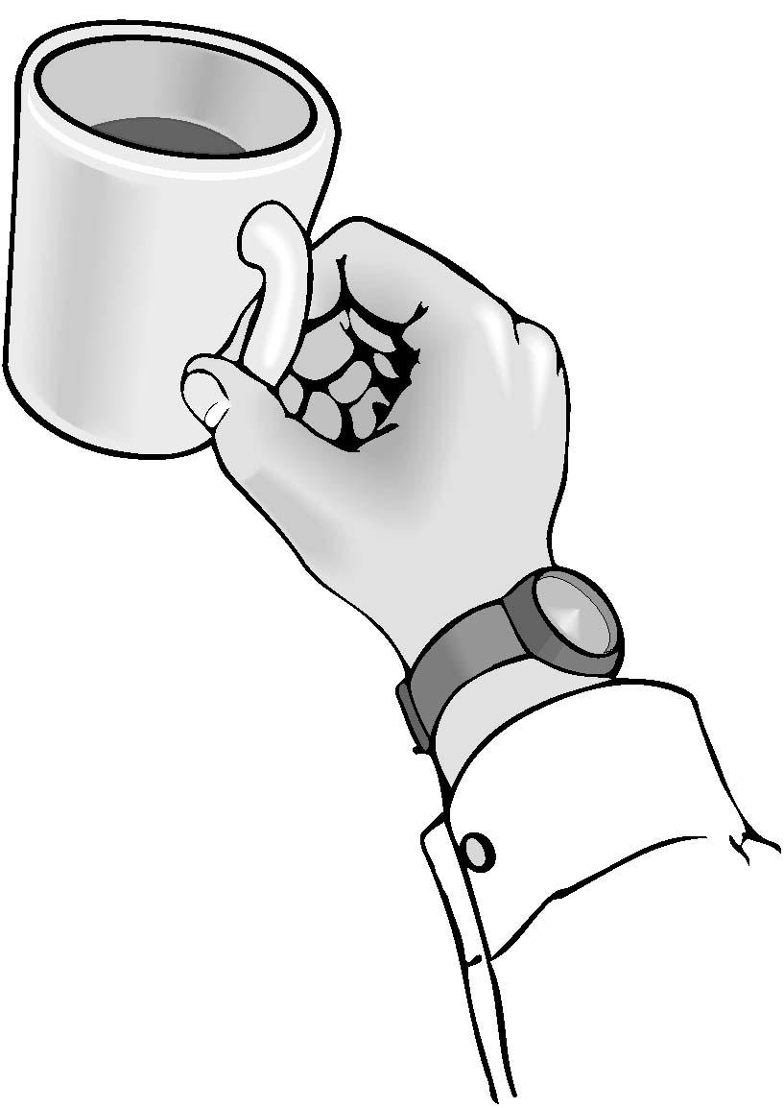
“Archivist?”
(Digital) Archivist
Systems Archivist
Librarian
Museum folk
Metadata Specialist
Notes:
I think the term archivist encompasses so many regular tasks, especially “digital archivist.” I think the previous talks are indicative of the kind of work we are faced with tackling every day: writing automation scripts, collaborating, working with data, working in and around larger systems, doing operations work, and more. So what are some of the other things?

Slide 4
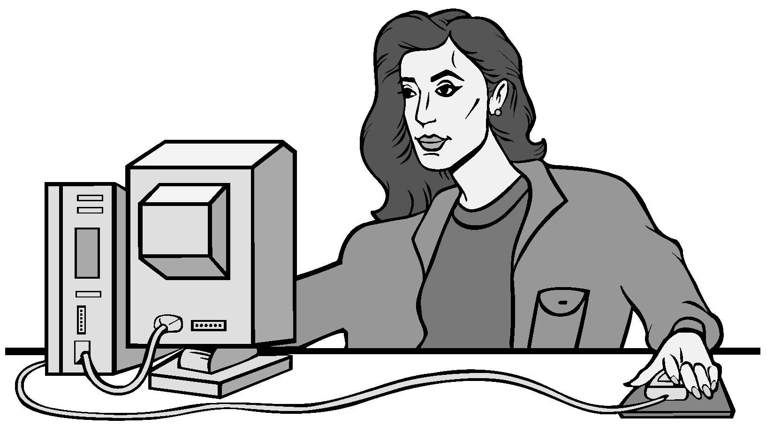
“Developer?”
Developer
Engineer
Programmer
Client-side engineer
Server-side engineer
Person writing scripts for me
Notes:
In addition to being an archivist, part of my experience is also that of a developer, engineer, programmer, whatever title works for you. Sometimes this job is fulfilling this role of “person who is writing scripts for me without a specific title” and I think the people talking on this panel fulfill both of the two categories, working holistically, irregardless of if that is in their job titles or not … if you’re writing scripts in any capacity, you are a developer, full stop. Okay, so, archivist, developer, those are two categories of work. Let’s talk about more.

Slide 5

“Tech support?”
Information Technology
Systems administrator
DevOps
Infrastructure engineer
Digital repository manager
System rebooter
Communicator
Notes:
A lot of the role I fulfill day-to-day is that of what I would consider “tech support” -- some of these roles involve IT management, system administration, developer operations support, stuff like that -- but I think there’s a field beyond that of just doing the work, but people who are communicating the work that has been done to the people who asked the work to be done, and that is the work that I find myself doing frequently -- either I am the person making adjustments to the system, or I am a the person explaining the work that has been done to someone’s system in a translated computer-to-human way. I think this is a role we frequently play as archivists but isn’t really a title that exists so much. But on to the next title --

Slide 6

“Consultant?”
Analyst
Consultant
Solutions architect
Workflow magician
Notes:
This brings me to consultant, an ambiguous title that can mean many things. I’ll highlight solutions architect -- its all about figuring out solutions to problems and how to make certain software systems work within the context of other applications. I do this a whole lot as part of my job and it doesn’t involve writing any code, but it takes a lot of work to figure out how software systems work together and can talk to each other.

Slide 7
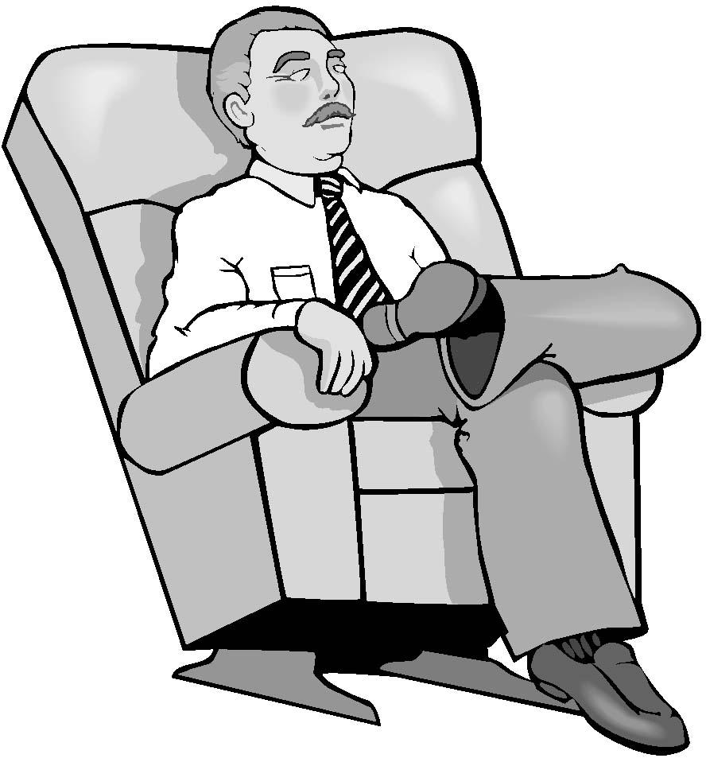
“Maintainer”
Legacy system user
Code updater
Systems caretaker
Infrastructure engineer
Open source contributor
Data migration expert
Notes:
Following that thought -- the work of getting systems working together isn’t a thing that happens once, it’s a continual process and practice. Maintainer is a role that is under-utilized and doesn’t show up in job titles but is absolutely crucial to doing work with technology in the archives field. Working with legacy systems, fixing code so that old things work with the necessary new things, and working and understanding workflows are essential jobs.

Slide 8
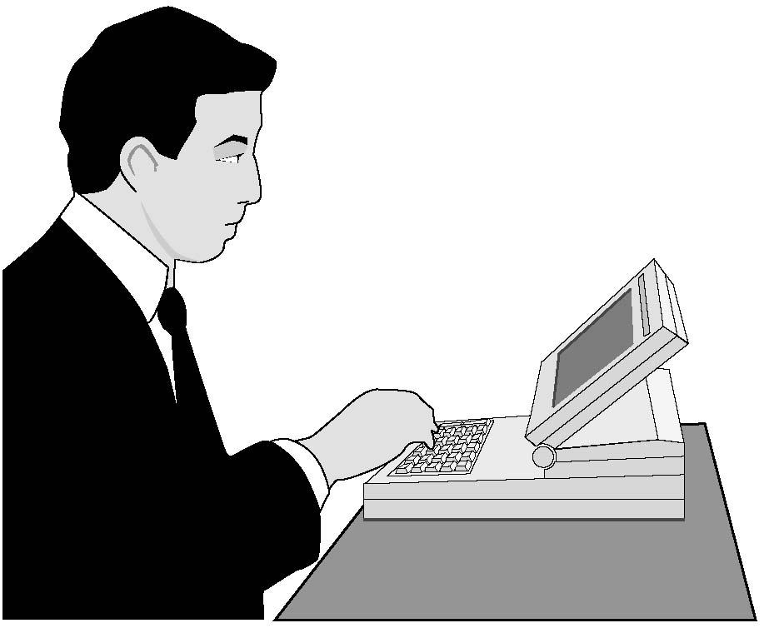
“Designer?”
Designer
UX Specialist
UI Specialist
Product designer
Accessibility Lead
Notes:
If you do have the luxury of being able to work with and design a new system, Designer is a kind of job that I have had -- a role I’ve filled in a few grant projects. UX / UI work is a really important skillset that is often popped on top of a cake like frosting but ought to be integral to the foundation of systems development, and takes a lot of empathy and a manner of understanding not only how systems work and how people work, but how these things work together!

Slide 9
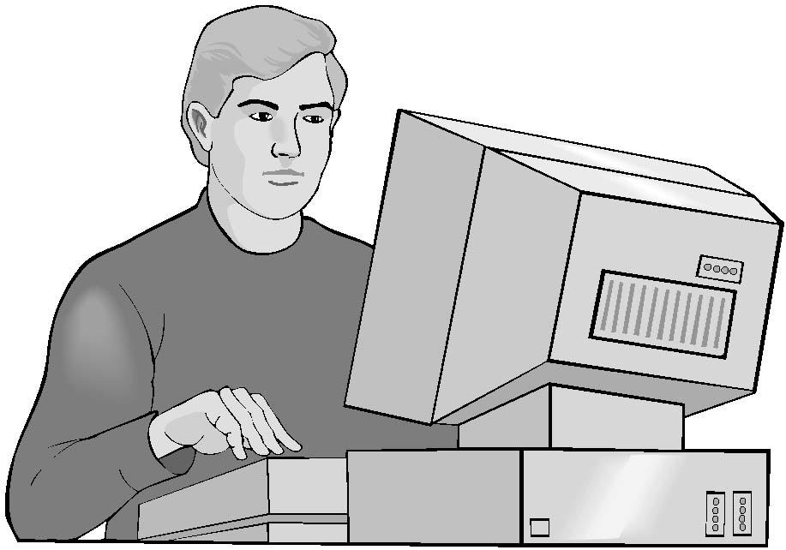
“Writer?”
Technical writer
Specification reader/writer
Policy author
Bug filer
Issue tracker
Notes:
Alongside design is the ability to articulate these things -- either to other people, to institutional stakeholders, to outside groups, et cetera, and being able to write that down and pass it over to the general community is an incredibly valuable skill -- some people legit do not know how to do this well, and it is a skill.

Slide 10
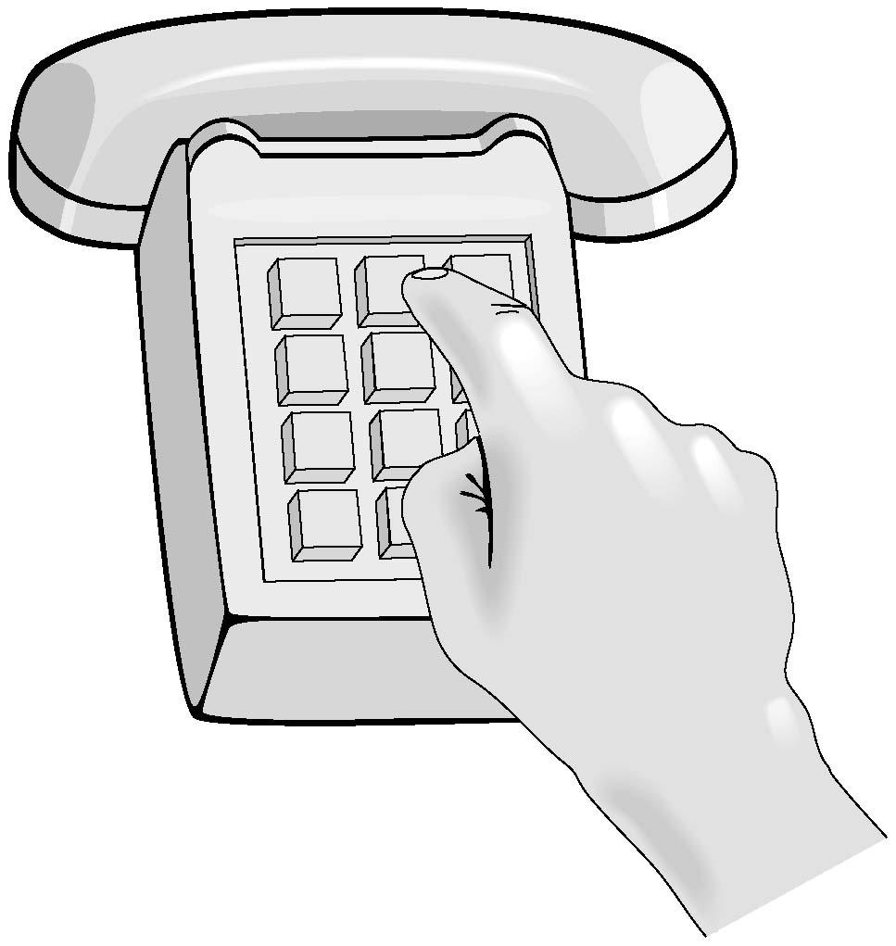
“Manager?”
Project Manager
Product Manager
Community Manager
Cat herder/wrangler
Coordinator
Notes:
Finally, manager is another ambiguous title. Project manager -- Making sure all the pieces fit together. Product manager -- making sure the vision of what you are making is aligned. Community manager -- making sure the community is engaged with the thing you are building. It is akin to the next bullet point which is cat wrangler and herder, getting people to agree on a path forward. Something we do at Artefactual is talking to one org about a feature, talk to another org that wants the same thing, and then making something happen with the support of both organizations that otherwise wouldn’t have had that communication. And then that feature is available to the public afterwards. But this kind of work takes time and effort and foresight. Management is a lot of work, and archives are a lot of work.

Slide 11
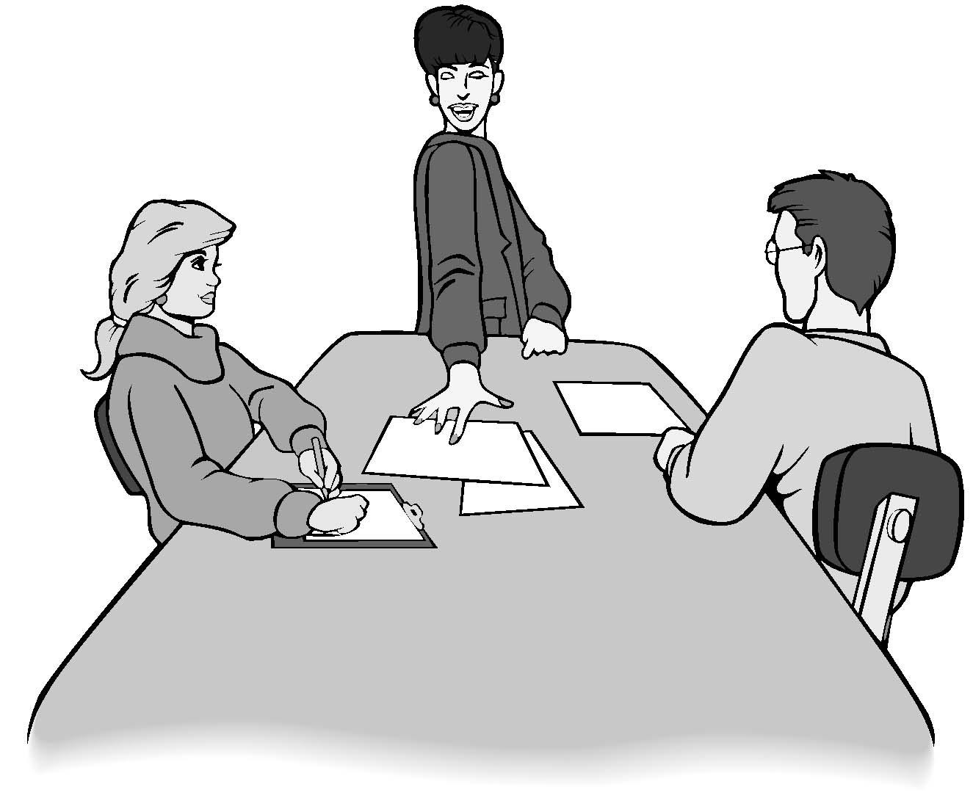
Disclaimer
Notes:
To conclude this talk, I want to end with a caveat: I get to do all of these things and I enjoy doing them, but with it is with the caveat that I have the space at my company to learn and grow and try things. There's a mutual consent there. This is not to say I approve of job postings that take the jobs of 3 people and expect one person to fulfill them all. That's setting people up for failure.
I hope these jobs and job titles serve as inspiration for starting-off points for researching technical skills development, and ways you can learn or grow into a career as an archivist, because I believe our jobs encompass all of these skills, which are their own skillsets and independent from, yet integrated into programming skills.

Slide 12
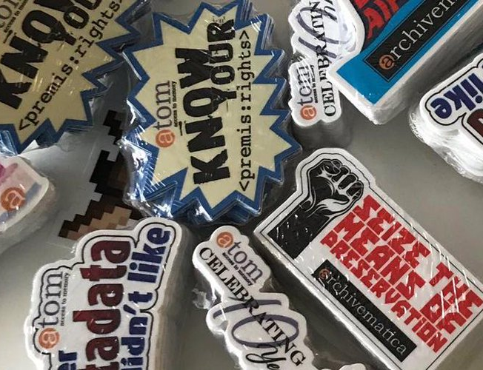
You!
Notes:
Also I have stickers! Come talk to me after!

