Slide 1
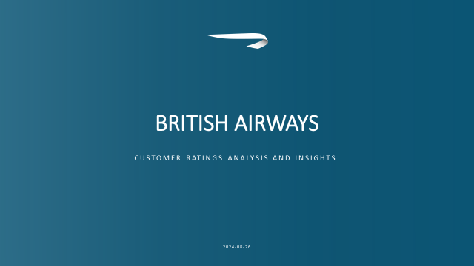
TITLE
For PURPOSES OF FORAGE VIRTUAL WORK EXPERIENCE

Slide 2
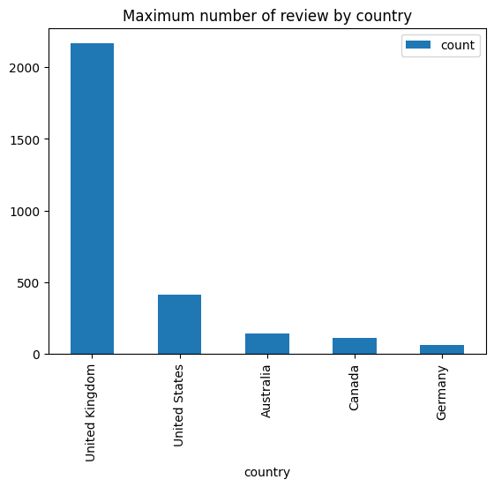
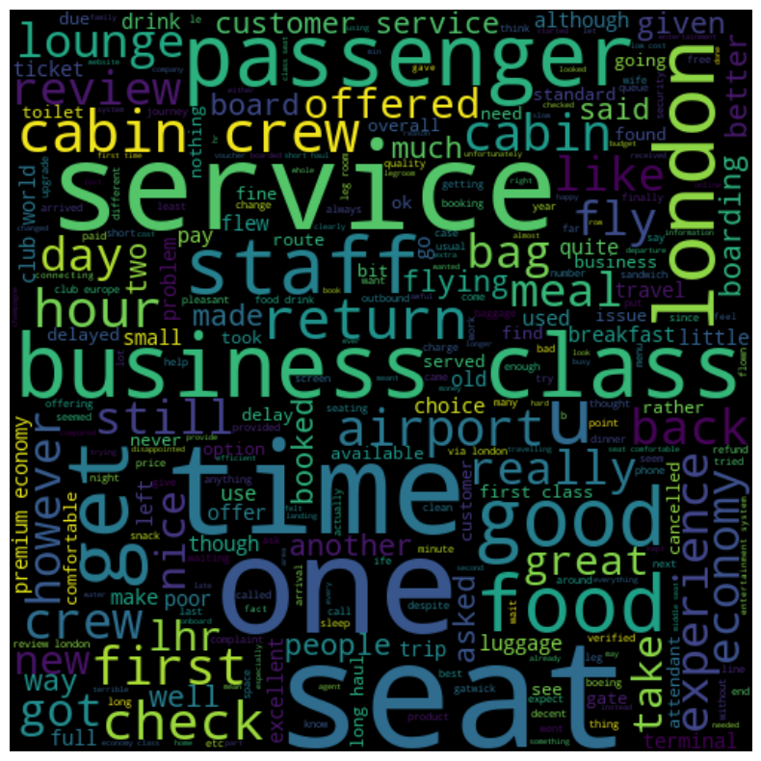
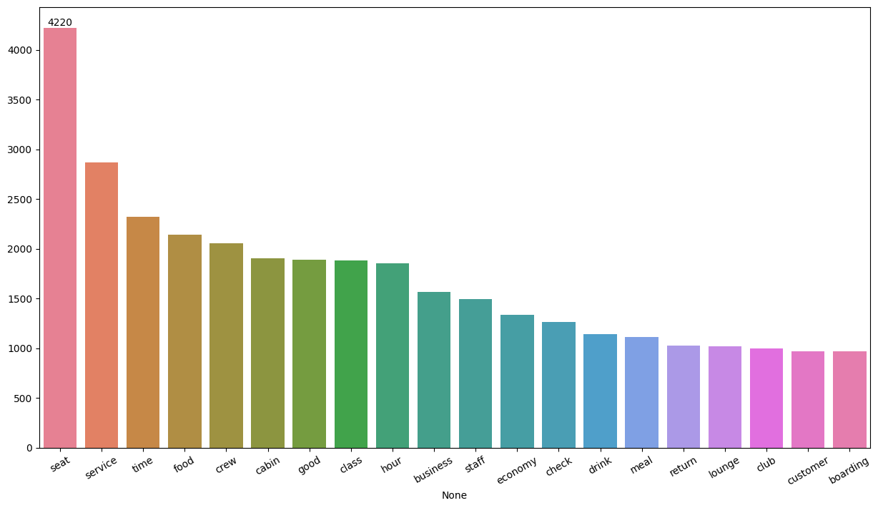
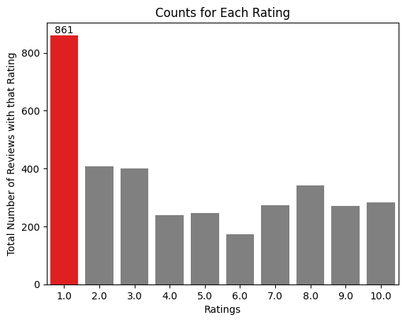
KEY METRICS
Average Overall
Rating
4.84/10
Reviews from
71 Countries
Total Reviews
3500 collected
What customers ae happy and unsatisfied about for different ratings class:
7-10 ratings reviews about comfortable seats, good inflight service and descent food quality.
4-6 ratings faced problem with small entertainment screen, long passport check queue, bad business class experience.
1-3 ratings reviews dissatisfaction on tight middle seat and small screen while they liked the seats and the food
All Customers liked Cabin crew service and staff, general economy seats. Many travelled in Business class.
Focus on – Economy class service, seats, enhance inflight entertainment experience and importantly Delays. Enhance the experience of business class, it seems customers want value for money. Improve Customer service on refund requests and process.

