Slide 1

VAS Performance and IDC Airtime System tracker
Technical Documentation
Architecture · Performance· Security · Infrastructure · Operations
October 2026 · v1.0

Slide 2
Current Identified Problem
VAS Section
IDC section
Scattered Revenue Data: Service revenue information is maintained across multiple Excel files, making consolidated analysis difficult.
Manual Revenue Target Collection: Revenue targets for individual VAS services are collected and maintained manually.
No Real-Time Performance Monitoring: There is no centralized tool to track real-time revenue performance against defined targets.
Lack of Centralized Performance Visibility: Relevant team members do not have a centralized platform for monitoring overall VAS performance.
No Centralized Communication Hub: There is no dedicated platform for sharing strategic ideas, recommendations, and inputs aimed at improving VAS performance.
Manual Action Tracking: There is no automated mechanism for recording action items, assigning responsibilities to team members, and monitoring follow-up progress.
Manual Data Collection: IDC-related data is primarily collected and maintained through manual processes.
Limited Distribution Network Tracking: There is no system-based mechanism for tracking distributors, sub-distributors, and retailers across the distribution network.
Unverified Retailer Registration: IDC retailer registration lacks sufficient verification mechanisms, increasing the risk of inaccurate or invalid data.
Data Accuracy Challenges: Manual retailer registration creates significant data quality and accuracy issues.
Lack of Automated Daily Reporting: There is no centralized automated reporting system for monitoring daily performance and operational activities.
No Geographical Distribution Visualization: There is no system for visualizing distribution density and retailer coverage geographically on a map.
VAS Performance Tracker — Technical Documentation
3

Slide 3
Current System Solution
VAS Section
IDC section
Time-Filtered Comprehensive Dashboard & Reporting: Provides consolidated dashboards and reports with flexible time-based filtering
Single & Batch Data Management: Supports both individual and bulk data entry and record management.
Real-Time Revenue Alerts: Generates real-time alerts when VAS service revenue exceeds or deviates from defined performance targets.
Goal & Performance Tracking: Enables cascading goal tracking to monitor service performance against defined targets over specific periods.
Action Task Planner: Allows teams to create action items, assign tasks to responsible team members, and track progress through completion.
Communication & Collaboration Hub: Provides individual and group communication channels for discussing revenue alerts, operational issues, strategic ideas, and performance improvement initiatives.
PPT & Excel Reporting: Enables automated generation and export of performance reports in PowerPoint and Excel formats.
AI-Powered Strategic Assistant: Provides AI-based insights and recommendations to support strategic planning and performance improvement.
Verified Retailer Registration: Validates IDC retailer registration through TIN verification using the eTrade platform.
Comprehensive Channel Reporting: Provides consolidated reports covering distributors, sub-distributors, and retailers.
Geographical Retailer Tracking: Captures and tracks retailer locations using online geographical positioning.
Distribution Density Visualization: Displays retailer distribution density and geographical coverage on an interactive map.
Single & Batch Data Registration: Supports both individual and bulk IDC data registration.
Communication & Collaboration: Provides individual and group chat functionality for internal discussions, coordination, and information sharing.
SMS Notifications: Supports single and bulk SMS notifications for IDC-related service information, updates, and important operational communications.
VAS Performance Tracker — Technical Documentation
3

Slide 4
Technology stack
Layer | Technology | Role in the System
Frontend | React 19 · Vite 5 · Tailwind CSS v4 · Recharts | Provides the user interface, responsive screens, dashboards, charts, and interactive components.
Backend | Node.js · Express 4 (CommonJS) | Handles business logic, API services, data processing, authentication, and communication between the frontend and database.
Database | MySQL | Stores and manages application data, including users, services, revenue, targets, reports, and operational records.
Authentication & Security | JSON Web Token (JWT) · bcryptjs · Slider Puzzle CAPTCHA | Protects user accounts, securely handles passwords, manages authenticated sessions, and helps prevent automated attacks.
Documents & Data | PPTXGenJS · PDFKit · XLSX | Generates and exports reports in PowerPoint, PDF, and Excel formats for business analysis and reporting.
VAS Performance Tracker — Technical Documentation
4

Slide 5
Why this technology was chosen
Technology | Why We Selected It | Key Benefits to the System
React 19 | A modern framework for building interactive and responsive web applications. | Provides a fast, consistent user experience and allows us to build reusable UI components.
Vite 5 | A lightweight and high-performance development and build tool for modern web applications. | Faster development, quick application loading, and efficient production builds.
Tailwind CSS v4 | Provides a simple and consistent approach to designing the application's user interface. | Ensures a consistent design across all screens and reduces unnecessary styling overhead.
Node.js + Express | Provides a lightweight and scalable platform for developing the application's backend services. | Handles business logic, APIs, user requests, and integrations efficiently while using JavaScript across the application stack.
MySQL | A reliable relational database suitable for structured business and transactional data. | Provides secure data storage, reliable relationships, fast queries, and strong support for reporting and analytics.
JWT + bcrypt + CAPTCHA | Uses established security technologies for authentication and user protection. | Protects user accounts, securely stores passwords, verifies users, and helps prevent automated or unauthorized access.
Deliberately NOT chosen: heavyweight frameworks (NestJS, Django) and ORMs — a single-VPS deployment favors few moving parts and full SQL control for revenue math.
VAS Performance Tracker — Technical Documentation
5

Slide 6
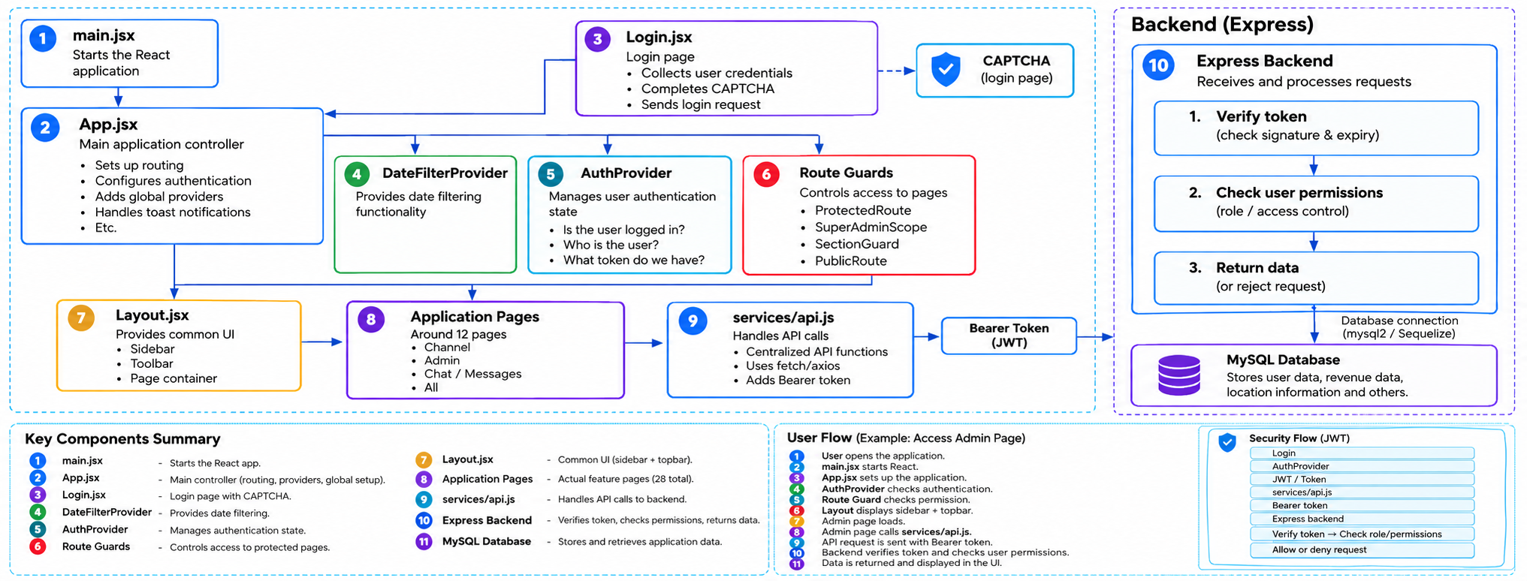
System Architecture Stack
Front End
VAS Performance Tracker — Technical Documentation
4

Slide 7
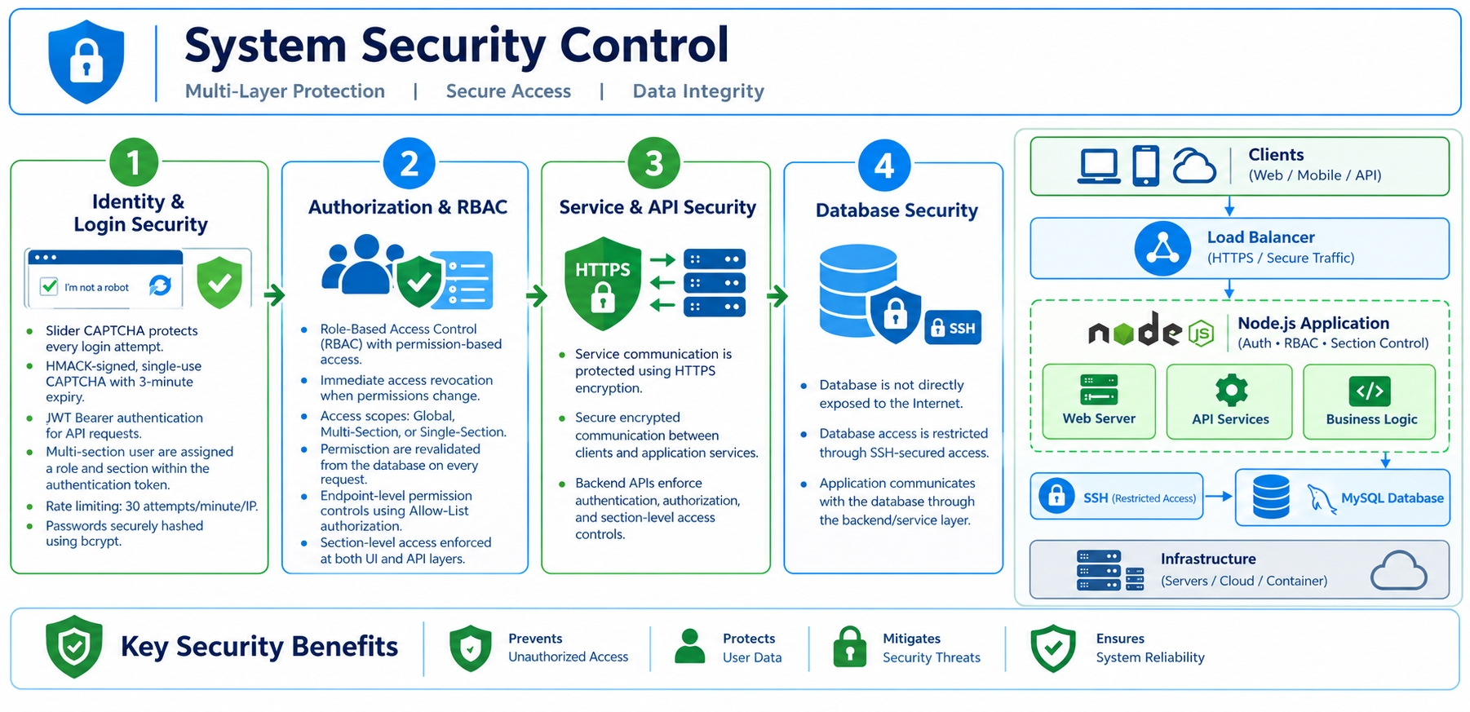
VAS Performance Tracker — Technical Documentation
6

Slide 8
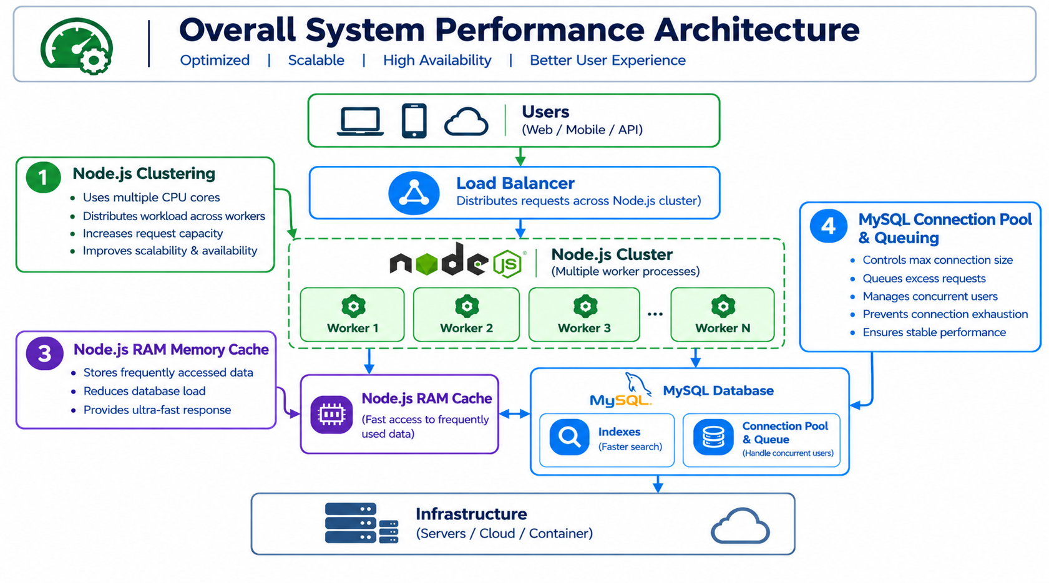
VAS Performance Tracker — Technical Documentation
6

Slide 9
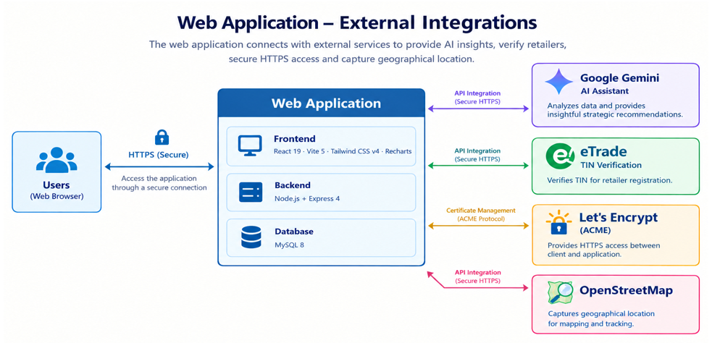

Slide 10
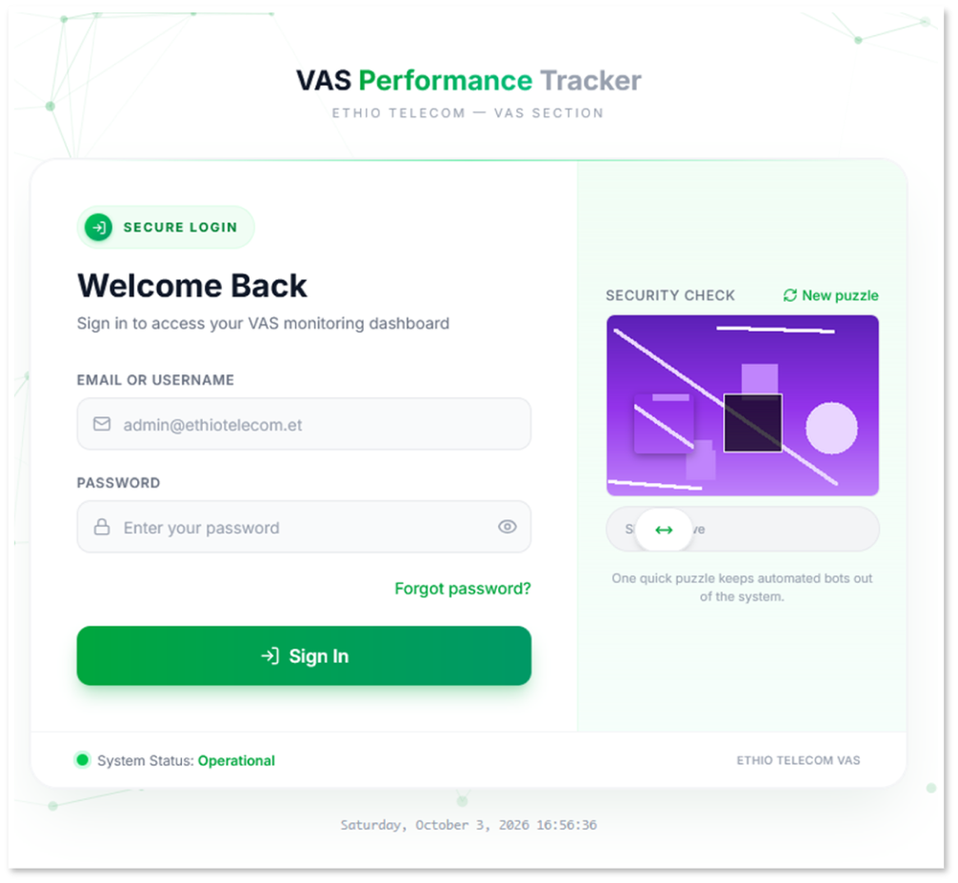
System Prototype
Login Page

Slide 11
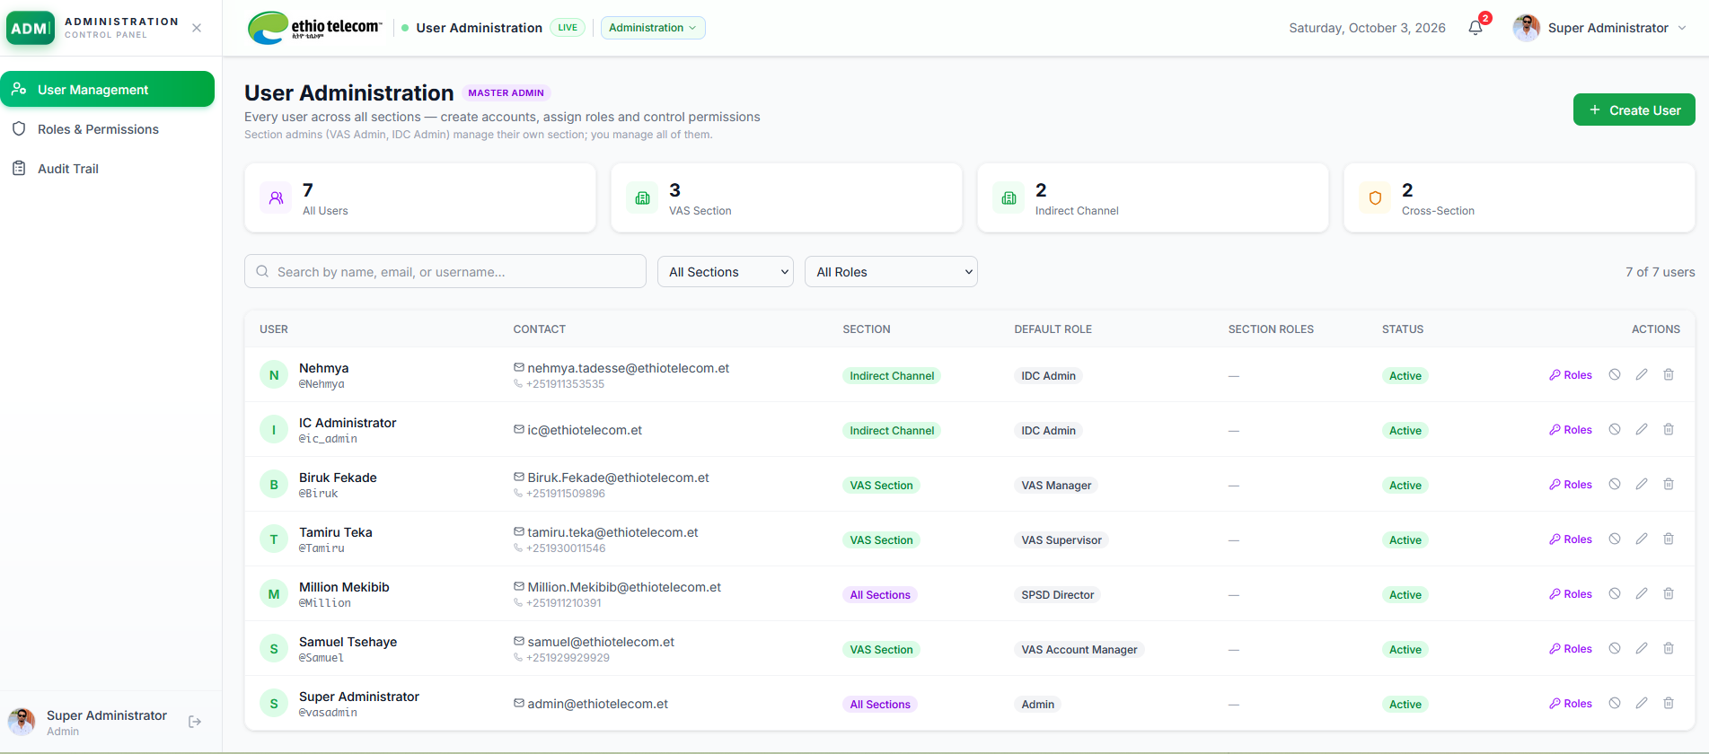
Super Admin User Management Page

Slide 12
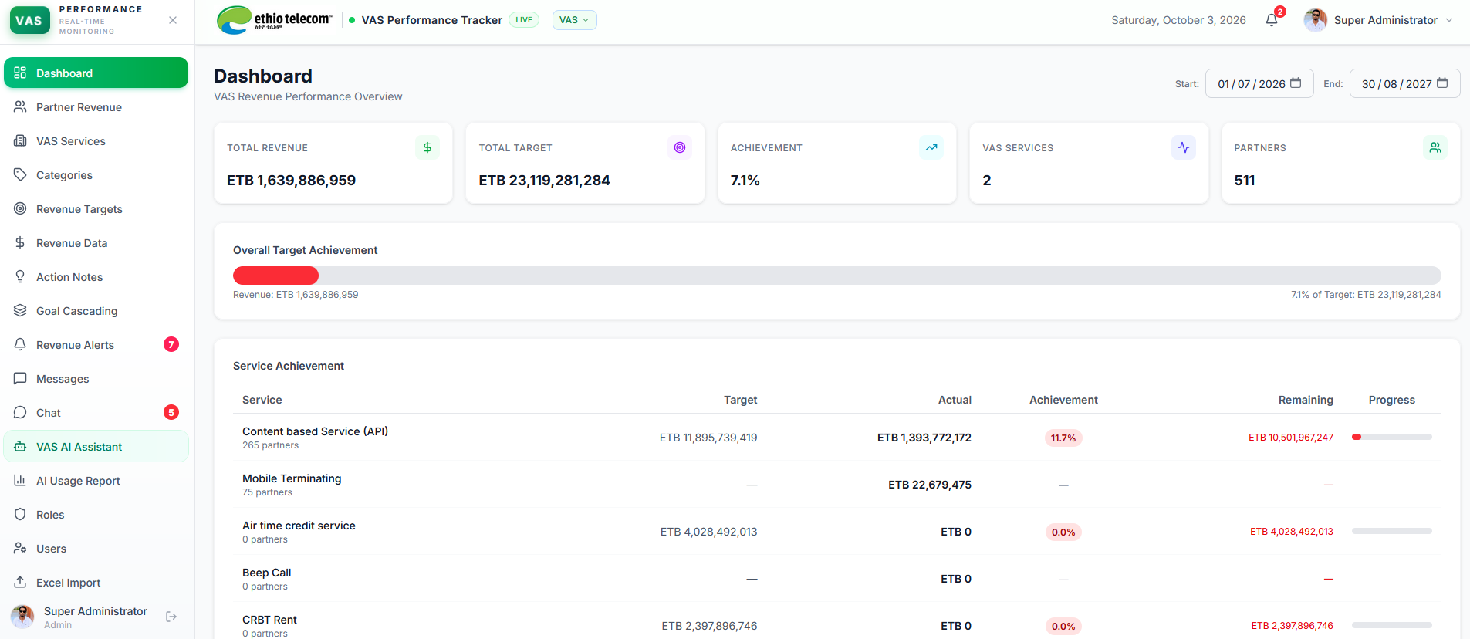
VAS Section Main Page

Slide 13
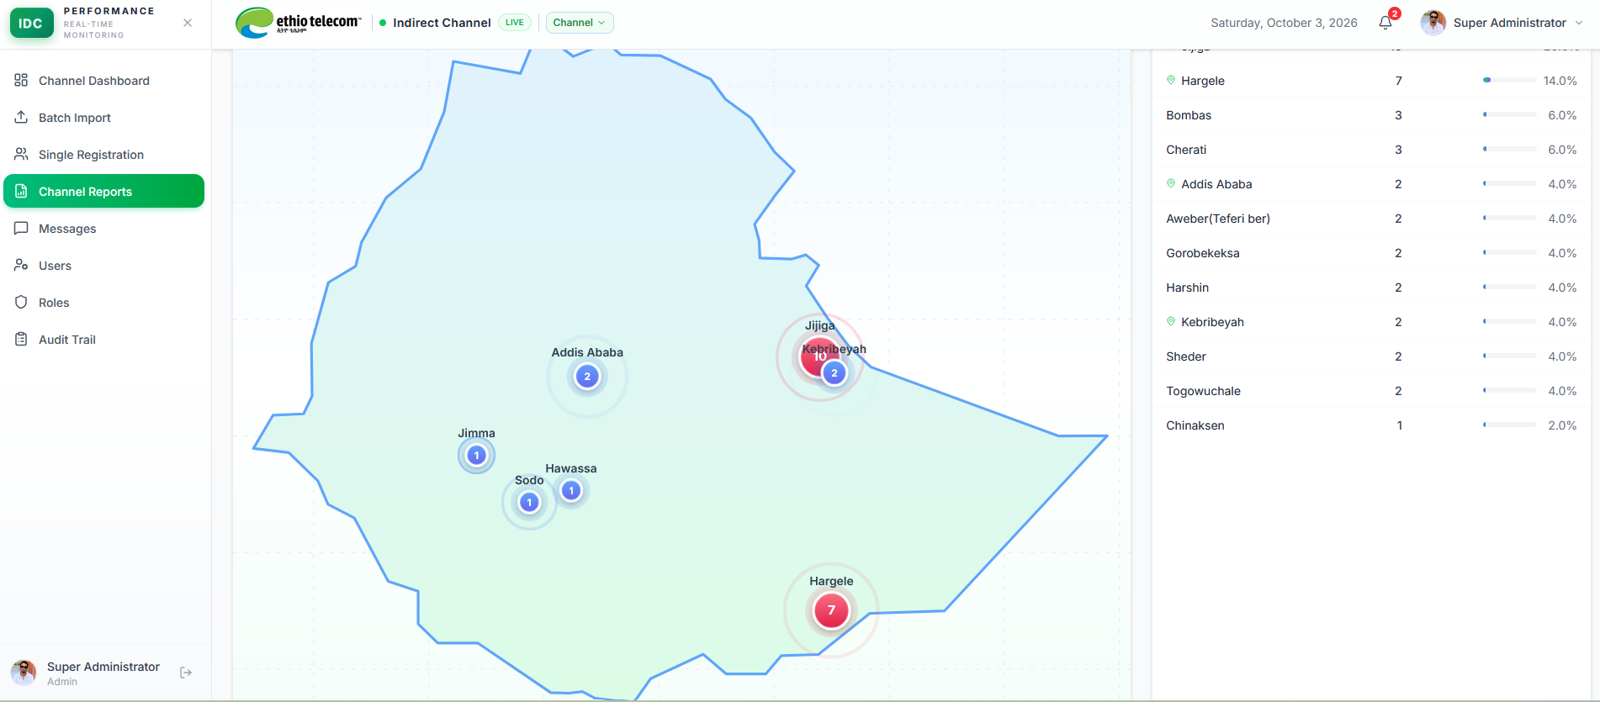
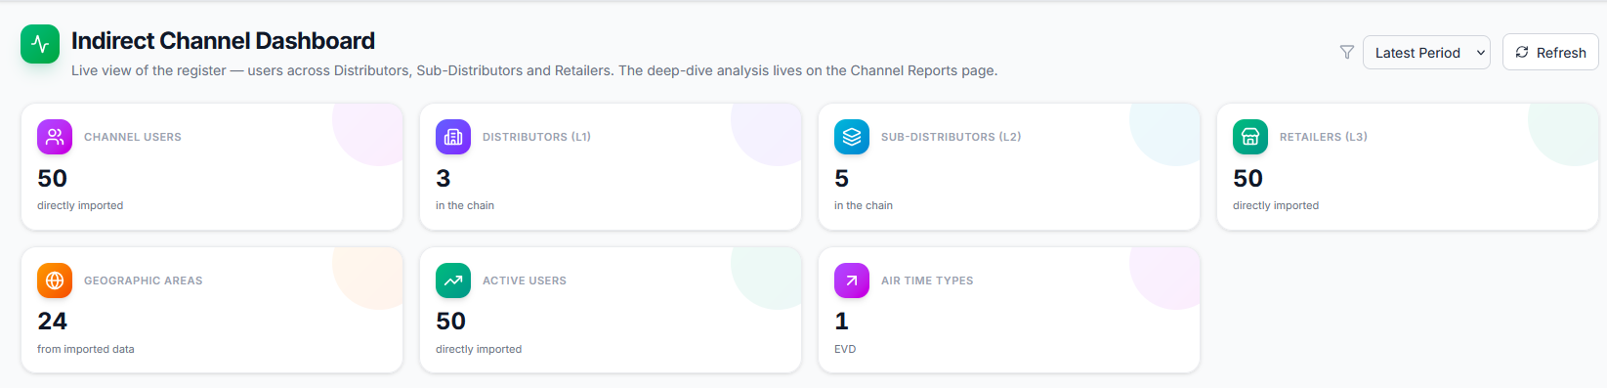
IDC Section Main Page

Slide 14
Thank You

