Slide 1
GPSANDWELLNESS
File created on: 2/1/2022 11:11:18 AM

Slide 2
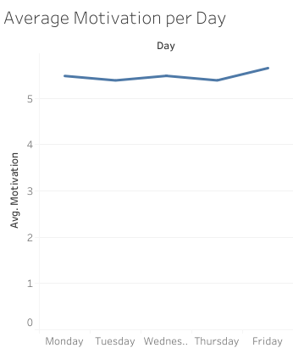

Slide 3
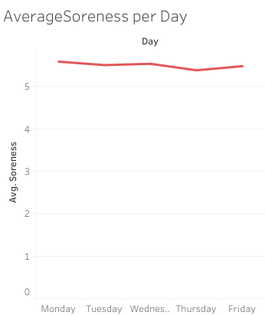

Slide 4
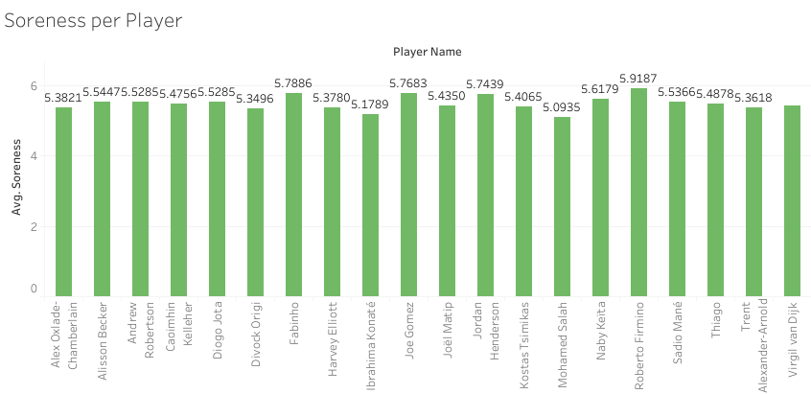

Slide 5
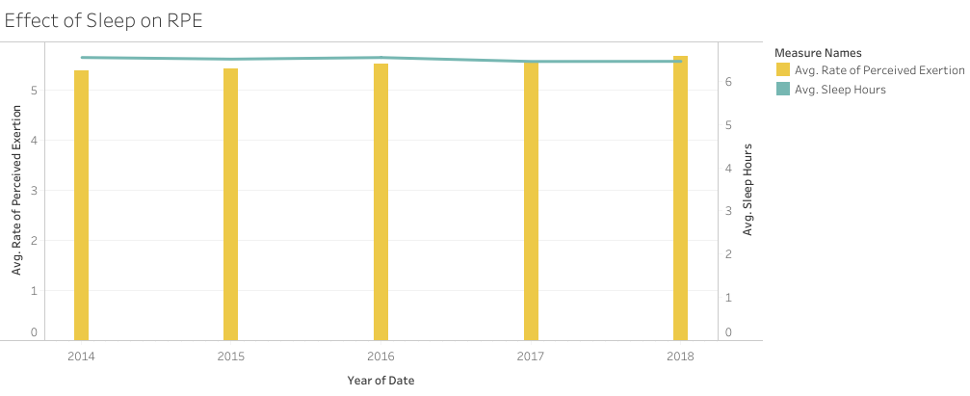

Slide 6
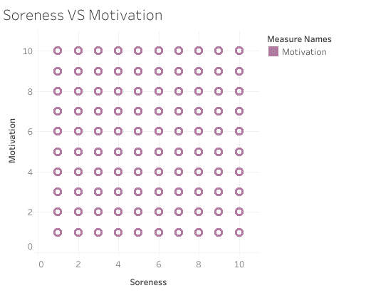

Slide 7


