Slide 1
Welcome to My Presentation

Slide 2
About Me
Name: Antor Pal
Department: English
Serial: 23
Topic: Monthly Salary Sheet of ABC Company Limited

Slide 3
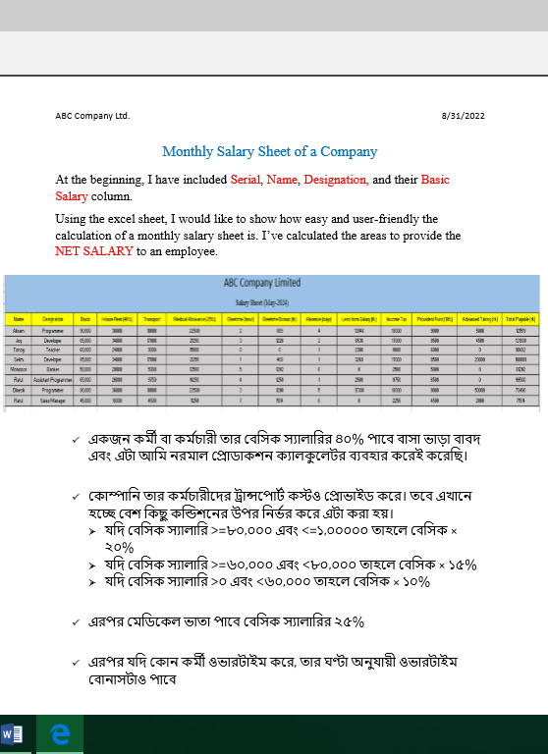
Salary Sheet of May-2024
MS Word

Slide 4
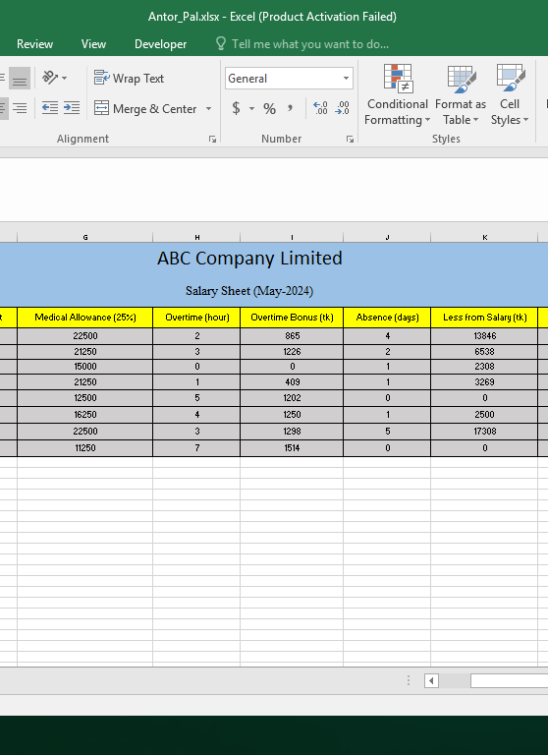
Salary Sheet of May-2024
MS Excel

Slide 5
? Why I’ve chosen Excel to create the Salary Sheet
Customization:
Company’s specific needs
Columns for employee details, allowances, deductions, and net payable amounts.
Calculation Accuracy:
Easily computing gross salary, allowances, and deductions based on employee data
Automation:
Automating repetitive tasks. Formulas update automatically when I input new data
Data Organization:
Organizing and sorting data by employee name, basic salary, allowances, and deductions.

Slide 6
Thank You
ANTOR PAL
+8801790-396964
antorpal31@gmail.com

