Slide 1
TexTruth
Ensuring Authenticity in the Age of AI
Team Bit-Chess

Slide 2
Problem Statement
Develop an AI-powered solution to distinguish between AI-generated and human-authored text while evaluating the quality and sophistication of AI-generated content. Participants must create nuanced algorithms capable of detecting subtle differences in language fluency, coherence, and contextual understanding, advancing content verification tools for enhanced trust and reliability in an AI-driven information landscape.
AI powered classifier to distinguish between ai and human text.
Measure the quality of any given text on predefined metrics
Verifications tools
Browser Extension for accessibility

Slide 3
Need for TexTruth
Rise of LLMs and Transformers
Flooding of “AI generated text” in social media platforms.
Plagiarism in academic settings.

Slide 4
Proposed Idea
AI-powered website & Chrome extension to identify AI-generated text.
BERT to perform statistical analysis on text
Analyzes language fluency, coherence, and contextual understanding using NLP.
User-friendly interface to verify online content trustworthiness.
Provide citations on the text for further exploration

Slide 5
Working
The user provides input text or uploads a PDF file through the frontend interface.
The frontend sends the user's input to the backend via REST API calls.
The backend receives the text data and forwards it to the model API for analysis.
The model API preprocesses the text using keras_nlp models, tokenizes it and makes predictions to determine whether it is human-authored or AI-generated using Distill BERT Model.
If the text is AI-generated, the backend requests citations from the Gemini API.
The Gemini API retrieves citations for the AI-generated text and sends them back to the backend.
Finally, the backend aggregates the detection results and citations and sends the response back to the frontend for display to the user.

Slide 6
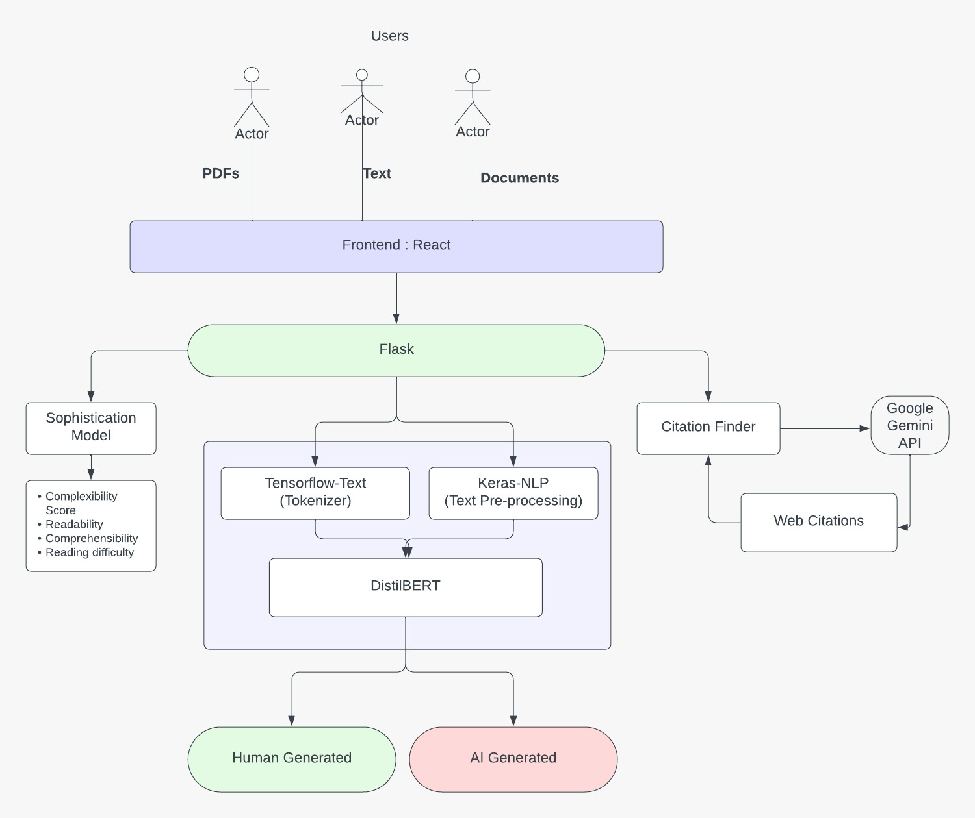
Workflow:

Slide 7
Impact
Verification of real vs ai text
Plagiarism
Sources of information
Prevention of running automated misinformation campaigns
Transparency

Slide 8
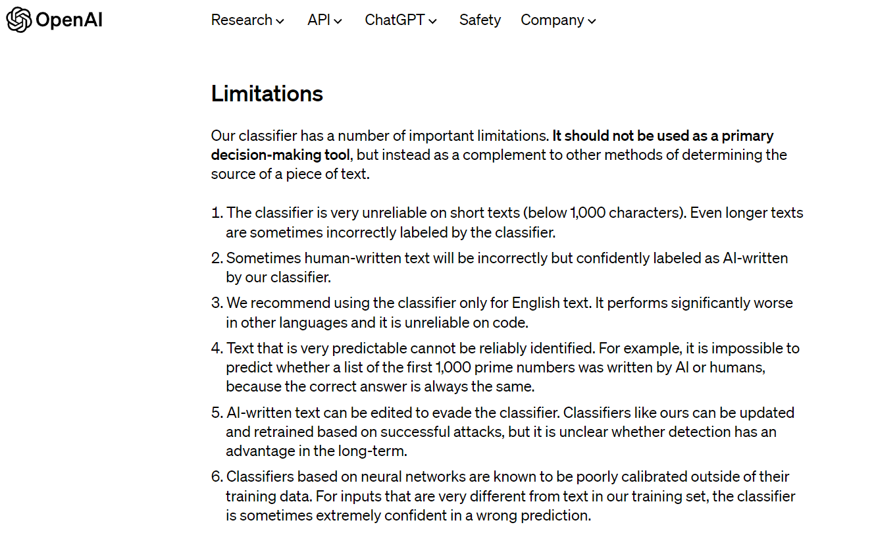
Industrial Limitations
Unreliable on short texts (<1,000 characters)
Can sometimes incorrectly label
human-written text as AI-generated with high confidence
Only recommended for use on English text currently (poor performance on other languages/code)
Cannot reliably classify very predictable text (e.g. list of prime numbers)

Slide 9
Future Work
Continuous Model Improvements
Expanding to Multiple Languages
Multimodal Classification : Images , Audio and Video
Integration with content platforms : Twitter , Quora , Reddit

