Slide 1
Agent Based Modeling and GIS
Schelling Segregation Polygon Model

Slide 2
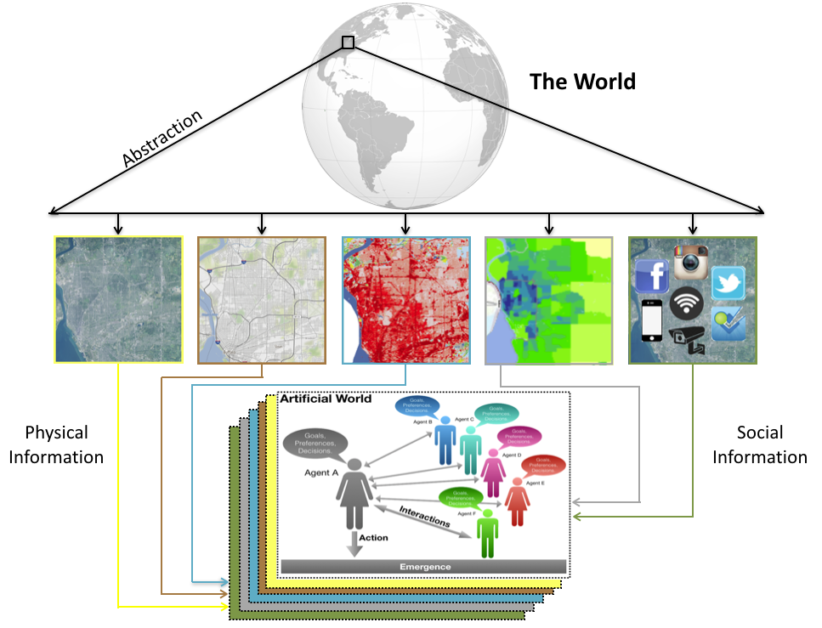
Why is Space Important?
Space matters: our perception of the World is naturally spatial.
GIS allows us to link a place and often a time to agents behaviors within a model
There are many examples of how agents and their aggregations interact and change in space and time

Slide 3
GIS and Agent Based Modelling
Linking models to GIS provide a more realistic representation of the world
GISystems represent the world in a series of layers and objects of different types
Layers and objects can be referenced and translated into an ABM

Slide 4
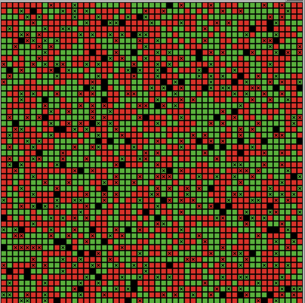
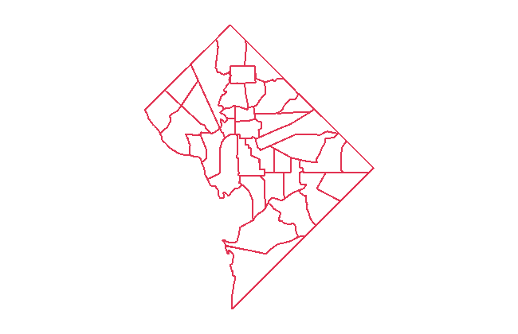
A Simple GIS & Agent-based Modeling Example
Schelling Segregation Model
Model provides an understanding the behavior of two types of agents in a neighborhood over time.
In this example, a GIS layer allows a realistic representation of neighborhoods (i.e., surrounding census tracks)
Stylized on Washington DC

Slide 5
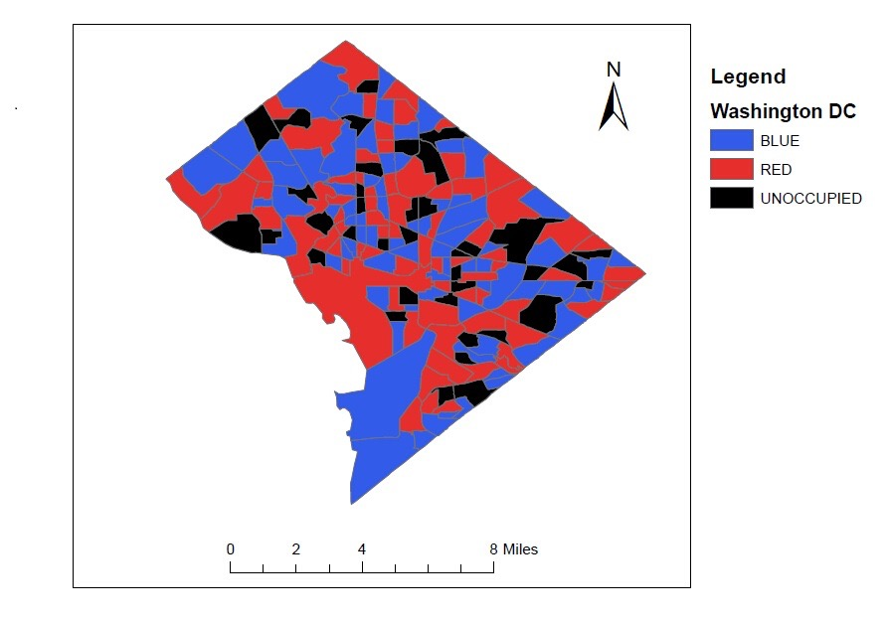
GIS and NetLogo
NetLogo’s GIS extension provides support for reading both vector data (in the form of ESRI shapefiles) and raster data (in the form of ESRI ASCII grid files).
The NetLogo documentation states: ‘This extension adds GIS (Geographic Information Systems) support to NetLogo. It provides the ability to load vector GIS data (points, lines, and polygons), and raster GIS data (grids) into your model.’
As with all NetLogo extensions, the model needs to ‘activate’ it with the following line at the beginning of the model code:
extensions[gis]
Notes:
Does not allow for export of shapefiles

Slide 6
GIS in NetLogo
Although the Shapefile is a proprietary format, it has become the de facto standard GIS data format for most GIS tools.
A number of files are associated with the Shapefile format:
the Shapefile (.shp), which stores the geographical information needed to display the feature (x, y, z coordinates of vertexes and edges of the geometric shapes);
the database file (.dbf), which stores the data records for the feature; and
the index file (.shx) which links the database file to the Shapefile (via the feature ID).

Slide 7
Lets Build a Model
To get the most out of this, refer to Chapters 3, 4 and 6 from
Crooks, A.T., Malleson, N., Manley, E. and Heppenstall, A.J. (2019), Agent-based Modelling and Geographical Information Systems: A Practical Primer, Sage, London, UK.

Slide 8
Lets First Create the Basic Scaffolding of a Model

Slide 9
Setting up the Globals, and Patches
extensions [gis] ;; informs NetLogo to call the GIS extension
globals [dc-dataset
] ;;this will be the container for the data
patches-own [ID ;;patch ID is identical with polygon ID_ID
popu ;;population
mycolor ;;its color
myneighbors ;;neighboring polygons' centroid patches
]

Slide 10
Setting up the Agents
turtles-own[tcolor ;;sets the color of the agent
percentage-same ;;percentage of same color turtles on neighbors
happy? ;;happy if neighboring same color agents >= 50%
tneighbors ;;an agentset of its neighbor turtles
rneighbors ;;number of red neighbors
bneighbors ;;number of blue neighbors
tneighborpolygons ;;neighboring polygons' centroid patches
]

Slide 11
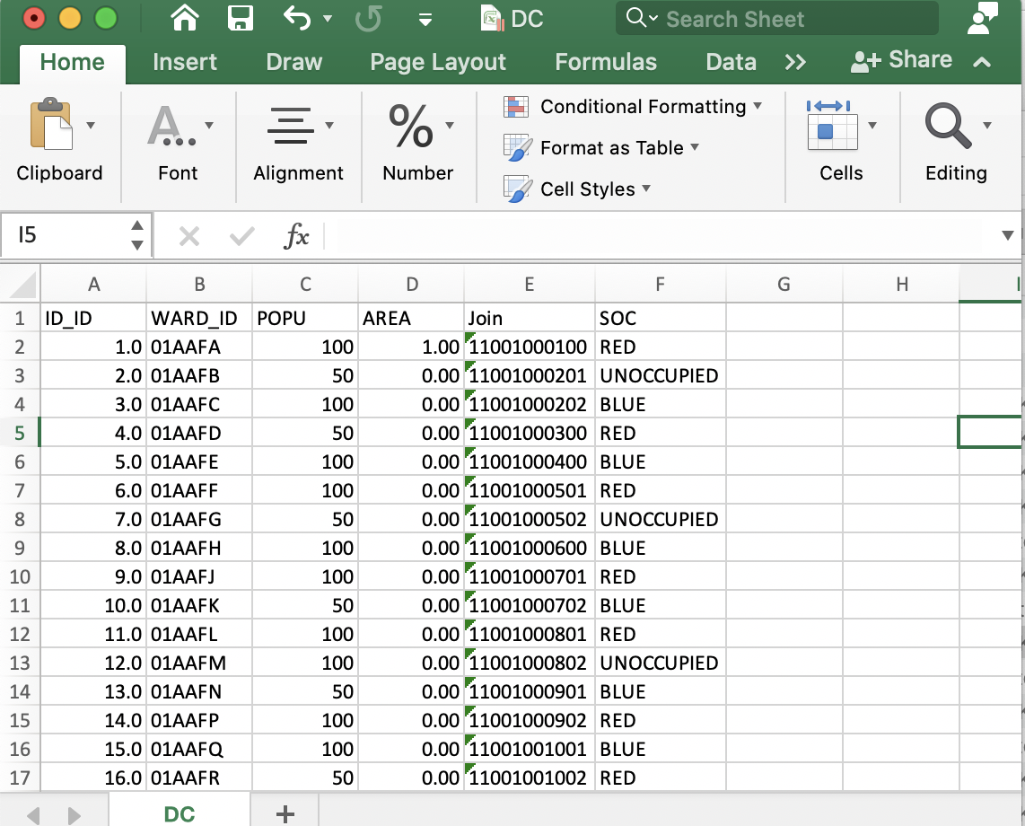
Importing the data and Creating Agents
to setup
ca
reset-ticks
set dc-dataset gis:load-dataset "data/DC.shp" ;;loading the vector data of DC
gis:set-world-envelope gis:envelope-of dc-dataset
;;drawing the map
foreach gis:feature-list-of dc-dataset
[ [?1] -> if gis:property-value ?1 "SOC" = "RED" [ gis:set-drawing-color red gis:fill ?1 2.0]
if gis:property-value ?1 "SOC" = "BLUE" [ gis:set-drawing-color blue gis:fill ?1 2.0]
if gis:property-value ?1 "SOC" = "UNOCCUPIED" [ gis:set-drawing-color grey gis:fill ?1 2.0]
]
;;In the next two lines, we use gis:draw to draw the boundary of polygon data using white color
gis:set-drawing-color white
gis:draw dc-dataset 1
end
All the agents Properties are held within the .DBF
Notes:
For each: [?1] for each is a netlogo command for lists, and increments through all features.

Slide 12
Setting the Extent of the World
It is also necessary to set the extent of the world using the tis:set-world-envelope command, which maps the envelope of the NetLogo world to the GIS envelope, maintaining the same x and y scale
See gis:set-world-envelope documentation for more information:
https://ccl.northwestern.edu/netlogo/docs/gis.html#gis:set-world-envelope

Slide 13
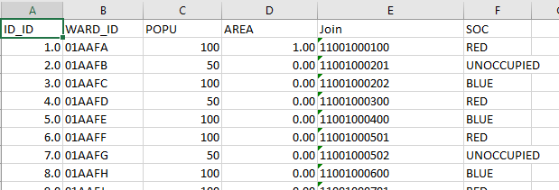
Importing the data and Creating Agents
set dc-dataset gis:load-dataset "data/DC.shp"
The line of code above loads the shapefile (dc.shp) along with the attribute data file (DC.dbf)

Slide 14
Copying Attributes to Patches
Make one patch represent one polygon (one color) by copy the color attributes to the patch centroid (add this to setup before the end)
let n 1
foreach gis:feature-list-of dc-dataset
[ [?1] -> let center-point gis:location-of gis:centroid-of ?1
ask patch item 0 center-point item 1 center-point [
set ID n
set mycolor gis:property-value ?1 "SOC"
if mycolor != "UNOCCUPIED" [sprout 1 [ ht set tcolor [mycolor] of myself setcolor]
]]
set n n + 1 ]
Notes:
We have to do this as net log turns polygons into patches.

Slide 15
Setup Color of Patches
to setcolor
if tcolor = "RED" [set color red]
if tcolor = "BLUE" [set color blue]
end

Slide 16
So far we have:
Set the bounding rectangle to shape envelope of the GIS space
Color the polygons with either red or blue or grey and borderline of 2 points
Go back to Interface and add a set up button

Slide 17
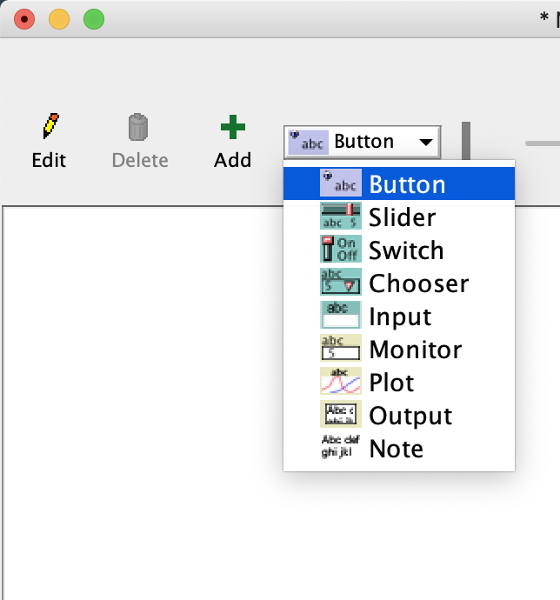
Interface Objects
Add some user interface control objects
To improve the usability, we'll add some interface control objects to the Interface tab.
Click on the Interface tab, and click on the pulldown selector labeled "button". Highlight the "button" type as shown to the right.

Slide 18
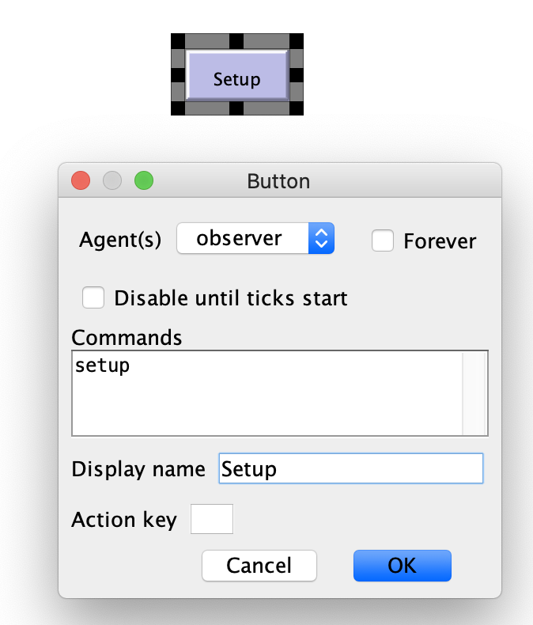
Interface Objects
In the "Commands" field of the dialog box, type "setup". In the "Display name" field, type "Setup". Your dialog box should now look like this.
Press OK, and the dialog box will close. To reposition your button, place the cursor on the button, Right-click, and choose "select". You may now reposition the button on the screen.
Notes:
Note this is the observer prompt

Slide 19
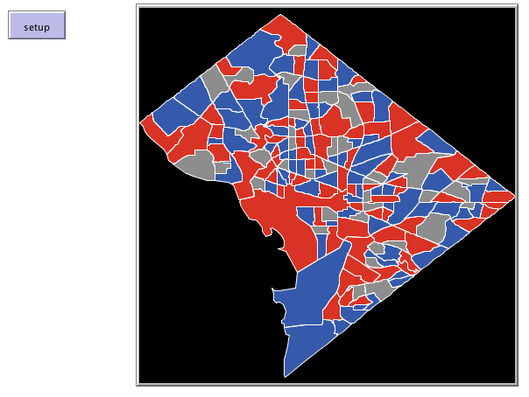
Draw Vector Data

Slide 20
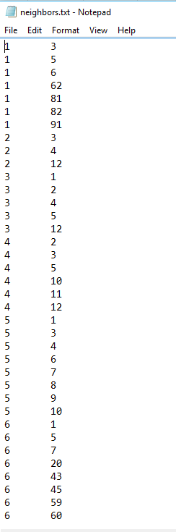
Set the Neighbors for Each Patch (in setup)
We have data about polygons with coinciding edges.
Polygon 1 has 3, 5, 6, 62, 81, 82 and 91 as neighbor
Load this from neighbors.txt
ask patches with [ID > 0] [ set myneighbors n-of 0 patches ;;empty agentset
]
;;find neighbors using a txt file produced by ArcGIS Polygon Neighbors. Please read NETLOGO FEATURES in info tab for more information.
file-close
file-open "data/neighbors.txt"
while [not file-at-end?] [
let x file-read let y file-read
ask patches with [ID = x ] [set myneighbors (patch-set myneighbors patches with [ID = y ]) ]
]
file-close

Slide 21
Calculating Polygon Neighbors
While it is possible to calculating polygon neighbours via the model it is easier to do this outside of the model.
In this example, the neighbours are calculated separately in a GIS (using the ‘Polygon Neighbors’ function in ArcGIS in this case) and stored in a plain text (.txt) file.

Slide 22
Now Lets make the model run….
to go
move
ask patches with [ID > 0] [if count turtles-here > 1 [print "ERROR"]] ;;verification
update-colors
tick
if count turtles with [happy? = true] = count turtles [stop];;stops the model when all agents are happy
end

Slide 23
Don’t Forget to Add the “Go” Button

Slide 24
In “Go” we ask the agents to “Move”:
to move
;;count the number of red or blue turtles in neighboring polygons
ask turtles [set tneighbors turtles-on [myneighbors] of patch-here
set tneighborpolygons [myneighbors] of patch-here
set bneighbors count tneighbors with [tcolor = "BLUE"]
set rneighbors count tneighbors with [tcolor = "RED"]]
;;calculate the percentage of same color turtles
ask turtles [ ifelse rneighbors + bneighbors = 0 [set percentage-same 1][
if tcolor = "RED" [set percentage-same rneighbors / (rneighbors + bneighbors)]
if tcolor = "BLUE" [set percentage-same bneighbors / (rneighbors + bneighbors)]]
ifelse percentage-same < (Percentage-same-to-be-happy / 100) [set happy? false][set happy? true]]
;;move to an unoccupied polygon if not happy. change the color here.
ask turtles [if happy? = false and count tneighborpolygons with [mycolor = "UNOCCUPIED"] > 0
[ask patch-here [set mycolor "UNOCCUPIED"]
move-to one-of tneighborpolygons with [mycolor = "UNOCCUPIED"]
ask patch-here [set mycolor [tcolor] of myself]]
]
end

Slide 25
In “Go” we also asked the agents to “update-colors”:
Update Colors of the Patches
;if agents move patch colors need to be updated
to update-colors ;;update polygon colors
ask patches with [ID > 0][
if mycolor = "RED" [ gis:set-drawing-color red gis:fill item (ID - 1) gis:feature-list-of dc-dataset 2.0]
if mycolor = "BLUE" [ gis:set-drawing-color blue gis:fill item (ID - 1) gis:feature-list-of dc-dataset 2.0]
if mycolor = "UNOCCUPIED" [ gis:set-drawing-color grey gis:fill item (ID - 1) gis:feature-list-of dc-dataset 2.0]
]
gis:set-drawing-color white
gis:draw dc-dataset 1
end

Slide 26
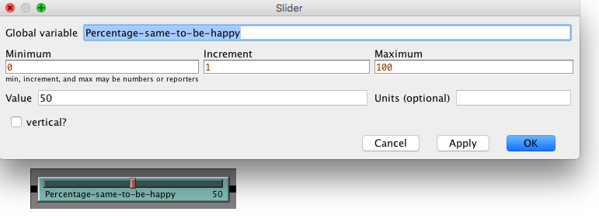
Error
You should of Noticed an Error
Need to add a global parameter called “Percentage-same-to-be-happy”

Slide 27
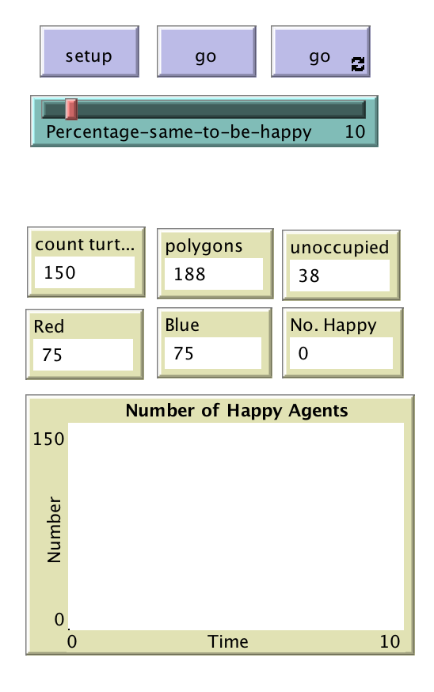
Adding GUI Elements
Add monitors so we can see what is going on:
count turtles,
Count polygons :
count patches with [ID > 0]
UNOCCUPIED areas:
count patches with [mycolor = "UNOCCUPIED"]
Count of Red Agents:
count turtles with [mycolor = “RED"]
Count of Blue Agents:
count turtles with [mycolor = "BLUE"]
Count Number of happy agents:
count turtles with [happy? = true]
Add Plot of Happy Agents
plot count turtles with [happy? = true]

Slide 28
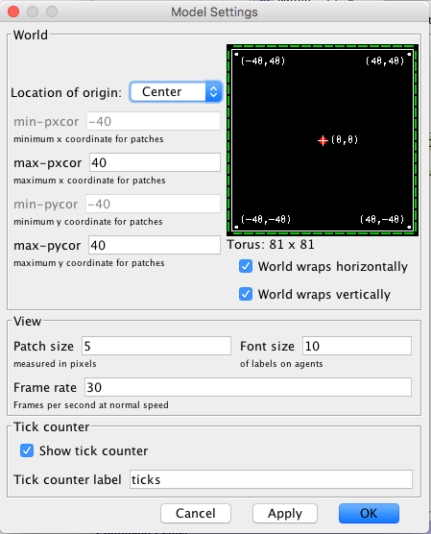
Resize the world
How many Polygons and Agents do you have?

Slide 29
Resize the world
How many Polygons and Agents do you have?
But the DBF file has:
188 wards, 75 are Red, 75 are Blue; and 38 are Unoccupied
Why?
Some of the wards are smaller than the patches, therefore multiple centroids are place on top of each other.
Therefore we need to resize the world.
Now check the monitors

Slide 30
Running the Model
Verify the code for errors
Go back to Interface tab
Click on Setup
Run the model with 25% Percentage-same to be happy
Reset and run the model with 50% Percentage-same to be happy
Reset and run the model with 75% Percentage-same to be happy

Slide 31
Recap
Why is GIS is important for ABM ?
How to load GIS vector data into NetLogo
How to integrate GIS attributes to NetLogo Elements

Slide 32
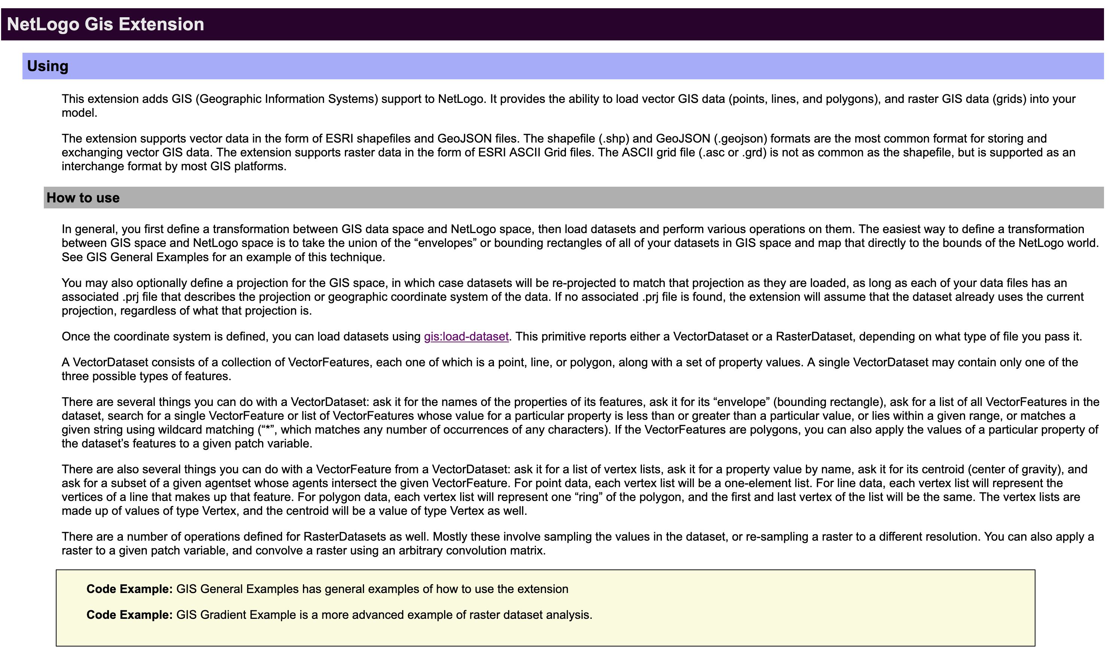
Find out More
https://ccl.northwestern.edu/netlogo/docs/gis.html

