Slide 1
Mesa 项目介绍
Boyu Wang
2025.12.07

Slide 2
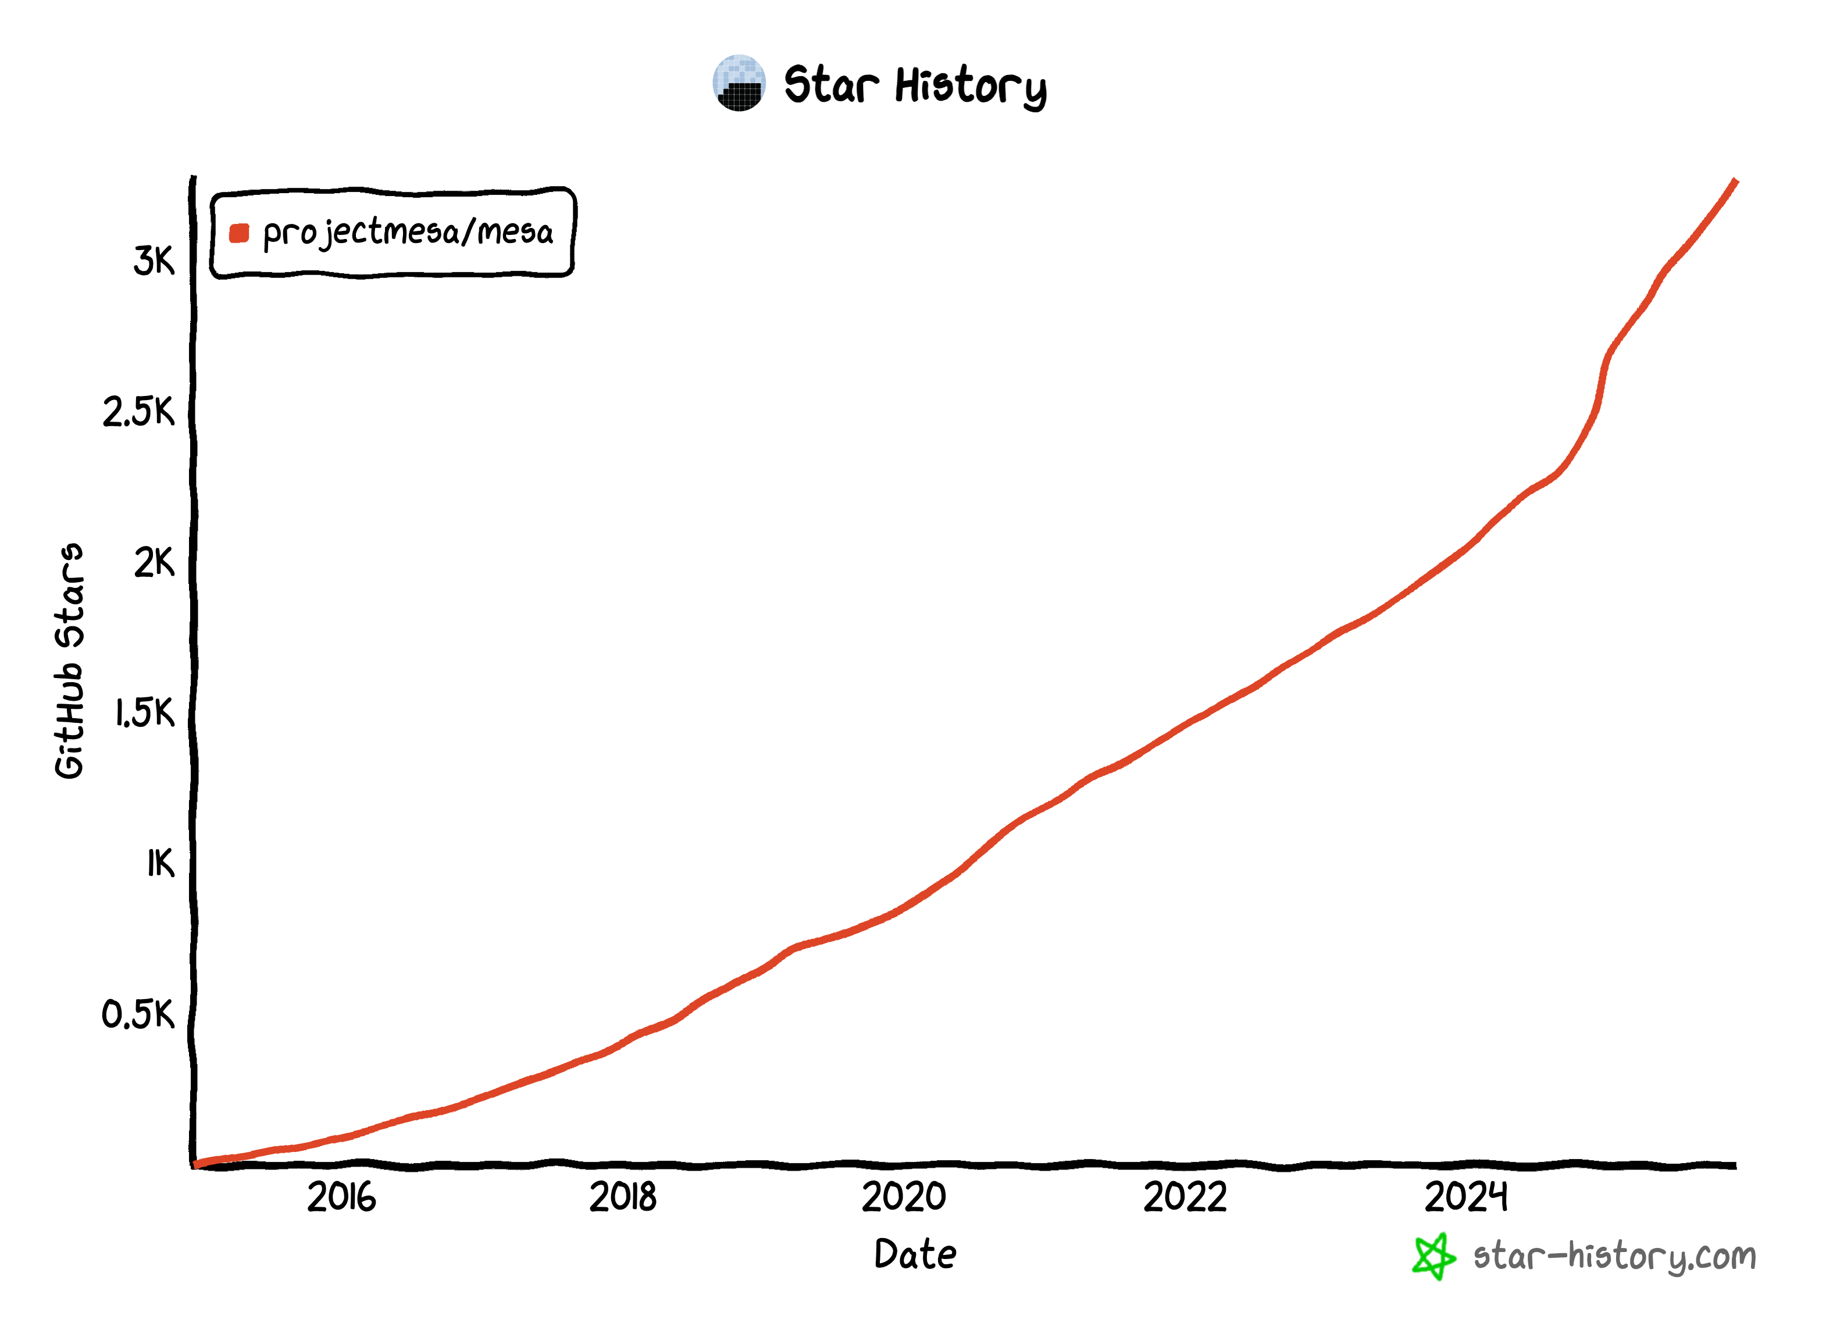
Mesa: Agent-Based Modeling in Python
Open-source project created in 2014
~110k downloads per month (PyPI statistics as of Dec 2025)
600+ citations of three Mesa papers
Used in various fields including health, energy, technical, biological, ecological…

Slide 3
其它 ABM 框架
Non-Python
Python
NetLogo https://ccl.northwestern.edu/netlogo
Swarm https://www.swarm.org
Repast https://repast.github.io
MASON https://cs.gmu.edu/~eclab/projects/mason
GAMA https://gama-platform.org
AnyLogic https://www.anylogic.com
Agents.jl https://juliadynamics.github.io/Agents.jl
krABMaga https://krabmaga.github.io
Repast4Py https://repast.github.io/repast4py.site
AgentPy https://agentpy.readthedocs.io
PyCX https://github.com/hsayama/PyCX
PyABM https://github.com/azvoleff/pyabm
SimX https://github.com/sim-x/simx
Melodie https://github.com/ABM4ALL/Melodie

Slide 4

Mesa 用户
University at Buffalo
TU Delft (Netherlands)
University of Chicago
University of Pisa (Italy)
National Research Council of Italy
Universidad Politécnica de Madrid (Spain)
University of Illinois (Urbana)
University of Mary Washington
Mitre
Princeton University
George Mason University
… goal is to be a Python 3-based alternative to other popular frameworks based in other languages such as NetLogo, Repast, or MASON. …
Masad, D., & Kazil, J. L. (2015, July). Mesa: An Agent-Based Modeling Framework. In SciPy (pp. 51-58).

Slide 5





参与方式
Small Development Grants¹:
3 funding rounds per year
1 application per grant cycle
max 2 grants per year
up to $10k for each proposal
prior involvement in the project required (?)
once per year for an open-source beginner or a student²
small projects: 90 hours in 8-12 weeks, $900
medium/large projects: 175/350 hours in 10-22 weeks (default 12 weeks), $1800/$3600
once per year for technical writers³
$5k-$15k per project
5-30 hours per week, from April 10 to November 22 (2024)
¹ https://numfocus.org/programs/small-development-grants
² FAQ: https://developers.google.com/open-source/gsoc/faq
Contributor Stipends: https://developers.google.com/open-source/gsoc/help/student-stipends
³ Google Season of Docs: https://developers.google.com/season-of-docs?hl=zh-cn

Slide 6
培训计划
第一阶段: 基础入门
第二阶段: 深度实践
第三阶段: 实践项目开发
Mesa 框架入门
开源开发基础
AI 辅助编程
模型实践进阶
空间模型实战
项目管理进阶
复杂网络上的多主体建模
社区参与与沟通
GSoC 提案准备
真实项目实战

Slide 7
申请 GSoC 2026
Start NOW
Useful Resources
提前了解 GSoC 项目与流程
提前和 Mentor 或社区沟通，获得反馈，迭代你的想法
有时间熟悉 Mesa / 其它开源项目的代码与贡献流程
可以先做一些 small but real contributions（修文档、加测试、修小 bug）
Mesa GSoC Candidates Guide: https://mesa.readthedocs.io/latest/GSoC.html
Collection of accepted GSoC 2025 proposals: https://gsocguide.vercel.app
Look beyond Mesa:
  找到你真正感兴趣的项目/领域/社区/技术栈（e.g., ABSESpy）
  不要只等这次培训的后续阶段，现在就开始调研与阅读代码

Slide 8
社区行为准则
Code of Conduct
https://github.com/projectmesa/mesa/blob/main/CODE_OF_CONDUCT.md

Slide 9
Mentors
宋爽 · Shuang Song
  马克斯·普朗克研究所 · 博士后研究员
  cv.songshgeo.com
王博宇 · Boyu Wang
  美国布法罗大学 · 博士生
  wang-boyu.github.io
林鑫 · Xin Lin
  中国地质大学（武汉） · 硕士研究生
  github.com/peter-kinger
周正梓 · Adam Zhou
  伦敦大学学院 · 博士生
  github.com/AdamZh0u
胡博 · Bo Hu
  南京大学· 博士生
  hubo-home.com
郭家乐 · Jiale Guo
  米兰理工大学· 硕士研究生
  guojialegeographer.github.io

