Slide 1
Contribution Workflow
Boyu Wang
2025.12.14

Slide 2
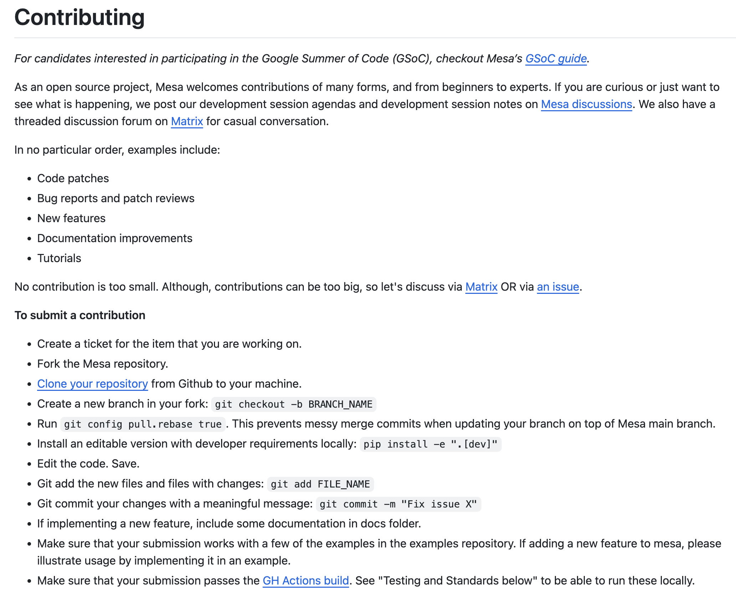
CONTRIBUTING.md
https://github.com/mesa/mesa/blob/main/CONTRIBUTING.md

Slide 3
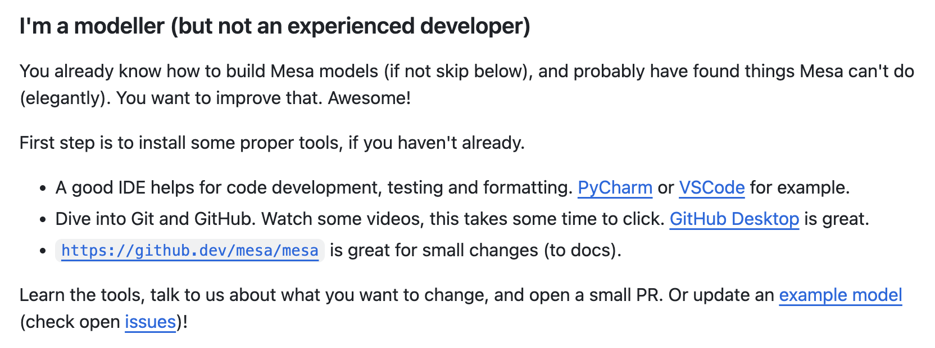
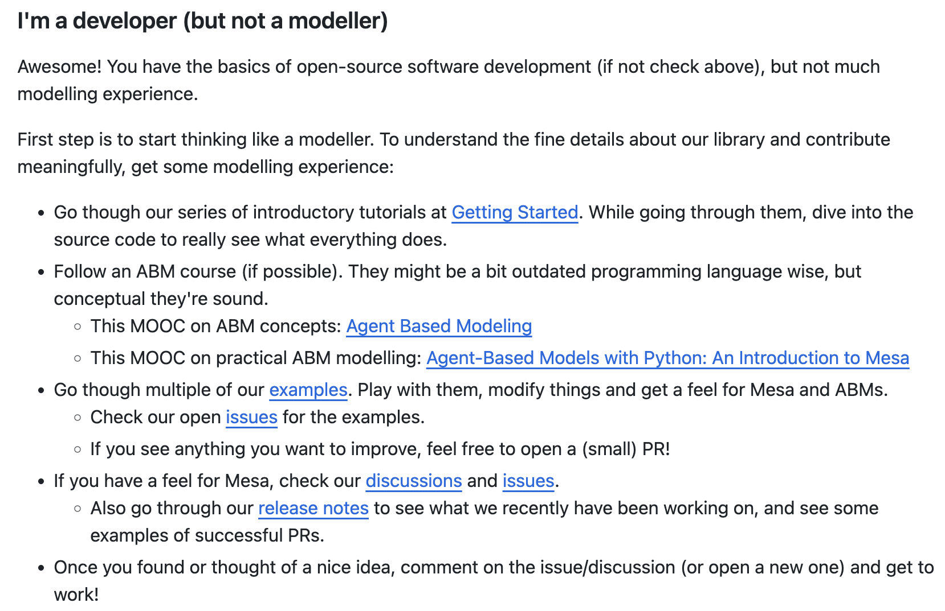
Modeller and/or developer
https://github.com/mesa/mesa/blob/main/CONTRIBUTING.md

Slide 4
Part I: Setup
Create a ticket for the item that you are working on.
Fork the Mesa repository.
Clone your repository from Github to your machine.
Create a new branch in your fork: git checkout -b BRANCH_NAME
Run git config pull.rebase true. This prevents messy merge commits when updating your branch on top of Mesa main branch.
Install an editable version with developer requirements locally: pip install -e ".[dev]"

Slide 5
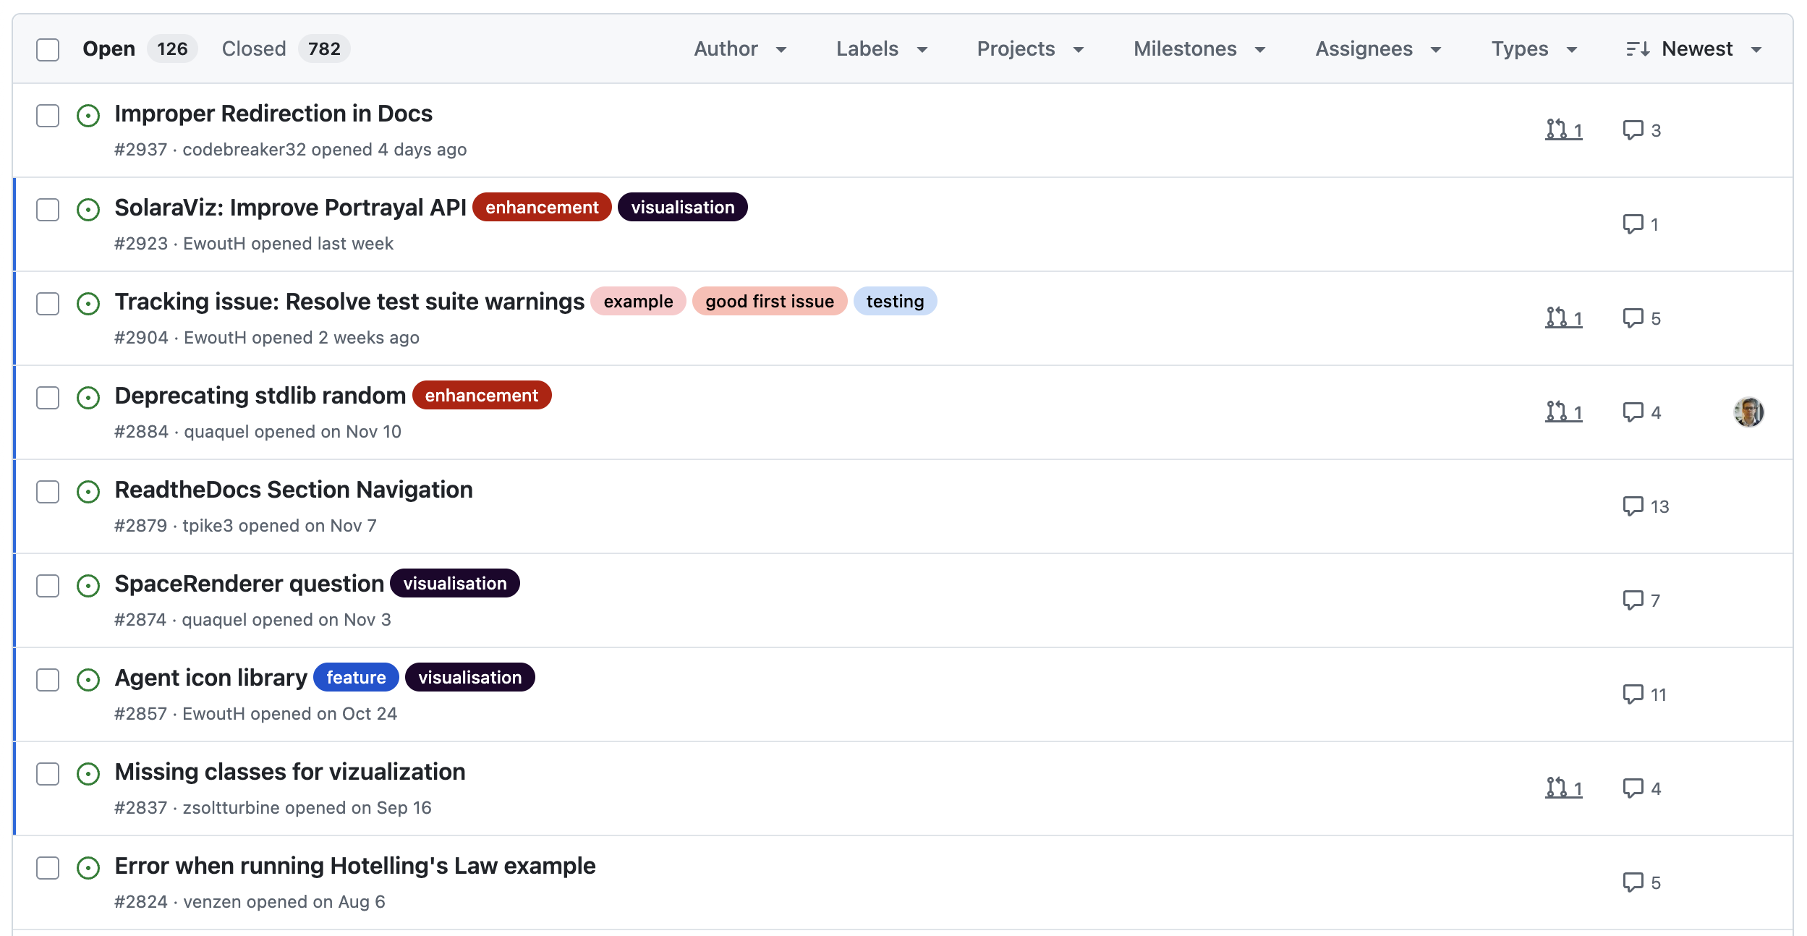
1.1 Create a ticket (or find one)

Slide 6
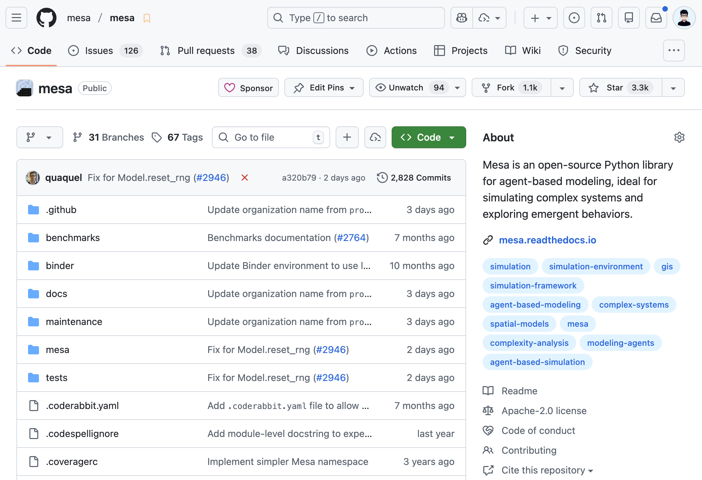
1.2 Fork the repository

Slide 7

1.2 Fork the repository
After forking, there are now two GitHub repos: upstream (Mesa) and your fork.
github.com/mesa/mesa
(upstream)
github.com/
<your_username>/mesa
(origin)
main
main

Slide 8
1.3 Clone to local machine
github.com/mesa/mesa
(upstream)
github.com/
<your_username>/mesa
(origin)
Local Machine
main
main
main

Slide 9
1.3 Clone to local machine
$ git remote -v
origin https://github.com/<your_username>/mesa.git (fetch)
origin https://github.com/<your_username>/mesa.git (push)
Local Machine
main

Slide 10
1.3 Clone to local machine
Optionally add upstream remote to pull latest from Mesa:
$ git remote add upstream https://github.com/mesa/mesa
$ git remote -v
origin https://github.com/<your_username>/mesa.git (fetch)
origin https://github.com/<your_username>/mesa.git (push)
upstream https://github.com/mesa/mesa (fetch)
upstream https://github.com/mesa/mesa (push)
Local Machine
main

Slide 11
1.3 Clone to local machine
github.com/mesa/mesa
(upstream)
github.com/
<your_username>/mesa
(origin)
Local Machine
main
main
main

Slide 12
1.4 Create a branch
For clear history:
$ git config pull.rebase true
To isolate your work:
$ git checkout -b BRANCH_NAME
Local Machine
main
BRANCH_NAME

Slide 13
1.5 Install dev dependencies
Create a virtual environment (using venv as example):
$ python3 –m venv .venv
$ source .venv/bin/activate
Install development dependencies:
$ pip install -e ".[dev]"
Local Machine
main
BRANCH_NAME

Slide 14
Part I: Setup 🎉🎉🎉
github.com/mesa/mesa
(upstream)
github.com/
<your_username>/mesa
(origin)
Local Machine
main
main
main
BRANCH_NAME

Slide 15
Part II: Development
Edit the code. Save.
Git add the new files and files with changes: git add FILE_NAME
Git commit your changes with a meaningful message: git commit -m "Fix issue X"
If implementing a new feature, include some documentation in docs folder.
Make sure that your submission works with a few of the examples in the examples repository. If adding a new feature to mesa, please illustrate usage by implementing it in an example.
Make sure that your submission passes the GH Actions build. See "Testing and Standards below" to be able to run these locally.
Make sure that your code is formatted according to [the black] standard (you can do it via pre-commit).

Slide 16
2.1 Make changes
Edit the code. Save.
If implementing a new feature, include some documentation in docs folder.
Make sure that your submission works with a few of the examples in the examples repository. If adding a new feature to mesa, please illustrate usage by implementing it in an example.

Slide 17
2.2 Add & commit changes
Git add the new files and files with changes:
  $ git add FILE_NAME
Git commit your changes with a meaningful message (optionally with the #):
  $ git commit -m "fix issue #123"
Local Machine
main
BRANCH_NAME

Slide 18
2.3 Testing & formatting
Set up pre-commit if it’s not available:
  $ pip install pre-commit
  $ pre-commit install
Run pre-commit (or just ruff) locally:
  $ pre-commit run --all-files
  $ ruff check . --fix
Run tests locally:
  $ py.test --cov=mesa tests/
Note: GitHub will run these checks again via GitHub Actions when you open your PR.
Local Machine
main
BRANCH_NAME

Slide 19
Part II: Development 🎉🎉🎉
Edit the code. Save.
Git add the new files and files with changes: git add FILE_NAME
Git commit your changes with a meaningful message: git commit -m "Fix issue X"
If implementing a new feature, include some documentation in docs folder.
Make sure that your submission works with a few of the examples in the examples repository. If adding a new feature to mesa, please illustrate usage by implementing it in an example.
Make sure that your submission passes the GH Actions build. See "Testing and Standards below" to be able to run these locally.
Make sure that your code is formatted according to [the black] standard (you can do it via pre-commit).

Slide 20
Part III: Submission
Push your changes to your fork on Github: git push origin NAME_OF_BRANCH
Create a pull request.
Describe the change w/ ticket number(s) that the code fixes.
Format your commit message as per Tim Pope's guideline.

Slide 21
3.1 Push to your fork
Push your changes to your fork on GitHub:
  $ git push -u origin BRANCH_NAME
github.com/
<your_username>/mesa
(origin)
Local Machine
main
main
BRANCH_NAME
BRANCH_NAME

Slide 22
3.2 Create a pull request
On GitHub, propose merging BRANCH_NAME from your fork into Mesa’s main branch. Link PR to ticket.
github.com/mesa/mesa
(upstream)
github.com/
<your_username>/mesa
(origin)
main
main
BRANCH_NAME

Slide 23
Part III: Submission 🎉🎉🎉
github.com/mesa/mesa
(upstream)
github.com/
<your_username>/mesa
(origin)
Local Machine
main
main
main
BRANCH_NAME
BRANCH_NAME

Slide 24
Practice tasks
Check the tasks at https://github.com/abmind-community/contrib-practice
Task 01: Add yourself
Practise fork/branching/PR workflow.
Task 02: Fix style
Use ruff & pre-commit to fix style issues.
Task 03: Add tests
Write unit tests and update existing PR.
Task 04 & 05: Merge conflict
Simulate and resolve a basic merge/rebase conflict.

Slide 25

Book
Available at: https://git-scm.com/book
Chapters 1, 2, 3, 5 & 6.

Slide 26
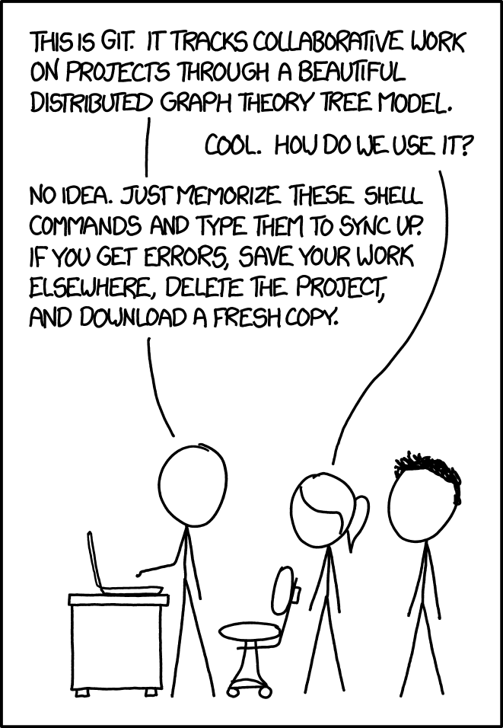
Source: https://xkcd.com/1597

