Slide 1
Recursion & Backtracking - Introduction
Recursion:
Rules for the recursive call
we need to make sure the following points:
the problem can be broken down into smaller problems of the same type,
the problem has some base case(s),
the base case is reached before the stack size limit exceeds.
Backtracking
Backtracking is an algorithmic paradigm that tries different solutions until a solution is found that works.
Problems that are typically solved using the Backtracking technique can only be solved by trying every possible configuration and each configuration is tried only once.
We can solve this by using Recursion.
https://github.com/abmishra1234/4AM_Club_Coding/tree/main/RecursionAndBacktracking

Slide 2
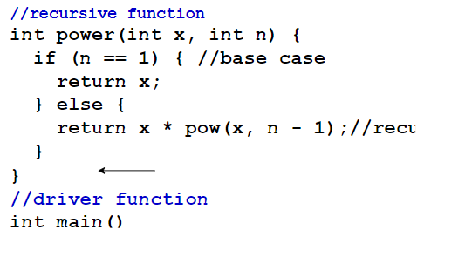
Level 01 : Recursion & Backtracking – Fundamentals
What is Recursion?
Recursion is when a function calls itself again and again until it reaches a specified stopping condition.
Parts of a Recursive Function
Each recursive function has two parts:
Base Case: The base case is where the call to the function stops i.e., it does not make any subsequent recursive calls
Recursive Case: The recursive case is where the function calls itself again and again until it reaches the base case.
How do you solve a problem using recursion?
To solve a problem using recursion, break the problem into one or more smaller problems, and add one or more base conditions that stop the recursion. i.e., make a recurrence relation for that problem.
How is memory allocated to different function calls in recursion?
When a function is called, the state of that function is saved in a stack. Each recursive call pushes a new stack frame. When the base case is reached the stack frames start popping from the stack until the stack becomes empty.
Visualization Through the Stack

Slide 3
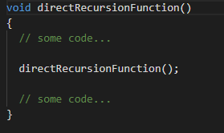
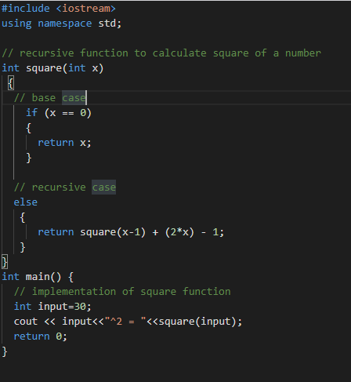
Recursion & Backtracking – Direct Recursion
Recursion continued…
Direct vs. Indirect Recursion
Direct Recursion
If a function calls itself, it’s known as direct recursion.
This results in a one-step recursive call: the function makes a recursive call inside its own function body.
One sample code for using the Direct Recursion, explained right side here

Slide 4
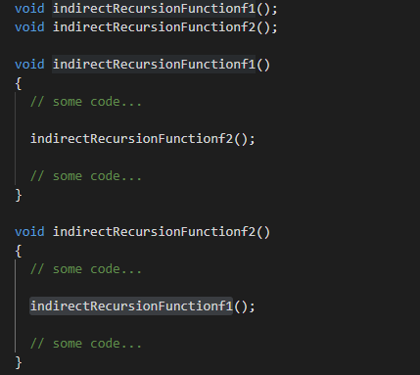
Recursion & Backtracking – Indirect Recursion
Recursion continued…
Indirect Recursion
If the function function01 calls another function function02 and function02 calls function01 then it is indirect recursion.
This is a two-step recursive call: the function calls another function to make a recursive call.
Sample Example code below…
#include <iostream>
using namespace std;
int n=0;
// declaring functions
void foo1(void);
void foo2(void);
// defining recursive functions
void foo1()
{
if (n <= 20)
{
cout<<n<<" "; // prints n
n++; // increments n by 1
foo2(); // calls foo2()
}
else
return;
}
void foo2()
{
if (n <= 20)
{
cout<<n<<" "; // prints n
n++; // increments n by 1
foo1(); // calls foo1()
}
else
return;
}
// Driver Program
int main(void)
{
foo1();
return 0;
}

Slide 5
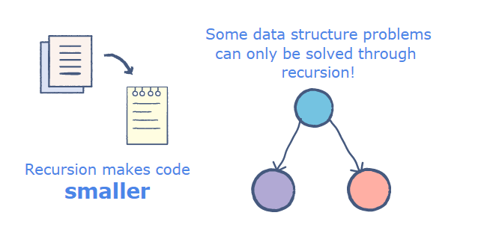
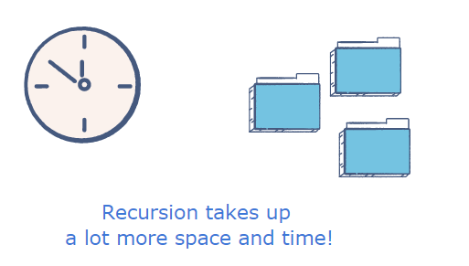
Recursion & Backtracking – Advantages & Disadvantages
Advantages & Disadvantages
Advantages
Code is simpler and it has limited case to handle. Meaning every recursion method have only two step ( base condition and recursion relationship )
Some problems are inherently recursive for example Graph and Tree etc.
Disadvantages
Recursion method have bigger memory requirement than their Iterative version
In theory recursion is taking more time than iterative method

Slide 6
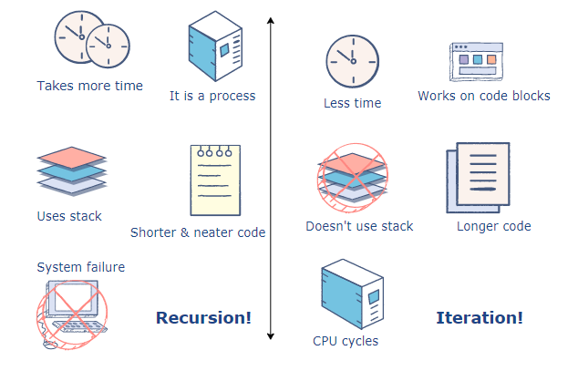
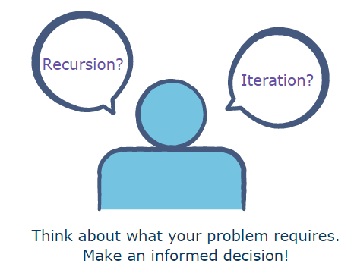
Recursion & Backtracking – Recursion vs Iteration
Advantages & Disadvantages
Iteration
Iterative code is much like recursion. It is a loop of repeating the same task again & again. If so than this is doing the same what recursion is doing for me. Then what is the difference in them?
Yes, There are good number of differences between them,
Recursion uses the system stack to store the variable changes for each recursive call, whereas iterative code does not.
Recursive code have overhead of space and time compared with iterative code
Recursive code is smaller and neater than iterative code
Recursion provides us with neater, more concise code but more than that it gives us the advantage of a stack that tracks all memory changes. For this reason, in problems like quicksort, recursion becomes a better solution as the recursion stack makes it easier to implement the sorting algorithm.
On the other hand, iteration is faster and more useful to solve simple problems like printing a string letter by letter, where the recursion stack just takes up extra memory.

Slide 7
Recursion & Backtracking – Convert iterative to recursive
Advantages & Disadvantages
Iteration to Recursive
Let’s learn this with example.

Slide 8
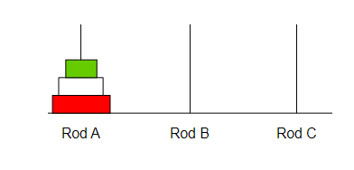
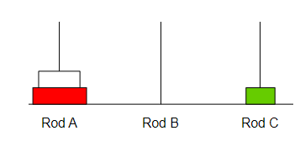
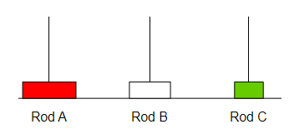
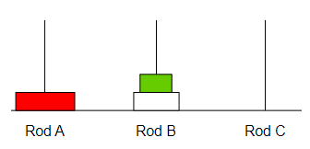
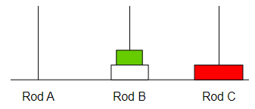
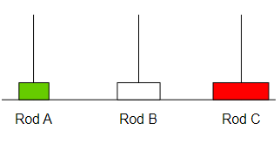
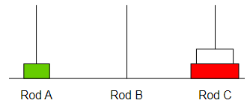
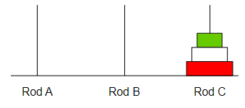
Tower of Hanoi Problem
1
2
3
4
5
6
7
8
Recursion Logic
Toh : n, src, dest, helper
// base case
n = 0
Stop
Toh: n-1, src, helper, dest
// print the message
Cout << “Move” << n << “ disk from ” << src << “ to ” << dest << endl;
Toh: n-1, helper, dest, src
Code : https://github.com/abmishra1234/4AM_Club_Coding/tree/main/RecursionAndBacktracking

Slide 9
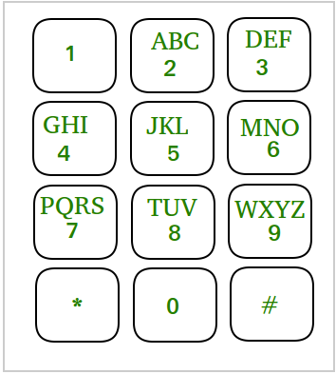
Phone keypad problem
Phone Keypad Problem
Before the advent of QWERTY keyboards, texts and numbers were placed on the same key. For example, 2 had ABC and if we wanted to write anything starting with A, we needed to type key 2 once. If we wanted to type B, key 2 had to be pressed twice, and thrice for typing C.
Right side is a picture of such a keypad.
Given a keypad as shown in the diagram, and an n digit number, list all possible words by pressing these numbers.
For example,
the value of n = 234.
Then, we can generate the following words: total 27 words can be formed from this
adg adh adi aeg aeh aei afg afh afi bdg bdh bdi beg beh bei bfg bfh bfi cdg cdh cdi ceg ceh cei cfg cfh cfi
Solution ( Recursive Approach)
It can be observed that each digit can represent 3 to 4 different alphabets (apart from 0 and 1).
The Idea is to form a recursive function. Map the number with its string of probable alphabets, i.e., 2 with ABC, 3 with DEF, etc. The recursive function will try all the alphabets mapped to the current digit in alphabetic order and again call the recursive function for the next digit and print the current output string.

Slide 10
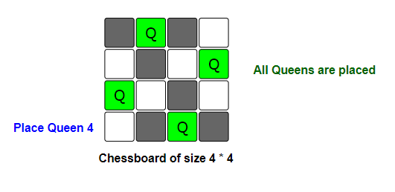
N Queens problem
N Queens Problem – Very famous recursive and backtrack problem
N - Queens Problem
Problem statement
Problem statement
You are given an empty chessboard of size N * N.
Find the number of ways to place N queens on the board,
such that no two queens can kill each other in one move.
A queen can move vertically, horizontally, and diagonally.
Solution:
[Backtracking Approach]
The idea is to place queens one by one in different columns, starting from the leftmost column.
When we place a queen in a column, we checked for clashes with already placed queens.
In the current column, if we find a row for which there is no clash, we mark this row & column
as part of solution. if we don't find such a row due to clashes, we return false and backtrack.
Code Link :
N Queen Problem – https://github.com/abmishra1234/4AM_Club_Coding/tree/main/RecursionAndBacktracking
Rat In a Maze - https://github.com/abmishra1234/4AM_Club_Coding/tree/main/10-02-2022

Slide 11
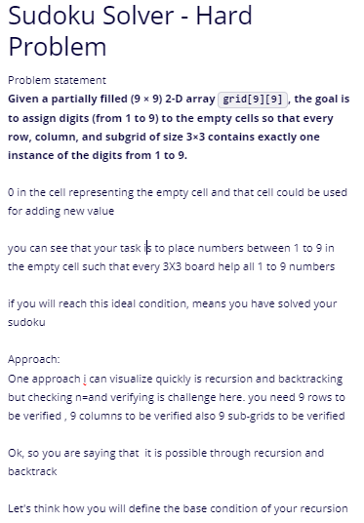
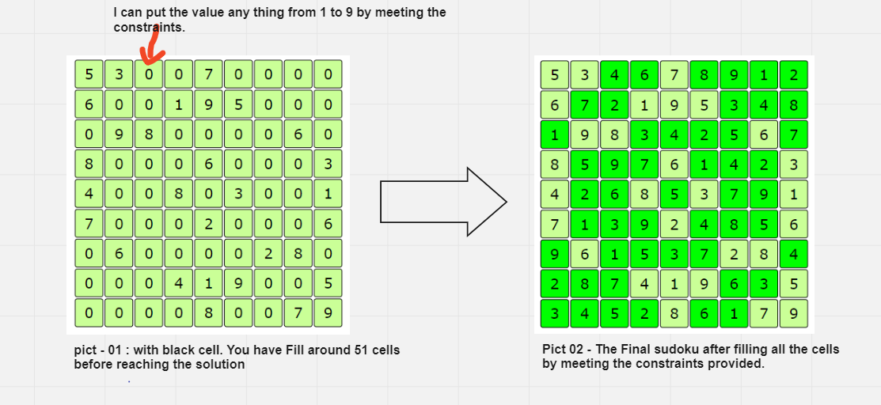
Sudoku problem
Solution is at link - https://github.com/abmishra1234/4AM_Club_Coding/tree/main/10-02-2022

