Slide 1
Distributed File Storage System : GFS, Introduction
GFS, Purpose
GFS is a scalable distributed file system developed by Google for its large data-intensive applications.
GFS was built for handling batch processing on large data sets and is designed for system-to-system interaction, not user-to-system interaction.
GFS Use-cases
What purpose drive google to build GFS like system?
Google crawling and indexing system was generating large data
Gmail, YouTube Application which is very data intensive application
And so on…
GFS was built keeping following feature of system in mind
Scalable : GFS should run reliably on a very large system built from commodity hardware.
Fault-tolerant : The design must be fault tolerant for software and hardware failure.
Large Files : Performance for large file as equivalent as small files. User shouldn’t observe any such differences for different size.
Large sequential and small random reads: The workloads primarily consist of two kinds of reads: large, streaming reads and small, random reads.
Concurrent access: The level of concurrent access will also be high, with large numbers of concurrent appends being particularly prevalent, often accompanied by concurrent reads.
High throughput: GFS should be optimized for high and sustained throughput in reading the data, and this is prioritized over latency. This is not to say that latency is unimportant; rather, GFS needs to be optimized for high-performance reading and appending large volumes of data for the correct operation of the system.

Slide 2
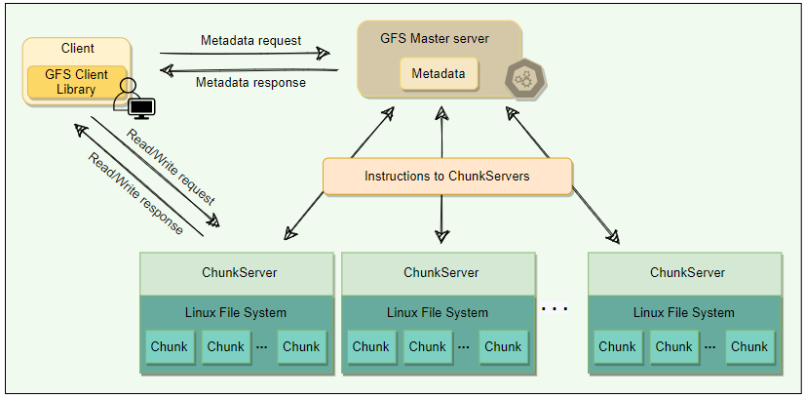
GFS : Cluster 1/3
APIs
GFS system has following user space api’s
create
delete
open
close
read
Write
APIs
In addition, there are two more api’s
snapshot
append
A GFS cluster consists of a single master and multiple Chunk Servers and is accessed by multiple clients.
Chunks
As files stored in GFS tend to be very large, GFS breaks files into multiple fixed-size chunks where each chunk is 64 megabytes in size.
Chunk handle :
Each chunk is identified by an immutable and globally unique 64-bit ID number called chunk handle. This allows for 2^64​ unique chunks.
As files are split into chunks, therefore, the job of GFS is to provide a mapping from files to chunks, and then to support standard operations on files, mapping down to operations on individual chunks.
Cluster :
GFS cluster having 03 kinds of entities
A Single master server
Multiple ChunkServer
Multiple clients
The master stores all metadata about the system, while the ChunkServers store the real file data.

Slide 3
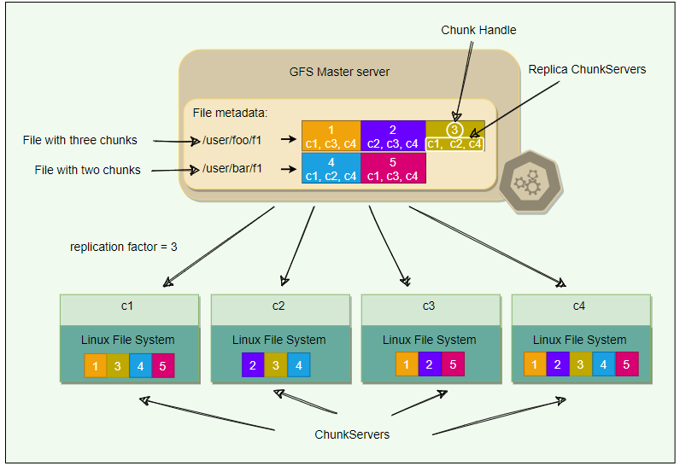
GFS : Cluster 2/3
ChunkServer
ChunkServers store chunks on local disks as regular Linux files and read or write chunk data specified by a chunk handle and byte-range.
For reliability, each chunk is replicated to multiple ChunkServers. By default, GFS stores three replicas, though different replication factors can be specified on a per-file basis.
Master
Master server is the coordinator of a GFS cluster and is responsible for keeping track of filesystem metadata.
The metadata stored at the master includes:
Name and directory of each file
Mapping of each file to its chunks
Current locations of chunks
Access control information
The master also controls system-wide activities such as chunk lease management (locks on chunks with expiration), garbage collection of orphaned chunks, and chunk migration between ChunkServers. Master assigns chunk-handle to chunks at the time of chunk creation.
The master periodically communicates with each ChunkServer in Heartbeat messages to give it instructions and collect its state.
For performance and fast random access, all metadata is stored in the master’s main memory. This includes the entire filesystem namespace as well as all the name-to-chunk mappings.
For fault tolerance and to handle a master crash, all metadata changes are written to the disk onto an operation log. This operation log is also replicated onto remote machines. The operation log is like a journal. Every operation to the file system is logged into this file.
The master is a single point of failure; hence, it replicates its data onto several remote machines so that the master can be readily restored on failure.
The benefit of having a single, centralized master is that it has a global view of the file system, and hence, it can make optimum management decisions, for example, related to chunk placement.

Slide 4
GFS : Cluster 3/3
ChunkServer
ChunkServers store chunks on local disks as regular Linux files and read or write chunk data specified by a chunk handle and byte-range.
For reliability, each chunk is replicated to multiple ChunkServers. By default, GFS stores three replicas, though different replication factors can be specified on a per-file basis.
Master
Master server is the coordinator of a GFS cluster and is responsible for keeping track of filesystem metadata.
The metadata stored at the master includes:
Name and directory of each file
Mapping of each file to its chunks
Current locations of chunks
Access control information
The master also controls system-wide activities such as chunk lease management (locks on chunks with expiration), garbage collection of orphaned chunks, and chunk migration between ChunkServers. Master assigns chunk-handle to chunks at the time of chunk creation.
The master periodically communicates with each ChunkServer in Heartbeat messages to give it instructions and collect its state.
For performance and fast random access, all metadata is stored in the master’s main memory. This includes the entire filesystem namespace as well as all the name-to-chunk mappings.
For fault tolerance and to handle a master crash, all metadata changes are written to the disk onto an operation log. This operation log is also replicated onto remote machines. The operation log is like a journal. Every operation to the file system is logged into this file.
The master is a single point of failure; hence, it replicates its data onto several remote machines so that the master can be readily restored on failure.
The benefit of having a single, centralized master is that it has a global view of the file system, and hence, it can make optimum management decisions, for example, related to chunk placement.
Client
Client is an entity that makes a read or write request to GFS. GFS client library is linked into each application that uses GFS. This library communicates with the master for all metadata-related operations like creating or deleting files, looking up files, etc. To read or write data, the client interacts directly with the ChunkServers that hold the data.
Neither the client nor the ChunkServer caches file data. Client caches offer little benefit because most applications stream through huge files or have working sets too large to be cached. ChunkServers rely on the buffer cache in Linux to maintain frequently accessed data in memory.

Slide 5
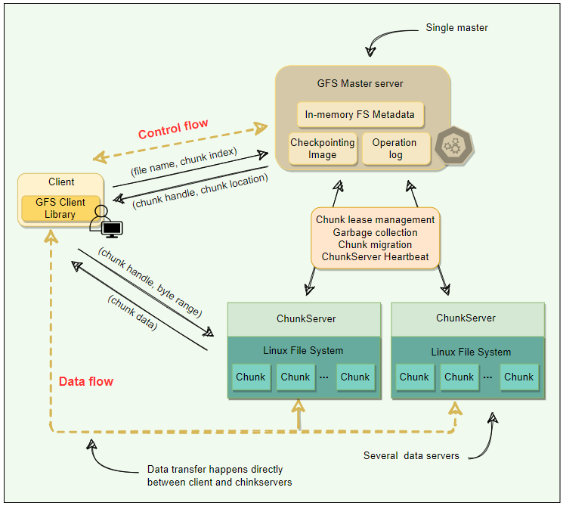
GFS : Single Master & Large Chunk size 1/4
Single Master
Having single master is sometime good for simple design. It helps in chunk placement & replication efficiently using global knowledge about chunk servers.
Also, GFS design smartly handled data read & write directly via ChunkServer to avoid bottleneck condition for Master server ( Metadata server ).
Clients never read or write file data through the master. Instead, a client asks the master which ChunkServers it should contact. The client caches this information for a limited time and interacts with the ChunkServers directly for many subsequent operations. I know, many different situation occurs if ChunkServer fails etc. Hold your though for now , will see these condition in coming pages.
Chunk Size
Chunk size is one of the key design parameters. GFS has chosen 64 MB, which is much larger than typical filesystem block sizes (which are often around 4KB). So, what GFS design seeing value in large chunk size, let’s see the below :
If GFS decided to take the small chunk size than imagine how many chunk needs to manage incase the data size of in GB’s. So Large chunk size is helping GFS to manage lower number of chunks corresponding to the large files.
Even though we are saying that our Master server is not involve while data read/write still it got involve as we modify the data. So, involvement will grow if we have many small chunks. This also got optimized as per Large chunk size.
As per GFS design Master server is putting the all metadata into memory for fast access, so as per design master server expecting that metadata size should be small, which is only possible if you consider the Large chunk size corresponding to the small chunk size.
By using a large chunk size, GFS reduces the need for frequent communication with the master to get chunk location information. It becomes feasible for a client to cache all information related to chunk locations of a large file. Client metadata caches have timeouts to reduce the risk of caching stale data.
A large chunk size also makes it possible to keep a TCP connection open to a ChunkServer for an extended time, amortizing the time of setting up a TCP connection.
A large chunk size simplifies ChunkServer management, i.e., to check which ChunkServers are near capacity, or which are overloaded.
Large chunk size provides highly efficient sequential reads and appends of large amounts of data.

Slide 6
GFS : Single Master & Large Chunk size 2/4
Chunk Size
Large Chunk Size have few disadvantages also, but GFS smartly handled this disadvantages by their design decision. This is one of the good way to handle the design decision by GFS architects, please follow the analysis more detail below…
Lazy Space allocation
Let’s first understand that how this chunk replica is getting stored on ChunkServer.
Something smart build here, GFS does not allocate the whole 64MB of disk space when creating a chunk.
Instead, as the client appends data, the ChunkServer lazily extends the chunk. This lazy space allocation avoids wasting space due to internal fragmentation. Internal fragmentation refers to having unused portions of the 64 MB chunk.
One disadvantage of having a large chunk size is the handling of small files. Since a small file will have one or a few chunks, the ChunkServers storing those chunks can become hotspots if a lot of clients access the same file. You can see this as challenge front of GFS architect. And so, they handled this challenge very beautifully. GFS stores such files with a higher replication factor and adds a random delay in the start times of the applications accessing these files.
Metadata
Let's explore how GFS manages the filesystem metadata.
The master stores three types of metadata:
The file and chunk namespaces (i.e., directory hierarchy).
The mapping from files to chunks.
The locations of each chunk’s replicas.
There are three aspects of how master manages the metadata:
Master keeps all this metadata in memory.
The first two types (i.e., namespaces and file-to-chunk mapping) are also persisted on the master’s local disk.
The third (i.e., chunk replicas’ locations) is not persisted.

Slide 7
GFS : Single Master & Large Chunk size 3/4
Storing Metadata in Memory
Since metadata is stored in memory, the master operates very quickly.
Is this only reason to put Metadata in memory on master server?
No, along with fast processing, few more prevalent requirement to move on this strategy and those cases are :
Chunk garbage collection
Re-replication in the case of ChunkServer failures
Chunk migration to balance load and disk-space usage across ChunkServer.
Above 03 condition, if we have one master server for Metadata that will be more efficient.
As discussed above, one potential concern for this memory-only approach is that the number of chunks, and hence the capacity of the whole system, is limited by how much memory the master has.
So, how to handle the above concern?
Let’s calculate the memory requirement chunk by chunk
The master maintains less than 64 bytes of metadata for each 64 MB chunk. Similarly, the file namespace data typically requires less than 64 bytes per file because the master stores file names compactly using prefix compression.
If the need for supporting an even larger file system arises, the cost of adding extra memory to the master is a small price to pay for the simplicity, reliability, performance, and flexibility gained by storing the metadata in memory.
Chunk location
The master does not keep a persistent record of which ChunkServers have a replica of a given chunk.
instead, the master asks each chunk server about its chunks at master startup, and whenever a ChunkServer joins the cluster. The master can keep itself up-to-date after that because it controls all chunk placements and monitors ChunkServer status with regular Heartbeat messages.
But why GFS architect took this decision?
By having the ChunkServer as the ultimate source of truth of each chunk’s location, GFS eliminates the problem of keeping the master and ChunkServers in sync.
Otherwise, you must maintain a consistent view of chunk locations on the master, because errors on a ChunkServer may cause chunks to vanish spontaneously (e.g., a disk may go bad and be disabled, or ChunkServer is renamed or failed, etc.) In a cluster with hundreds of servers, these events happen all too often.

Slide 8
GFS : Single Master & Large Chunk size 4/4
Operation Log
This is the task master server is doing in addition to maintain metadata information on in-memory.
Let’s understand , why they need to perform this extra precaution?
The master maintains an operation log that contains the namespace and file-to-chunk mappings and stores it on the local disk.
Specifically, this log stores a historical record of all the metadata changes.
Operation log is very important to GFS.
It contains the persistent record of metadata and serves as a logical timeline that defines the order of concurrent operations.
For fault tolerance and reliability, this operation log is replicated on multiple remote machines, and changes to the metadata are not made visible to clients until they have been persisted on all replicas(kind of maintaining quorum of write).
The Master using batch operation for performing operation log replication for optimization.
Upon restart, the master can restore its file-system state by replaying the operation log. This log must be kept small to minimize the startup time, and that is achieved by periodically checkpointing it.
Checkpointing
Master’s state is periodically serialized to disk and then replicated, so that on recovery, a master may load the checkpoint into memory, replay any subsequent operations from the operation log, and be available again very quickly.
To further speed up the recovery and improve availability, GFS stores the checkpoint in a compact B-tree like format that can be directly mapped into memory and used for namespace lookup without extra parsing.
The checkpoint process can take time, therefore, to avoid delaying incoming mutations, the master switches to a new log file and creates the new checkpoint in a separate thread. The new checkpoint includes all mutations before the switch.

Slide 9
GFS : Master Operation
This is the task master server is doing in addition to maintain metadata information on in-memory.
These are followings :
Making replica placement decision
Creating new chunks and their replicas
Making sure that replica as per replication factor followed
Balancing the load across the ChunkServers
Reclaim unused storage
Namespace Management & Locking
GFS does not have an i-node like tree structure for directories and files. Instead, it has a hash-map that maps a filename to its metadata, and reader-writer locks are applied on each node of the hash table for synchronization.
Each filename or absolute directory name has an associated read & write lock
Each master operation need to be protected with proper lacking so that no simultaneous operation directory allowed but at leaf level(meaning of file level)not allowed
To make operation on /dir1/dir2/leaf, it first needs the following locks:
Reader lock on /dir1
Reader lock on /dir1/dir2
Reader or Writer lock on /dir1/dir2/leaf
File creation does not require write-lock on the parent directory; a read-lock on its name is sufficient to protect the parent directory from deletion, rename, or snapshot.
Write-lock on a file name stops attempts to create multiple files with the same name.
Locks are acquired in a consistent order to prevent deadlock:
First ordered by level in the namespace tree
Lexicographically ordered within the same level
Replica Placement
Let’s understand the underlying challenge here.
What if Replica placement done within the Rack?
So, by this way, you will get advantage in less data travel while writing the data, and reading the data will have advantage of same rack
But biggest disadvantage here is what if rack fails. In that case you open with system fault tolerant capability, which is great risk in distributed system where your client expect 100% fault tolerant system.
That’s why Replica placement should be done in multiple rack.
But this approach also have some disadvantage, like writing of data is little slow than same rack. Also, data need to travel more, and it may impact your bandwidth usage but with all cost you are achieving super cool feature of 100% Fault Tolerant system tag.
And so, GFS decided to take 2nd approach where they are placing replica in different Racks.
Replica creation & re-replication
Let’s discuss the strategy of selection of ChunkServer.
The goals of a master are to place replicas on servers with
less-than-average disk utilization
spread replicas across racks
reduce the number of ‘recent’ creations on each ChunkServer (in simple term prefer new server over last used server if condition is same for both)
Make sure the replica factor count maintained for Chunk at all the possible time
Re-replication priorities or managed from master in such a way that it must not create bottleneck into the system
Another smart strategy placed here is to put bandwidth restriction over ChunkServer, to manage some rationality in usage of system

Slide 10
GFS : Master Operation
How are chunked prioritized for Replication?
Delta in Replication Factor Expected – Replication factor Actual
Priority always given to Live chunks rather than deleted file ( this situation comes bcz deletion of chunk from ChunkServer not happened immediately )
Replica rebalancing
Let’s understand the purpose, why and when we need rebalancing?
If replicas are rebalanced across the cluster well than our load balancing will effective work optimally. Another important factor of rebalancing is Disk Usage of ChunkServer.
Stale Replica detection
For each chunk, the master maintains a chunk Version Number to distinguish between up-to-date and stale replicas. The master increments the chunk version every time it grants a lease (more on this later) and informs all up-to-date replicas. The master and these replicas all record the new version number in their persistent state.
If the ChunkServer hosting a chunk replica is down during a mutation, the chunk replica will become stale and will have an older version number.
The master will detect this when the ChunkServer restarts and reports its set of chunks and their associated version numbers.
Master removes stale replicas during regular garbage collection.
There are some situation where your client may have stale data because client caching data for better experience, and that is not because data served to them as stale data. It happens because client himself cache data for better performance.
The impact of this is low since most operations to a chunk are append-only. This means that a stale replica usually returns a premature end of a chunk rather than outdated data for a value.

Slide 11
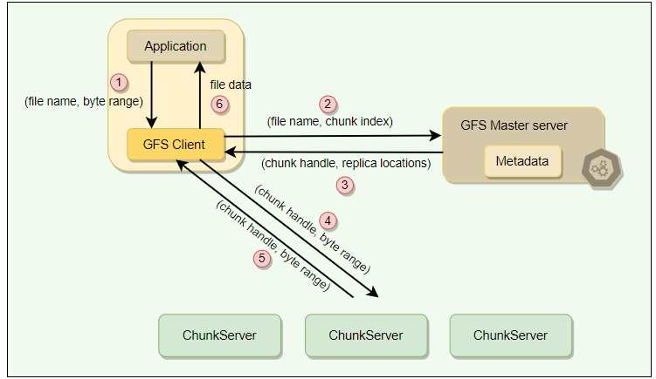
GFS : Client Read Operation
System or application which is suppose to store the large file into GFS, they will first calculate the chunk index using GFS client agent installed on client device.
GFS Client convert byte offset into chunk index, than DFS client call RPC on GFS master server(metadata)
GFS Master Server will return chunk handle, replica locations to GFS client
GFS client will send request for chunk to the ChunkServer which they received from GFS master server
GFS client will get that particular chunk
The same logical process repeats for all chunks and after receiving all chunks, GFS client have logic to stitch chunks together and return file data to the application
Many other work done by this GFS client, additionally which will be discussed in later pages

Slide 12
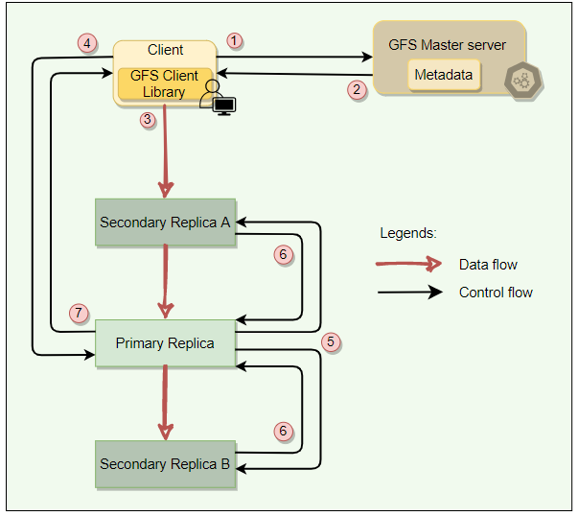
GFS : Client Write Operation
Chunk Lease
Let’s understand , why we need chunk lease?
Imagine the scenario, where chunk and their replica in another ChunkServer getting update simultaneously. At the update cycle, both chunk might have out of order data, meaning not in sync. So, this is a problem, right?
So to solve this problem, GFS architect introduced Chunk Lease concept. And Global Master Server will hold and subsequent call from client till this chunk lease not release by current holder.
Also, there is chance of someone will hold that lease for longer and that will create some race condition. For optimal usage of Lease concept , GFS architect also introduced 60 seconds lease time window, and the ChunkServer who has this lease are also termed as Primary ChunkServer. They have responsibility to execute all update regarding the chunk sequentially. Here, Master server have responsibility of redirecting all the update call to the same primary server during this lease period.
There is only one lease per chunk at any time, so that if two write requests go to the master, both see the same lease denoting the same primary.

Slide 13
GFS : Client Write Operation
Data Writing
Let’s understand how actually data writing happen in GFS system.
So, in GFS data writing is divided into two phase
Sending
Sending is like chaining of action.
The client sends the data to the closest replica. Then replicas send the data in chain to all other replicas to maximize bandwidth and throughput. Eventually, all the replicas get the data.
Writing
Post completion of sending data client then sends a write request to the primary, identifying the data that was sent in the previous phase.
The primary is responsible for the serialization of writes. It assigns consecutive serial numbers to all write requests that it has received, applies the writes to the file in serial-number order, and forwards the write requests in that order to the secondaries.
Once the primary gets acknowledgments from all the secondaries, the primary responds back to the client, and the write operation is complete.
Any failure or error will be backed with retries. On eventual failure, an error is returned to the client.
The key point to note is that the data flow is different from the control flow.
The data flows from the client to a ChunkServer and then from that ChunkServer to another ChunkServer, until all ChunkServers that store replicas for that chunk have received the data.
The control (the write request) flow goes from the client to the primary ChunkServer for that chunk. The primary then forwards the request to all the secondaries. This ensures that the primary controls the order of writes even if it receives multiple concurrent write requests. All replicas will have data written in the same sequence. Chunk version numbers are used to detect if any replica has stale data which has not been updated because that ChunkServer was down during some update.

Slide 14
GFS : Client Append Operation
Append Operation
Record append operation is optimized in a unique way that distinguishes GFS from other distributed file systems.

