Slide 1
Dynamo
Why is this important?
Dynamo is true picture of distributed system major requirement.
These have below mentioned major distinctive features…
Distributed Hash table and their complexity in general
How to achieve the High Availability, Very low latency, High Throughput, Super Reliability and Eventual consistency?
Dynamo is one of the good paper to get the sense of distributed system required…

Slide 2
Dynamo
Dynamo (and Apache Cassandra) often uses a simple conflict resolution policy: last-write-wins (LWW), based on the wall-clock timestamp.
Three Different approach for resolving the conflicts in systems
Approach 01 : Resolving conflicts using vector clock assigned with each write.
This is same as git is doing
Resolving conflicts is like how Git works. If Git can merge different versions into one, merging is done automatically. If not, the client (i.e., the developer) must reconcile conflicts manually.
Approach 02 : Conflict-free replicated data types (CRDTs)
Approach 03 : Last-write-wins (LWW)

Slide 3
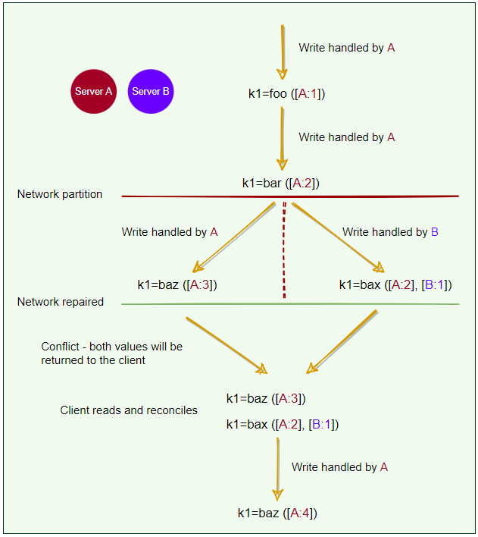

Slide 4
The Life of Dynamo’s put() & get() Operations
Dynamo is also called a zero-hop DHT, as the client can directly contact the node that holds the required data.
Dynamo clients can use one of the two strategies to choose a node for their get() and put() requests
Clients can route their requests through a generic load balancer.
Clients can use a partition-aware client library that routes the requests to the appropriate coordinator nodes with lower latency.
Off course 2nd option are good for system, so let’s understand the 2nd in more detailed.
Because of this option, Dynamo is also called a zero-hop DHT, as the client can directly contact the node that holds the required data

Slide 5
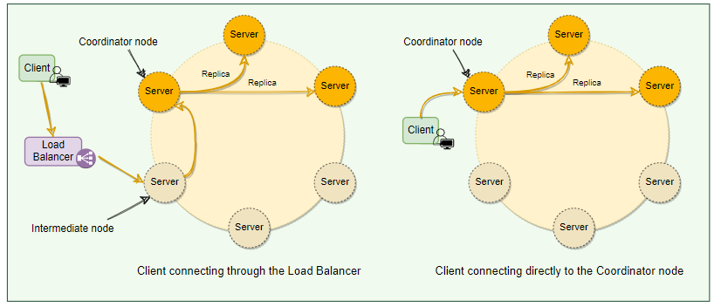

Slide 6
Consistency protocol
A Common (N, R, W) configuration used by Dynamo is (3, 2, 2).
(3, 3, 1): fast W, slow R, not very durable
(3, 1, 3): fast R, slow W, durable
In this model, the latency of a get() (or put()) operation depends upon the slowest of the replicas. For this reason, R and W are usually configured to be less than NN to provide better latency.
‘put()’ process
Dynamo’s put() request will go through the following steps:
The coordinator generates a new data version and vector clock component. Saves new data locally.
Sends the write request to N−1 highest-ranked healthy nodes from the preference list.
The put() operation is considered successful after receiving W−1 confirmation.

Slide 7
Consistency protocol
‘get()’ process
Dynamo’s get() request will go through the following steps:
The coordinator requests the data version from N−1 highest-ranked healthy nodes from the preference list.
Waits until R−1 replies.
Coordinator handles causal data versions through a vector clock. Returns all relevant data versions to the caller.

