Slide 1
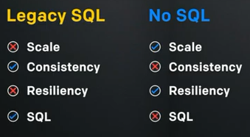
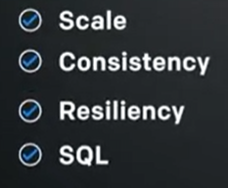
Distributed SQL : CockroachDB, Introduction
CockroachDB, Introduction?
Cockroach DB had focussed two primary factor differentiating with Traditional SQL Database.
Distributed SQL Database
OLTP ( Online transactional Processing )
Let’s define the term distributed SQL first
Not a legacy SQL
Not NoSQL
Combines the best of both
So, what is the must have feature of distributed SQL
This is what fundamental feature of our CockroachDB.
From where it got started?
The most public example of this is Google Cloud Spanner.
In 2012, Google published a paper on Spanner that demonstrated a new way of looking at databases, one that was rooted in distributed systems and global scale.
“Spanner is Google’s scalable, multi-version, globally distributed, and synchronously-replicated database. It is the first system to distribute data at global scale and support externally-consistent distributed transactions.”
SQL ( Legacy SQL Api + ACID Property)
A – Atomic
C – Consistency
I – Isolation
D - Durability

Slide 2
Distributed SQL : Distributed SQL, Core Conditions
Distributed SQL?
Distributed SQL is a single logical database deployed across multiple physical nodes in a single data center or across many data centers if need be; all of which allow it to deliver elastic scale and bulletproof resilience.
What comprises a Distributed SQL database?
The requirement can be summarized with 5 core conditions
Scale
A distributed SQL database must seamlessly scale in order to mirror the capabilities of cloud environments without introducing operational complexity. Just as we can scale up compute without heavy lifting, the database should be able to scale as well.
Consistency
In a cloud-based world with distributed systems and microservices are the default architectures, transactional consistency becomes difficult as multiple operators may be trying to work on the same data. The database should mediate contention and deliver the same level of isolation of transactions as we expect in a single instance database.
Resilience
A distributed SQL database must naturally deliver the highest level of resiliency without any need of external tooling to accomplish this. With a distributed database we can reduce the time it takes to recover from a failure down to near zero and replicate data naturally without any external configuration.
Geo-replication
A distributed SQL database should allow for distribution of data throughout a complex, widely dispersed geographic environment. The cloud presents an ability to reach every corner of the globe with an acceptable quality of service and the database should not restrict your applications from doing so.
ACID(SQL)
The database must speak SQL. It is the language of data and the default for all application logic. We should not have to retrain developers to use the database. They should be able to use the SQL dialect they are already familiar with.

Slide 3
Distributed SQL : Distributed SQL, Core Conditions
Distributed SQL?
The devil is six: Data Locality
Using the database to geo-partition data based on some field in a table is a new requirement for Distributed SQL. This allows you to use the database to address data sovereignty concerns. It can also be used to have data follow a user so you can ensure low latency access to their information.
Multi Cloud
Abstracted and integrated with cloud infra across the public or private cloud vendor. No locking with any specific cloud
ACID Transaction in CockroachDB
CockroachDB provides SERIALIZABLE transactions by default to ensure that you always see the consistency that you expect from a transactional database.

Slide 4
CockroachDB : Availability & Resiliency
Cluster Concepts: The Keyspace, Ranges, and Replicas
The Complete range could be termed as Keyspace
Keyspace divided into range
Replicas = copies of ranges
Replicas distributed among nodes of cluster

