Slide 1
Micro Service Learning | SCS(Self Contained System)
Micro-Service 01
SCS 01
SCS 02
Micro-Service 02
Monolithic
App
SCS 03
Micro-Service 03
Micro-Service 04

Slide 2
Micro Service Learning | SCS(Self Contained System)
Logic
Data
SCS - Variations
Microservice
UI
Microservice

Slide 3
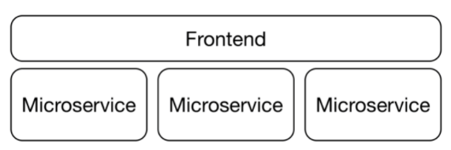
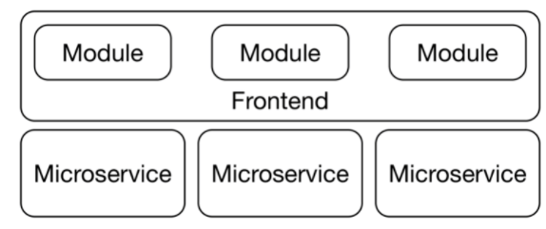
Micro Service Learning | Frontend Integration
This chapter explains how microservices can be integrated in the web frontend.
Frontend: Monolith or Modular?
Let’s take example of Frontend : Monolith
modularly developed frontend
Monolith Frontend
Modular Frontend

Slide 4
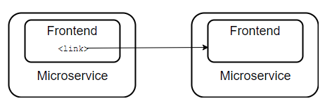
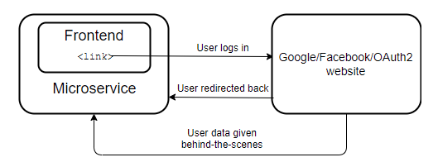
Micro Service Learning | Frontend Integration
Various options for frontend integration.
Links
One frontend displays a link that another frontend handles.
Redirects
OAuth2 uses this approach:
Transclusions
This involves combining the content of a website with the content of another website.
https://www.innoq.com/en/blog/transclusion/

Slide 5
Micro Service Learning | Resource-oriented Client Architecture (ROCA)
ROCA applications are perfectly normal web applications. They use web principles as they were originally intended.
ROCA has several advantages:
Clean architecture
The applications have a clean architecture.
Web features can be harnessed
URLs based accessed
HTTP Cache
Browser based optimization
Low Bandwidth consumption (Modern browsers are optimized to make user interaction with simple web applications as fast and responsive as possible.)
High speed

Slide 6
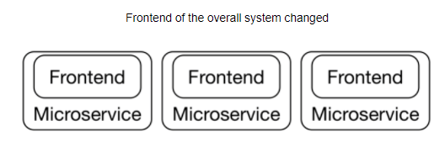
Micro Service Learning | Resource-oriented Client Architecture (ROCA)
UI changes impact multiple modules
One of the drawback of modular GUI is if small changes required in multiple Microservices than it will change complete system eventually. This is one of the side effect of Modular Frontend.
Frontend integration offers several benefits which make the approach attractive.
Loose coupling
Logic and UI in one microservice
Free choice of frontend technologies
Frontend integration allows loose coupling of microservices. Already the use of links and of some JavaScript code can be enough to integrate the frontends of different microservices. It is therefore important not to immediately define a complex technology stack, but to first find out what can be achieved by simple means.

Slide 7
Micro Service Learning | Resource-oriented Client Architecture (ROCA)
UI changes impact multiple modules
One of the drawback of modular GUI is if small changes required in multiple Microservices than it will change complete system eventually. This is one of the side effect of Modular Frontend.
Frontend integration offers several benefits which make the approach attractive.
Loose coupling
Logic and UI in one microservice
Free choice of frontend technologies
Frontend integration allows loose coupling of microservices. Already the use of links and of some JavaScript code can be enough to integrate the frontends of different microservices. It is therefore important not to immediately define a complex technology stack, but to first find out what can be achieved by simple means.

