Slide 1
Distributed File Storage System : GFS, Introduction
GFS, Purpose
GFS is a scalable distributed file system developed by Google for its large data-intensive applications.
GFS was built for handling batch processing on large data sets and is designed for system-to-system interaction, not user-to-system interaction.
GFS Use-cases
What purpose drive google to build GFS like system?
Google crawling and indexing system was generating large data
Gmail, YouTube Application which is very data intensive application
And so on…
GFS was built keeping following feature of system in mind
Scalable : GFS should run reliably on a very large system built from commodity hardware.
Fault-tolerant : The design must be fault tolerant for software and hardware failure.
Large Files : Performance for large file as equivalent as small files. User shouldn’t observe any such differences for different size.
Large sequential and small random reads: The workloads primarily consist of two kinds of reads: large, streaming reads and small, random reads.
Concurrent access: The level of concurrent access will also be high, with large numbers of concurrent appends being particularly prevalent, often accompanied by concurrent reads.
High throughput: GFS should be optimized for high and sustained throughput in reading the data, and this is prioritized over latency. This is not to say that latency is unimportant; rather, GFS needs to be optimized for high-performance reading and appending large volumes of data for the correct operation of the system.

Slide 2
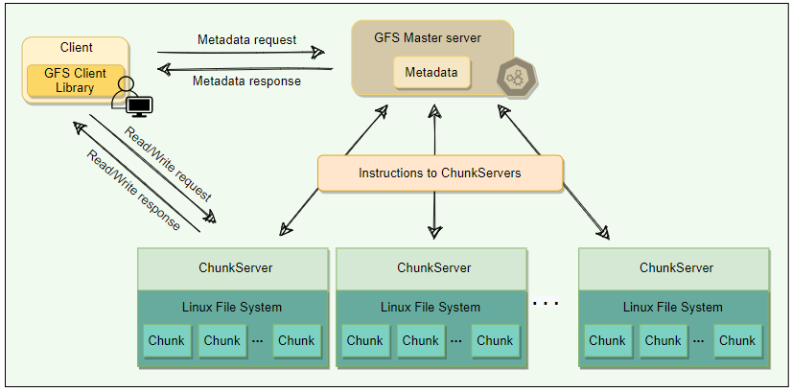
GFS : Cluster 1/3
APIs
GFS system has following user space api’s
create
delete
open
close
read
Write
APIs
In addition, there are two more api’s
snapshot
append
A GFS cluster consists of a single master and multiple Chunk Servers and is accessed by multiple clients.
Chunks
As files stored in GFS tend to be very large, GFS breaks files into multiple fixed-size chunks where each chunk is 64 megabytes in size.
Chunk handle :
Each chunk is identified by an immutable and globally unique 64-bit ID number called chunk handle. This allows for 2^64​ unique chunks.
As files are split into chunks, therefore, the job of GFS is to provide a mapping from files to chunks, and then to support standard operations on files, mapping down to operations on individual chunks.
Cluster :
GFS cluster having 03 kinds of entities
A Single master server
Multiple ChunkServer
Multiple clients
The master stores all metadata about the system, while the ChunkServers store the real file data.

Slide 3
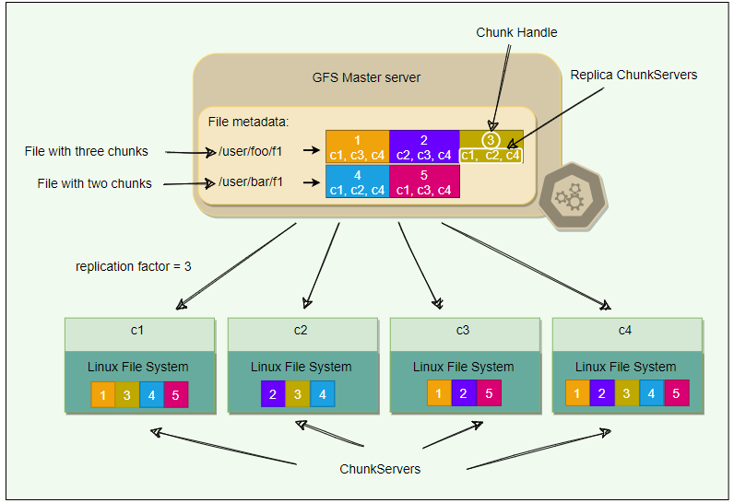
GFS : Cluster 2/3
ChunkServer
ChunkServers store chunks on local disks as regular Linux files and read or write chunk data specified by a chunk handle and byte-range.
For reliability, each chunk is replicated to multiple ChunkServers. By default, GFS stores three replicas, though different replication factors can be specified on a per-file basis.
Master
Master server is the coordinator of a GFS cluster and is responsible for keeping track of filesystem metadata.
The metadata stored at the master includes:
Name and directory of each file
Mapping of each file to its chunks
Current locations of chunks
Access control information
The master also controls system-wide activities such as chunk lease management (locks on chunks with expiration), garbage collection of orphaned chunks, and chunk migration between ChunkServers. Master assigns chunk-handle to chunks at the time of chunk creation.
The master periodically communicates with each ChunkServer in Heartbeat messages to give it instructions and collect its state.
For performance and fast random access, all metadata is stored in the master’s main memory. This includes the entire filesystem namespace as well as all the name-to-chunk mappings.
For fault tolerance and to handle a master crash, all metadata changes are written to the disk onto an operation log. This operation log is also replicated onto remote machines. The operation log is like a journal. Every operation to the file system is logged into this file.
The master is a single point of failure; hence, it replicates its data onto several remote machines so that the master can be readily restored on failure.
The benefit of having a single, centralized master is that it has a global view of the file system, and hence, it can make optimum management decisions, for example, related to chunk placement.

Slide 4
GFS : Cluster 3/3
ChunkServer
ChunkServers store chunks on local disks as regular Linux files and read or write chunk data specified by a chunk handle and byte-range.
For reliability, each chunk is replicated to multiple ChunkServers. By default, GFS stores three replicas, though different replication factors can be specified on a per-file basis.
Master
Master server is the coordinator of a GFS cluster and is responsible for keeping track of filesystem metadata.
The metadata stored at the master includes:
Name and directory of each file
Mapping of each file to its chunks
Current locations of chunks
Access control information
The master also controls system-wide activities such as chunk lease management (locks on chunks with expiration), garbage collection of orphaned chunks, and chunk migration between ChunkServers. Master assigns chunk-handle to chunks at the time of chunk creation.
The master periodically communicates with each ChunkServer in Heartbeat messages to give it instructions and collect its state.
For performance and fast random access, all metadata is stored in the master’s main memory. This includes the entire filesystem namespace as well as all the name-to-chunk mappings.
For fault tolerance and to handle a master crash, all metadata changes are written to the disk onto an operation log. This operation log is also replicated onto remote machines. The operation log is like a journal. Every operation to the file system is logged into this file.
The master is a single point of failure; hence, it replicates its data onto several remote machines so that the master can be readily restored on failure.
The benefit of having a single, centralized master is that it has a global view of the file system, and hence, it can make optimum management decisions, for example, related to chunk placement.
Client
Client is an entity that makes a read or write request to GFS. GFS client library is linked into each application that uses GFS. This library communicates with the master for all metadata-related operations like creating or deleting files, looking up files, etc. To read or write data, the client interacts directly with the ChunkServers that hold the data.
Neither the client nor the ChunkServer caches file data. Client caches offer little benefit because most applications stream through huge files or have working sets too large to be cached. ChunkServers rely on the buffer cache in Linux to maintain frequently accessed data in memory.

Slide 5
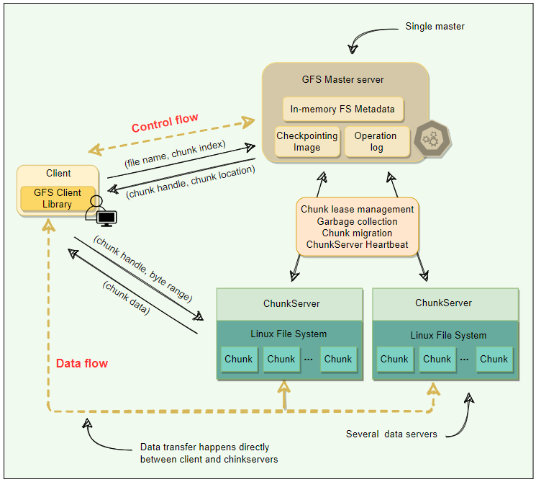
GFS : Single Master & Large Chunk size 1/4
Single Master
Having single master is sometime good for simple design. It helps in chunk placement & replication efficiently using global knowledge about chunk servers.
Also, GFS design smartly handled data read & write directly via ChunkServer to avoid bottleneck condition for Master server ( Metadata server ).
Clients never read or write file data through the master. Instead, a client asks the master which ChunkServers it should contact. The client caches this information for a limited time and interacts with the ChunkServers directly for many subsequent operations. I know, many different situation occurs if ChunkServer fails etc. Hold your though for now , will see these condition in coming pages.
Chunk Size
Chunk size is one of the key design parameters. GFS has chosen 64 MB, which is much larger than typical filesystem block sizes (which are often around 4KB). So, what GFS design seeing value in large chunk size, let’s see the below :
If GFS decided to take the small chunk size than imagine how many chunk needs to manage incase the data size of in GB’s. So Large chunk size is helping GFS to manage lower number of chunks corresponding to the large files.
Even though we are saying that our Master server is not involve while data read/write still it got involve as we modify the data. So, involvement will grow if we have many small chunks. This also got optimized as per Large chunk size.
As per GFS design Master server is putting the all metadata into memory for fast access, so as per design master server expecting that metadata size should be small, which is only possible if you consider the Large chunk size corresponding to the small chunk size.
By using a large chunk size, GFS reduces the need for frequent communication with the master to get chunk location information. It becomes feasible for a client to cache all information related to chunk locations of a large file. Client metadata caches have timeouts to reduce the risk of caching stale data.
A large chunk size also makes it possible to keep a TCP connection open to a ChunkServer for an extended time, amortizing the time of setting up a TCP connection.
A large chunk size simplifies ChunkServer management, i.e., to check which ChunkServers are near capacity, or which are overloaded.
Large chunk size provides highly efficient sequential reads and appends of large amounts of data.

Slide 6
GFS : Single Master & Large Chunk size 2/4
Chunk Size
Large Chunk Size have few disadvantages also, but GFS smartly handled this disadvantages by their design decision. This is one of the good way to handle the design decision by GFS architects, please follow the analysis more detail below…
Lazy Space allocation
Let’s first understand that how this chunk replica is getting stored on ChunkServer.
Something smart build here, GFS does not allocate the whole 64MB of disk space when creating a chunk.
Instead, as the client appends data, the ChunkServer lazily extends the chunk. This lazy space allocation avoids wasting space due to internal fragmentation. Internal fragmentation refers to having unused portions of the 64 MB chunk.
One disadvantage of having a large chunk size is the handling of small files. Since a small file will have one or a few chunks, the ChunkServers storing those chunks can become hotspots if a lot of clients access the same file. You can see this as challenge front of GFS architect. And so, they handled this challenge very beautifully. GFS stores such files with a higher replication factor and adds a random delay in the start times of the applications accessing these files.
Metadata
Let's explore how GFS manages the filesystem metadata.
The master stores three types of metadata:
The file and chunk namespaces (i.e., directory hierarchy).
The mapping from files to chunks.
The locations of each chunk’s replicas.
There are three aspects of how master manages the metadata:
Master keeps all this metadata in memory.
The first two types (i.e., namespaces and file-to-chunk mapping) are also persisted on the master’s local disk.
The third (i.e., chunk replicas’ locations) is not persisted.

Slide 7
GFS : Single Master & Large Chunk size 3/4
Storing Metadata in Memory
Since metadata is stored in memory, the master operates very quickly.
Is this only reason to put Metadata in memory on master server?
No, along with fast processing, few more prevalent requirement to move on this strategy and those cases are :
Chunk garbage collection
Re-replication in the case of ChunkServer failures
Chunk migration to balance load and disk-space usage across ChunkServer.
Above 03 condition, if we have one master server for Metadata that will be more efficient.
As discussed above, one potential concern for this memory-only approach is that the number of chunks, and hence the capacity of the whole system, is limited by how much memory the master has.
So, how to handle the above concern?
Let’s calculate the memory requirement chunk by chunk
The master maintains less than 64 bytes of metadata for each 64 MB chunk. Similarly, the file namespace data typically requires less than 64 bytes per file because the master stores file names compactly using prefix compression.
If the need for supporting an even larger file system arises, the cost of adding extra memory to the master is a small price to pay for the simplicity, reliability, performance, and flexibility gained by storing the metadata in memory.
Chunk location
The master does not keep a persistent record of which ChunkServers have a replica of a given chunk.
instead, the master asks each chunk server about its chunks at master startup, and whenever a ChunkServer joins the cluster. The master can keep itself up-to-date after that because it controls all chunk placements and monitors ChunkServer status with regular Heartbeat messages.
But why GFS architect took this decision?
By having the ChunkServer as the ultimate source of truth of each chunk’s location, GFS eliminates the problem of keeping the master and ChunkServers in sync.
Otherwise, you must maintain a consistent view of chunk locations on the master, because errors on a ChunkServer may cause chunks to vanish spontaneously (e.g., a disk may go bad and be disabled, or ChunkServer is renamed or failed, etc.) In a cluster with hundreds of servers, these events happen all too often.

Slide 8
GFS : Single Master & Large Chunk size 4/4
Operation Log
This is the task master server is doing in addition to maintain metadata information on in-memory.
Let’s understand , why they need to perform this extra precaution?
The master maintains an operation log that contains the namespace and file-to-chunk mappings and stores it on the local disk.
Specifically, this log stores a historical record of all the metadata changes.
Operation log is very important to GFS.
It contains the persistent record of metadata and serves as a logical timeline that defines the order of concurrent operations.
For fault tolerance and reliability, this operation log is replicated on multiple remote machines, and changes to the metadata are not made visible to clients until they have been persisted on all replicas(kind of maintaining quorum of write).
The Master using batch operation for performing operation log replication for optimization.
Upon restart, the master can restore its file-system state by replaying the operation log. This log must be kept small to minimize the startup time, and that is achieved by periodically checkpointing it.
Checkpointing
Master’s state is periodically serialized to disk and then replicated, so that on recovery, a master may load the checkpoint into memory, replay any subsequent operations from the operation log, and be available again very quickly.
To further speed up the recovery and improve availability, GFS stores the checkpoint in a compact B-tree like format that can be directly mapped into memory and used for namespace lookup without extra parsing.
The checkpoint process can take time, therefore, to avoid delaying incoming mutations, the master switches to a new log file and creates the new checkpoint in a separate thread. The new checkpoint includes all mutations before the switch.

Slide 9
GFS : Master Operation
Master Operations
This is the task master server is doing in addition to maintain metadata information on in-memory.
These are followings :
Making replica placement decision
Creating new chunks and their replicas
Making sure that replica as per replication factor followed
Balancing the load across the ChunkServers
Reclaim unused storage

