Slide 1
Distributed File Storage System : GFS
If this Editorial can answer the following discussion points , then it served my purpose.
Discussion points are :
How does GFS scale?
How does GFS ensure fault-tolerance and reliability of data?
How does GFS manage high availability?
How does GFS perform master failover?
What benefits does GFS get from a single master?
What problems does GFS face by having a single master?
How does GFS ensure file data integrity?
How does GFS decouple control flow from data flow, and what benefits does it provide?
How does lazy space allocation help GFS?
Can GFS handle small files efficiently?
What are reference counts in context of snapshotting?
Let’s assume C1 is the primary replica ChunkServer of a chunk, and there is a network partition between the master and C1. When the master notices this, it will designate some other ChunkServer as primary, say C2. Since C1 did not actually fail, are there now two primaries for the same chunk?
How does GFS handle data consistency?
As GFS preferred performance and simplicity over correctness, how did it work for GFS?

Slide 2
Distributed File Storage System : GFS, Introduction
GFS, Purpose
GFS is a scalable distributed file system developed by Google for its large data-intensive applications.
GFS was built for handling batch processing on large data sets and is designed for system-to-system interaction, not user-to-system interaction.
GFS Use-cases
What purpose drive google to build GFS like system?
Google crawling and indexing system was generating large data
Gmail, YouTube Application which is very data intensive application
And so on…
GFS was built keeping following feature of system in mind
Scalable : GFS should run reliably on a very large system built from commodity hardware.
Fault-tolerant : The design must be fault tolerant for software and hardware failure.
Large Files : Performance for large file as equivalent as small files. User shouldn’t observe any such differences for different size.
Large sequential and small random reads: The workloads primarily consist of two kinds of reads: large, streaming reads and small, random reads.
Concurrent access: The level of concurrent access will also be high, with large numbers of concurrent appends being particularly prevalent, often accompanied by concurrent reads.
High throughput: GFS should be optimized for high and sustained throughput in reading the data, and this is prioritized over latency. This is not to say that latency is unimportant; rather, GFS needs to be optimized for high-performance reading and appending large volumes of data for the correct operation of the system.

Slide 3
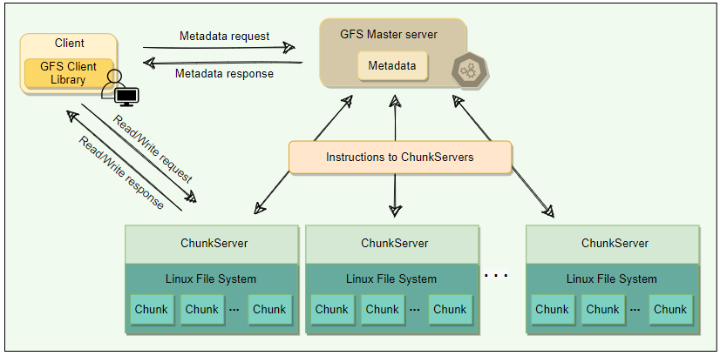
GFS : Cluster 1/3
APIs
GFS system has following user space api’s
create
delete
open
close
read
Write
APIs
In addition, there are two more api’s
snapshot
append
A GFS cluster consists of a single master and multiple Chunk Servers and is accessed by multiple clients.
Chunks
As files stored in GFS tend to be very large, GFS breaks files into multiple fixed-size chunks where each chunk is 64 megabytes in size.
Chunk handle :
Each chunk is identified by an immutable and globally unique 64-bit ID number called chunk handle. This allows for 2^64​ unique chunks.
As files are split into chunks, therefore, the job of GFS is to provide a mapping from files to chunks, and then to support standard operations on files, mapping down to operations on individual chunks.
Cluster :
GFS cluster having 03 kinds of entities
A Single master server
Multiple ChunkServer
Multiple clients
The master stores all metadata about the system, while the ChunkServers store the real file data.

Slide 4
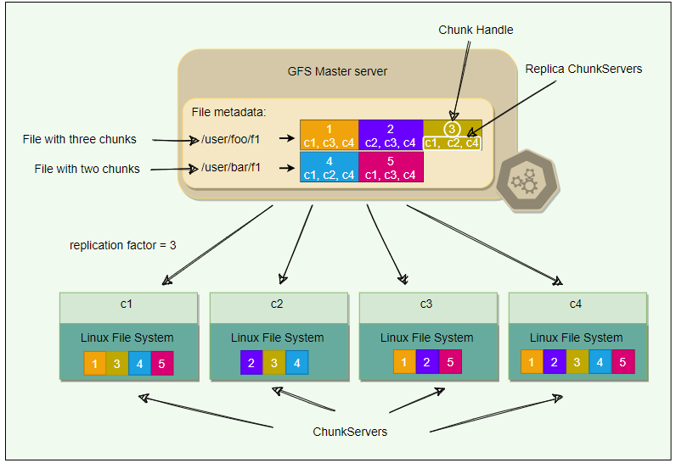
GFS : Cluster 2/3
ChunkServer
ChunkServers store chunks on local disks as regular Linux files and read or write chunk data specified by a chunk handle and byte-range.
For reliability, each chunk is replicated to multiple ChunkServers. By default, GFS stores three replicas, though different replication factors can be specified on a per-file basis.
Master
Master server is the coordinator of a GFS cluster and is responsible for keeping track of filesystem metadata.
The metadata stored at the master includes:
Name and directory of each file
Mapping of each file to its chunks
Current locations of chunks
Access control information
The master also controls system-wide activities such as chunk lease management (locks on chunks with expiration), garbage collection of orphaned chunks, and chunk migration between ChunkServers. Master assigns chunk-handle to chunks at the time of chunk creation.
The master periodically communicates with each ChunkServer in Heartbeat messages to give it instructions and collect its state.
For performance and fast random access, all metadata is stored in the master’s main memory. This includes the entire filesystem namespace as well as all the name-to-chunk mappings.
For fault tolerance and to handle a master crash, all metadata changes are written to the disk onto an operation log. This operation log is also replicated onto remote machines. The operation log is like a journal. Every operation to the file system is logged into this file.
The master is a single point of failure; hence, it replicates its data onto several remote machines so that the master can be readily restored on failure.
The benefit of having a single, centralized master is that it has a global view of the file system, and hence, it can make optimum management decisions, for example, related to chunk placement.

Slide 5
GFS : Cluster 3/3
ChunkServer
ChunkServers store chunks on local disks as regular Linux files and read or write chunk data specified by a chunk handle and byte-range.
For reliability, each chunk is replicated to multiple ChunkServers. By default, GFS stores three replicas, though different replication factors can be specified on a per-file basis.
Master
Master server is the coordinator of a GFS cluster and is responsible for keeping track of filesystem metadata.
The metadata stored at the master includes:
Name and directory of each file
Mapping of each file to its chunks
Current locations of chunks
Access control information
The master also controls system-wide activities such as chunk lease management (locks on chunks with expiration), garbage collection of orphaned chunks, and chunk migration between ChunkServers. Master assigns chunk-handle to chunks at the time of chunk creation.
The master periodically communicates with each ChunkServer in Heartbeat messages to give it instructions and collect its state.
For performance and fast random access, all metadata is stored in the master’s main memory. This includes the entire filesystem namespace as well as all the name-to-chunk mappings.
For fault tolerance and to handle a master crash, all metadata changes are written to the disk onto an operation log. This operation log is also replicated onto remote machines. The operation log is like a journal. Every operation to the file system is logged into this file.
The master is a single point of failure; hence, it replicates its data onto several remote machines so that the master can be readily restored on failure.
The benefit of having a single, centralized master is that it has a global view of the file system, and hence, it can make optimum management decisions, for example, related to chunk placement.
Client
Client is an entity that makes a read or write request to GFS. GFS client library is linked into each application that uses GFS. This library communicates with the master for all metadata-related operations like creating or deleting files, looking up files, etc. To read or write data, the client interacts directly with the ChunkServers that hold the data.
Neither the client nor the ChunkServer caches file data. Client caches offer little benefit because most applications stream through huge files or have working sets too large to be cached. ChunkServers rely on the buffer cache in Linux to maintain frequently accessed data in memory.

Slide 6
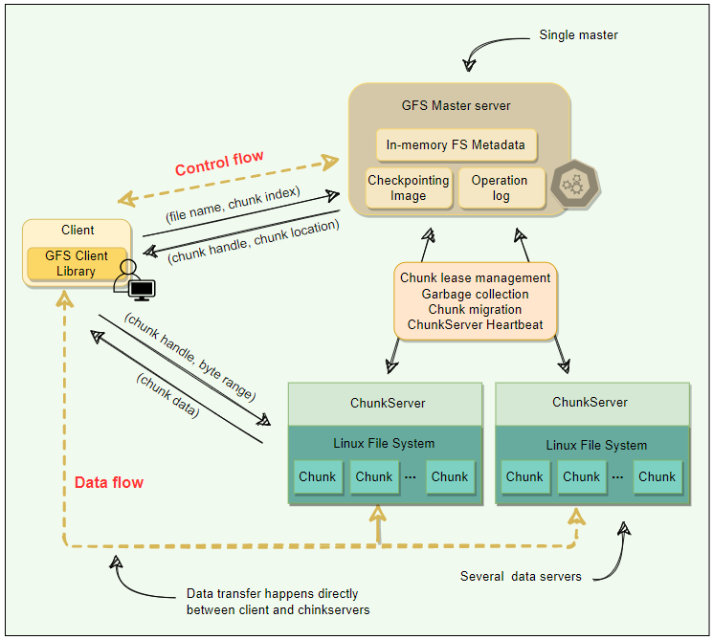
GFS : Single Master & Large Chunk size 1/4
Single Master
Having single master is sometime good for simple design. It helps in chunk placement & replication efficiently using global knowledge about chunk servers.
Also, GFS design smartly handled data read & write directly via ChunkServer to avoid bottleneck condition for Master server ( Metadata server ).
Clients never read or write file data through the master. Instead, a client asks the master which ChunkServers it should contact. The client caches this information for a limited time and interacts with the ChunkServers directly for many subsequent operations. I know, many different situation occurs if ChunkServer fails etc. Hold your though for now , will see these condition in coming pages.
Chunk Size
Chunk size is one of the key design parameters. GFS has chosen 64 MB, which is much larger than typical filesystem block sizes (which are often around 4KB). So, what GFS design seeing value in large chunk size, let’s see the below :
If GFS decided to take the small chunk size than imagine how many chunk needs to manage incase the data size of in GB’s. So Large chunk size is helping GFS to manage lower number of chunks corresponding to the large files.
Even though we are saying that our Master server is not involve while data read/write still it got involve as we modify the data. So, involvement will grow if we have many small chunks. This also got optimized as per Large chunk size.
As per GFS design Master server is putting the all metadata into memory for fast access, so as per design master server expecting that metadata size should be small, which is only possible if you consider the Large chunk size corresponding to the small chunk size.
By using a large chunk size, GFS reduces the need for frequent communication with the master to get chunk location information. It becomes feasible for a client to cache all information related to chunk locations of a large file. Client metadata caches have timeouts to reduce the risk of caching stale data.
A large chunk size also makes it possible to keep a TCP connection open to a ChunkServer for an extended time, amortizing the time of setting up a TCP connection.
A large chunk size simplifies ChunkServer management, i.e., to check which ChunkServers are near capacity, or which are overloaded.
Large chunk size provides highly efficient sequential reads and appends of large amounts of data.

Slide 7
GFS : Single Master & Large Chunk size 2/4
Chunk Size
Large Chunk Size have few disadvantages also, but GFS smartly handled this disadvantages by their design decision. This is one of the good way to handle the design decision by GFS architects, please follow the analysis more detail below…
Lazy Space allocation
Let’s first understand that how this chunk replica is getting stored on ChunkServer.
Something smart build here, GFS does not allocate the whole 64MB of disk space when creating a chunk.
Instead, as the client appends data, the ChunkServer lazily extends the chunk. This lazy space allocation avoids wasting space due to internal fragmentation. Internal fragmentation refers to having unused portions of the 64 MB chunk.
One disadvantage of having a large chunk size is the handling of small files. Since a small file will have one or a few chunks, the ChunkServers storing those chunks can become hotspots if a lot of clients access the same file. You can see this as challenge front of GFS architect. And so, they handled this challenge very beautifully. GFS stores such files with a higher replication factor and adds a random delay in the start times of the applications accessing these files.
Metadata
Let's explore how GFS manages the filesystem metadata.
The master stores three types of metadata:
The file and chunk namespaces (i.e., directory hierarchy).
The mapping from files to chunks.
The locations of each chunk’s replicas.
There are three aspects of how master manages the metadata:
Master keeps all this metadata in memory.
The first two types (i.e., namespaces and file-to-chunk mapping) are also persisted on the master’s local disk.
The third (i.e., chunk replicas’ locations) is not persisted.

Slide 8
GFS : Single Master & Large Chunk size 3/4
Storing Metadata in Memory
Since metadata is stored in memory, the master operates very quickly.
Is this only reason to put Metadata in memory on master server?
No, along with fast processing, few more prevalent requirement to move on this strategy and those cases are :
Chunk garbage collection
Re-replication in the case of ChunkServer failures
Chunk migration to balance load and disk-space usage across ChunkServer.
Above 03 condition, if we have one master server for Metadata that will be more efficient.
As discussed above, one potential concern for this memory-only approach is that the number of chunks, and hence the capacity of the whole system, is limited by how much memory the master has.
So, how to handle the above concern?
Let’s calculate the memory requirement chunk by chunk
The master maintains less than 64 bytes of metadata for each 64 MB chunk. Similarly, the file namespace data typically requires less than 64 bytes per file because the master stores file names compactly using prefix compression.
If the need for supporting an even larger file system arises, the cost of adding extra memory to the master is a small price to pay for the simplicity, reliability, performance, and flexibility gained by storing the metadata in memory.
Chunk location
The master does not keep a persistent record of which ChunkServers have a replica of a given chunk.
instead, the master asks each chunk server about its chunks at master startup, and whenever a ChunkServer joins the cluster. The master can keep itself up-to-date after that because it controls all chunk placements and monitors ChunkServer status with regular Heartbeat messages.
But why GFS architect took this decision?
By having the ChunkServer as the ultimate source of truth of each chunk’s location, GFS eliminates the problem of keeping the master and ChunkServers in sync.
Otherwise, you must maintain a consistent view of chunk locations on the master, because errors on a ChunkServer may cause chunks to vanish spontaneously (e.g., a disk may go bad and be disabled, or ChunkServer is renamed or failed, etc.) In a cluster with hundreds of servers, these events happen all too often.

Slide 9
GFS : Single Master & Large Chunk size 4/4
Operation Log
This is the task master server is doing in addition to maintain metadata information on in-memory.
Let’s understand , why they need to perform this extra precaution?
The master maintains an operation log that contains the namespace and file-to-chunk mappings and stores it on the local disk.
Specifically, this log stores a historical record of all the metadata changes.
Operation log is very important to GFS.
It contains the persistent record of metadata and serves as a logical timeline that defines the order of concurrent operations.
For fault tolerance and reliability, this operation log is replicated on multiple remote machines, and changes to the metadata are not made visible to clients until they have been persisted on all replicas(kind of maintaining quorum of write).
The Master using batch operation for performing operation log replication for optimization.
Upon restart, the master can restore its file-system state by replaying the operation log. This log must be kept small to minimize the startup time, and that is achieved by periodically checkpointing it.
Checkpointing
Master’s state is periodically serialized to disk and then replicated, so that on recovery, a master may load the checkpoint into memory, replay any subsequent operations from the operation log, and be available again very quickly.
To further speed up the recovery and improve availability, GFS stores the checkpoint in a compact B-tree like format that can be directly mapped into memory and used for namespace lookup without extra parsing.
The checkpoint process can take time, therefore, to avoid delaying incoming mutations, the master switches to a new log file and creates the new checkpoint in a separate thread. The new checkpoint includes all mutations before the switch.

Slide 10
GFS : Master Operation
This is the task master server is doing in addition to maintain metadata information on in-memory.
These are followings :
Making replica placement decision
Creating new chunks and their replicas
Making sure that replica as per replication factor followed
Balancing the load across the ChunkServers
Reclaim unused storage
Namespace Management & Locking
GFS does not have an i-node like tree structure for directories and files. Instead, it has a hash-map that maps a filename to its metadata, and reader-writer locks are applied on each node of the hash table for synchronization.
Each filename or absolute directory name has an associated read & write lock
Each master operation need to be protected with proper lacking so that no simultaneous operation directory allowed but at leaf level(meaning of file level)not allowed
To make operation on /dir1/dir2/leaf, it first needs the following locks:
Reader lock on /dir1
Reader lock on /dir1/dir2
Reader or Writer lock on /dir1/dir2/leaf
File creation does not require write-lock on the parent directory; a read-lock on its name is sufficient to protect the parent directory from deletion, rename, or snapshot.
Write-lock on a file name stops attempts to create multiple files with the same name.
Locks are acquired in a consistent order to prevent deadlock:
First ordered by level in the namespace tree
Lexicographically ordered within the same level
Replica Placement
Let’s understand the underlying challenge here.
What if Replica placement done within the Rack?
So, by this way, you will get advantage in less data travel while writing the data, and reading the data will have advantage of same rack
But biggest disadvantage here is what if rack fails. In that case you open with system fault tolerant capability, which is great risk in distributed system where your client expect 100% fault tolerant system.
That’s why Replica placement should be done in multiple rack.
But this approach also have some disadvantage, like writing of data is little slow than same rack. Also, data need to travel more, and it may impact your bandwidth usage but with all cost you are achieving super cool feature of 100% Fault Tolerant system tag.
And so, GFS decided to take 2nd approach where they are placing replica in different Racks.
Replica creation & re-replication
Let’s discuss the strategy of selection of ChunkServer.
The goals of a master are to place replicas on servers with
less-than-average disk utilization
spread replicas across racks
reduce the number of ‘recent’ creations on each ChunkServer (in simple term prefer new server over last used server if condition is same for both)
Make sure the replica factor count maintained for Chunk at all the possible time
Re-replication priorities or managed from master in such a way that it must not create bottleneck into the system
Another smart strategy placed here is to put bandwidth restriction over ChunkServer, to manage some rationality in usage of system

Slide 11
GFS : Master Operation
How are chunked prioritized for Replication?
Delta in Replication Factor Expected – Replication factor Actual
Priority always given to Live chunks rather than deleted file ( this situation comes bcz deletion of chunk from ChunkServer not happened immediately )
Replica rebalancing
Let’s understand the purpose, why and when we need rebalancing?
If replicas are rebalanced across the cluster well than our load balancing will effective work optimally. Another important factor of rebalancing is Disk Usage of ChunkServer.
Stale Replica detection
For each chunk, the master maintains a chunk Version Number to distinguish between up-to-date and stale replicas. The master increments the chunk version every time it grants a lease (more on this later) and informs all up-to-date replicas. The master and these replicas all record the new version number in their persistent state.
If the ChunkServer hosting a chunk replica is down during a mutation, the chunk replica will become stale and will have an older version number.
The master will detect this when the ChunkServer restarts and reports its set of chunks and their associated version numbers.
Master removes stale replicas during regular garbage collection.
There are some situation where your client may have stale data because client caching data for better experience, and that is not because data served to them as stale data. It happens because client himself cache data for better performance.
The impact of this is low since most operations to a chunk are append-only. This means that a stale replica usually returns a premature end of a chunk rather than outdated data for a value.

Slide 12
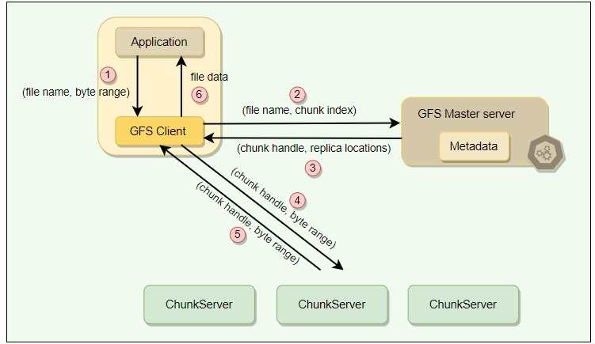
GFS : Client Read Operation
System or application which is suppose to store the large file into GFS, they will first calculate the chunk index using GFS client agent installed on client device.
GFS Client convert byte offset into chunk index, than DFS client call RPC on GFS master server(metadata)
GFS Master Server will return chunk handle, replica locations to GFS client
GFS client will send request for chunk to the ChunkServer which they received from GFS master server
GFS client will get that particular chunk
The same logical process repeats for all chunks and after receiving all chunks, GFS client have logic to stitch chunks together and return file data to the application
Many other work done by this GFS client, additionally which will be discussed in later pages

Slide 13
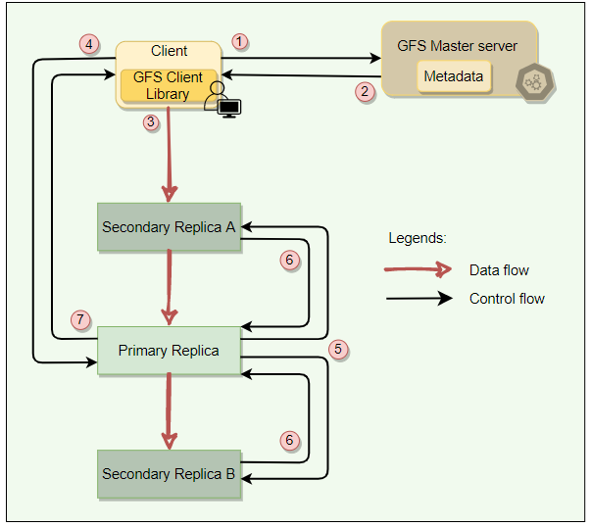
GFS : Client Write Operation
Chunk Lease
Let’s understand , why we need chunk lease?
Imagine the scenario, where chunk and their replica in another ChunkServer getting update simultaneously. At the update cycle, both chunk might have out of order data, meaning not in sync. So, this is a problem, right?
So to solve this problem, GFS architect introduced Chunk Lease concept. And Global Master Server will hold and subsequent call from client till this chunk lease not release by current holder.
Also, there is chance of someone will hold that lease for longer and that will create some race condition. For optimal usage of Lease concept , GFS architect also introduced 60 seconds lease time window, and the ChunkServer who has this lease are also termed as Primary ChunkServer. They have responsibility to execute all update regarding the chunk sequentially. Here, Master server have responsibility of redirecting all the update call to the same primary server during this lease period.
There is only one lease per chunk at any time, so that if two write requests go to the master, both see the same lease denoting the same primary.

Slide 14
GFS : Client Write Operation
Data Writing
Let’s understand how actually data writing happen in GFS system.
So, in GFS data writing is divided into two phase
Sending
Sending is like chaining of action.
The client sends the data to the closest replica. Then replicas send the data in chain to all other replicas to maximize bandwidth and throughput. Eventually, all the replicas get the data.
Writing
Post completion of sending data client then sends a write request to the primary, identifying the data that was sent in the previous phase.
The primary is responsible for the serialization of writes. It assigns consecutive serial numbers to all write requests that it has received, applies the writes to the file in serial-number order, and forwards the write requests in that order to the secondaries.
Once the primary gets acknowledgments from all the secondaries, the primary responds back to the client, and the write operation is complete.
Any failure or error will be backed with retries. On eventual failure, an error is returned to the client.
The key point to note is that the data flow is different from the control flow.
The data flows from the client to a ChunkServer and then from that ChunkServer to another ChunkServer, until all ChunkServers that store replicas for that chunk have received the data.
The control (the write request) flow goes from the client to the primary ChunkServer for that chunk. The primary then forwards the request to all the secondaries. This ensures that the primary controls the order of writes even if it receives multiple concurrent write requests. All replicas will have data written in the same sequence. Chunk version numbers are used to detect if any replica has stale data which has not been updated because that ChunkServer was down during some update.

Slide 15
GFS : Client Append Operation
Append Operation
Record append operation is optimized in a unique way that distinguishes GFS from other distributed file systems.
In a record append, however, the client specifies only the data. GFS appends it to the file at least once atomically (i.e., as one continuous sequence of bytes) at an offset of GFS’s choosing and returns that offset to the client. This process is similar to the append operation on a file opened with O_APPEND mode on a POSIX-compliant file system but without the race conditions when multiple writers do so concurrently.
Record Append is a kind of mutation that changes the contents of the metadata of a chunk.
When an application tries to append data on a chunk by sending a request to the client, the client pushes the data to all replicas of the last chunk of the file just like the write operation.
When the client forwards the request to the primary, the primary checks whether appending the record to the existing chunk will increase the chunk’s size more than its limit (maximum size of a chunk is 64MB).
If answer is YES, it pads the chunk to the maximum limit, commands the secondary to do the same, and requests the clients to try to append to the next chunk.
If the answer was NO, the primary appends the data to its replica, tells the secondary to write the data at the exact offset where it has, and finally replies success to the client.

Slide 16
GFS : Consistency in data and operation, Snapshot
Consistency in data & operation
GFS have relaxed consistency model.
Metadata operation are atomic. They handled exclusively by master. Namespace locking guarantees atomicity and correctness.
The master’s operation log defines a global total order of these operations.
In data mutations, there is an important distinction between write and append operations.
Write operations specify an offset at which mutations should occur, whereas appends are always applied at the end of the file.
This means that for the write operation, the offset in the chunk is predetermined, whereas for append, the system decides.
Snapshotting
A snapshot is a copy of some subtree of the global namespace as it exists at a given point in time.
GFS clients use snapshotting to efficiently branch two versions of the same data.
GFS clients use snapshotting to efficiently branch two versions of the same data.
Snapshots in GFS are initially zero-copy.
This means that data copies are made only when clients make a request to modify the chunks. This scheme is known as copy-on-write.
Steps Followed in Snapshotting
When the master receives a snapshot request, it first revokes any outstanding leases on the chunks in the files to snapshot.
It waits for leases to be revoked or expired and logs the snapshot operation to the operation log.
The snapshot is then made by duplicating the metadata for the source directory tree. Newly created snapshot files still point to the original chunks.
When a client makes a request to write to one of these chunks, the master detects that it is a copy-on-write chunk by examining its reference count (which will be more than one). At this point, the master asks each ChunkServer holding the replica to make a copy of the chunk and store it locally. These local copies are made to avoid copying the chunk over the network. Once the copy is complete, the master issues a lease for the new copy, and the write proceeds.

Slide 17
GFS : Fault tolerance into system
Fault tolerance
GFS is adopted Fault tolerance based on two principles
Fast recovery in case of component failure
Replication used for high availability
If Master Fail ?
Your System will act with following sequence of action points
External System or global monitoring system once detect the Master failure, they will start diverting the all-master calls to backup master.
They also need to prepare master backup if any thing left out to prepare,
They will use operation log and checkpoint to replay the action as per requirement on backup master
Once the system is ready with complete update, they will start serving as master
Simultaneously, this system also start preparing the backup master for future master failure, also other activity followed
Also, practically GFS is not taking much time in preparation but in theory seems some downtime. But GFS don’t have such downtime so maybe they used some active-active master for preparing the backup master. Also, they have concept of Shadow master for reading the master content, it almost neglects the system downtime for reading content for client.
Shadow master
Shadow masters are replicas of master and provide read-only access to the file system even when the primary is down. All shadow masters keep themselves updated by applying the same sequence of updates exactly as the primary master does by reading its operation log. Shadow masters may lag the primary slightly, but they enhance read availability for files that are not being actively changed or applications that do not mind getting slightly stale metadata. Since file contents are read from the ChunkServers, applications do not observe stale file contents.
What if primary replica of master Fail?
If an active primary replica fails (or there is a network partition), the master detects this failure (as there will be no heartbeat) and waits for the current lease to expire (in case the primary replica is still serving traffic from clients directly), and then assigns the lease to a new node.
When the old primary replica recovers, the master will detect it as ‘stale’ by checking the version number of the chunks. The master node will pick new nodes to replace the stale node and garbage-collect it before it can join the group again.
What if secondary replica of master Fail?
As described above, stale nodes will be replaced by new nodes picked by the master, and eventually garbage-collected.

Slide 18
GFS : High availability into system
High Availability through chunk replication
GFS have default replica factor three for ChunkServer. So, most of the time there is no issue in the case of if some chunk server is not available.
Now in worst scenario, all replicas goes off together , in that case might be data is not available.
So, to handle such situation, we may have few strategy of using multiple racks, geography or zones etc…
Data integrity with checksum into GFS System
How will the system maintain the data sanity?
Checksum is used by each ChunkServer to detect the corruption of stored data.
The Chunk is broken down into 64KB blocks. Each has a corresponding 32-bit checksum.
Like other metadata, checksums are kept in memory and stored persistently with logging, separate from logging data.
For Reads : Client asked with read range, checksum value for that read range verified by ChunkServer first.
Case 01 : Mismatch of checksum stored and calculated, in this case error is returned to client and regrading the error, master got update from ChunkServer. There after master server will do the needful activity to update this data and post the updating ChunkServer notified again for handled their request kind of..
Case 02 : no mismatch found than just return the requested chunk data, and stop
For writes, ChunkServer verifies the checksum of first and last data blocks that overlap the write range before performing the write. Then, it computes and records the new checksums. For a corrupted block, the ChunkServer returns an error to the requestor and reports the mismatch to the master.
For appends, checksum computation is optimized as there is no checksum verification on the last block; instead, just incrementally update the checksum for the last partial block and compute new checksums for any brand-new blocks filed by the append. This way, if the last partial block is already corrupted (and GFS fails to detect it now), the new checksum value will not match the stored data, and the corruption will be detected as usual when the block is next read.

Slide 19
GFS : Garbage Collection
Garbage collection by lazy deletion
When a file is deleted, GFS does not immediately reclaim the physical space used by that file. Instead, it follows a lazy garbage collection strategy.
When the client initiate delete command for file, The GFS system does two steps
The Master logs the delete operation
The deleted file renamed to some hidden file name updated with delete timestamp
Why GFS probably implemented using this approach?
If I must think, the probable reason of this approach, I could see the following reason to do so
It will handle well in case user changed their mind and wanted to un-delete the just deleted file
Garbage collection is always impact system regular performance, so it is always recommended to do such task when your system has little less load
The master, while performing regular scans of chunk namespace, deletes the metadata of all chunks that are not part of any file. Also, during the exchange of regular HeartBeat messages with the master, each ChunkServer reports a subset of the chunks it has, and the master replies with a list of chunks from that subset that are no longer present in the master’s database; such chunks are then deleted from the ChunkServer.
Advantages of lazy deletion
Here are the advantages of lazy deletion.
Simple and reliable. If the chunk deletion message is lost, the master does not have to retry. The ChunkServer can perform the garbage collection with the subsequent heartbeat messages.
GFS merges storage reclamation into regular background activities of the master, such as the regular scans of the filesystem or the exchange of HeartBeat messages. Thus, it is done in batches, and the cost is amortized.
Garbage collection takes place when the master is relatively free.
Lazy deletion provides safety against accidental, irreversible deletions.
Disadvantages of lazy deletion
As we know, after deletion, storage space does not become available immediately. Applications that frequently create and delete files may not be able to reuse the storage right away. To overcome this, GFS provides following options:
If a client deletes a deleted file again, GFS expedites the storage reclamation.
Users can specify directories that are to be stored without replication.
Users can also specify directories where deletion takes place immediately.

Slide 20
GFS : Criticism on GFS system
Single Master Server as SPF
As GFS has grown in usage, Google has started to see the following problems with the centralized master scheme:
Despite the separation of control flow (i.e., metadata operations) and data flow, the master is emerging as a bottleneck in the design. As the number of clients grows, a single master could not serve them because it does not have enough CPU power.
Despite the reduced number of metadata (because of the large chunk size), the number of metadata stored by the master is increasing to a level where it is getting difficult to keep all the metadata in the main memory.
Chunk Size of 64MB
Large chunk size (64MB) in GFS has its disadvantages while reading. Since a small file will have one or a few chunks, the ChunkServers storing those chunks can become hotspots if a lot of clients are accessing the same file. As a workaround for this problem, GFS stores extra copies of small files for distributing the load to multiple ChunkServers. Furthermore, GFS adds a random delay in the start times of the applications accessing such files.

Slide 21
GFS : Summary
System Design Pattern
Write ahead log
Heartbeat
checksum
Link for GFS Paper : https://research.google/pubs/pub51/
Link for Bigtable paper : https://research.google/pubs/pub27898/
Link for GFS Evolution : https://queue.acm.org/detail.cfm?id=1594206
Summary :
GFS is a scalable distributed file storage system for large data-intensive applications.
GFS was designed with the understanding that system/hardware failures can and do occur.
Reading workload consists of large streaming reads and small random reads. Writing workloads consists of many large, sequential writes that append data to files.
GFS provides APIs for usual file operations like create, delete, open, close, read, and write. Additionally, GFS supports snapshot and record append operations. Snapshot creates a copy of the file or directory tree. Record append allows multiple clients to append data to the same file concurrently while guaranteeing atomicity.
A GFS cluster consists of a single master and multiple ChunkServers and is accessed by multiple clients.
Chunk: Files are broken into fixed-size chunks where each chunk is 64 megabytes in size. Each chunk is identified by an immutable and globally unique 64-bit chunk handle assigned by the master at the time of chunk creation.
ChunkServers store chunks on the local disk as Linux files.
For reliability, each chunk is replicated on multiple ChunkServers.
Master server is the coordinator of a GFS cluster and is responsible for keeping track of all the filesystem metadata. This includes namespace, authorization, mapping of files to chunks, and the current location of chunks.
Master keeps all metadata in memory for faster operations. For fault tolerance and to handle a master crash, all metadata changes are written to the disk onto an operation log. This operation log is also replicated onto remote machines.
The master does not keep a persistent record of which ChunkServers have a replica of a given chunk. Instead, the master asks each ChunkServer about what chunks it holds at master startup or whenever a ChunkServer joins the cluster.
Checkpointing: The master’s state is periodically serialized to disk and then replicated so that on recovery, a master may load the checkpoint into memory, replay any subsequent operations from the operation log, and be available again very quickly.
HeartBeat: The master communicates with each ChunkServer through Heartbeat messages to pass instructions to it and collects its state.
Client: GFS client code which is linked into each application, implements filesystem APIs, and communicates with the cluster. Clients interact with the master for metadata, but all data transfers happen directly between the client and ChunkServers.
Data Integrity: Each ChunkServer uses checksumming to detect the corruption of stored data.
Garbage Collection: After a file is deleted, GFS does not immediately reclaim the available physical storage. It does so only lazily during regular garbage collection at both the file and chunk levels.
Consistency: Master guarantees data consistency by ensuring the order of mutations on all replicas and using chunk version numbers. If a replica has an incorrect version, it is garbage collected.
GFS guarantees at-least-once writes for writers. This means that records could be written more than once as well (although rarely). It is the responsibility of the readers to deal with these duplicate chunks. This is achieved by having checksums and serial numbers in the chunks, which help readers to filter and discard duplicate data.
Cache: Neither the client nor the ChunkServer caches file data. Client caches offer little benefit because most applications stream through huge files or have working sets too large to be cached. However, clients do cache metadata.

