Slide 1
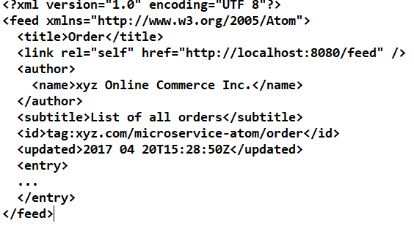
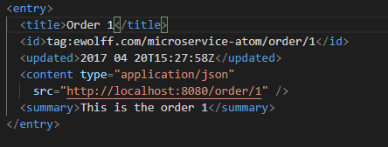
Asynchronous Microservice : Atom, Rest
Atom Format
Please note, Atom is not a protocol, it is a Format.
A GET request to a new URL such as http://innoq.com/order/feed can return a document with orders in the Atom format. This document can contain links to the details of the orders.
HTTP-based communication indicates the type of content with the help of MIME types (Multipurpose Internet Mail Extensions).
The MIME type for Atom is application/atom+xml
The Sample of Atom Feed ;
In the previous example, the most
important thing is missing, the feed
entries. Such an entry adheres to
the following format:
Entry
Format of Entry will be

Slide 2
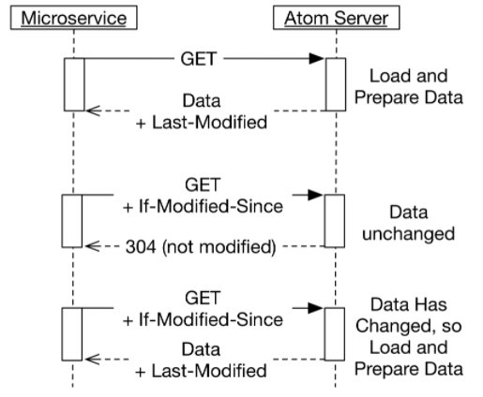
Asynchronous Microservice : Atom, Rest
Tool For Atom Generation
There are systems such as Atom Hopper that offer a server with the Atom format. In this way, an application does not have to generate Atom data, but can post new data to the server. The server then converts the information into Atom. Clients can fetch the Atom data from the server.
Approach for optimising the Atom Feed between Server and client
Approach 01
A very simple way to solve this problem is HTTP caching, see the drawing below.
HTTP provides a header with the name Last-Modified in the HTTP response. This header indicates when the data was last changed. This header takes over the function of the updated field from the feed.
Approach 02:
Another approach would be HTTP caching using ETag
Here, ETag returned with data from server
ETag compared with version number and checksum
The server uses the ETag to determine whether the data has changed, and it is available for use
Definition of ETag :
The ETag or entity tag is part of HTTP, the protocol for the World Wide Web. It is one of several mechanisms that HTTP provides for Web cache validation, which allows a client to make conditional requests. This mechanism allows caches to be more efficient and saves bandwidth, as a Web server does not need to send a full response if the content has not changed. ETags can also be used for optimistic concurrency control[1] to help prevent simultaneous updates of a resource from overwriting each other.

Slide 3
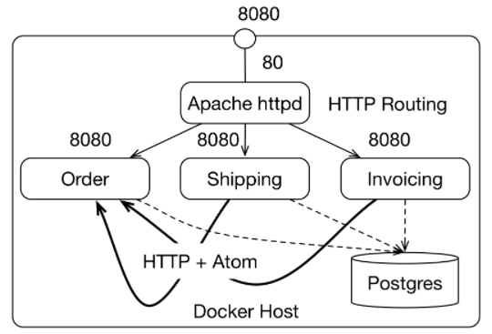
Asynchronous Microservice : Example
Tool For Atom Generation
There are systems such as Atom Hopper that offer a server with the Atom format. In this way, an application does not have to generate Atom data, but can post new data to the server. The server then converts the information into Atom. Clients can fetch the Atom data from the server.
Brief about example:
The Apache httpd distributes calls to the microservices.
For this purpose, the Apache httpd uses Docker Compose service links.
Docker compose offers simple load balancing. The Apache httpd uses the load balancing of Docker compose to forward external calls to one of the microservice instances.
The order microservice offers an Atom feed from which the invoicing and shipping microservice can read the information about new orders.
All microservices use the same Postgres database.
Within the database, each microservice has its own separate database schema. Thus, the microservices are completely independent regarding the database schema.
At the same time, one database instance is enough to run all microservices.

Slide 4
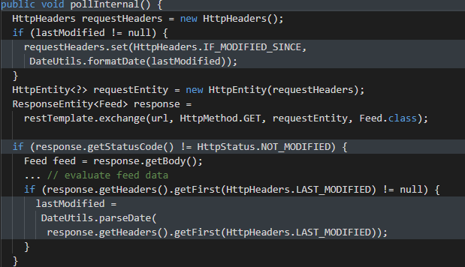
Asynchronous Microservice : Example
Implementation of HTTP Caching on the client

