Slide 1
Message Oriented Middleware : Kafka, Introduction
[Quick Bite] Fundamental characteristics must have
High Reliability
Low Latency
High Throughput
Microservices are decoupled by a MOM. A microservice sends a message to or receives it from the MOM.
This means that the sender and the recipient do not know each other, only the communication channel.
Service discovery is therefore not necessary. Sender and recipient find each other via the topic or queue through which they exchange messages.
The MOM is a complex software that handles all communication. Therefore, the MOM must be highly available and has to offer a high throughput.
Variants of MOMs Other Than Kafka
Java messaging service (Well known implementations are Apache ActiveMQ)
Advanced message queuing protocol (RabbitMQ, Apache ActiveMQ, and Apache Qpid are the best-known implementations of the AMQP standard.)
ZeroMQ (ZeroMQ is a library i.e., there is no need to install a message broker to use it.)
MQTT (MQTT is a messaging protocol that plays a prominent role for the Internet of Things (IoT).)

Slide 2
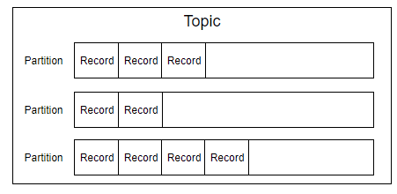
Message Oriented Middleware : Kafka, Architecture
In the area of microservices, Kafka is an interesting option. In addition to typical features such as high throughput and low latency, Kafka can compensate for the failure of individual servers via replication and can scale with a larger number of servers.
APIs
Kafka offers a separate API for each of the three different tasks of a MOM:
The producer API serves to send data.
The consumer API serves to receive data.
Finally, the streams API serves to transform the data.
Records
Kafka organizes data in records. This is what other MOMs call “messages”.
Records contain the transported data as a value. Kafka treats the value as a black box and does not interpret the data. In addition, records have a key and a timestamp.
Topics
A topic is a named set of records. Producers send records to a topic and consumers receive them from a topic.
If microservices in an e-commerce system are interested in new orders or
want to inform other microservices about new orders, they could use a topic called “order.”
Partitions
Topics are divided into partitions. Partitions allow strong guarantees concerning
the order of records, but also parallel processing.

Slide 3
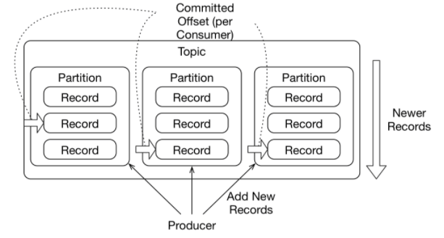
Message Oriented Middleware : Kafka, Architecture
Structure of Topics, Partition and Records
When a producer creates a new record, it is appended to a partition. Therefore, each record is stored in only one single partition.
Records are usually assigned to partitions by calculating the hash of the key to the record.
However, a producer can also implement its own algorithm to assign records to a partition.
There is no guarantee of order across partitions. Therefore, partitions are also a concept for parallel processing: reading in a partition is linear. A consumer must process each record in order. Across partitions, processing can be parallel.
Commit
For each consumer, Kafka stores the offset for each partition.
This offset indicates which record in the partition the consumer read and processed last.
It helps Kafka to ensure that each record is eventually handled.
When consumers have processed a record, they commit a new offset.
In this way, Kafka always knows which records have been processed by which consumer and which records still must be processed.
A consumer can commit a batch of records, which results in better performance because fewer commits are required.
Kafka also supports exactly once semantics that is, a guaranteed one-time delivery.
Polling
The consumers poll the data, meaning they fetch new data and process it.
Records, topics, partitions, and commits

Slide 4
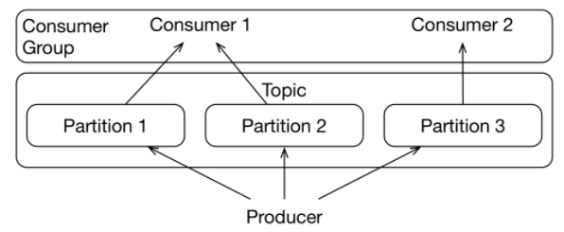
Message Oriented Middleware : Kafka, Architecture
Replication
Partitions store the data. Because data in one partition is independent of data in the other partitions, partitions can be distributed over servers:
Each server then processes some partitions. This allows load balancing.
To handle a larger load, new servers need to be added and some partitions need to be moved to the new server.
The partitions can also be replicated so that the data is stored on several servers, meaning Kafka can be made fail-safe. If one server crashes or loses its data, other replicas still exist.
The number N of replicas can be configured. When writing, you can determine how many in-sync replicas must commit changes.
With N=3 replicas and two in-sync replicas, the cluster remains available even if one of the three replicas fails.
Even if one server fails, new records can still be written to two replicas. If a replica fails, no data is lost because every write operation must have been successful on at least two replicas.
Even if a replica is lost, the data must still be stored on at least one additional replica.
Consumer Group & Partition

Slide 5
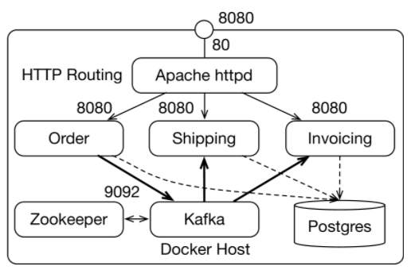
Message Oriented Middleware : Kafka, Technical Structure
Technical Structure
only the Apache httpd server is accessible from the outside.
Zookeeper
Zookeeper serves to coordinate the Kafka instances and stores, information about the
distribution of topics and partitions.
Kafka instance
The Kafka instance ensures the communication between the microservices.
Postgres database
Approach 01: Finally, the order, shipping, and invoicing microservices use the same Postgres database. Within the database instance, each microservice has its own separate database schema.
Approach 02 : Alternative would be to give each microservice its own database instance.
Disadvantage of Approach 02 is, it increase the number docker required and it creates more complexity compared to approach01
Apache httpd
The Apache httpd distributes incoming HTTP requests. Thus, there can be multiple instances of each microservice. This is useful for showing the distribution of records to multiple consumers.

Slide 6
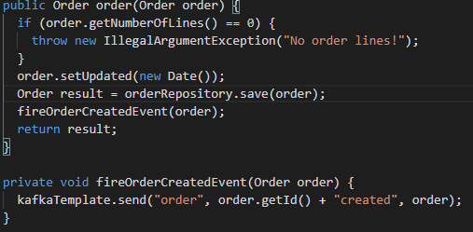
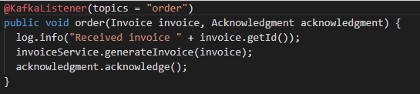
Message Oriented Middleware : Kafka, Example
Technical Structure
How to verify the Kafka after building from code?
The Apache httpd load balancer is available at port 8080. If Docker runs locally, it can be
found at http://localhost:8080/. From there, you can use the order microservice to
create an order. The microservices shipping and invoicing should display the order
data after some time.
Producers
Let’s focus now on producer side sample code
Consumers

Slide 7

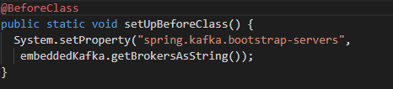
Message Oriented Middleware : Kafka, Tests with embedded Kafka
Testing the Kafka Workflow
In a JUnit test, an embedded Kafka server can be used to analyze the functionality of the microservices.
An embedded Kafka server has to be started. With a class rule, JUnit can be triggered to start a Kafka server prior to the tests and to shut it down again after the tests. Therefore, a variable with @ClassRule must be added to the code.
The Spring Boot configuration must be adapted in such a manner that Spring Boot uses the Kafka server. This code is found in a method annotated with @BeforeClass, so that it executes before the tests.

